Slide 1
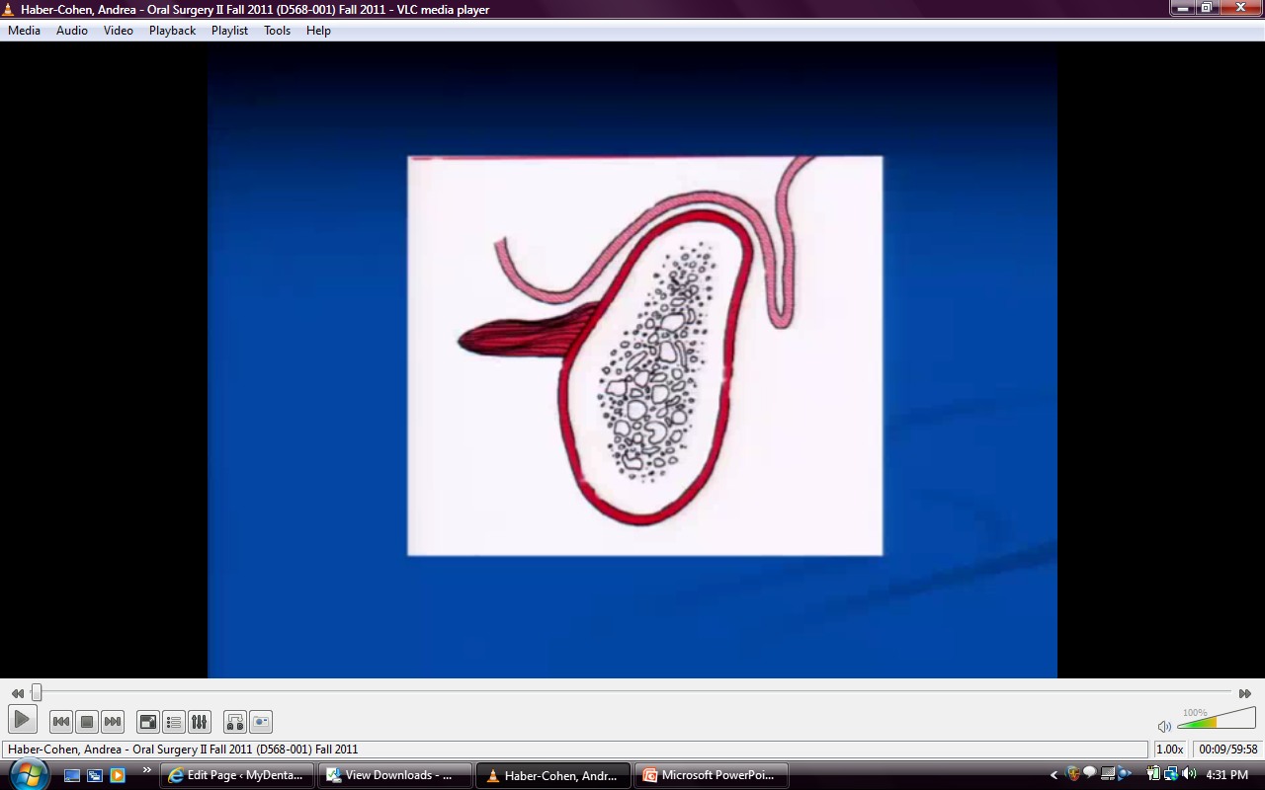
Notes:
Buccinator attachment, lingual vestibule
As bone resorbs, height decreases and muscle attachment stays where it is→ no denture retention

Slide 2
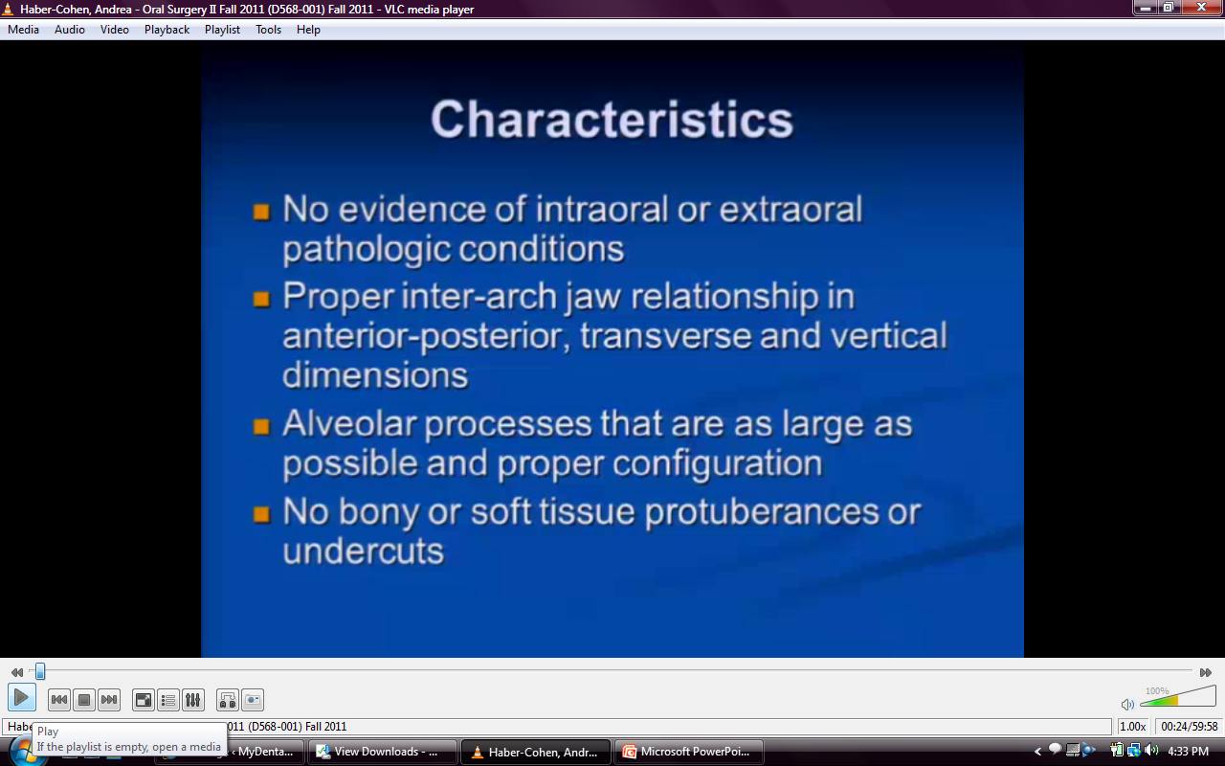
Notes:
Need normal mucosal tissue
Ant-post and transverse relationships good. Tipping when biting down due to transverse relationships being excessive on max and less so on mand.
Undercuts prevent seating

Slide 3
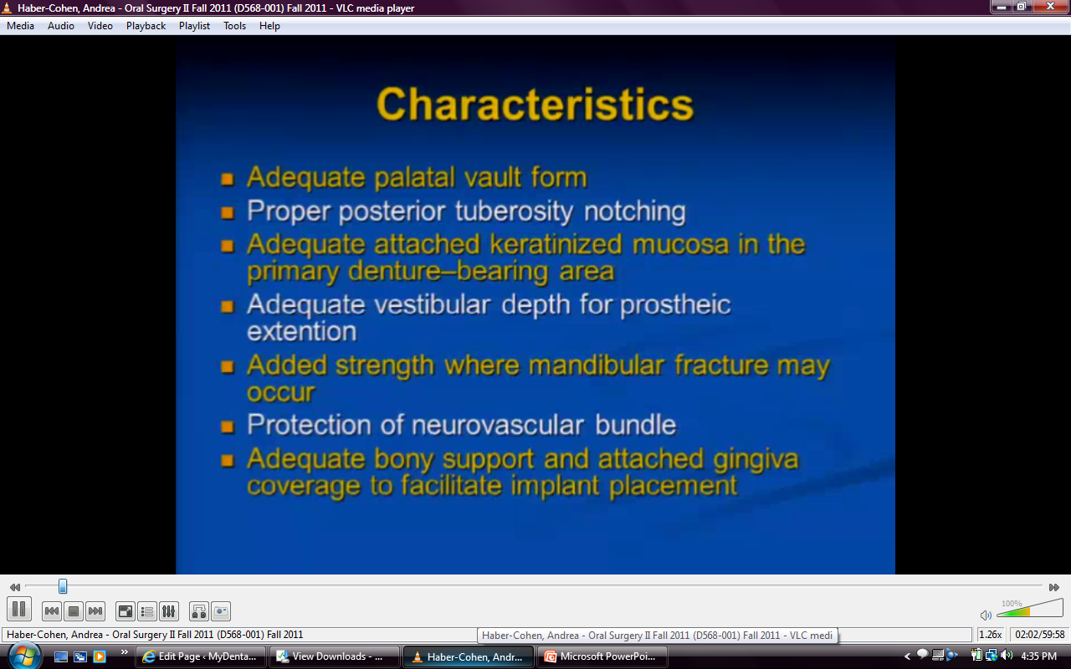
Notes:
Too flat palatal vault→ dislodgement
Notching→ suction
Vestibular depth- need to place flange without dislodgement
No impingement on mental formaen region- no numbness or paresthesia caused by pressure

Slide 4
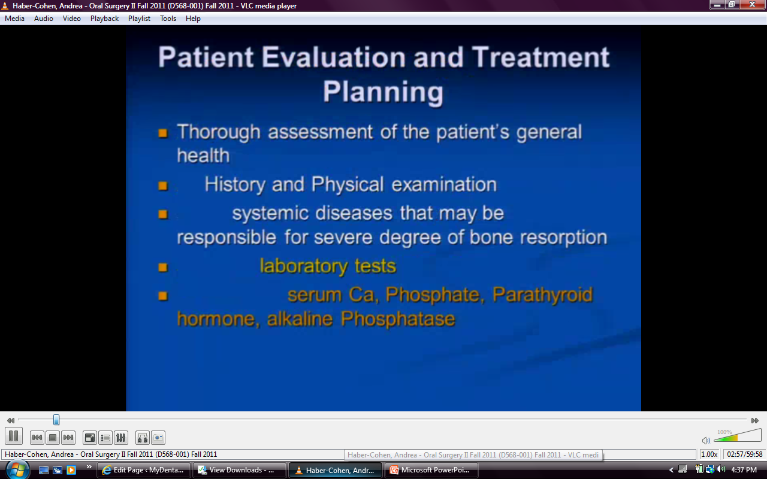

Slide 5
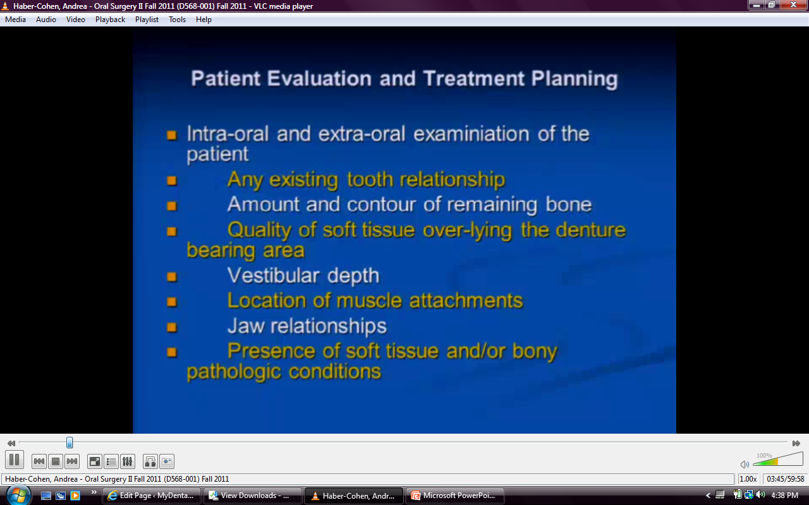
Notes:
Make sure you can take impression and make successful denture
May have to do frenectomy or removal of tori

Slide 6
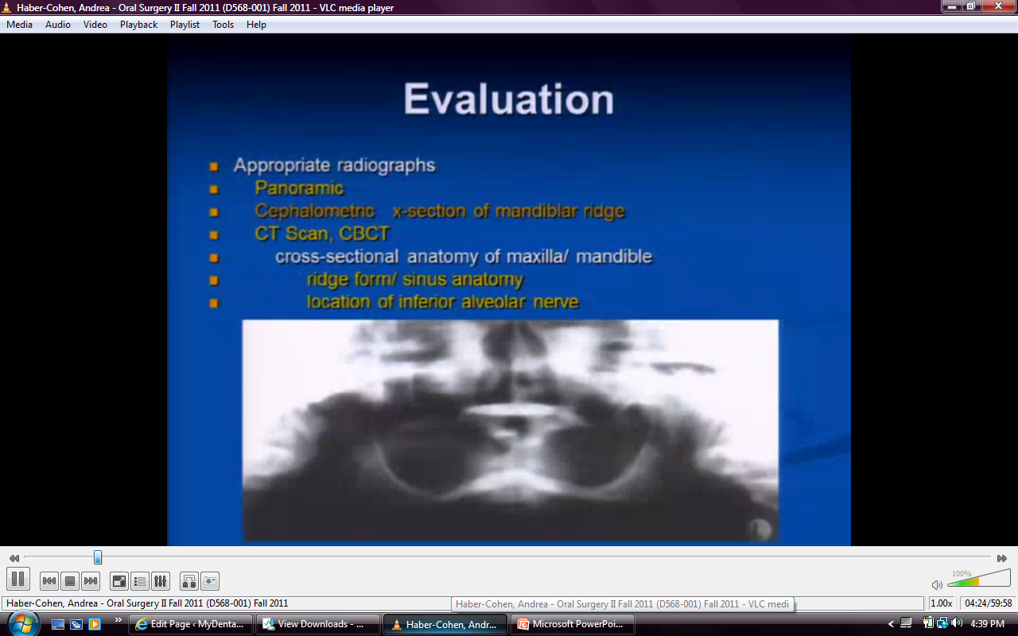
Notes:
Gives better idea of jaw problems and ridge form

Slide 7
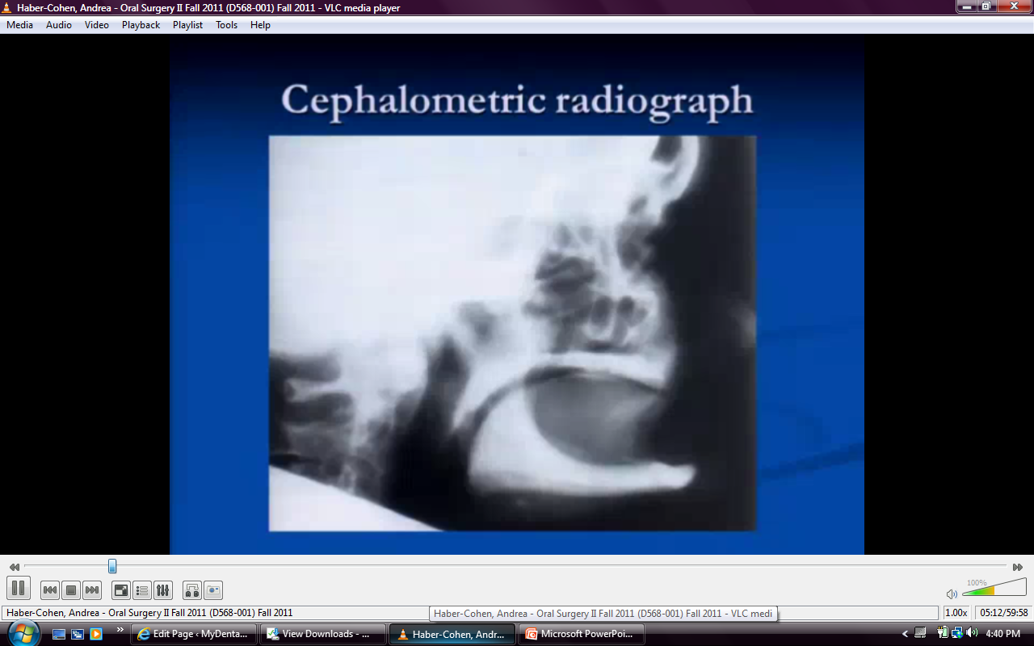
Notes:
Resorption patterns

Slide 8
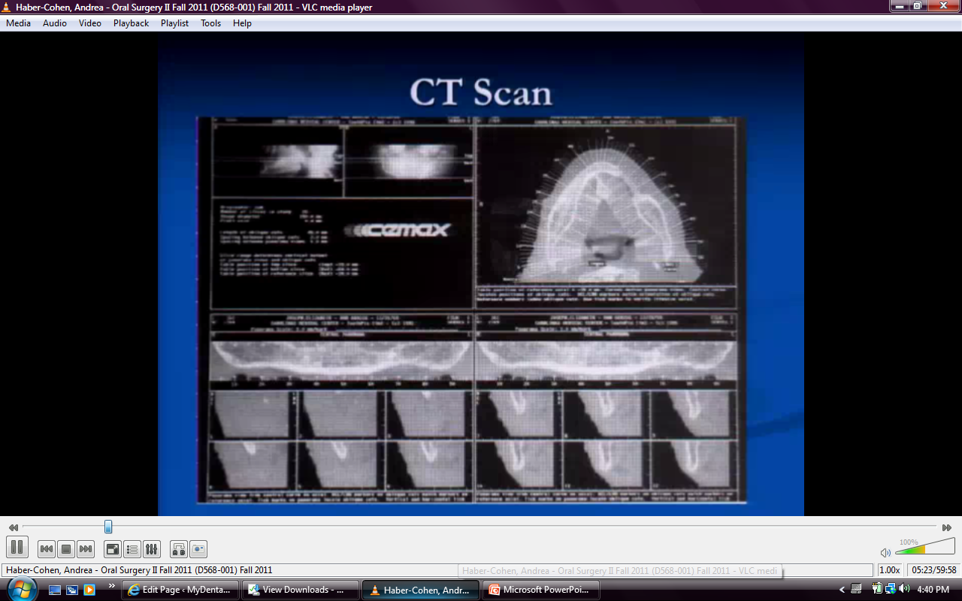
Notes:
CT scan- cut in windows

Slide 9
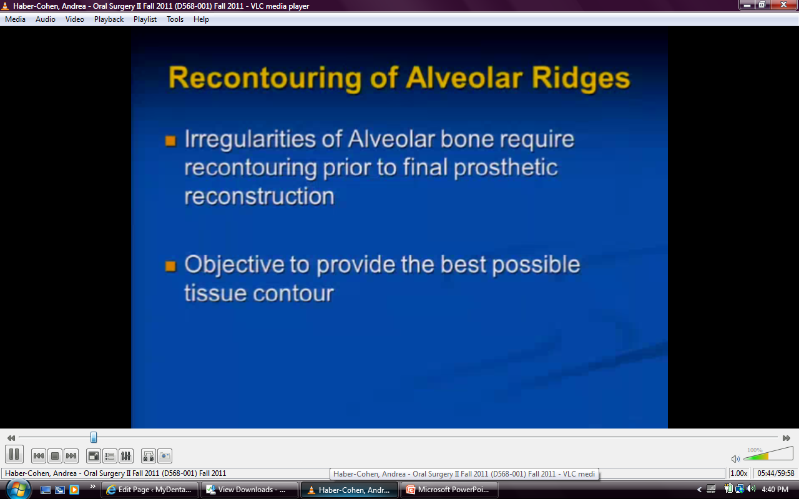
Notes:
Remove some protuberances/irregularities

Slide 10
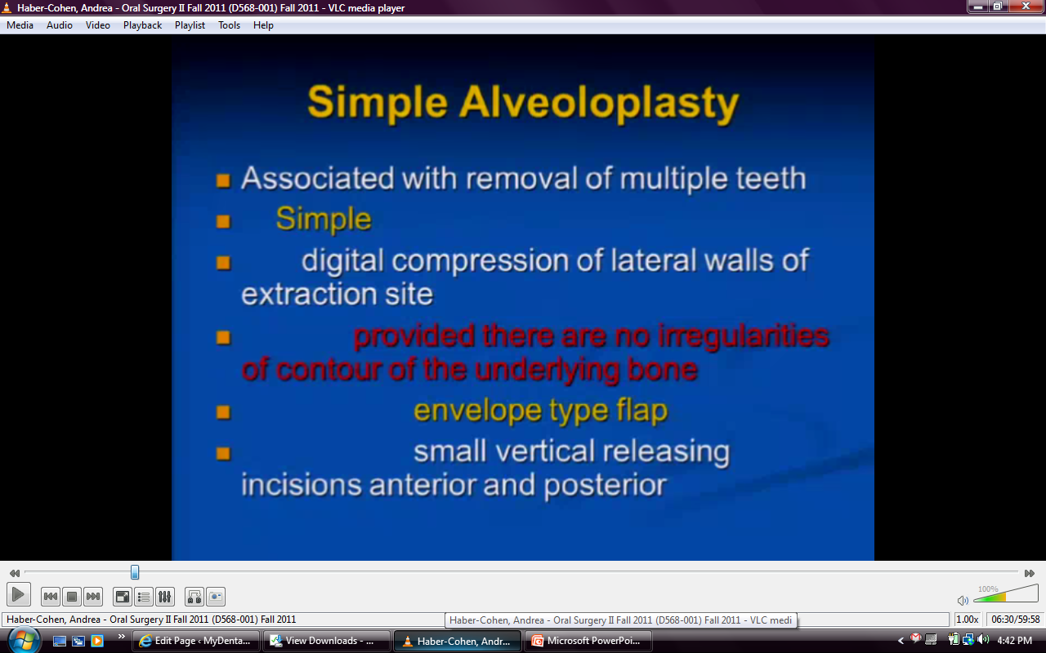
Notes:
Can compress if alveolar bone is soft (make cancellous more compact)
More dense bone palatally

Slide 11
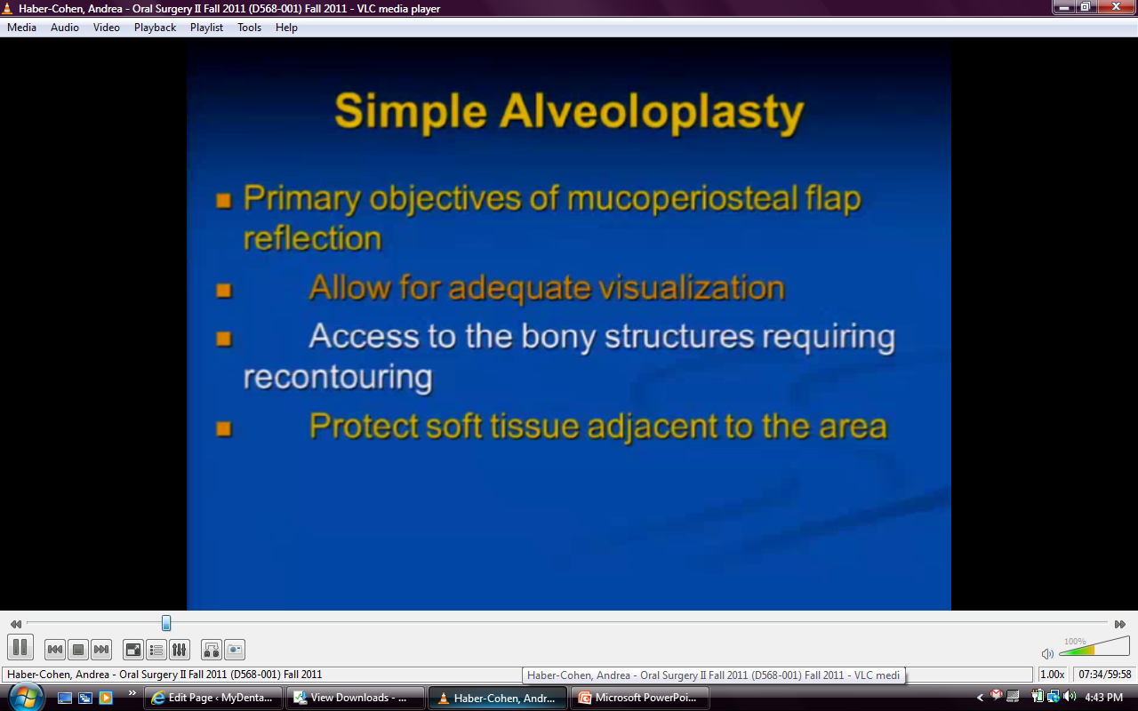

Slide 12
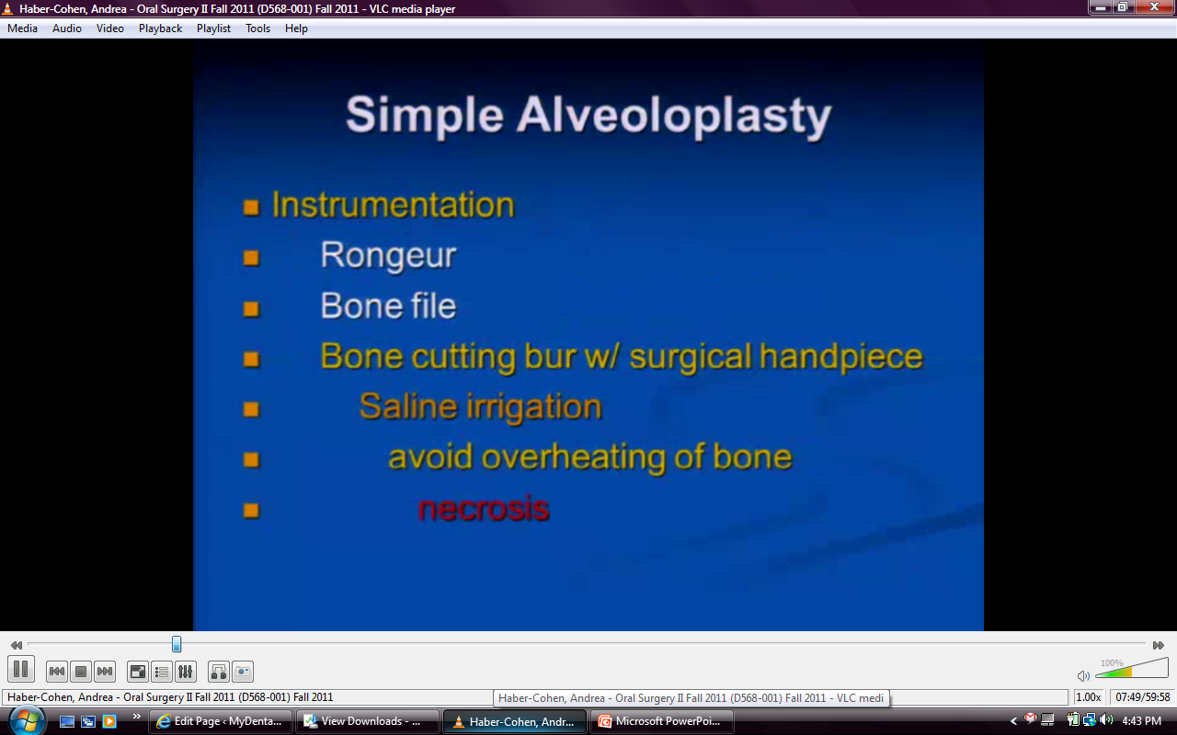
Notes:
Can do with mallet and chisel or burs (keep bone cool!!)

Slide 13
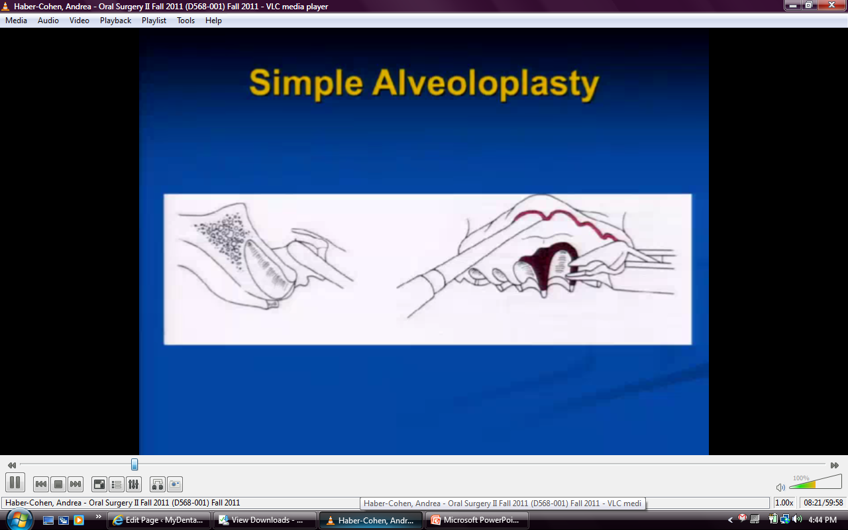
Notes:
Create path of insertion for denture by trimming with rongeur
2 aspects- engineer and sculptor
Don’t reduce too much bone because it is still going to go through natural resorption process. Remove too much bone→ very small ridge in future

Slide 14
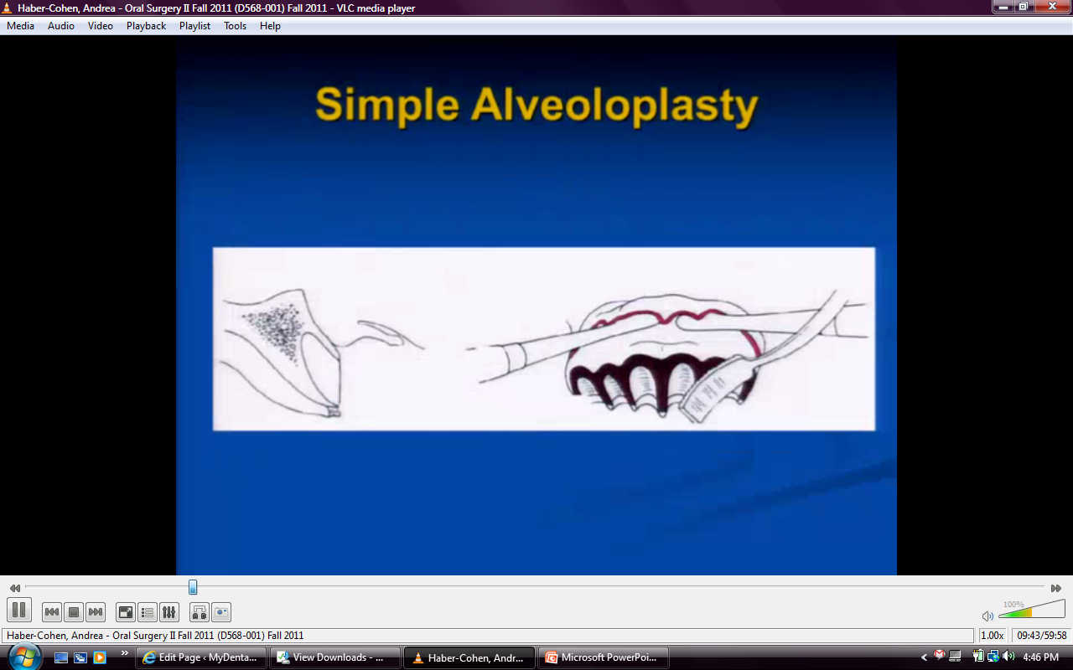
Notes:
Make sure no small fragments of bone left→ they will necrose

Slide 15
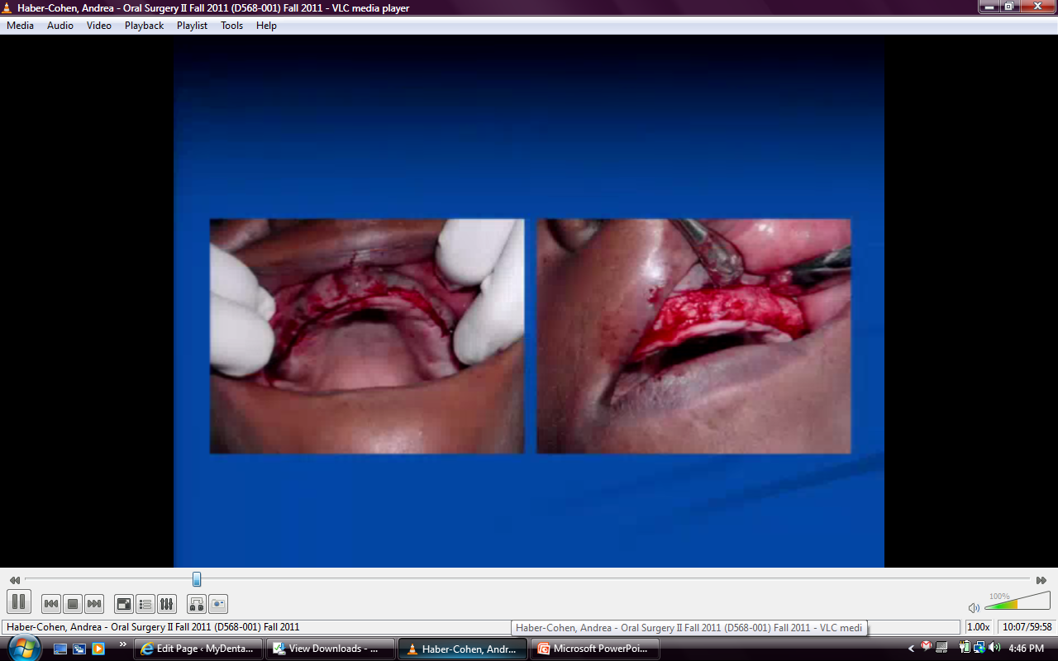
Notes:
Multiple vertical incisions, whole flap is lifted up, multiple irregularities of bone, reduced with rotatry instrument, replace soft tissue and feel with finger to make sure irregularities are gone, resuture (continuous interlocking)

Slide 16
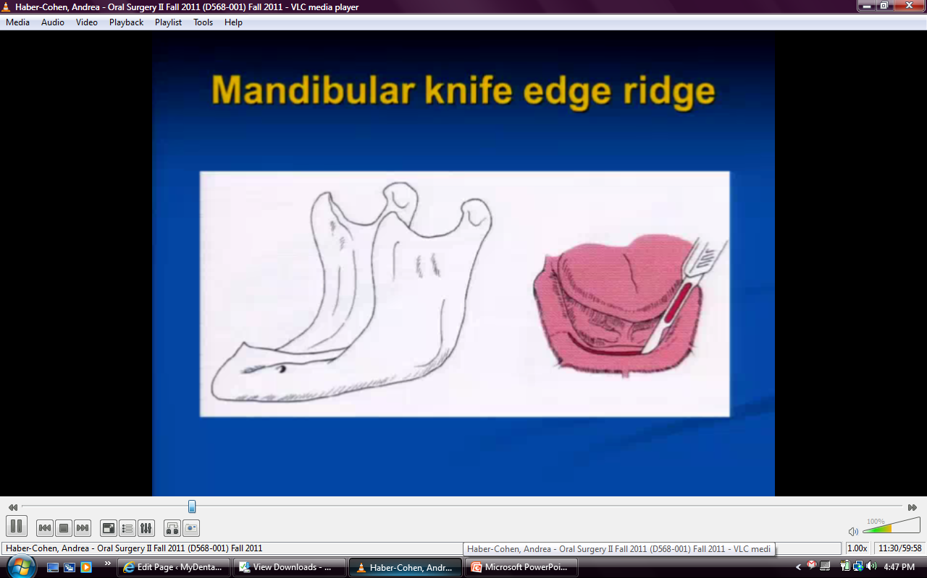
Notes:
For ppl who have been wearing dentures for years and have such resoprtion, have peak like razor blade. Sore because musocal covering is thin. Be careful of mental foramen because mental foramen becomes almost occlusal instead of buccal
If cut mental nerve→ anesthesia (via wallarian degeneration) avoid by looking for foramen on xrays

Slide 17
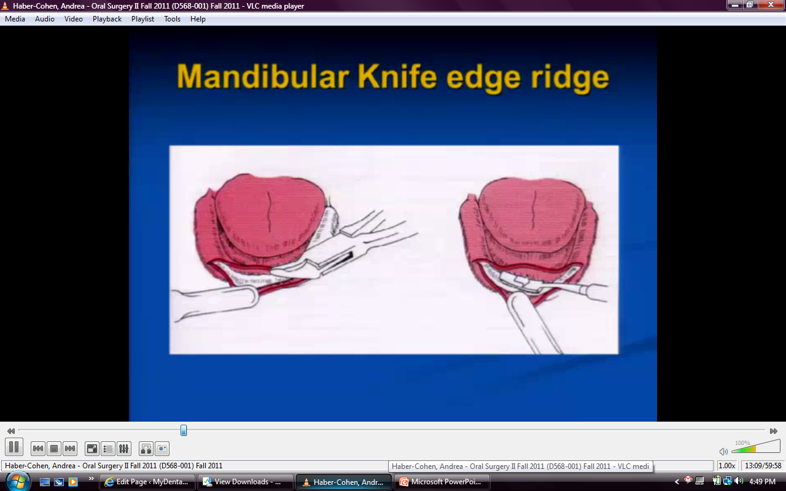
Notes:
Minimal recontouring with rongour and bone file

Slide 18
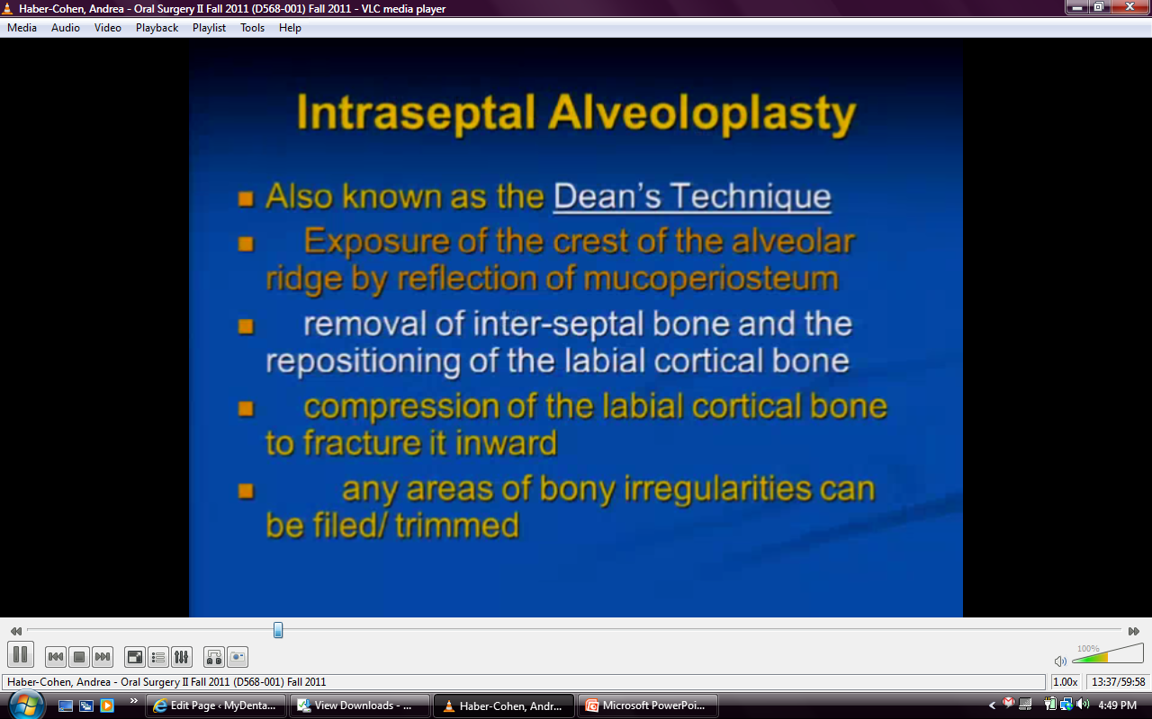
Notes:
Causing infracture at base of labial plate→ flattens our irregularities

Slide 19
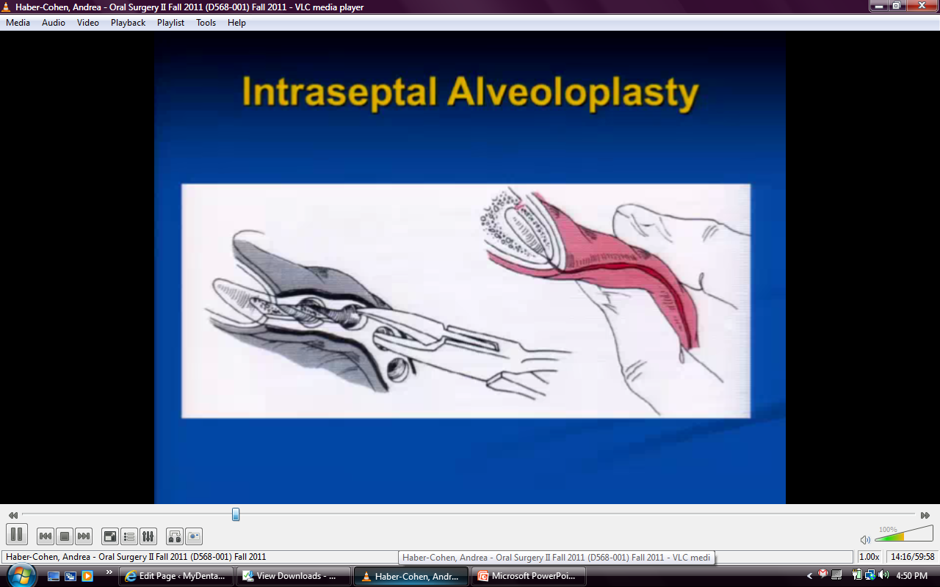
Notes:
Bone still ataches to periosteum, still blood supply → will heal
Not viable

Slide 20
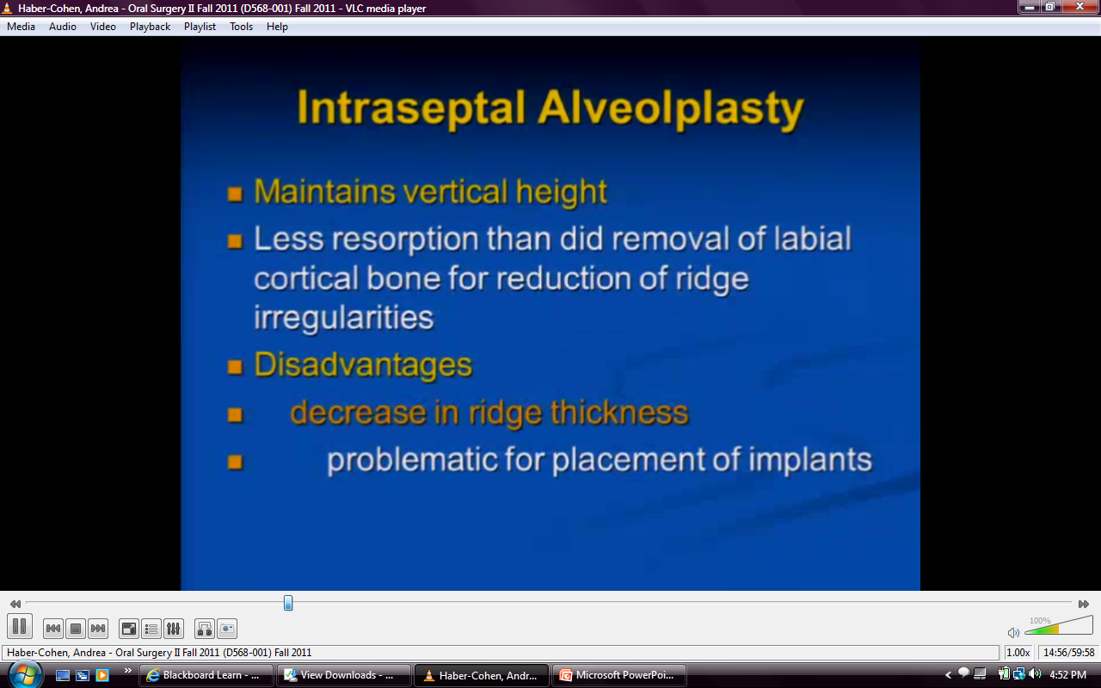

Slide 21
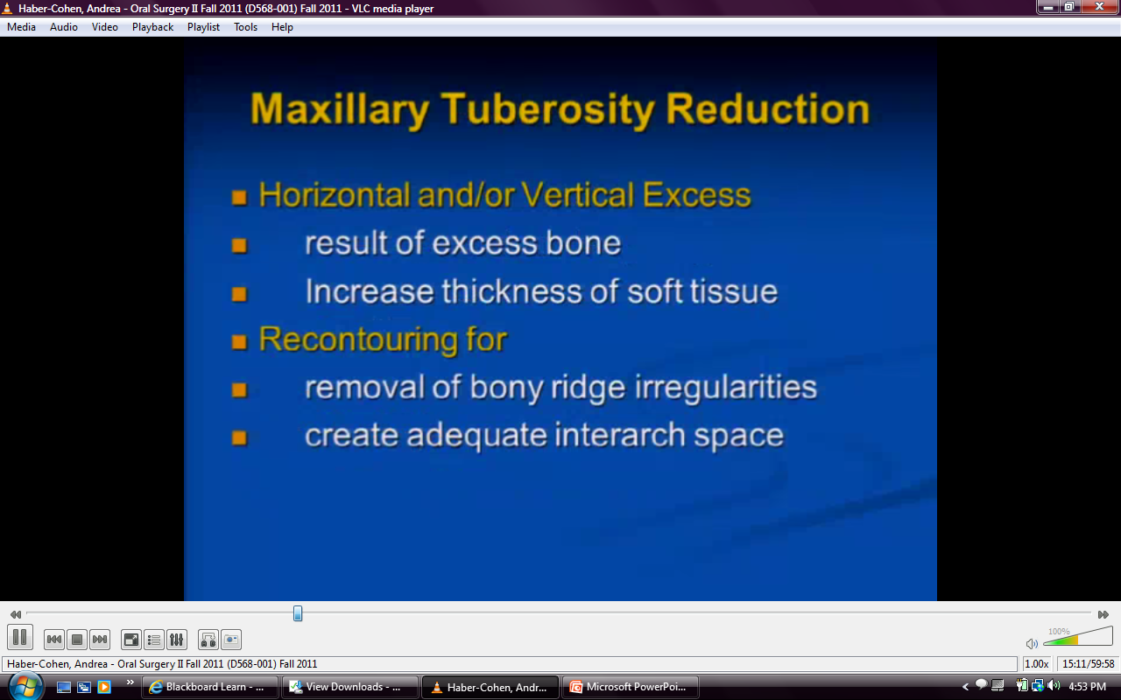
Notes:
End up with hyperplastic tuberosity
Look at xrays- also tell you if you have hyperpneumatized sinus that you cant do this in

Slide 22
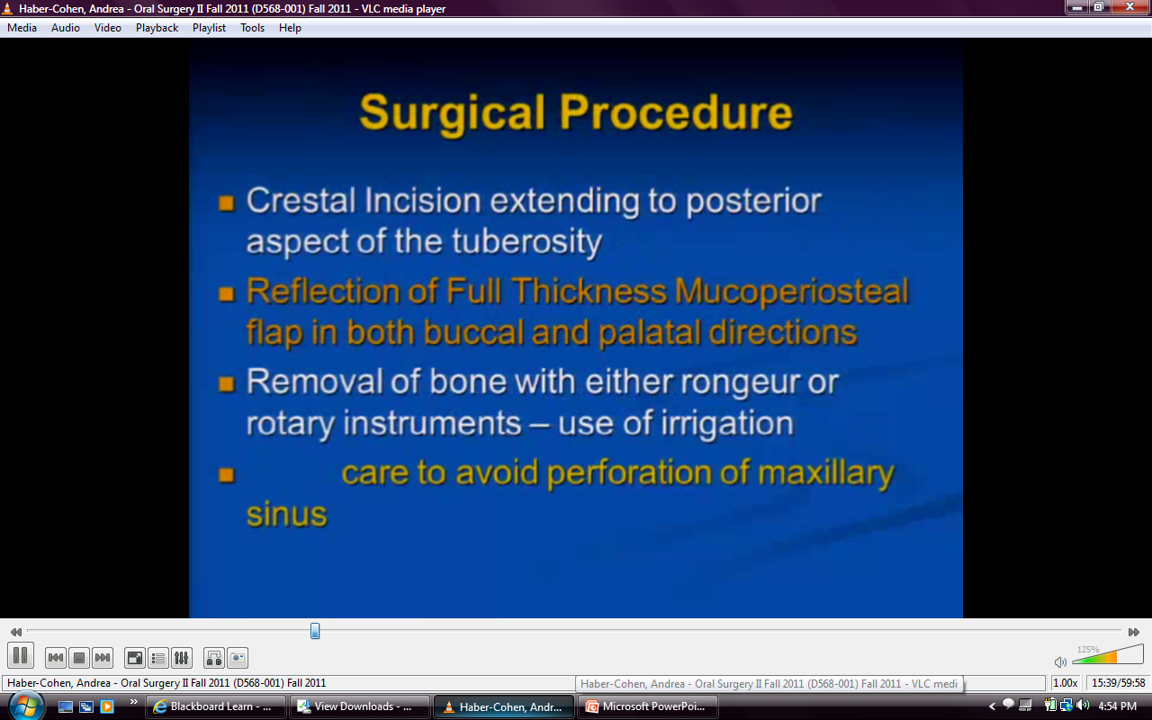

Slide 23
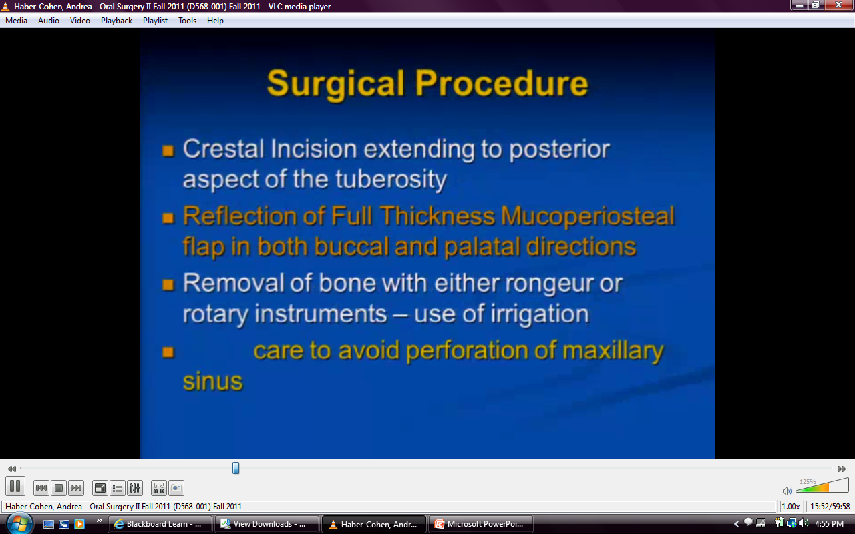
Notes:
Flap upward
(not dense cortical bone→ thin and easy to perforate)

Slide 24
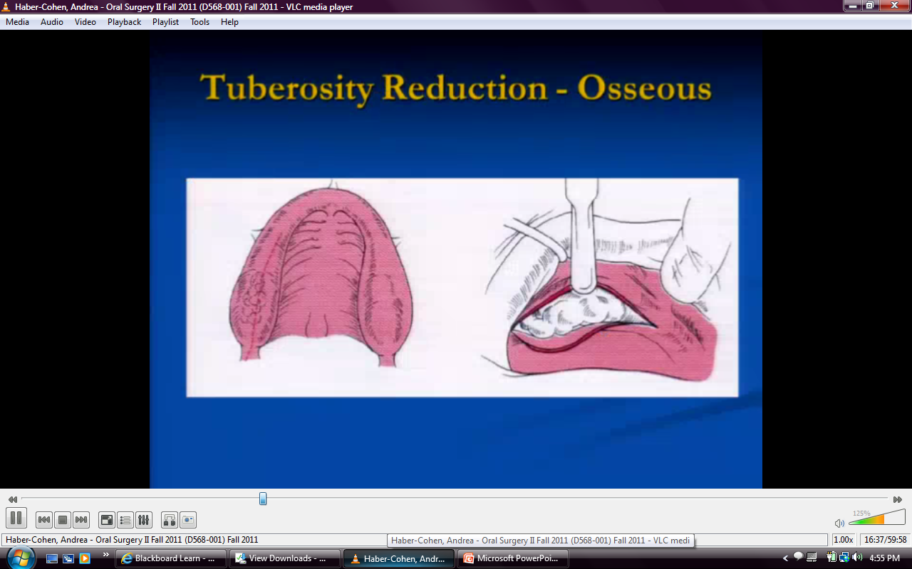

Slide 25
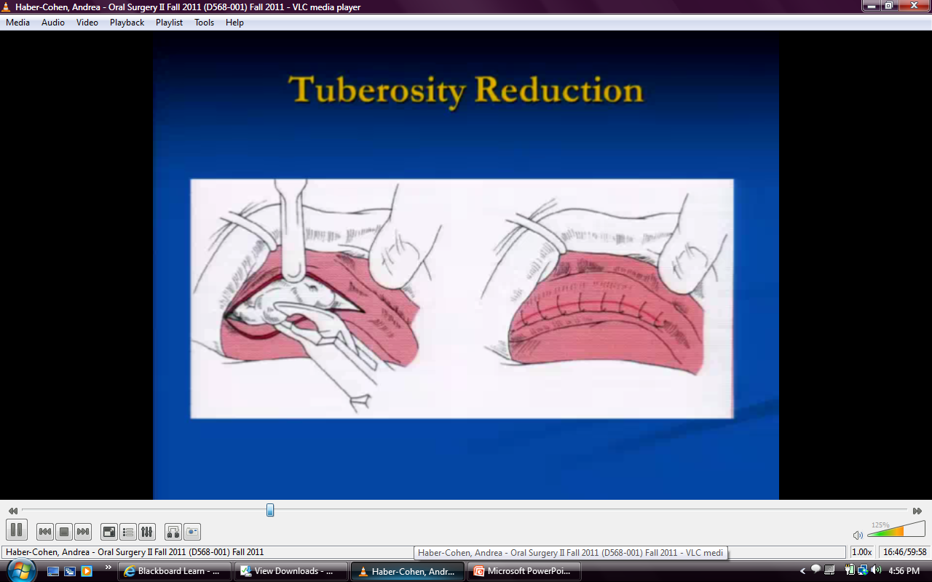

Slide 26
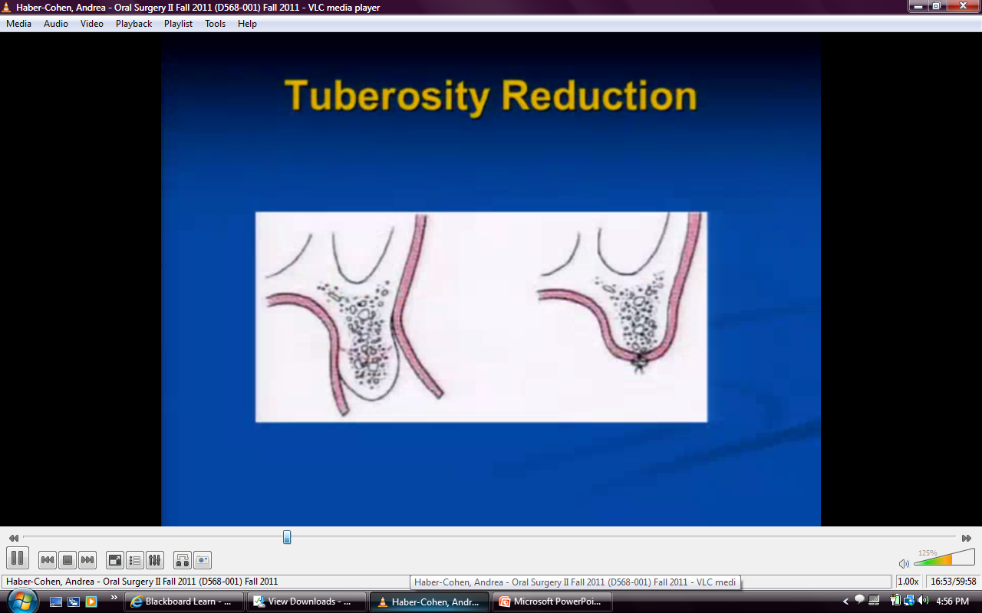
Notes:
Reduce vertical height for enough interarch difference, will have to trim excess soft tissue

Slide 27
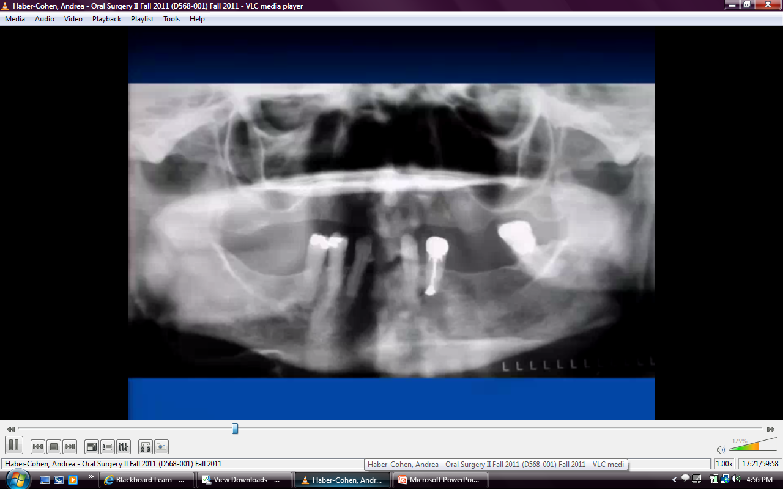
Notes:
Complications: hyperextruded molar→ resorbs opposing alveolas shape of tooth
Close to sinus

Slide 28
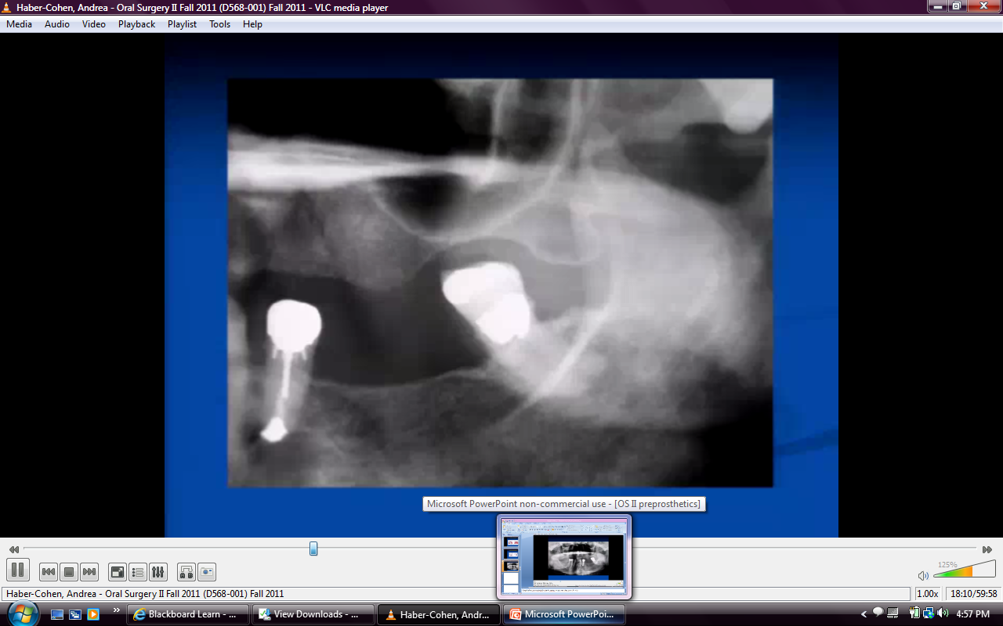

Slide 29
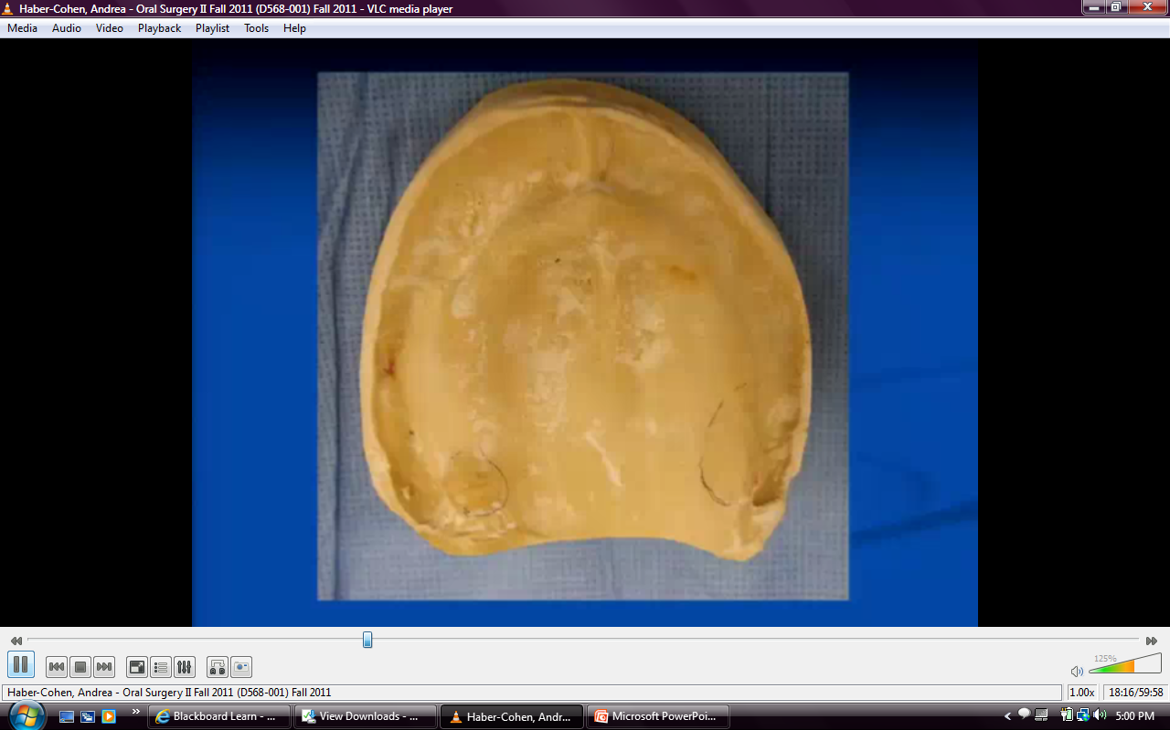
Notes:
2 areas that need trimming, study models

Slide 30
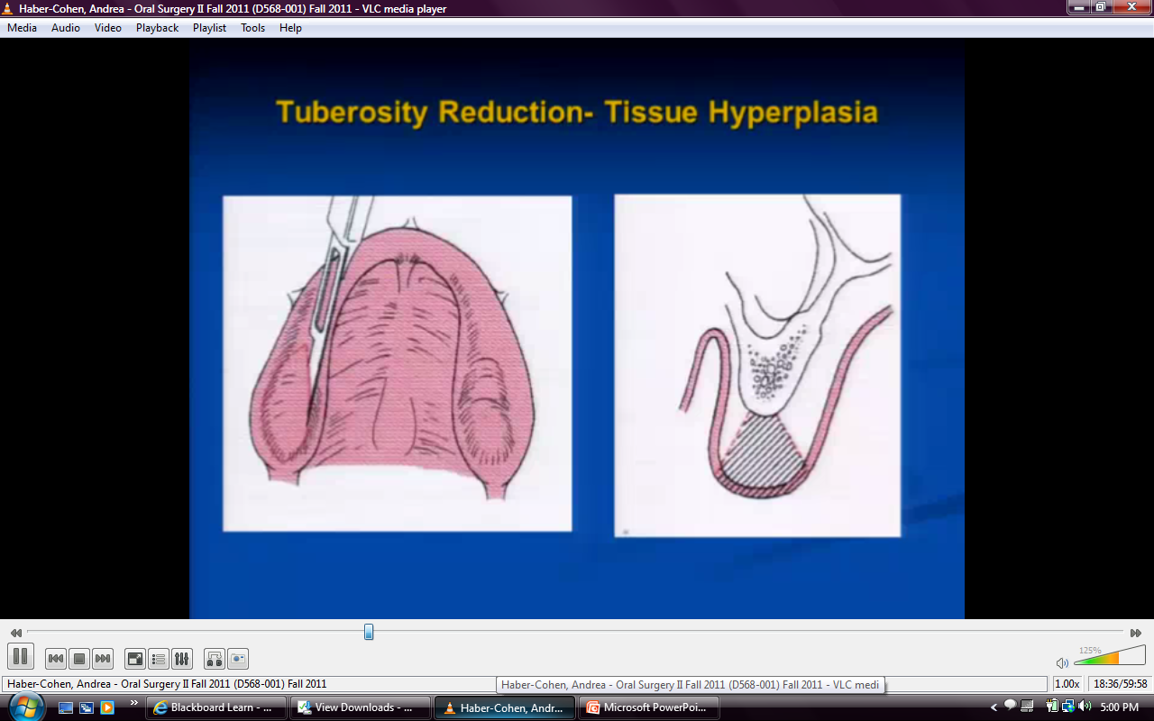
Notes:
Dense fibrous, hyperplastic tissue
Wedge incision of soft tissue

Slide 31
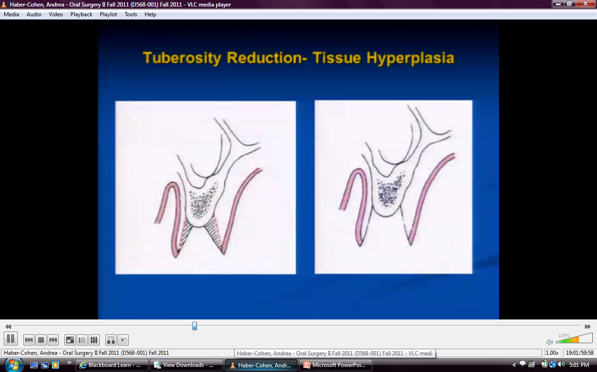
Notes:
Get out excess fibrous tissue

Slide 32
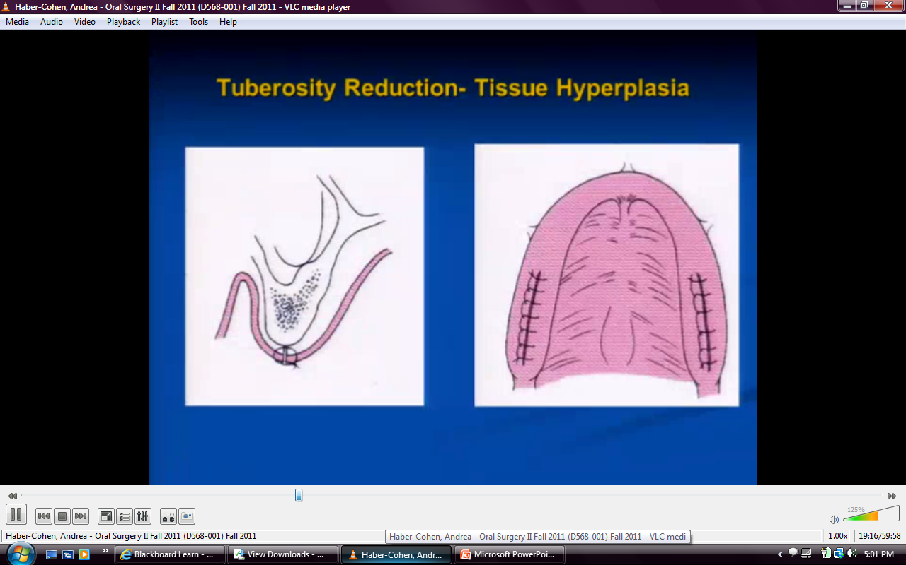
Notes:
Reposition and suture

Slide 33
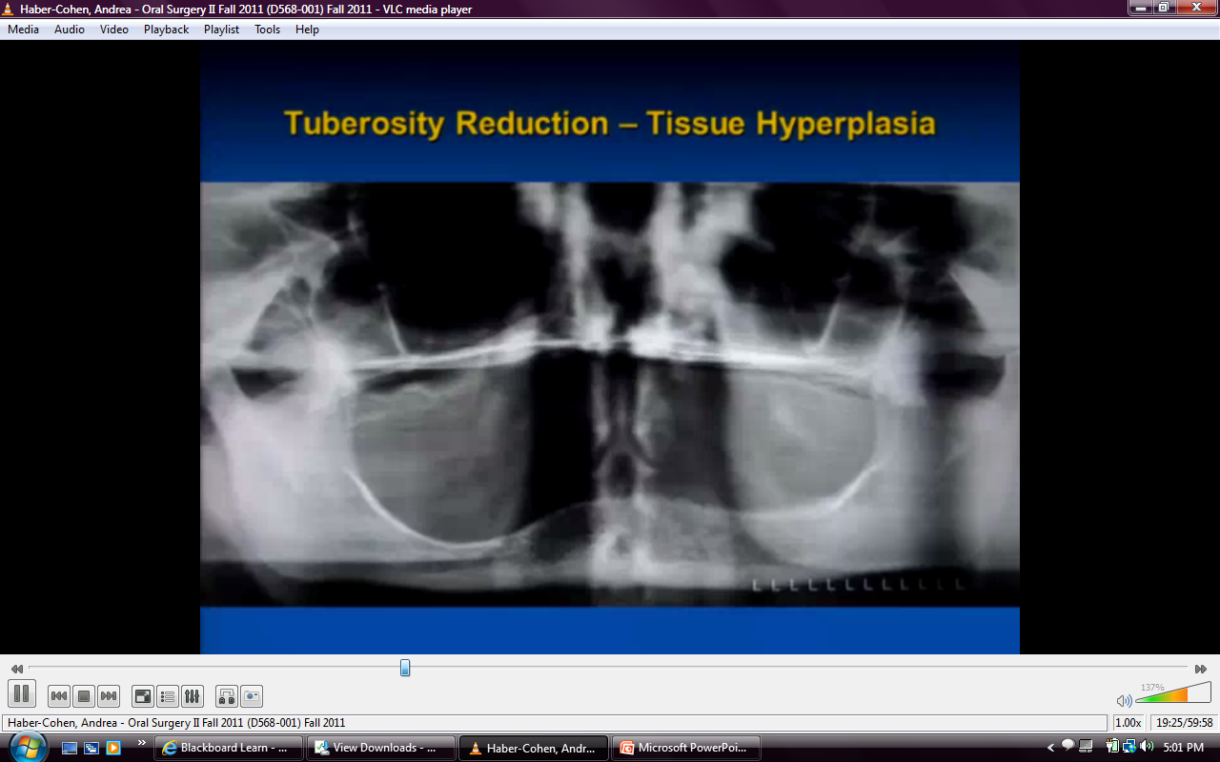
Notes:
No osseous reduction due to thinness of bone

Slide 34
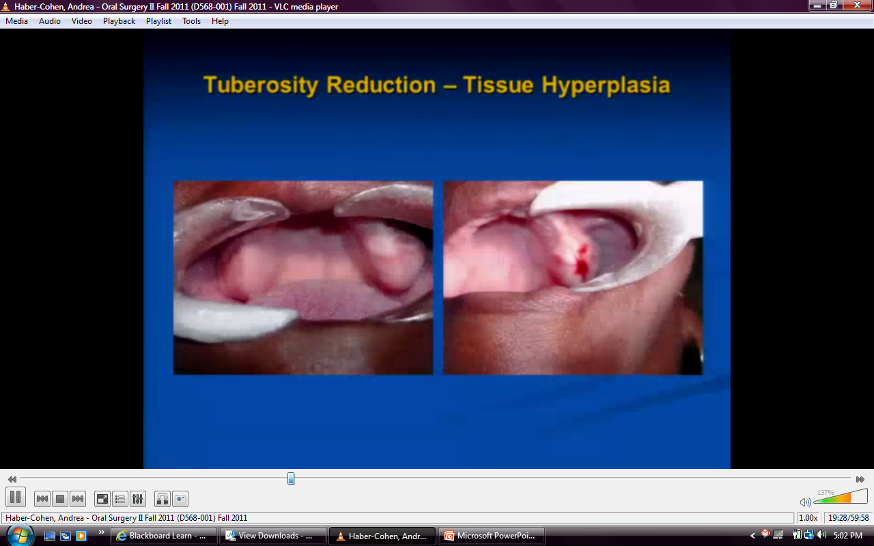
Notes:
Wide firbrotic tissue, midcrestal incision

Slide 35
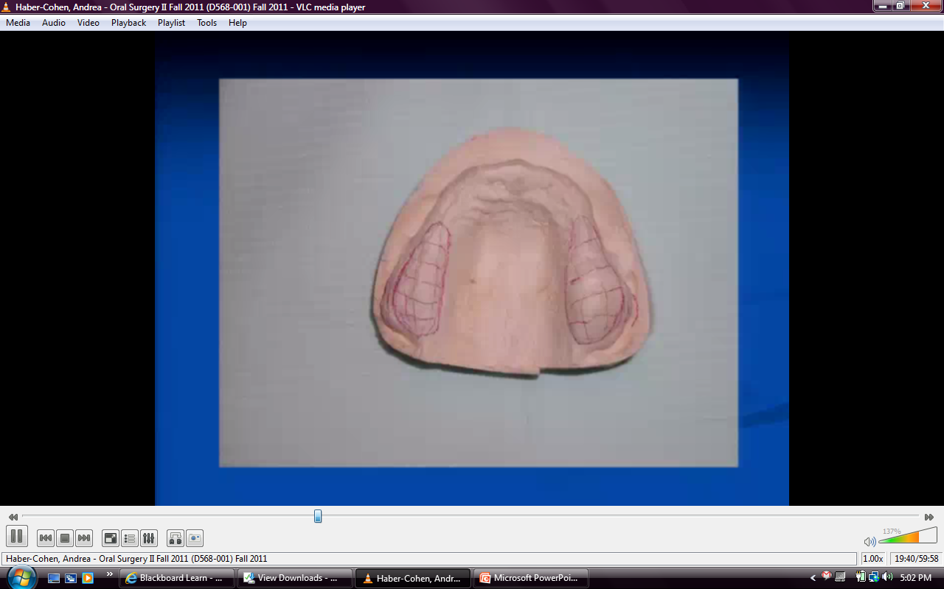

Slide 36
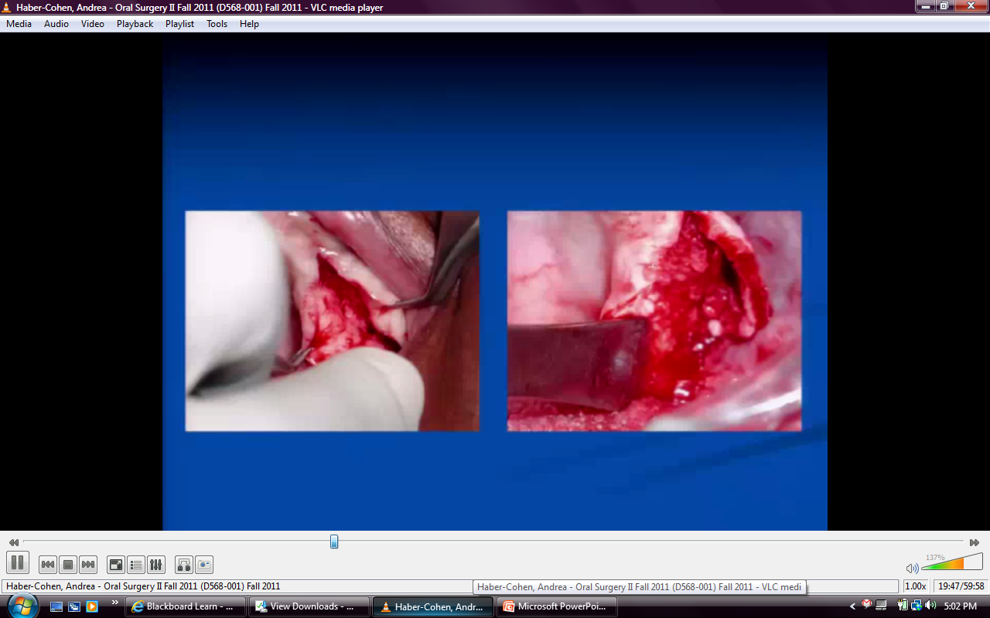

Slide 37
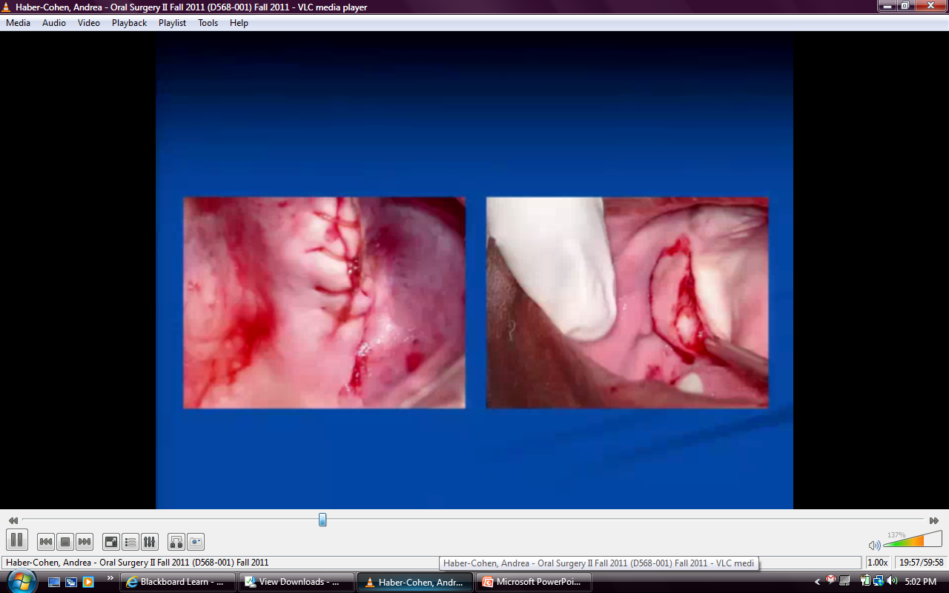
Notes:
Excess soft tissue

Slide 38
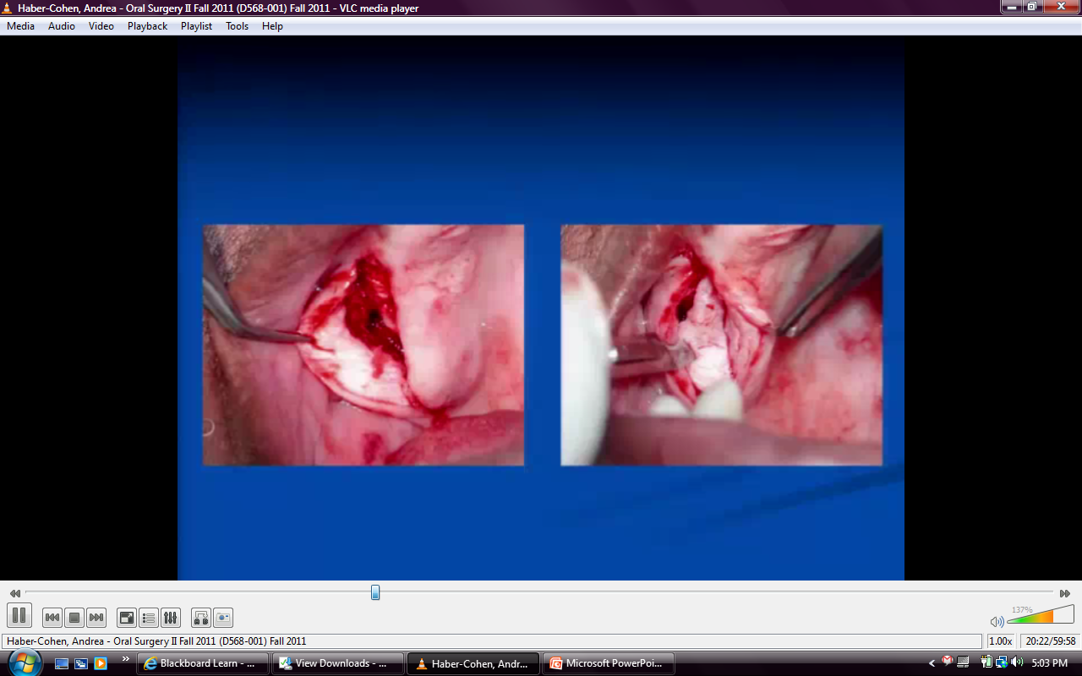
Notes:
Submusocal dissections
Being peeled away
A little bit of perforation into sinus
No bone was removed and membrane is intatct– due to hyperpneumatized sinuses

Slide 39
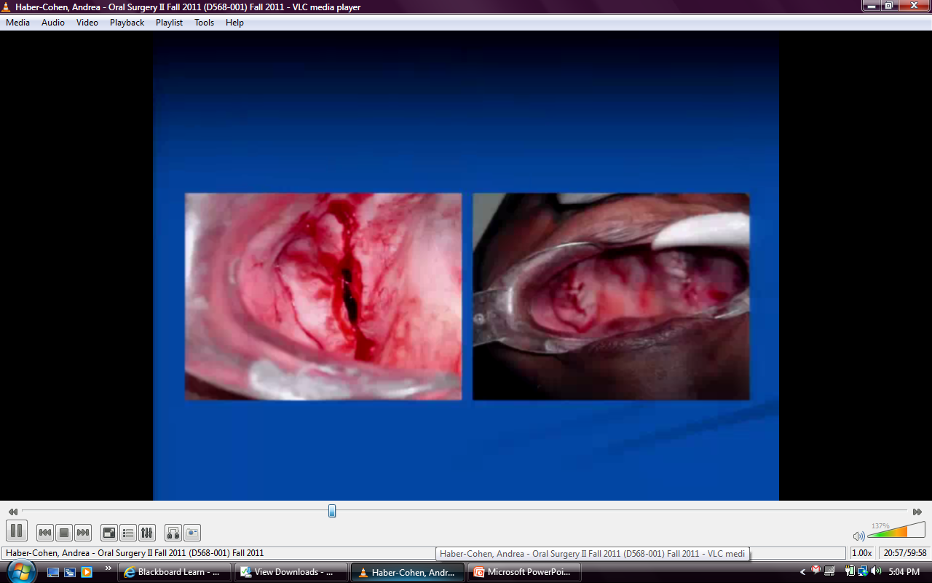
Notes:
Primary closure

Slide 40
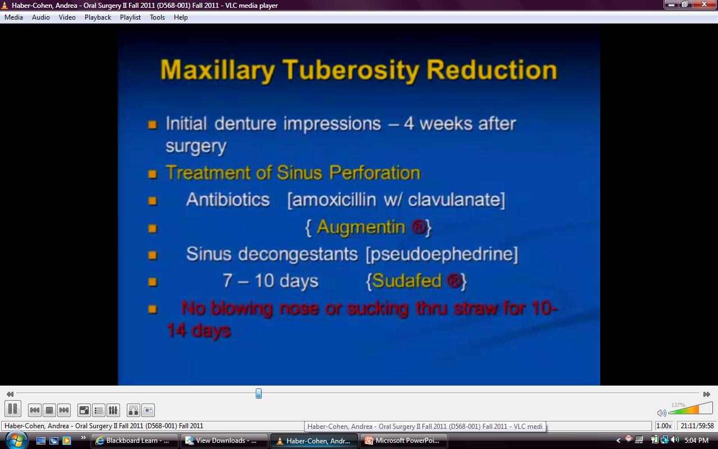
Notes:
*Not infected sinus, but take precautions

Slide 41
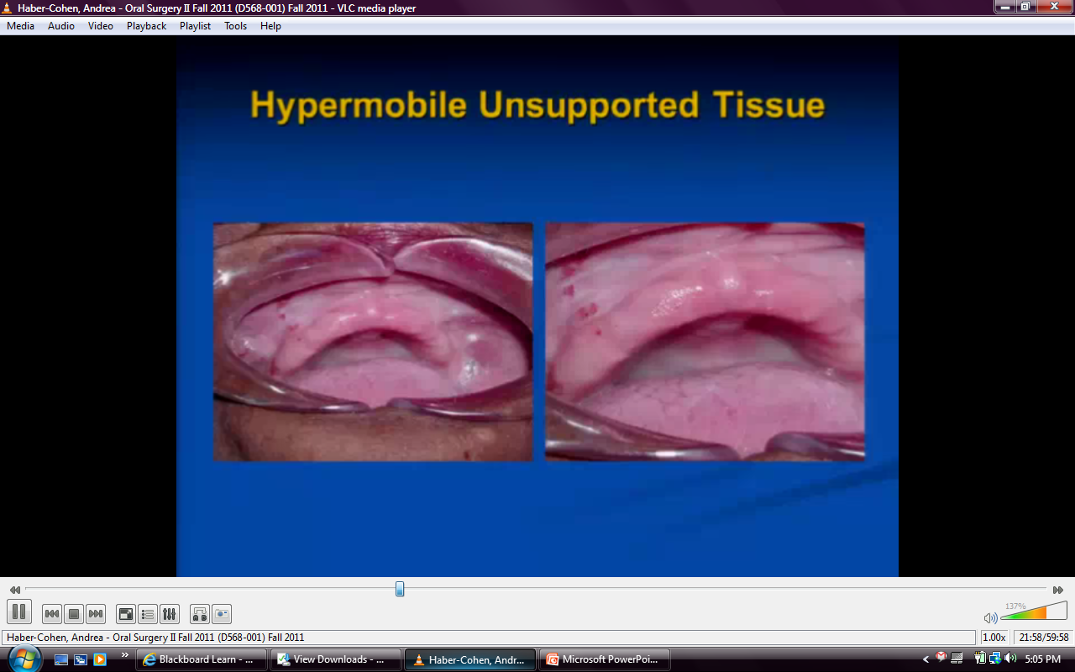
Notes:
Anterior hyperplastic tissue-moves around

Slide 42
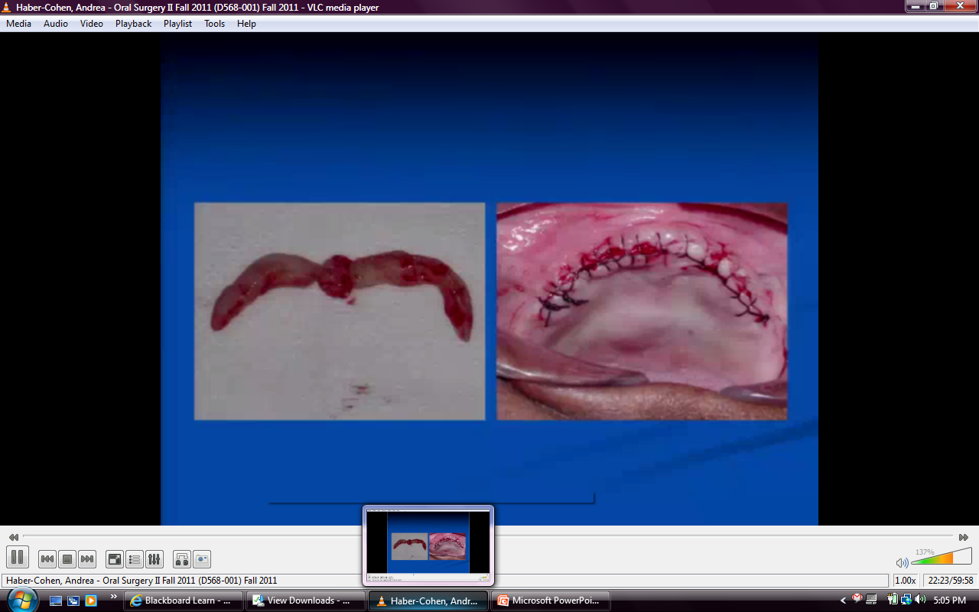
Notes:
Took wedge of tissue out

Slide 43
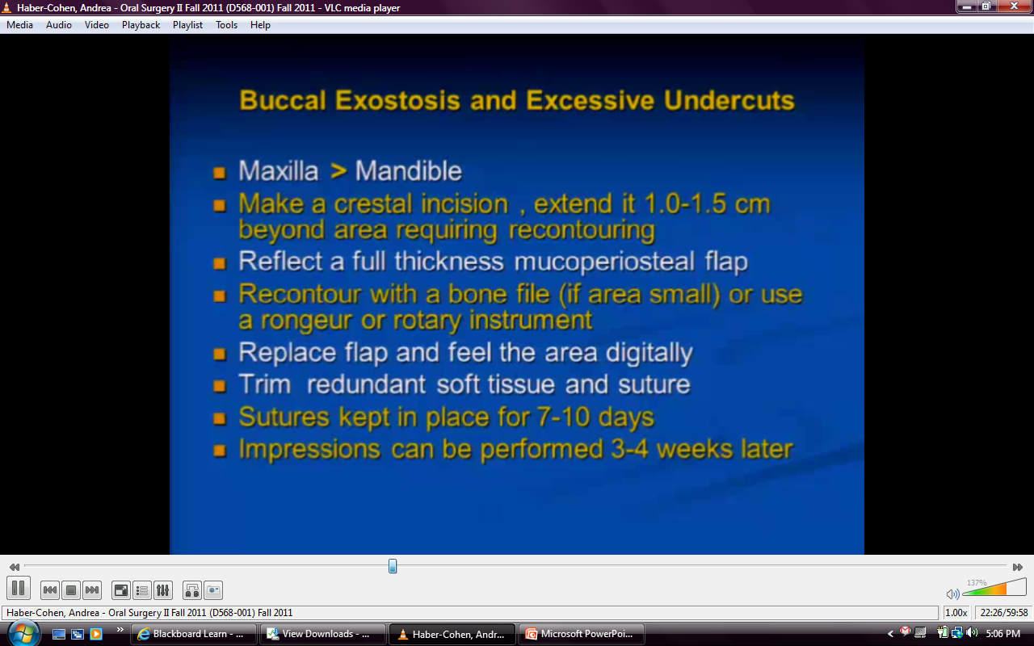

Slide 44
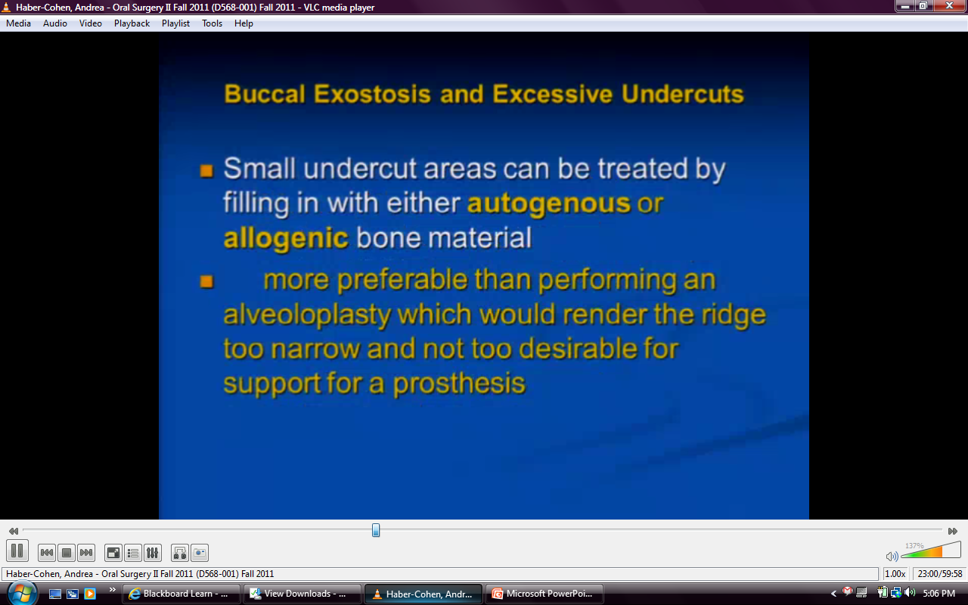
Notes:
8-10 weeks to fill in
Caveat is not to extend flap– key is tunneling, if strip periosteum too far inferiorly, graft material will migrate

Slide 45
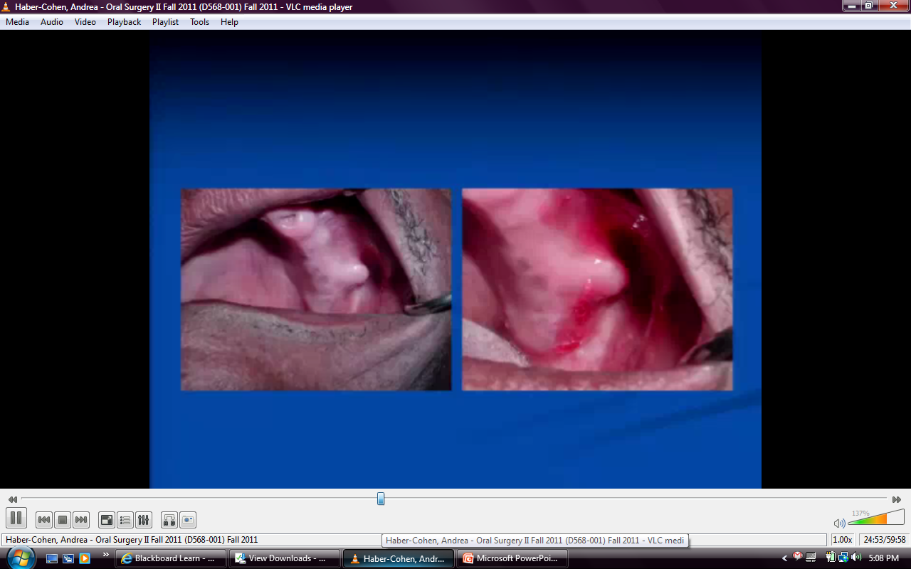

Slide 46
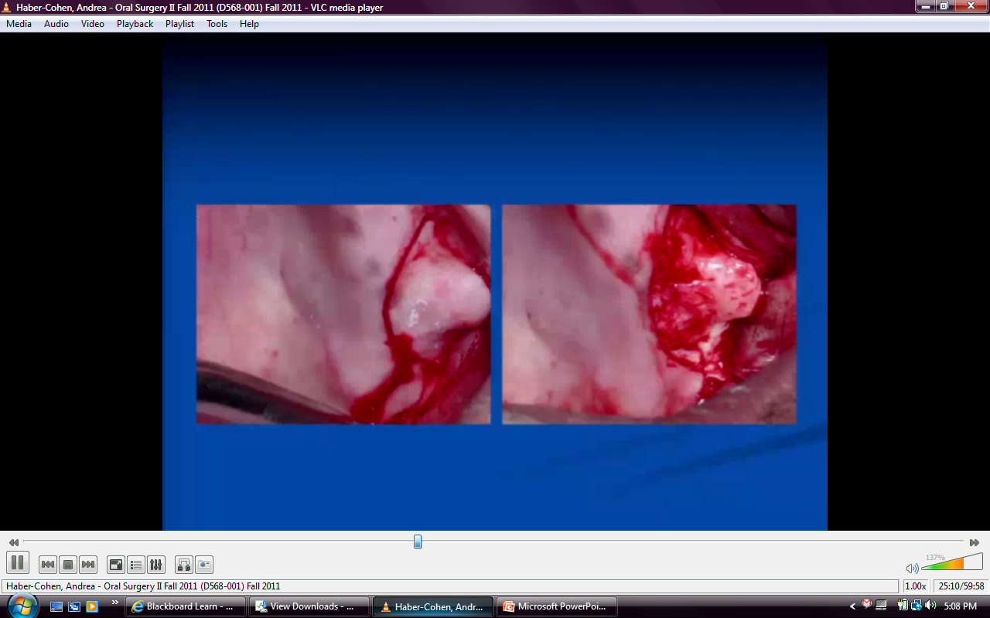

Slide 47
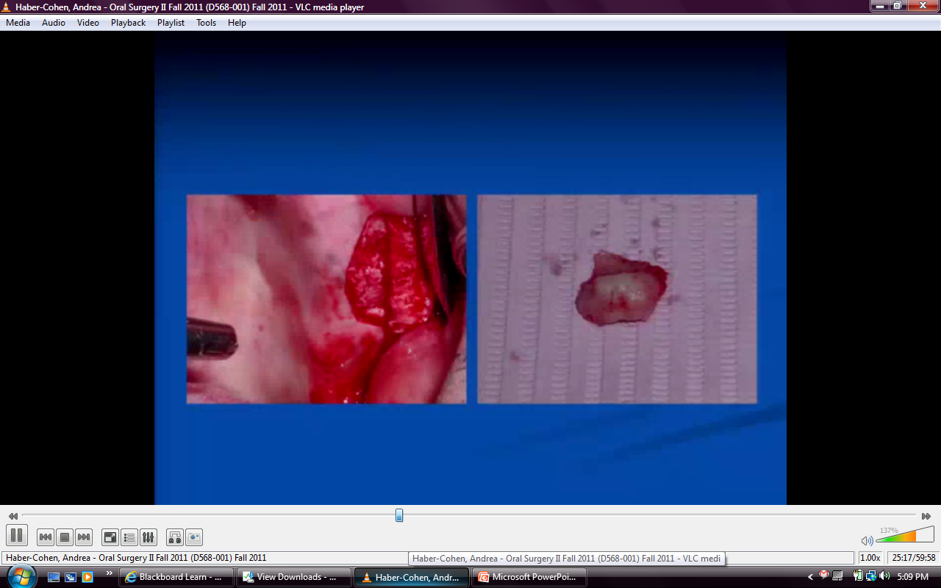

Slide 48
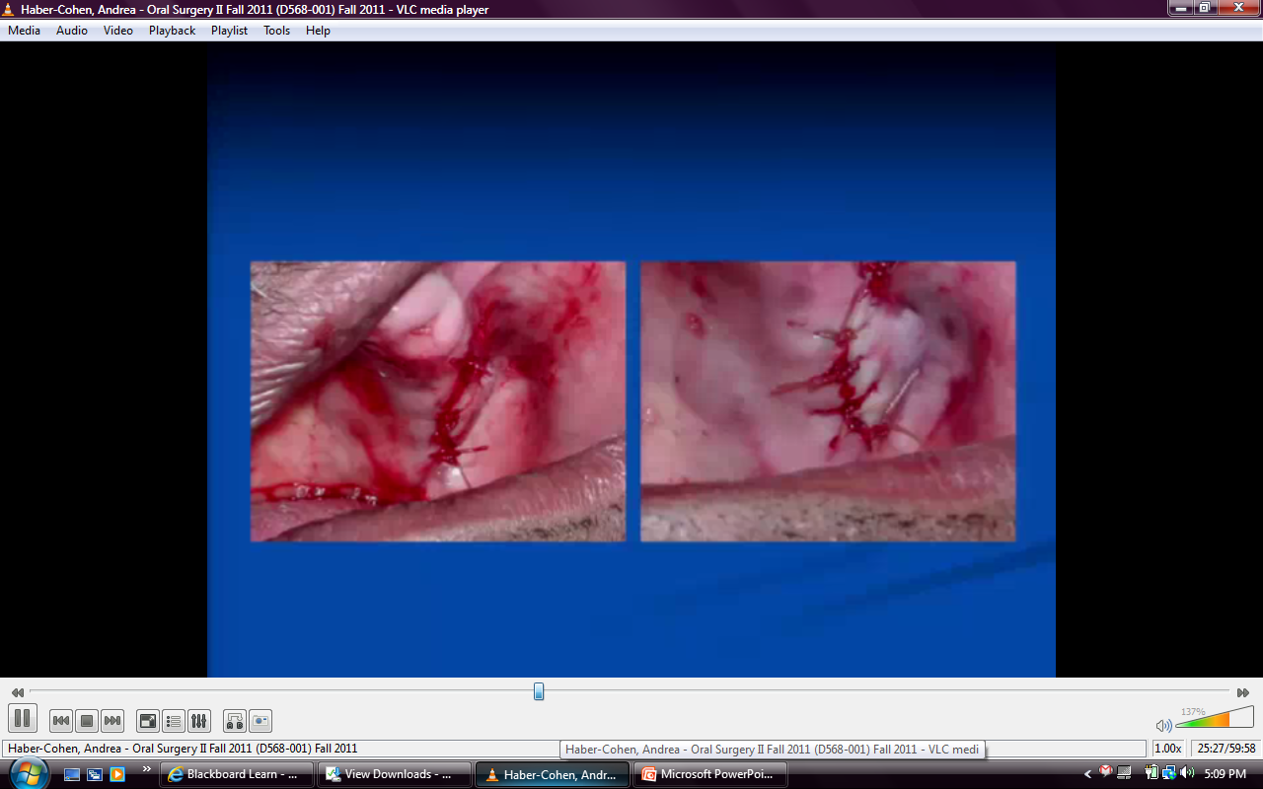
Notes:
* No soft tissue removed→ will contract in

Slide 49
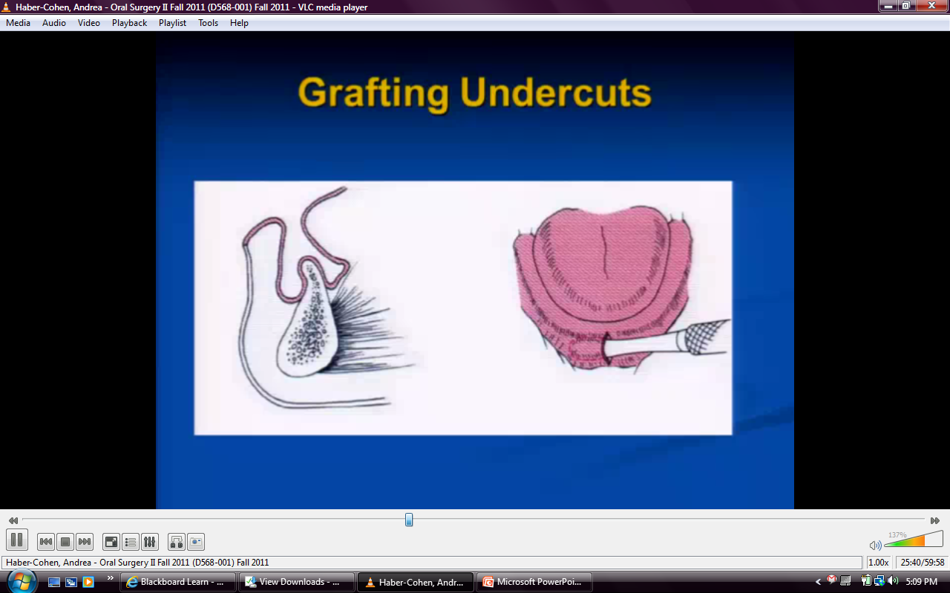
Notes:
*trying to preserve bone

Slide 50
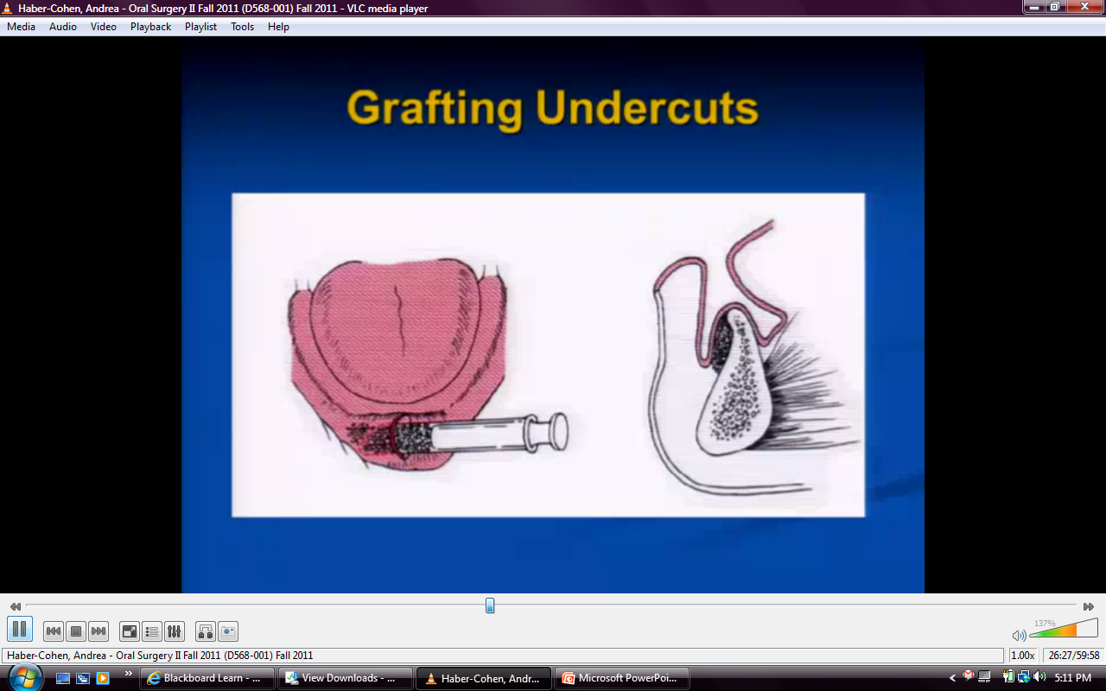
Notes:
Syringe filled with graft material, finger on outside can mold material. Subperiosteal dissection. Periosteum is holding in material

Slide 51

Notes:
Combine autogenous bone obtained from tuberosity→ milled into fine particles and mixed with xenograft

Slide 52

Notes:
Centrifuge blood→ PRP

Slide 53


Slide 54

Notes:
Denture possible or enough material to place implants

Slide 55

Notes:
Can only reduce and detach ½
Contains these muscle attachments→ if detach, tongue will fall back→ speech impediment

Slide 56

Notes:
Femlale> male

Slide 57

Notes:
Problem Manitaining mucoperisoteum/mucosa against bone→ hematoma→ breaks down
Excessive force→ instrument misguided→oral/nasal fistula (into nasal fossa)

Slide 58

Notes:
Midline incision with 2 vertical releasing on both sides
***Must remove in small sections***
After bulk is gone, use rotary instrument to smooth it out

Slide 59


Slide 60

Notes:
Make soft acrylic surgical stent from model, block out tori area
Place after surgery to support soft tissue to prevent hematoma from forming

Slide 61


Slide 62

Notes:
Midcrestal incision

Slide 63

Notes:
Rotary instrument→ series of holes→ connect the dots, once go to depth of bur, then mallet and chisel and quick strike, use bone file/round bur for sharp edges, irrigate, suture

Slide 64


Slide 65


Slide 66


Slide 67


Slide 68

Notes:
All specimens are sent to pathology lab

Slide 69


Slide 70


Slide 71


Slide 72

Notes:
Not problem to detach mylohyoid muscle
Problem: denture or implants?
Denture→ need to reposition that requires different surgical technique
Reposition muscle down
Suture pulls down

Slide 73


Slide 74

Notes:
Excess tissue around flange tissue

Slide 75

Notes:
Best event: removing
Worst event: created metaplasia, possible cancers, SCC from chronic irritation

Slide 76


Slide 77

Notes:
Grabbing with 2 hemostats and incising

Slide 78

Notes:
Leaves diamond shape area on ridge, simple suture

Slide 79


Slide 80

Notes:
Z Plasty- excise and make 2 incisions at 45 degree angles and transpose them
Tries to break up scar so you don’t get contraction
( takes 4 times longer and get same scar)

Slide 81

Notes:
V Section- heals by secondary intention
Very painful, 3-4 weeks, not usually done

Slide 82


Slide 83

Notes:
Clamping lingual frenum, excising band, opens up, just suture

Slide 84

Notes:
Autogenous= from patient
Allogenic= from cadaver
Xenograph=from another animal (usual bovine)
Alloplastic=artifical (usually HA)

Slide 85

Notes:
If tunnel and make overzealous tunnel→ migrates
Dehiscence from detaching blood supply
Encroaching on nerve→ paresthsia

Slide 86

Notes:
HISTORICAL
Or rib grafting
Superior border augmentations problem: resorbs very rapidly because bone wasn’t meant to be there

Slide 87

Notes:
Took cadaver mandible and hollowed it out, got marrow from iliac crest= live bone cells interspersed between cadaver bone and pts mandible
*NOT DONE ANYMORE*
Can graft superiorly to certain extent, but now we have implants

Slide 88


Slide 89

Notes:
Indication: Shallow alveolar process and vestibule- done years ago before implants
Iliac bone placed between base of skull and maxilla, rigid fixation
Problems: sinuses

Slide 90

Notes:
Lateral wall and subantral wall
2 Stages if minimal bone; 1 Stage if minimum of 4mm bone

Slide 91

Notes:
Enough bone for implant but need lateral wall lift first
** make sure sinus membrane is intact, place graft material (any) which acts as scaffold for bone cells. Once layered in bone, can do implant and pack around and put membrane around window and close it up
If perforation→ take collagen membrane and layer it in- helps heal (as long as small perforation)

Slide 92


Slide 93

Notes:
Made window, intact sinus membrane, pack graft material, place membrane over that, close u[

Slide 94

Notes:
Well contained
Can place implants in 5-6 months

Slide 95

Notes:
HISTORICAL due to implants
Done to get retention, get vestibule
Incision into lip, tucking down and suturing
Heals by secondary intention or get graft

Slide 96

Notes:
Taking periosteum and moving up

Slide 97

Notes:
HISTORICAL Mylohyoid muscle-extend vestibule
Pull muscle down and skin graft goes over, then surgical stent
Works but painful

Slide 98



Slide 99

Notes:
[Over time, these procedures gravitate back up and resorbs
Implants stimulate bone so don’t lose it]

Slide 100

Notes:
Tunneling in, separating fibrous band, placing premade surgical stent/guide to support tissue, leave in for 4-5 weeks, skin graft (from palate)
Palatal graft=* Split thickness (not full thickness)

Slide 101


Slide 102


Slide 103


Slide 104


Slide 105

Notes:
Denture held in with palatal screw

