Slide 1
PURPOSES:
Disinfection
Debridement
Demineralization
Lubrication
Stimulation of Repair

Slide 2
DISINFECTION:
Requirements for root canal disinfection
Effective as an antimicrobial agent
Non-Irritating
Stable in solution
Prolonged antimicrobial action
Active in the presence of blood, tissue and organic debris

Slide 3
DISINFECTION: (cont.)
Requirements for root canal disinfection
6. Not interfere with repair of periapical tissue
7. Not stain tooth structure
8. Easily introduced into root canals
9. Not toxic or carcinogenic
10. Not sensitizing

Slide 4
DISINFECTION: (cont.)
Solutions
Formocresol
Camphorated monochlorophenol (CMCP)
Cresatin
Eugenol
Chloramine T

Slide 5
DISINFECTION: (cont.)
Solutions (cont.)
6. Chlorhexidine Gluconate
7. Sodium Hypochlorite (Chlorinated Soda, Dakin’s Solution)
8. Calcium Hydroxide
9. Iodine/ Potassium Iodide
Polyantibiotic Paste (PBSC)
MTAD

Slide 6
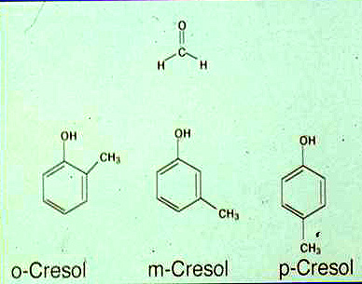
Formocresol (Buckley’s Solution)
1- Composition:
19% Formaldehyde
35% Cresol
15% Glycerol in Water
Cresol is a mixture of the three O, M, and P you see here.

Slide 7
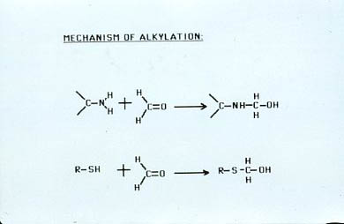
Formocresol (Buckley’s Solution) –cont.
2- Mode of Action:
Alkylation; Coagulation
Phenols (cresol) causes coagulation proteins.

Slide 8
Formocresol (Buckley’s Solution) –cont.
3- Advantages:
Highly bactericidal
4X more potent than phenol (phenol coefficient=4)
Does not require contact for antibacterial action (vapors are effective)

Slide 9
Formocresol (Buckley’s Solution) –cont.
4- Disadvantages : Highly cytotoxic Causes severe inflammatory tissue reactions Highly volatile – lost from root canal over time Possibly carcinogenic
5- Method of Application: saturated/ blotted cotton pellets sealed into pulp chamber

Slide 10
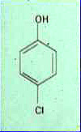
#2 Camphorated Monochlorophenol (CMCP)
1- Composition :
2- Mode of Action: coagulative antiseptic
Looks similar to the cresols but has a chloride attached to it.
It’s a derivative of phenol and works similar again causing COAGULATION

Slide 11
Camphorated Monochlorophenol (CMCP)
3- Advantages : Highly bacteriocidal
4- Disadvantages : Highly toxic and irritating to tissue Most be in direct contact to be effective (vapors not effective)
5- Method of Application : Saturated/ blotted cotton pellets sealed in pulp chamber

Slide 12
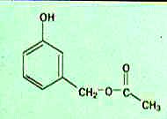
#3 Cresatin
1- Composition : acetic acid ester of metacresol
2- Mode of Action: coagulative antiseptic

Slide 13
Cresatin
3- Advantages : Less irritating than other phenolic antiseptics
4- Disadvantages : Only weakly bacteriocidal Requires direct contact for bacteriocidal effect
5- Method of Application : Saturated/ blotted cotton pellets sealed in pulp chamber

Slide 14
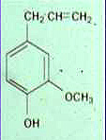
Eugenol
1- Composition : 2- Mode of Action: coagulative antiseptic
3- Advantages: moderately antiseptic

Slide 15
#4 Eugenol (cont.)
4- Disadvantages : Highly irritating and inflammatory (on direct contact) Requires direct contact (vapors not effective)
5- Method of Application : Saturated/ blotted cotton pellets sealed in pulp chamber

Slide 16
#5 Chloramine T
1- Composition : 2- Mode of Action: Released Chlorine acts as oxidizing agent
3- Advantages: Non-irritating

Slide 17
Chloramine T (cont.)
4- Disadvantages : Does not have solvent action on necrotic pulp as does Sodium Hypochlorite
5- Method of Application : Used to irrigate root canal

Slide 18
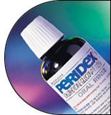
#6 Chlorhexidine Gluconate (Peridex)
1- Composition :

Slide 19
Chlorhexidine Gluconate (Peridex)- cont.
2- Mode of Action: - Positively charged portions of chlorhexidine bind to negatively charged groups on cell surfaces (Phosphates on lipids and carboxyl groups on proteins) - Lipophilic group of molecule react with lipoproteins to cause disorganization of cell membrane - Increases permeability of cell membrane - Causes leakage of low molecular weight substances from cells

Slide 20
Chlorhexidine Gluconate (Peridex)- cont.
3- Advantages: - Non-Irritating - High Substantivity
4- Disadvantages - Only moderate aseptic action - Possible emergence of resistant strains - Not active against bacterial endospores, some fungal spores or viruses -Forms precipitates with either NaOCl or EDTA -Breakdown product (parachoroaniline) may be carcinogenic

Slide 21
Chlorhexidine Gluconate (Peridex)- cont.
5- Method of Application: - Used to Irrigate root canal

Slide 22
#7 Sodium Hypochlorite
1- Composition : NaOCl (Used in 5.25%-6.0% solution)
2- Mode of Action: Liberates free Chlorine 3- Advantages: - Has solvent action on necrotic pulp tissue and organic debris - Highly antiseptic
Most commonly used

Slide 23
Sodium Hypochlorite (cont.)
4- Disadvantages : - Extremely irritating and caustic (must not come into contact with periapical tissue) - Does not inactivate or degrade LPS
5- Method of Application: - Used as irrigant (gently/ passively)
Use as gently as possible to prevent exposure to the patient (forcing it down thru the root canal, can cause severe burns to patient.

Slide 24
#8 Calcium Hydroxide
1- Composition : Ca(OH)₂
2- Mode of Action: pH 12.2 – high pH kills almost all organisms it comes in contact with! Itroduced and packed down as a thick paste so it fills the Root Canal space
3- Advantages: - “Fills space” - Remains in canal a long time

Slide 25
Calcium Hydroxide
4- Disadvantages : -Not effective against some endodontic microorganisms such as E. faecalis -Requires at least 1 week intracanal application to be effective in eliminating bacteria.

Slide 26
Ca(OH)₂
5-Mode of Application

Slide 27
#9 Iodine/ Potassium Iodide
1- Composition : Iodine 2% Potassium Iodide 4%
2- Mode of Action: Oxidizing antiseptic, attacks sulfhydryl groups of proteins

Slide 28
Iodine/ Potassium Iodide (cont.)
3- Advantages: - High antimicrobial - Much less (100X) irritating than phenolic antiseptics - Vapors have antimicrobial activity (does not require direct contact)
4- Disadvantages - Solution loose activity with age - Stains
-Effective against E. faecalis & Candida albicans

Slide 29
Iodine/ Potassium Iodide (cont.)
5- Method of Application: - Used to irrigate canals

Slide 30
#10 Polyantibiotic Paste (PBSC)
1- Composition : Penicillin, Bacitracin, Streptomycin, Sodium Caprylate
2- Mode of Action: Penicillin and Bacitracin – inhibit bacterial cell wall synthesis Streptomycin - inhibit bacterial protein synthesis Sodium Caprylate – disrupts fungal cell membranes

Slide 31
Polyantibiotic Paste (PBSC)- cont.
3- Advantages: - Highly antimicrobial - Highly specific in action
4- Disadvantages - Mildly irritating - Can sensitize the patient to the drug - Can result in emergence of resistant organisms

Slide 32
Polyantibiotic Paste (PBSC)- cont.
5- Method of Application: - PBSC made into a paste with a silicone vehicle is packed into the canal

Slide 33
#11 MTAD
1- Composition: - Doxycycline
-Citric Acid
-Tween 80 (detergent)
2-Mode of Action:
Doxycycline-Inhibits bacterial protein synthesis
Citric Acid-Chelating agent
Tween 80-Solubilizing agent/surfactant

Slide 34
MTAD
3-Advantages:
- Less irritating than many other disinfectants
-Claimed to be more effective than other disinfectants in rendering root canals bacteria-free
4-Disadvantages:
-Claims of superior disinfection capabilities are controversial [JOE, 33(1):48-51, 2007]
-Must be used for a 5 minute irrigation

Slide 35
MTAD
5-Method of Application:
- Used as an irrigant (in combination with NaOCl)
-Applied for 5 minutes

Slide 36
DEBRIDEMENT
Calcium Hydroxide + Sodium Hypochlorite
Hydrogen Peroxide + Sodium Hypochlorite
Allows Effervescence to occur
Urea Peroxide + EDTA (RC Prep) +
Sodium Hypochlorite

Slide 37
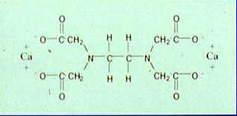
DEMINERALIZATION
EDTA – Ethylenediamine tetraacetic acid RC Prep contains EDTA

Slide 38
LUBRICATION
EDTA (RC Prep) + Urea Peroxide in
carbowax vehicle

Slide 39
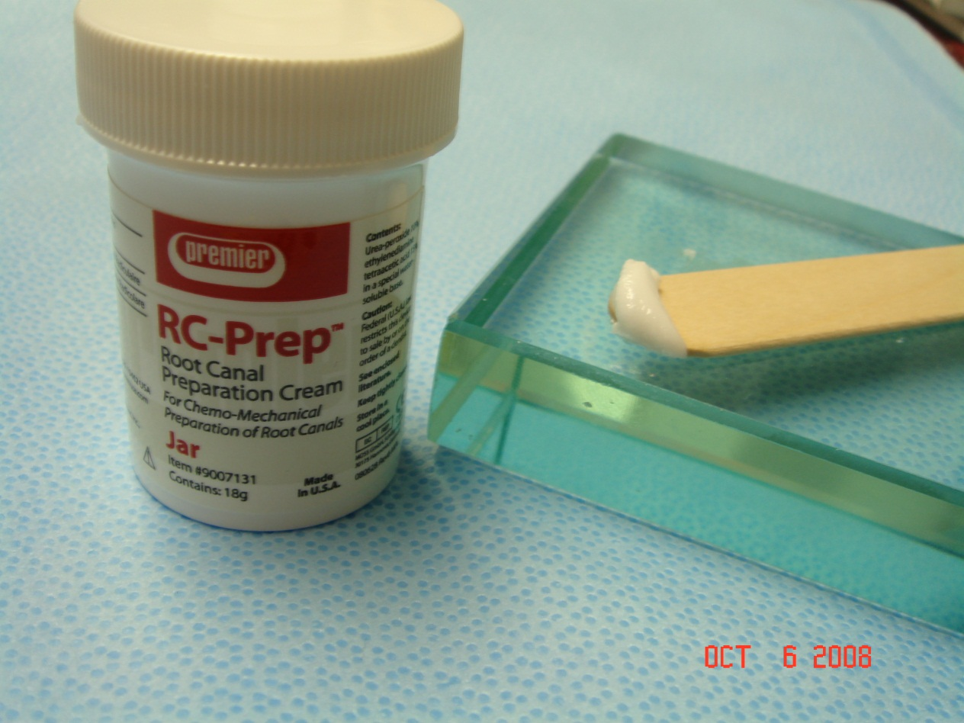
LUBRICATION
EDTA (RC Prep)

Slide 40
STIMULATION OF REPAIR
Calcium Hydroxide
High pH may favor calcification
Calcium proteinate precipitate formed
Induction of hard tissue-producing cells may be due to mild irritation to pulp from calcium-protein precipitate

