Slide 1
Diagnosis and Treatment in Endodontics
30 Aug 2011

Slide 2
Diagnosis in Endodontics
90% clear-cut
10% Difficult

Slide 3
Detective work
Information gathering
Identify irrelevant information
Keep relevant information only
Assessment
Conclusion / diagnosis

Slide 4
CHIEF COMPLAINT ?
Listen to
your
patient

Slide 5
CHIEF COMPLAINT
The first clue in finding the etiology and the location of the suspected endodontic problem

Slide 6
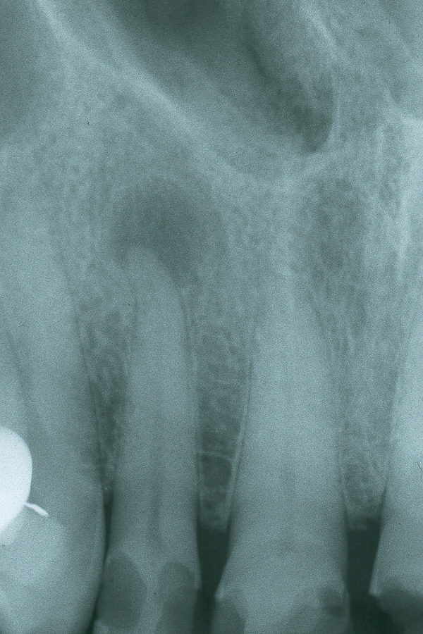
CHIEF
COMPLAINT
Listen to your patient if the patient on the right has cold sensitivity then the sensation must be from #8 and not #7 because #7 is already necrotic (PARL)
7
8

Slide 7
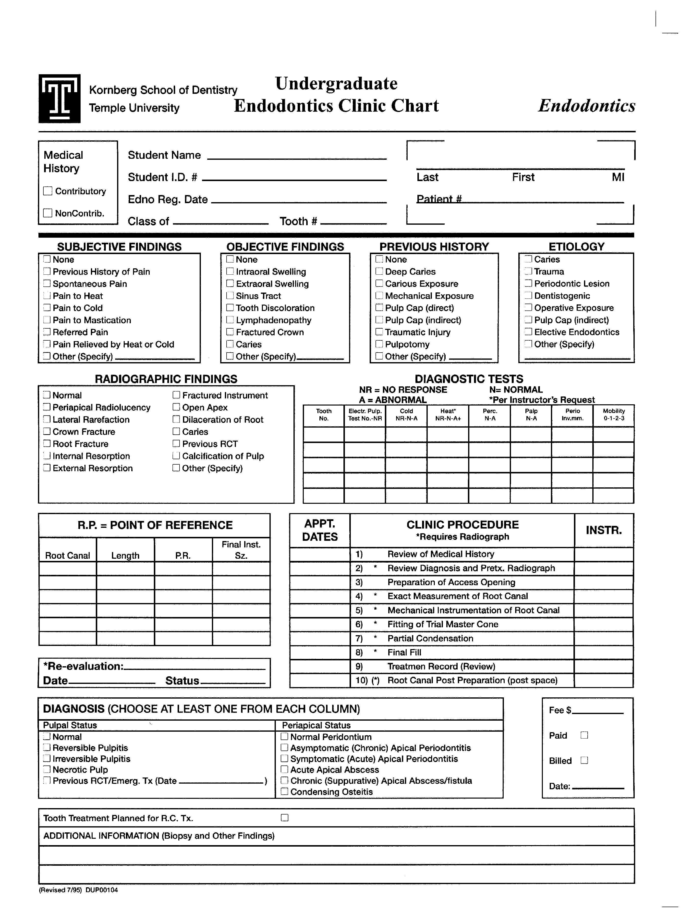
Endodontics clinic chart

Slide 8
Endodontics clinic chart

Slide 9
SUBJECTIVE FINDINGS
LIDS RS
Many times you have acculmulation of gas and fluid in an abscess, so the patient is telling you that cold gets rid of it and heat makes it worse (this is a more serious situation). Probably leading to necrosis.
PAIN OR DISCOMFORT
    1. Location
    Intensity=
      1-10 scale, or if they took any medication for this pain
    3. Duration
    Stimulus=
      What stimulus is provoking pain?? Pain only when they bite (cracked tooth) or cold sensitivity (vital tooth)☺
    5. Relief
    6. Spontaneity

Slide 10
OBJECTIVE FINDINGS
Extraoral examination
Intraoral examination
Soft tissue
Dentition
Periodontal status

Slide 11
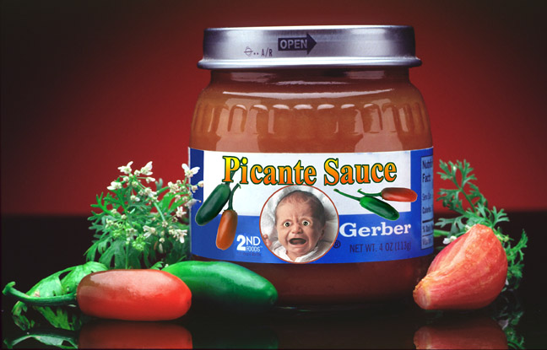
Pay attention to detail

Slide 12
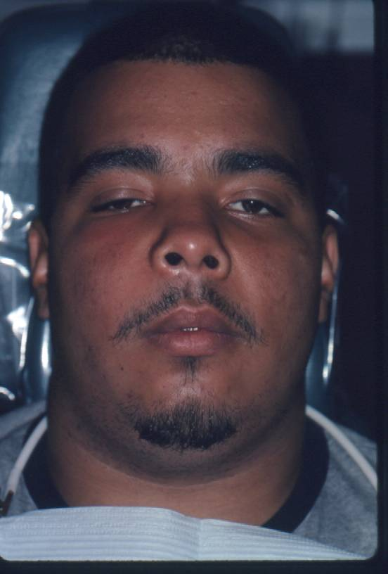
EXTRAORAL
SWELLING

Slide 13
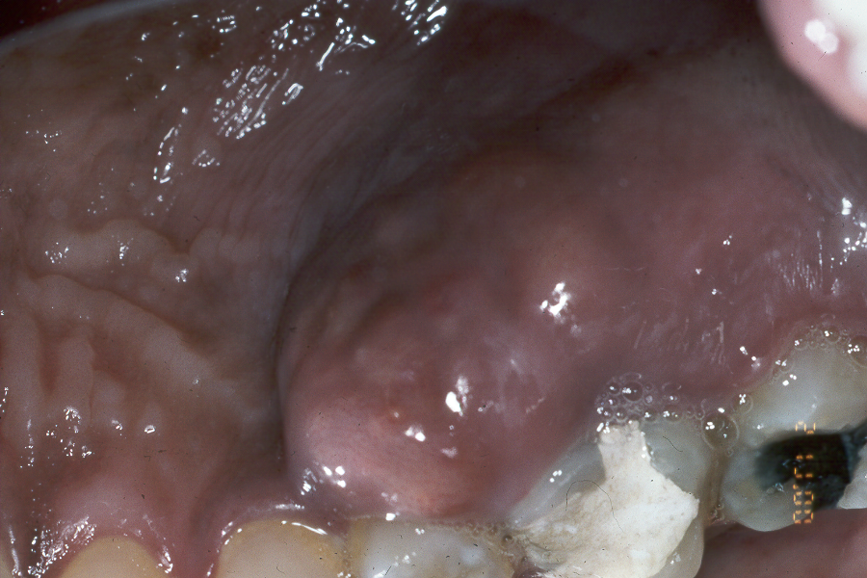
Intraoral swelling

Slide 14
CHIEF COMPLAINT
SUBJECTIVE FINDINGS
OBJECTIVE FINDINGS
CLINICAL
TESTS

Slide 15
Endodontics clinic chart

Slide 16
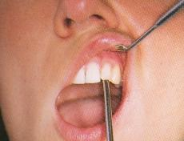
CLINICAL TESTS
So you percussion test these tooth twice in opposite order to locate tooth
Use to determine PDL INVOLVEMENT
1. Periradicular tests
  Percussion
  Palpation
1
2
3
4
4
3
2
1

Slide 17
CLINICAL TESTS
Periradicular tests
Pulp vitality tests
The appropriate test
  Cold
  Heat
  Electric Pulp Testing

Slide 18
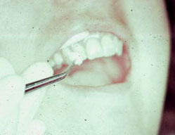
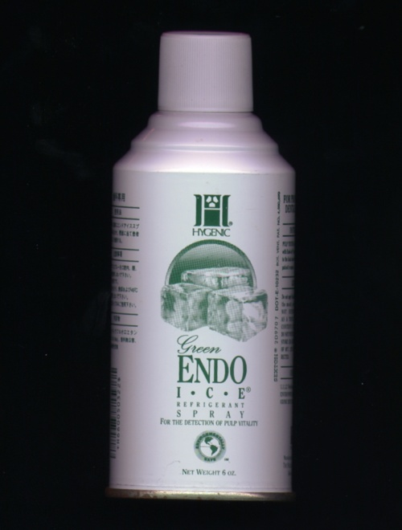
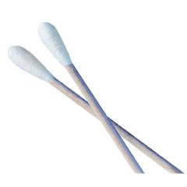
CLINICAL TESTS
Do not use cue tip!!! Use cotton on forcep.
No pain or lingering pain
Lingering pain=when pulp is inflamed the threshold for pain is very low so it fires even after stimulus is removed.
Periradicular tests
Pulp vitality tests
  Cold
Do not use

Slide 19
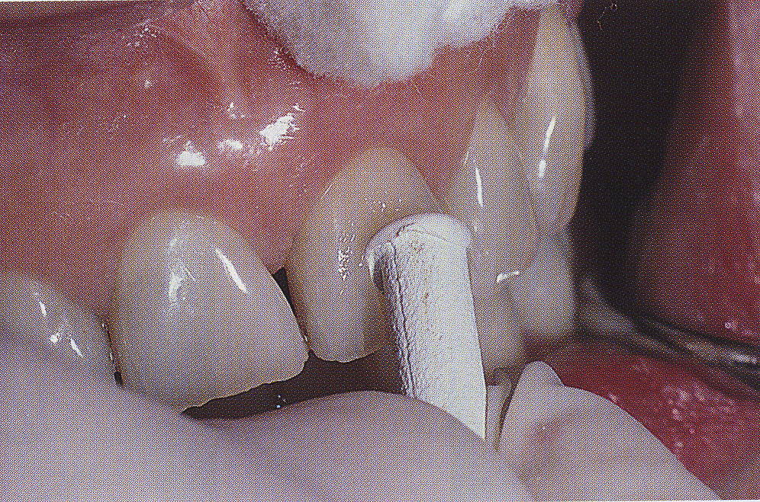
CLINICAL TESTS
Warm gutta percha shown here or have them drink warm water.
Periradicular tests
Pulp vitality tests
  Cold
  Heat

Slide 20
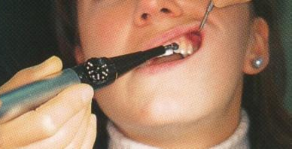
CLINICAL TESTS
Periradicular tests
Pulp vitality tests
  Cold
  Heat
  Electric Pulp Testing
Toothpaste used as conducting agent.

Slide 21
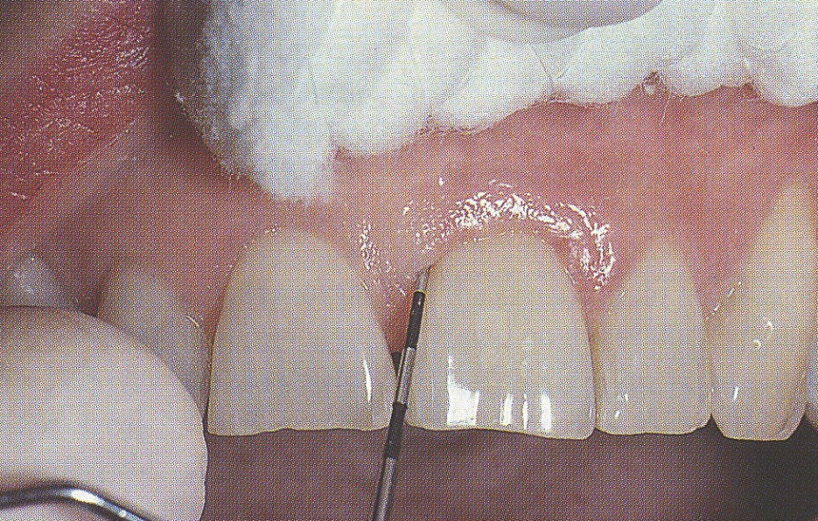
CLINICAL TESTS
Periradicular tests
Pulp vitality tests
Periodontal evaluation
Mobility
Gums
Probing

Slide 22
SPECIAL CLINICAL TESTS
Caries removal
Selective anesthesia
Transillumination

Slide 23
CHIEF COMPLAINT
SUBJECTIVE FINDINGS
OBJECTIVE FINDINGS
CLINICAL TESTS
Radiograph evaluation

Slide 24
Endodontics clinic chart

Slide 25
Radiograph evaluation
Always have a normal X ray image of the tooth in your mind so you can compare them mentally.
1. Crown
2. Pulp chamber
and canals
3. Periodontium and Bone

Slide 26
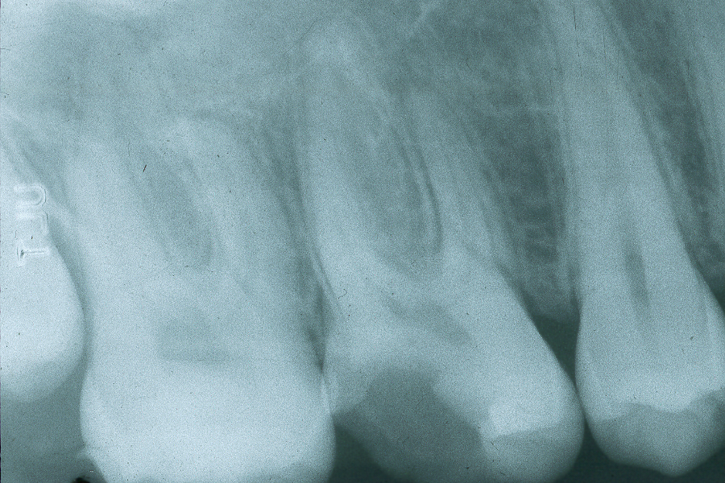
Radiograph evaluation
Crown

Slide 27
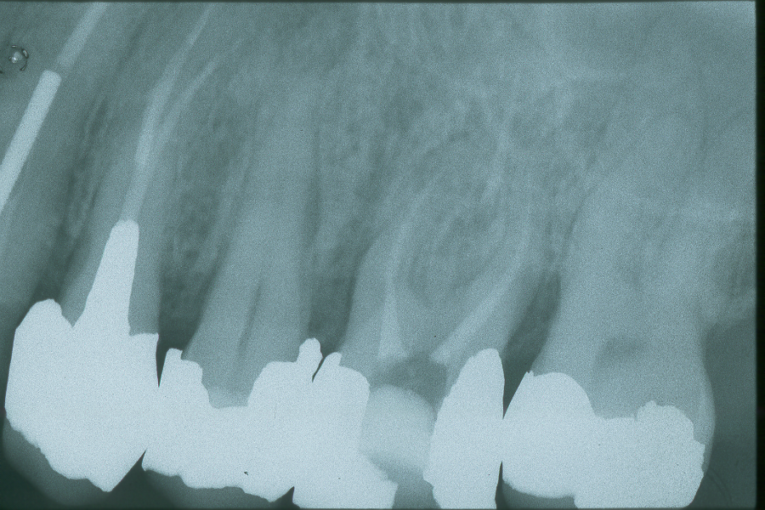
Radiograph evaluation
Crown

Slide 28
Radiograph evaluation
Pulp chamber and canals
Size
Curvature
Obliteration
Pathosis

Slide 29
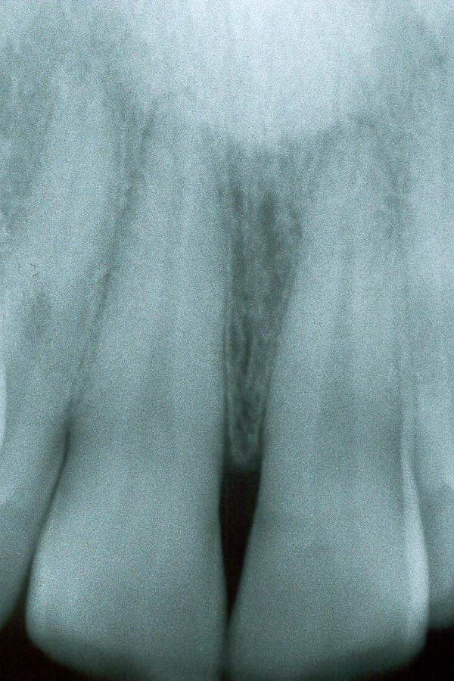
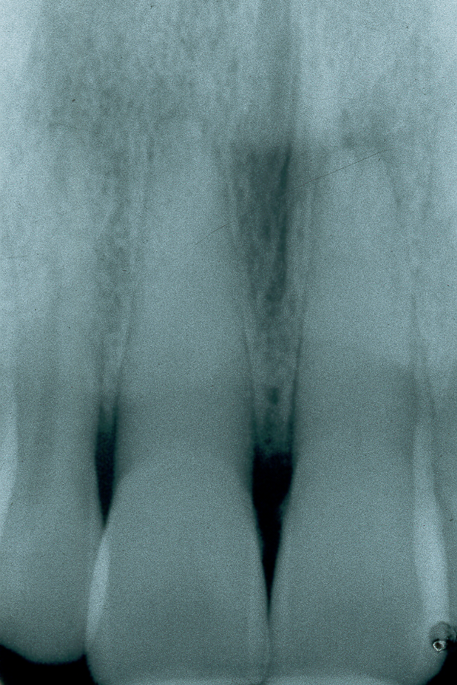
Radiograph evaluation
Pulp chamber and canals
Size
Obliterated canals,
Response to trauma!!☹

Slide 30
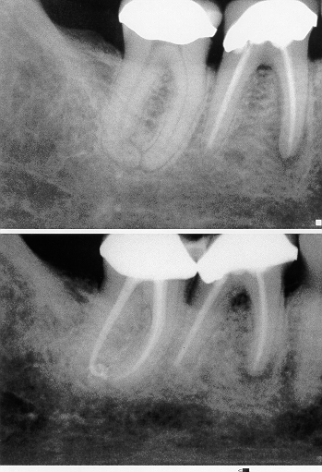
Radiograph evaluation
Pulp chamber
and canals
Size
Curvature
Distal root is curved!!! Like 90 degrees

Slide 31
Radiograph evaluation
Pulp chamber
and canals
Size
Curvature

Slide 32
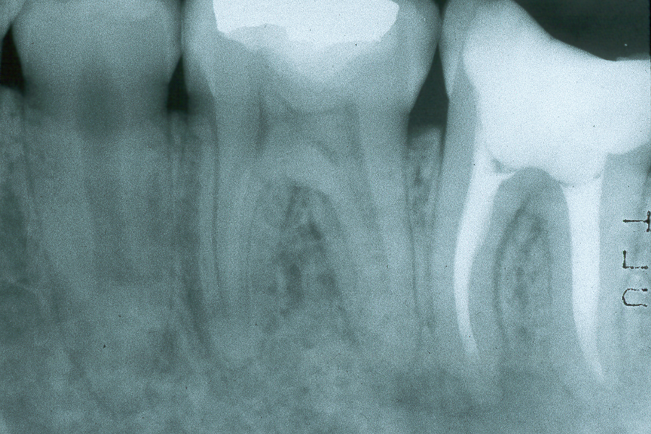
Radiograph evaluation
Pulp chamber and canals
Size
Curvature
Obliteration
Pulp stones!

Slide 33
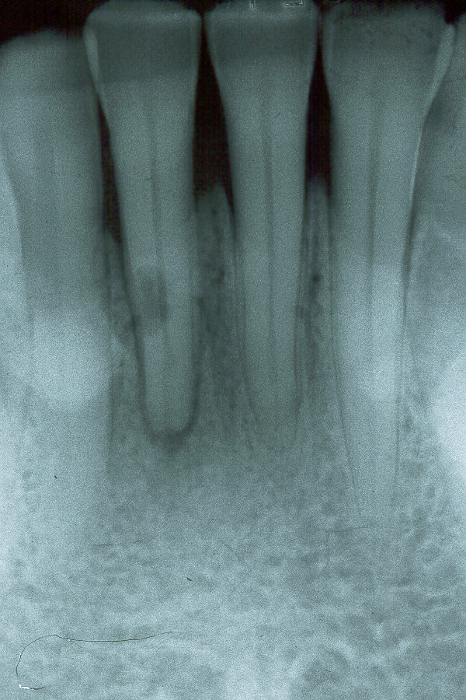
Radiograph evaluation
Pulp chamber
and canals
Size
Curvature
Obliteration
Pathosis
Resorption of root tip apices. Because eventually patient can lose the tooth.

Slide 34
Radiograph evaluation
Periodontium
Loss of lamina dura
Radiolucency (vital / nonvital)
Radiopacity

Slide 35
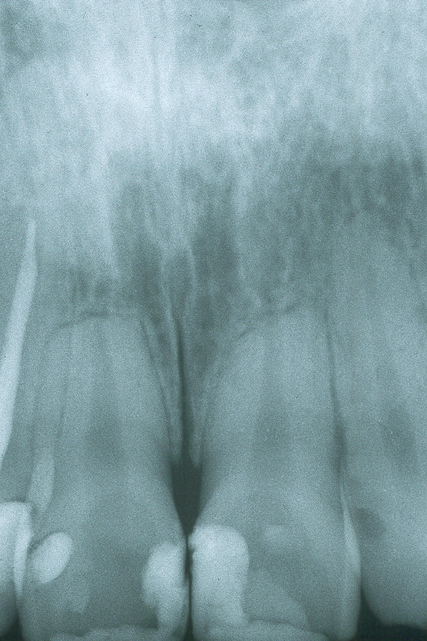
Radiograph evaluation
Periodontium
Large resorption from ortho tx or trauma.

Slide 36
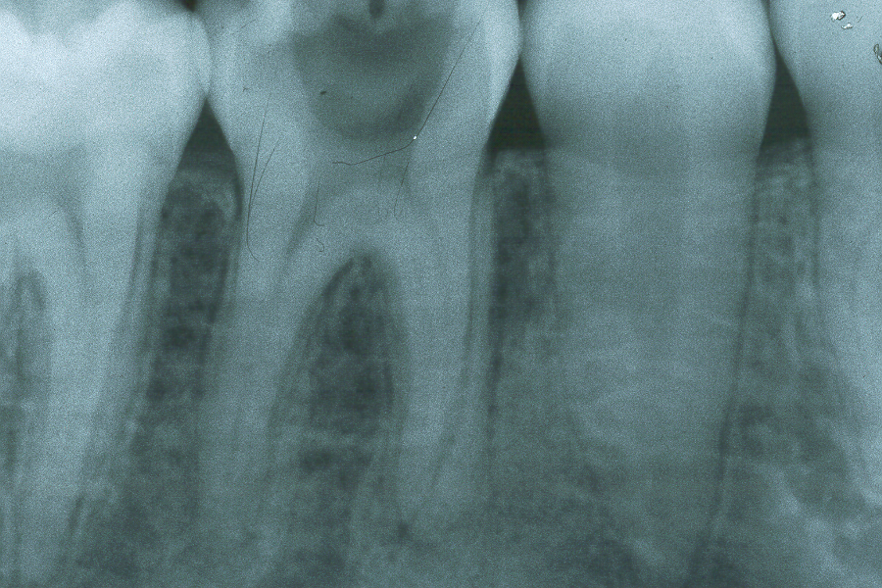
Radiograph evaluation
LAMINA DURA is a RADIOGRAPHIC ENTITY
Loss of the
lamina dura
Periradicular
Loss of
lamina
dura
lamina
dura

Slide 37
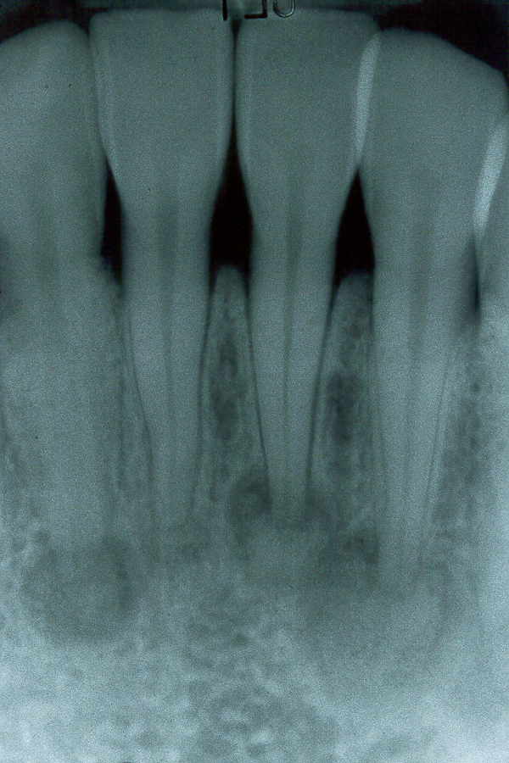
Radiograph evaluation
Periradicular
Radiolucency
Radiopacity
(vital / nonvital)
Got to test the teeth!

Slide 38
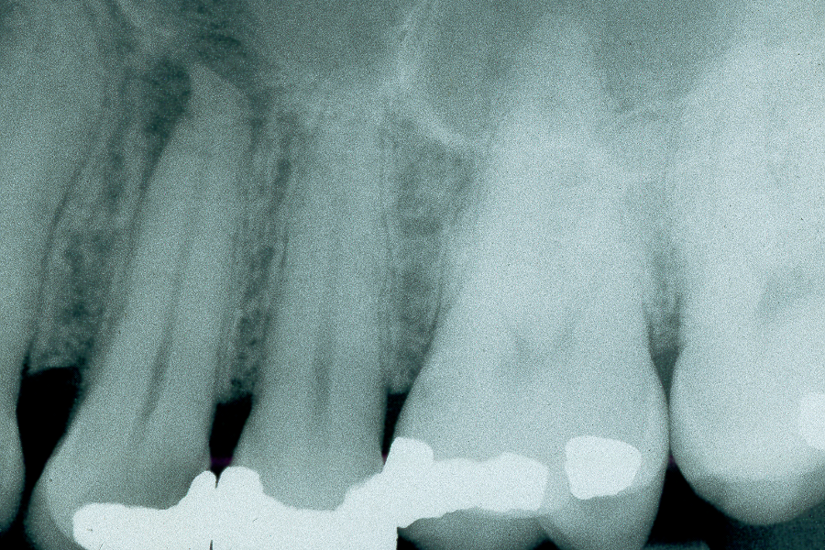
Radiograph evaluation
Periradicular
Radiolucency
Radiopacity
(vital / nonvital)

Slide 39
IS PATHOLOGY PRESENT ?

Slide 40
IS PATHOLOGY PRESENT ?
Yes
IS IT FROM DENTAL OR FROM NON DENTAL
ORIGIN ?
Sinus infection is the most common thing that mimics tooth pain.

Slide 41
ANALYSIS OF DATA
Medical history
Subjective findings
Objective findings
Clinical tests
Clinical findings
X-ray analysis
NO DIAGNOSIS NO TREATMENT

Slide 42
Indicators of a difficult diagnosis
Can not localize the pain
Can not identified local dental cause
Pain is not related to particular stimulus
Suspected tooth shows no clear etiology
Many teeth seems to be involved
NO DIAGNOSIS NO TREATMENT

Slide 43
ANALYSIS OF DATA
Medical history
Subjective findings
Objective findings
Clinical tests
Clinical findings
X-ray analysis
DIAGNOSIS

Slide 44
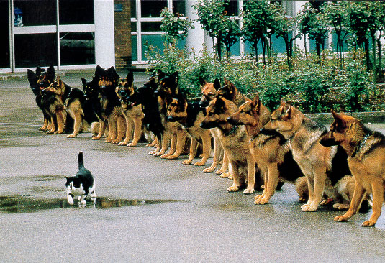
Be brave make a diagnosis

Slide 45
DIAGNOSTIC CLASSIFICATION SYSTEMS
ETIOLOGY
HISTOPATHOLOGIC
TREATMENT

Slide 46
PULPAL DIAGNOSIS
PERIRADICULAR DIAGNOSIS

Slide 47
Endodontics clinic chart

Slide 48
PULPAL DIAGNOSIS
1. Normal
Reversible pulpitis
  Caries removal
3. Irreversible pulpitis
4. Necrotic pulp

Slide 49
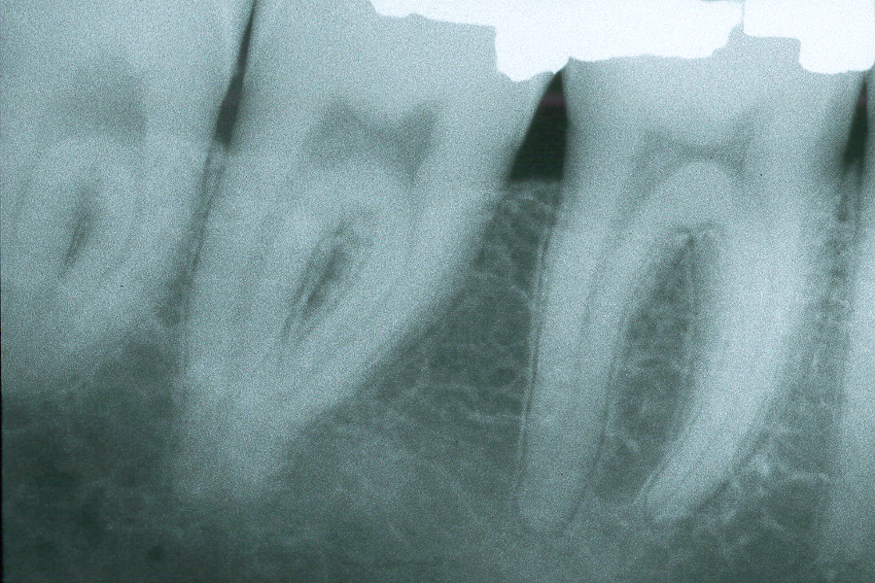
PULPAL DIAGNOSIS
1. Normal
2. Reversible pulpitis
3. Irreversible pulpitis
4. Necrotic pulp

Slide 50
PERIRADICULAR DIAGNOSIS
1. Normal Periodontium
2. Asymptomatic Apical periodontitis (Chronic)
3. Symptomatic Apical periodontitis (acute)
4. Acute Apical abscess (Swelling)
5. Chronic apical abscess (sinus tract)
6. Condensing osteitis

Slide 51
PERIRADICULAR
DIAGNOSIS
Apical periodontitis
Apical abscess

Slide 52
PERIRADICULAR DIAGNOSIS
Apical periodontitis with sinus track
Apical abscess
Trace to determine which tooth its coming from

Slide 53
VITAL
OR
NON VITAL
TREATMENT

Slide 54
TREATMENT
Reversible pulpitis - Vital
Caries control

Slide 55
TREATMENT
Irreversible pulpitis - Vital
Necrotic pulp - Nonvital
Apical periodontitis
(with sinus tract) - Nonvital
Apical abscess - Nonvital
Root canal therapy

Slide 56
TREATMENT PLANNING
Can we perform root canal
therapy ?
In 99% Yes

Slide 57
TREATMENT PLANNING
Should we perform the root
canal therapy ?
1. Is the tooth needed ?
2. Is the tooth restorable ?
3. Can the tooth withstand
the designated function ?
4. Periodontal status
  Mobility
  Pockets
  Crown / Root ratio

Slide 58
PROGNOSIS
KNOW !!!!
Success rates of root canal treatment
Overall 80 - 95 %
Vital teeth 90 - 96 %
Teeth with apical area 75 - 80 %
Retreatment 60 - 75 %

Slide 59
Diagnosis and Treatment in Endodontics

Slide 60
DIAGNOSTIC CLASSIFICATION SYSTEMS
ETIOLOGY
Mechanical Irritation
Bacterial Irritation
Periodontal

Slide 61
DIAGNOSTIC CLASSIFICATION SYSTEMS
ETIOLOGY
HISTOPATHOLOGIC
Acute / Chronic Pulpitis
Acute / Chronic abscess

