Slide 1
Neuroanatomy Study Guide 2010
Class of 2013
Contributors and Complete Ballers:
Jason Justison – Editor
Ryan Tuman- Neuro Atlas
Dominick Crummy
Eric Turner
Chris Hill
Andrew Poulson
Sarah Janowski
Danielle Ruht
Allen Liu
Nick Christianson
Matt Olmes
Robin Shore
Richie Rich Miller
Chris Green
Bill Noll
Jashank Sampat
Hitesh Sachdeva
Steph Boss Bloss
Jen Taylor
Anthony Gragg

Slide 2
The Tuman Neuro Atlas
Ryan Tuman, Class of 2013

Slide 3
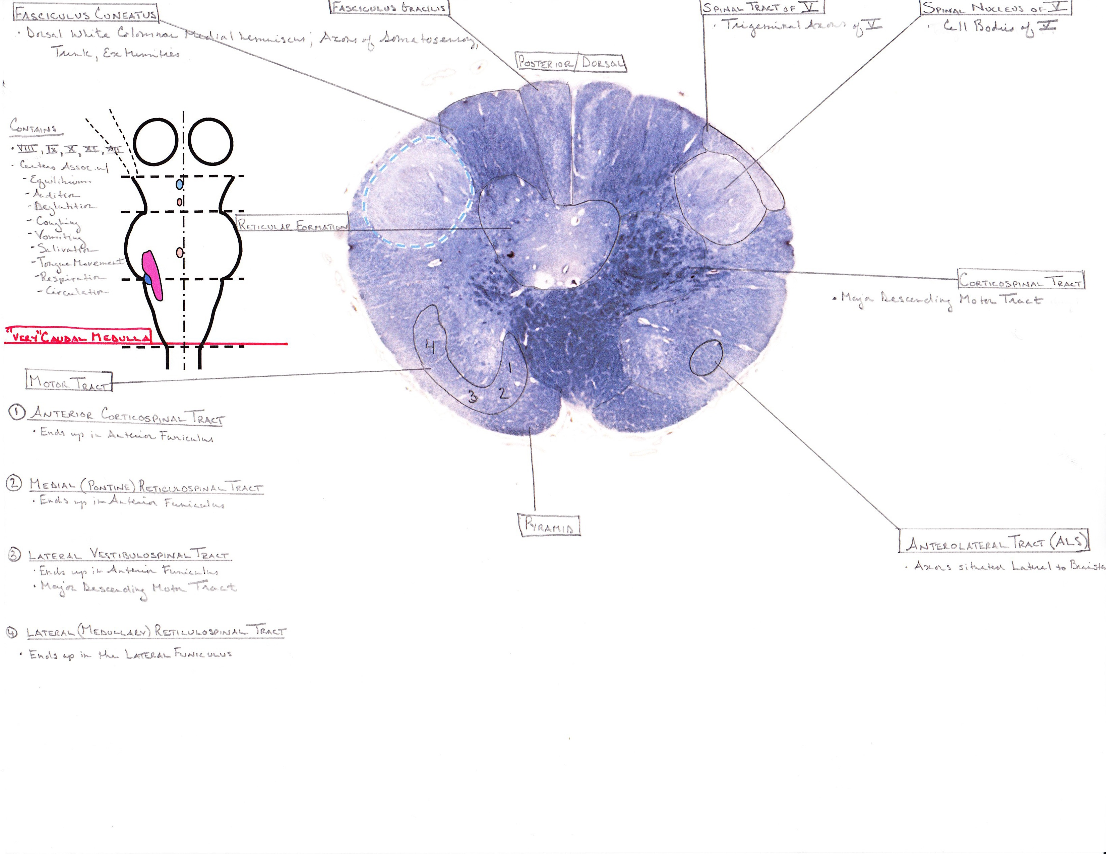

Slide 4
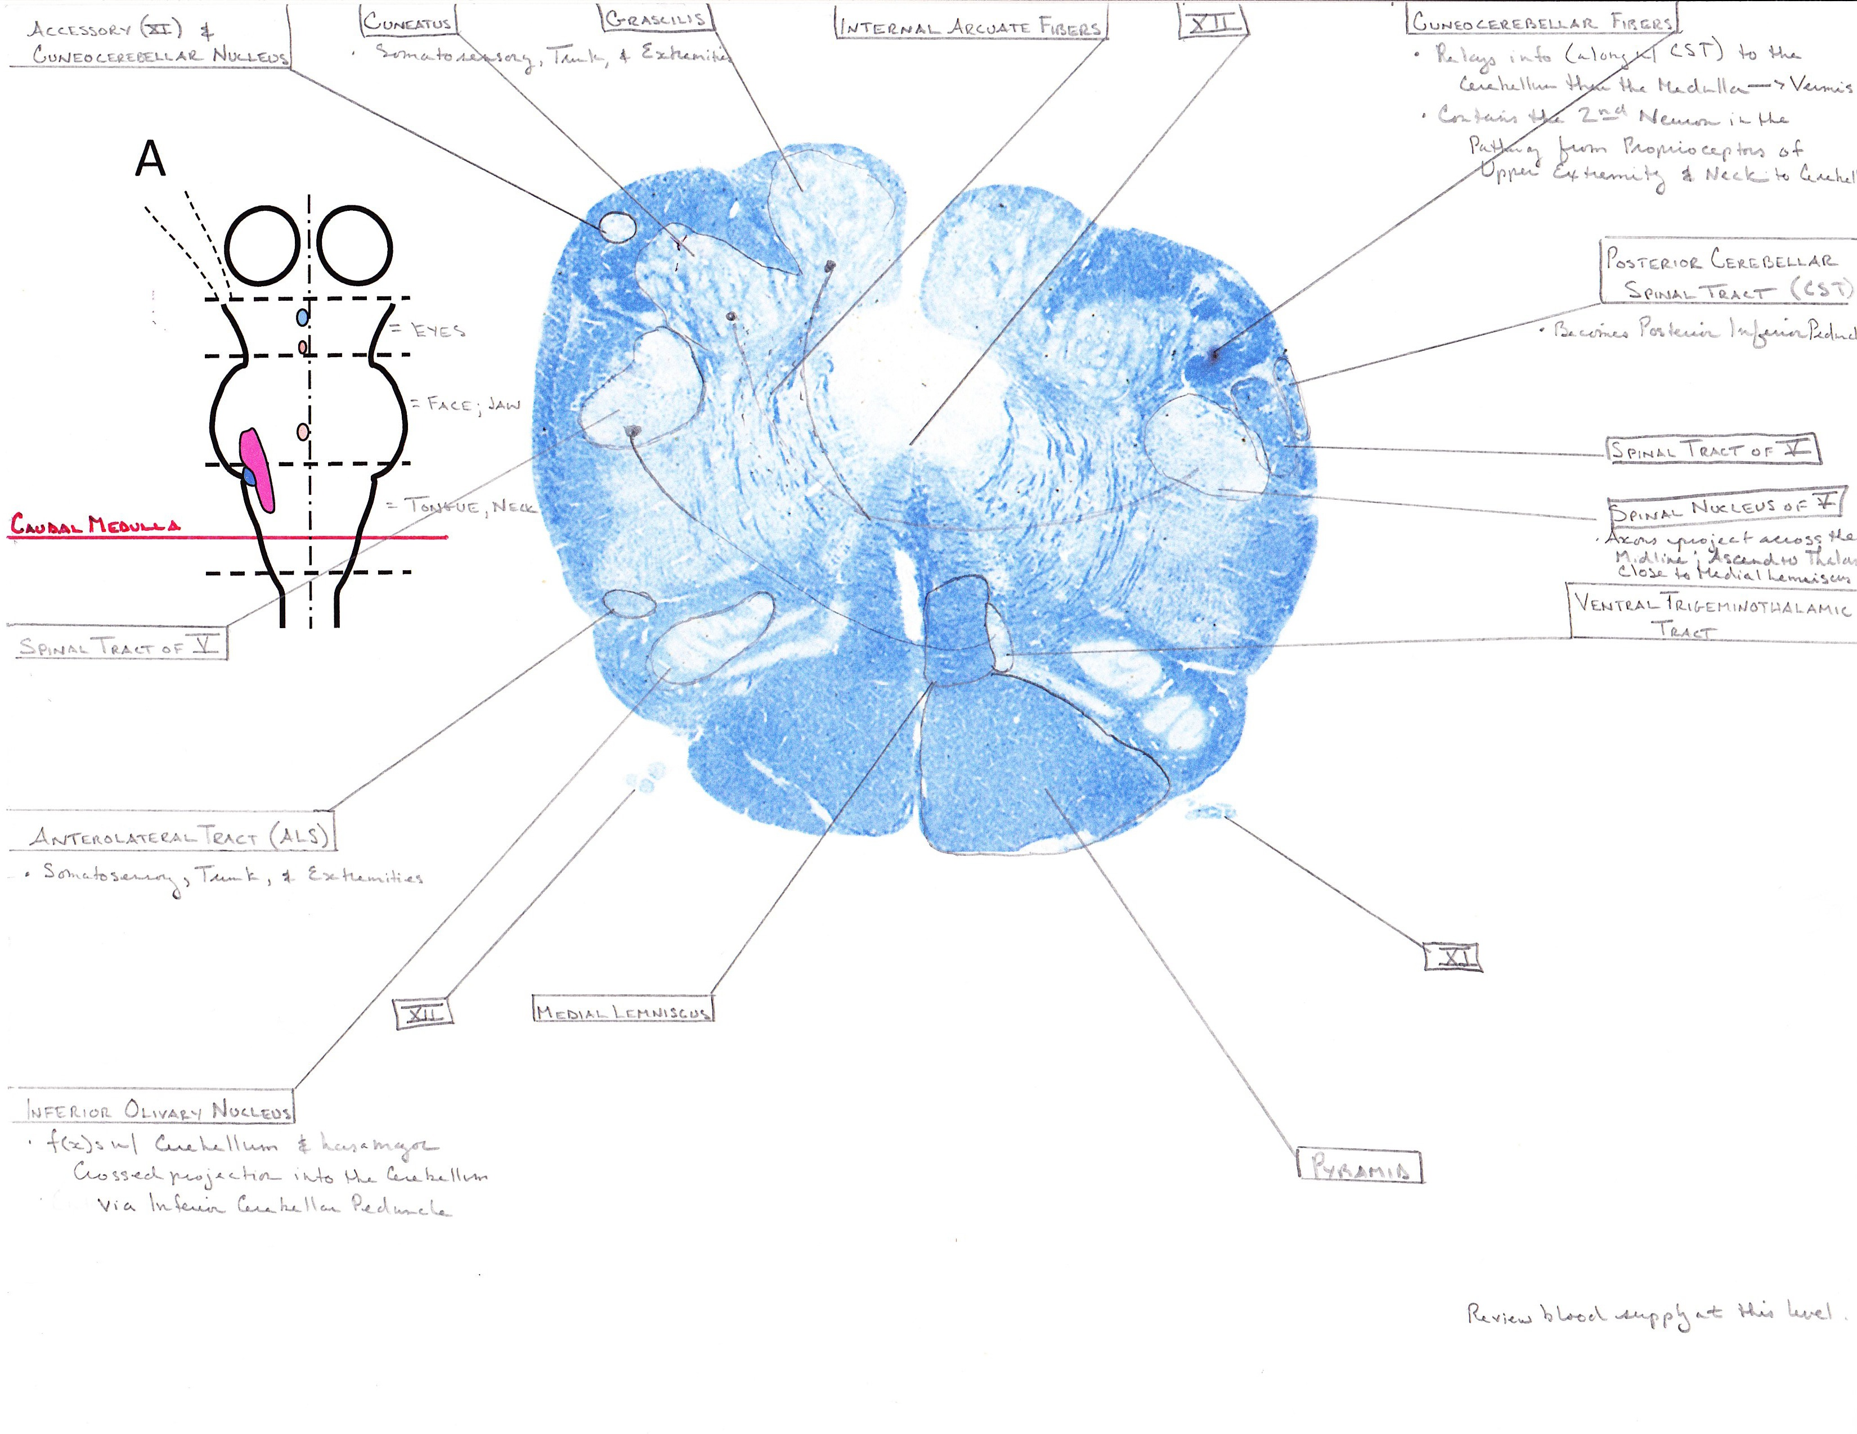
Note: Fibers from fasciculus cuneatus and gracilus decussate here and go up the medial lemniscus

Slide 5
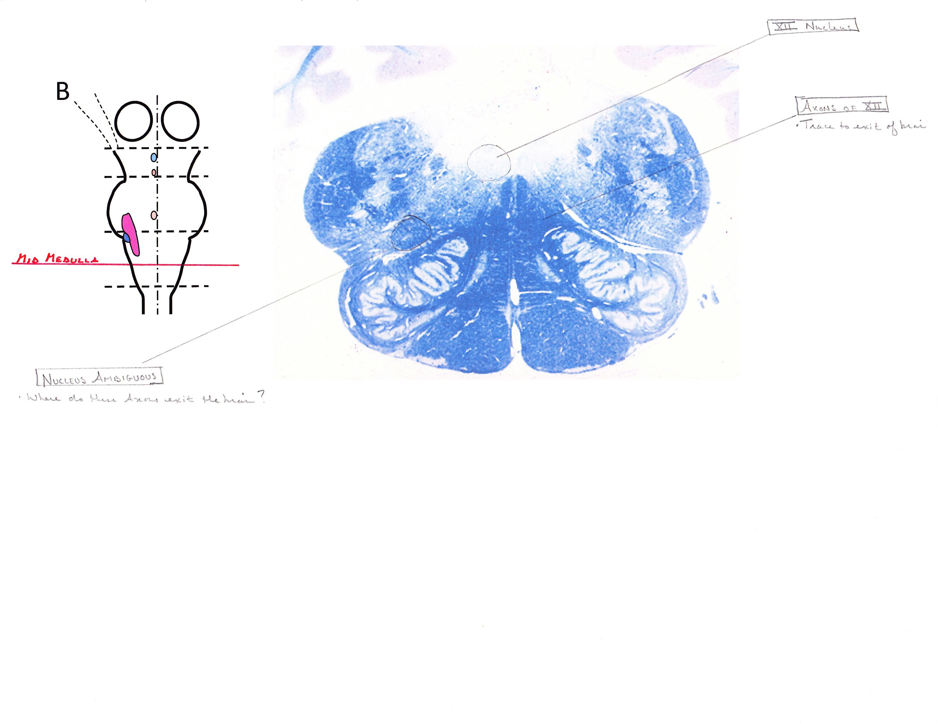

Slide 6
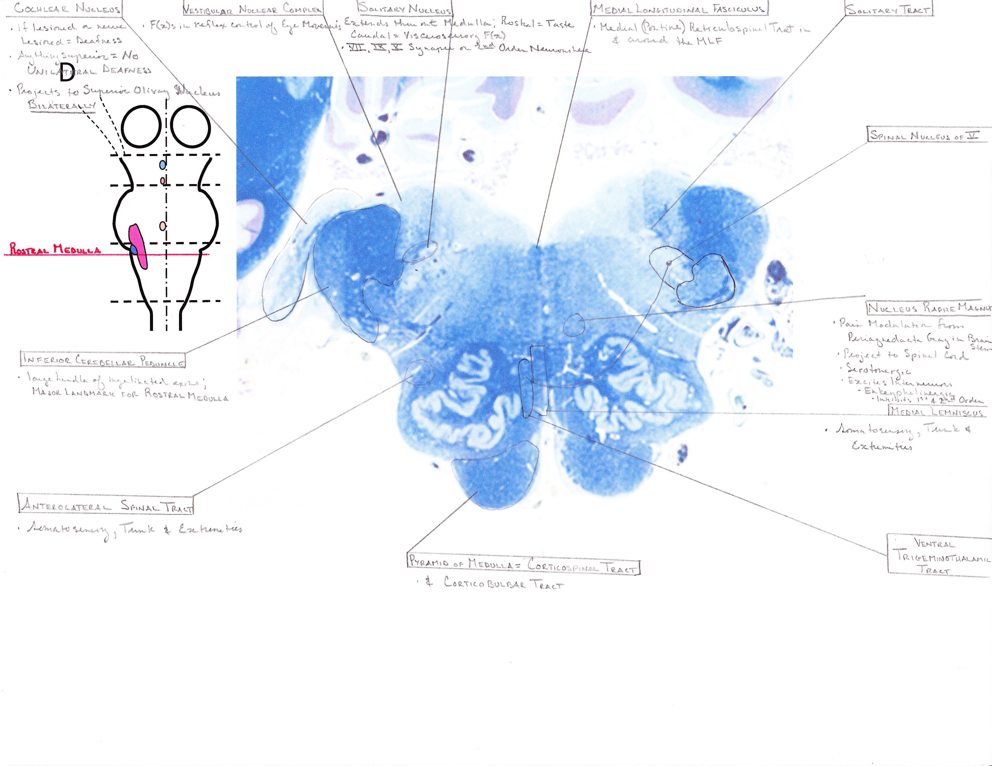

Slide 7
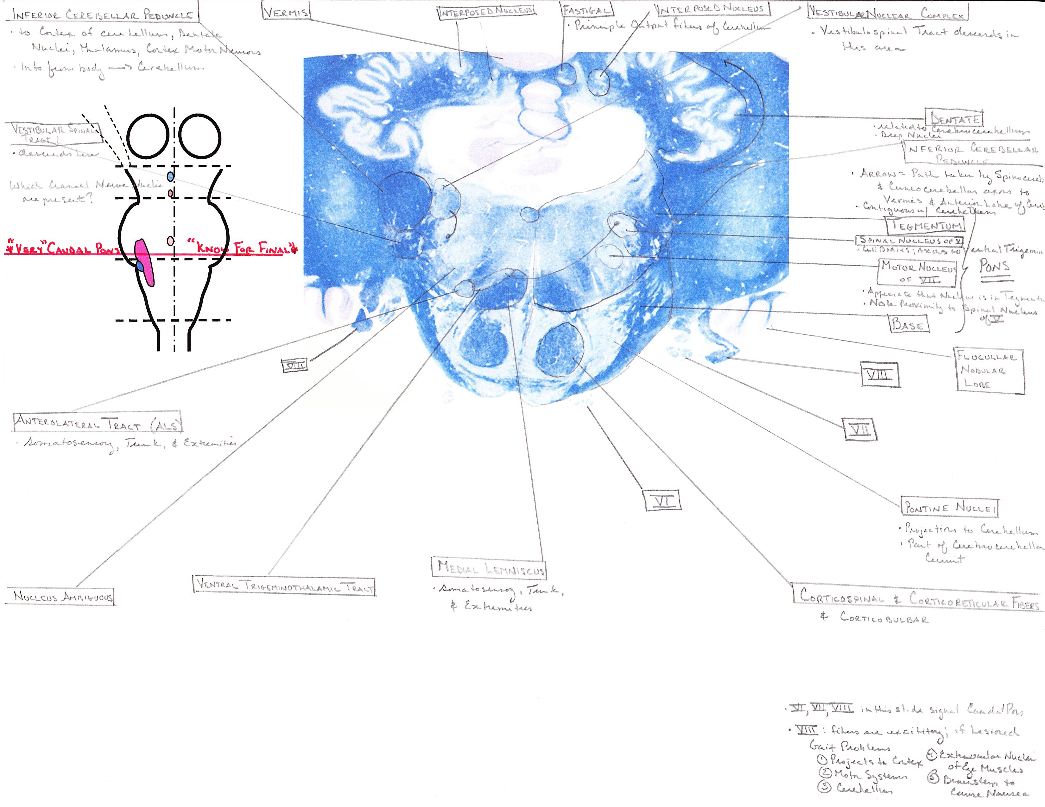

Slide 8
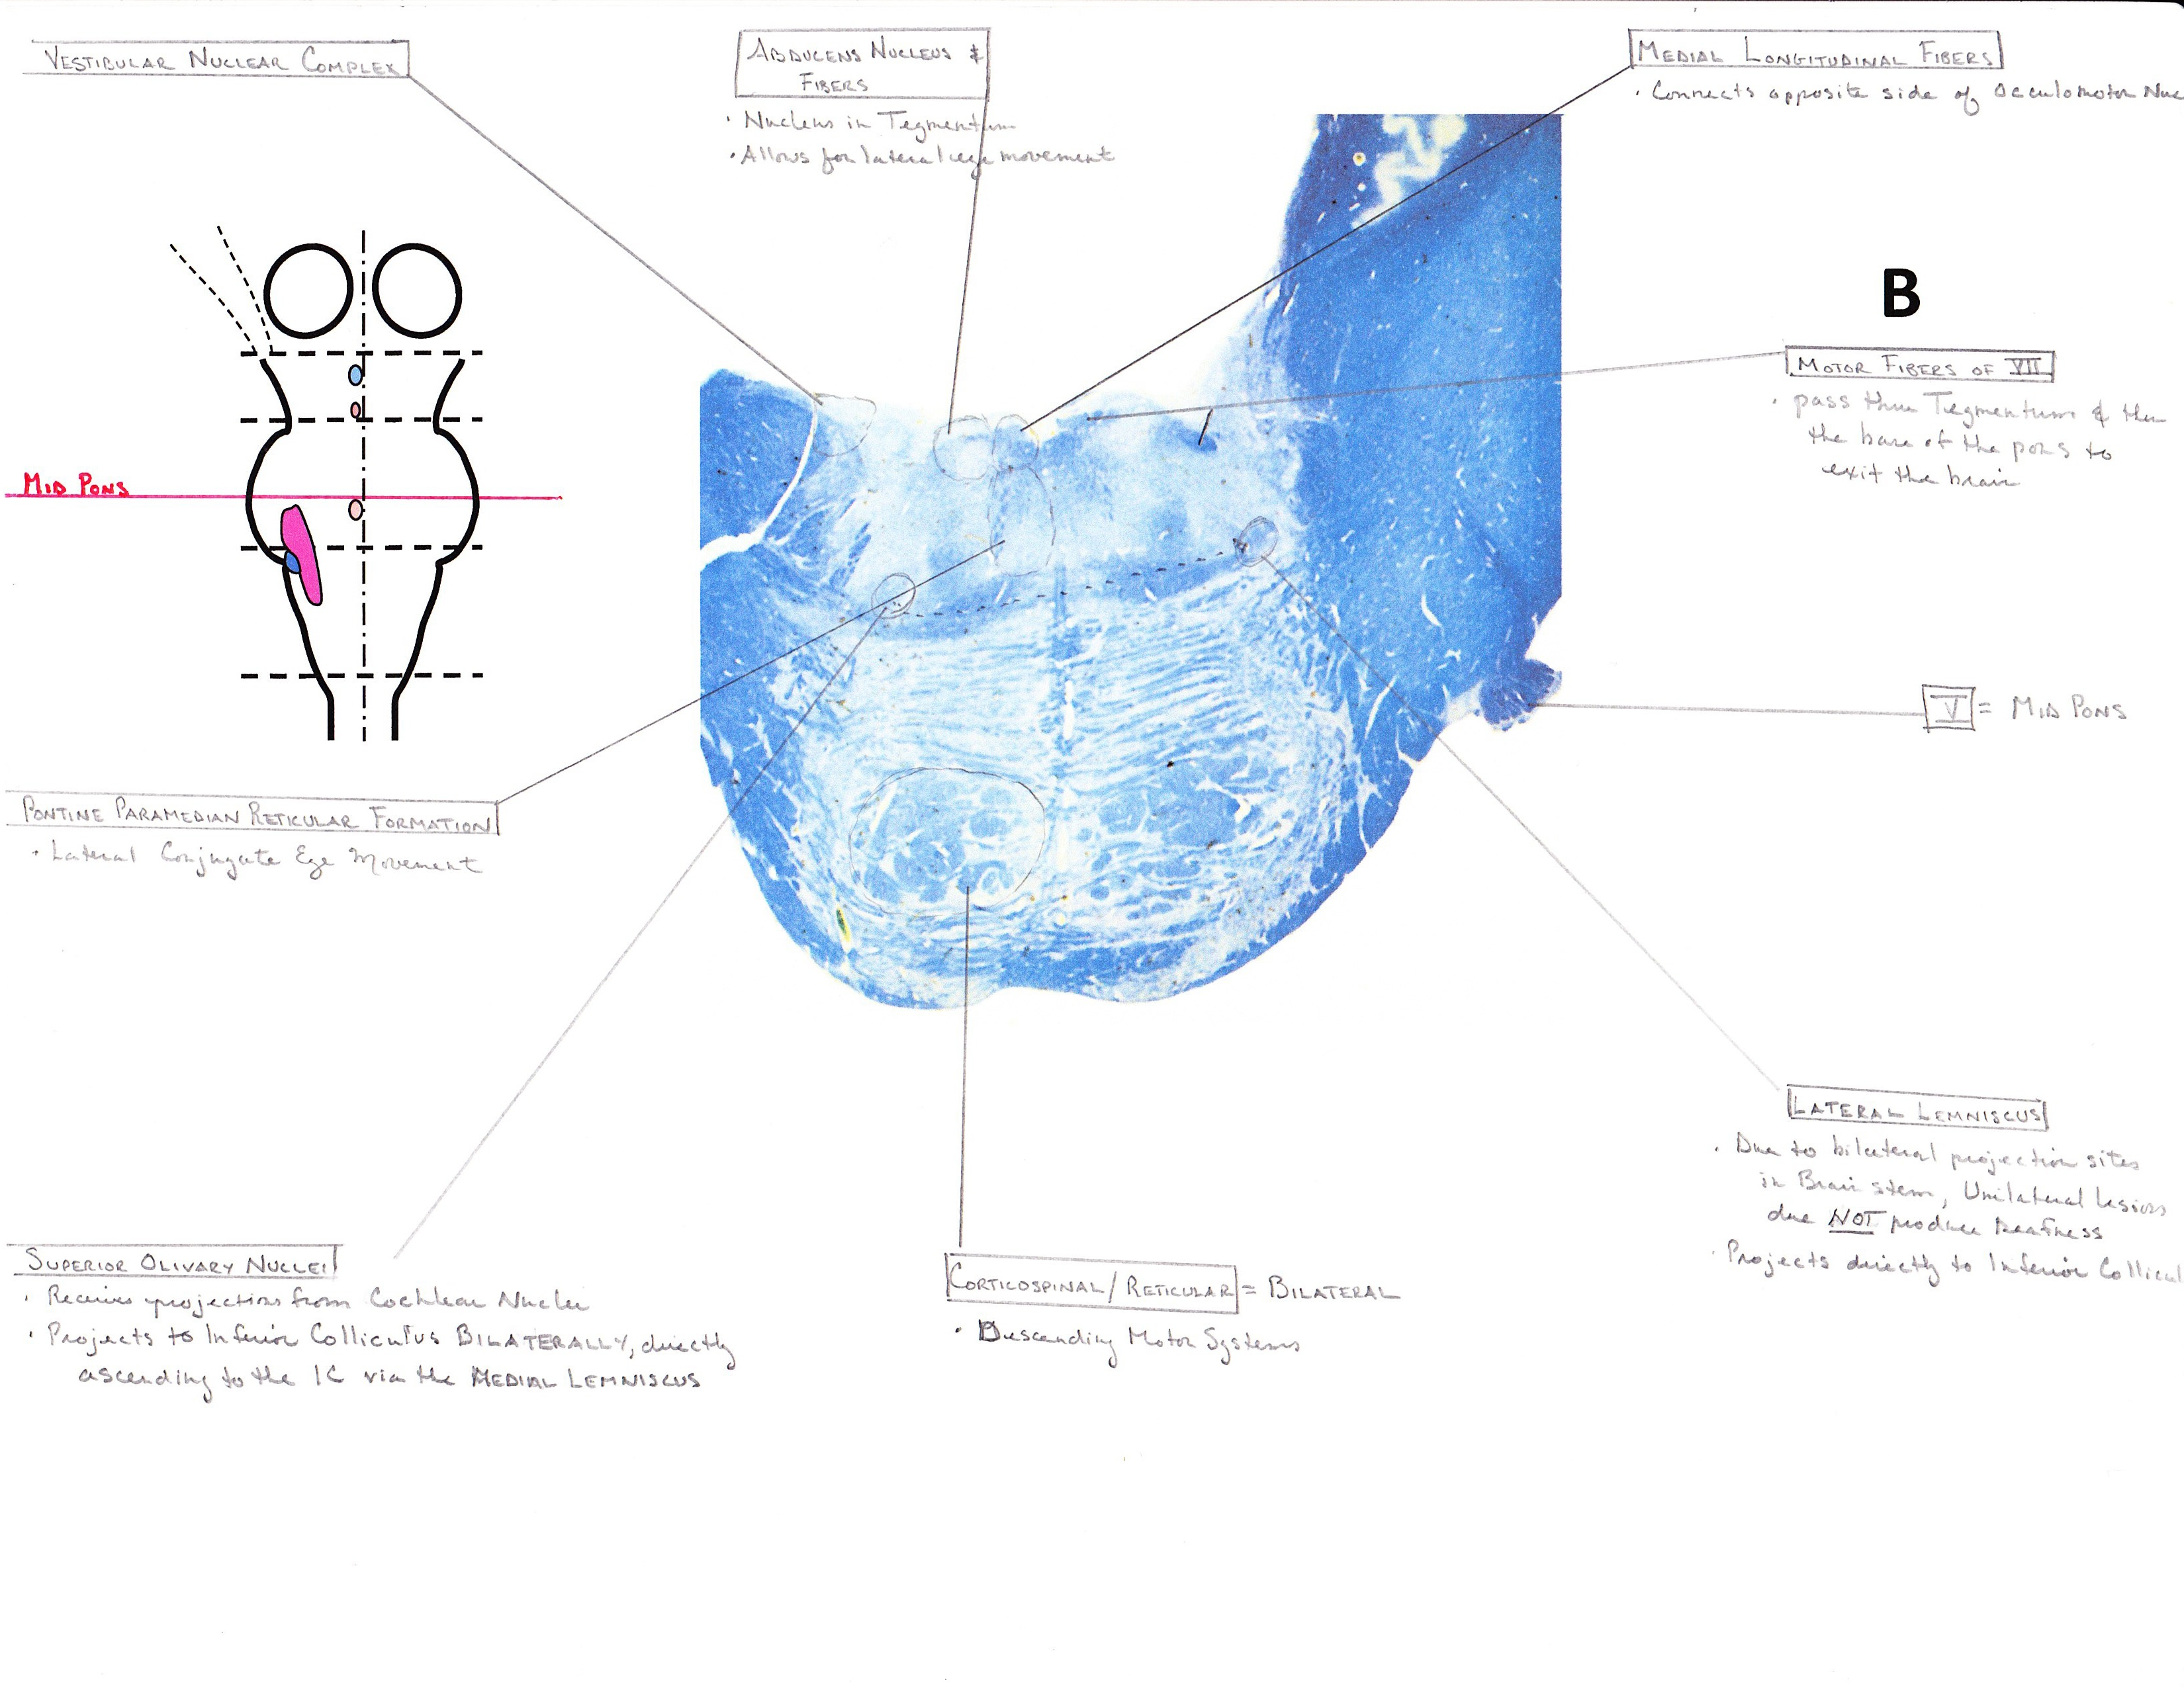

Slide 9
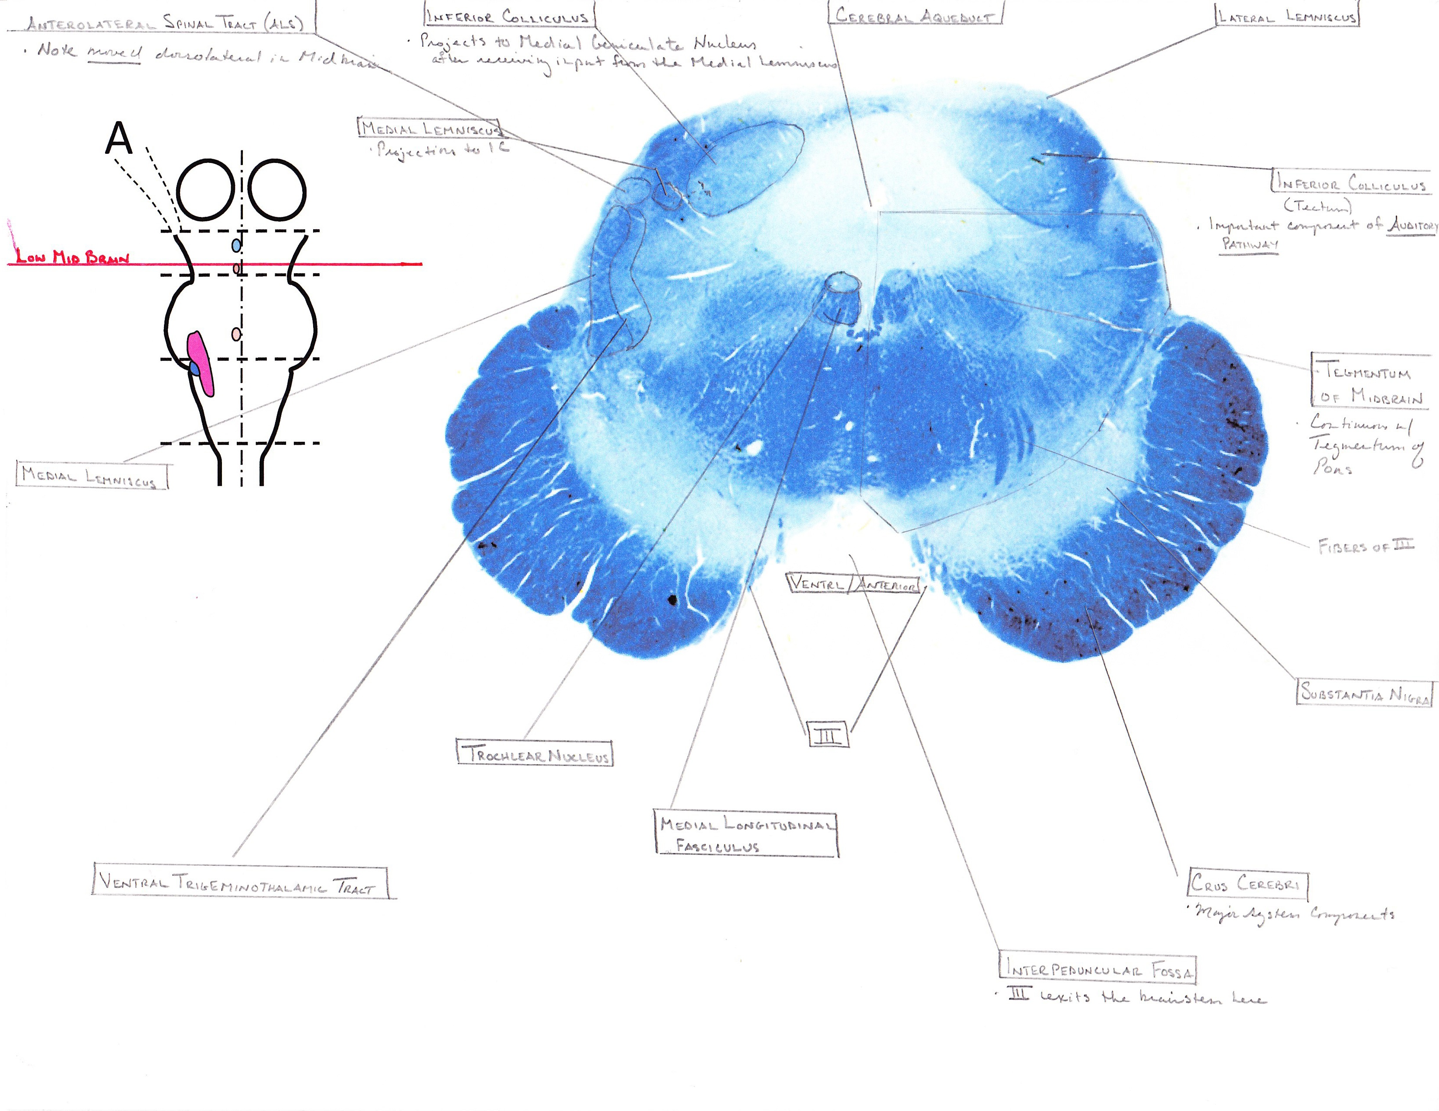

Slide 10
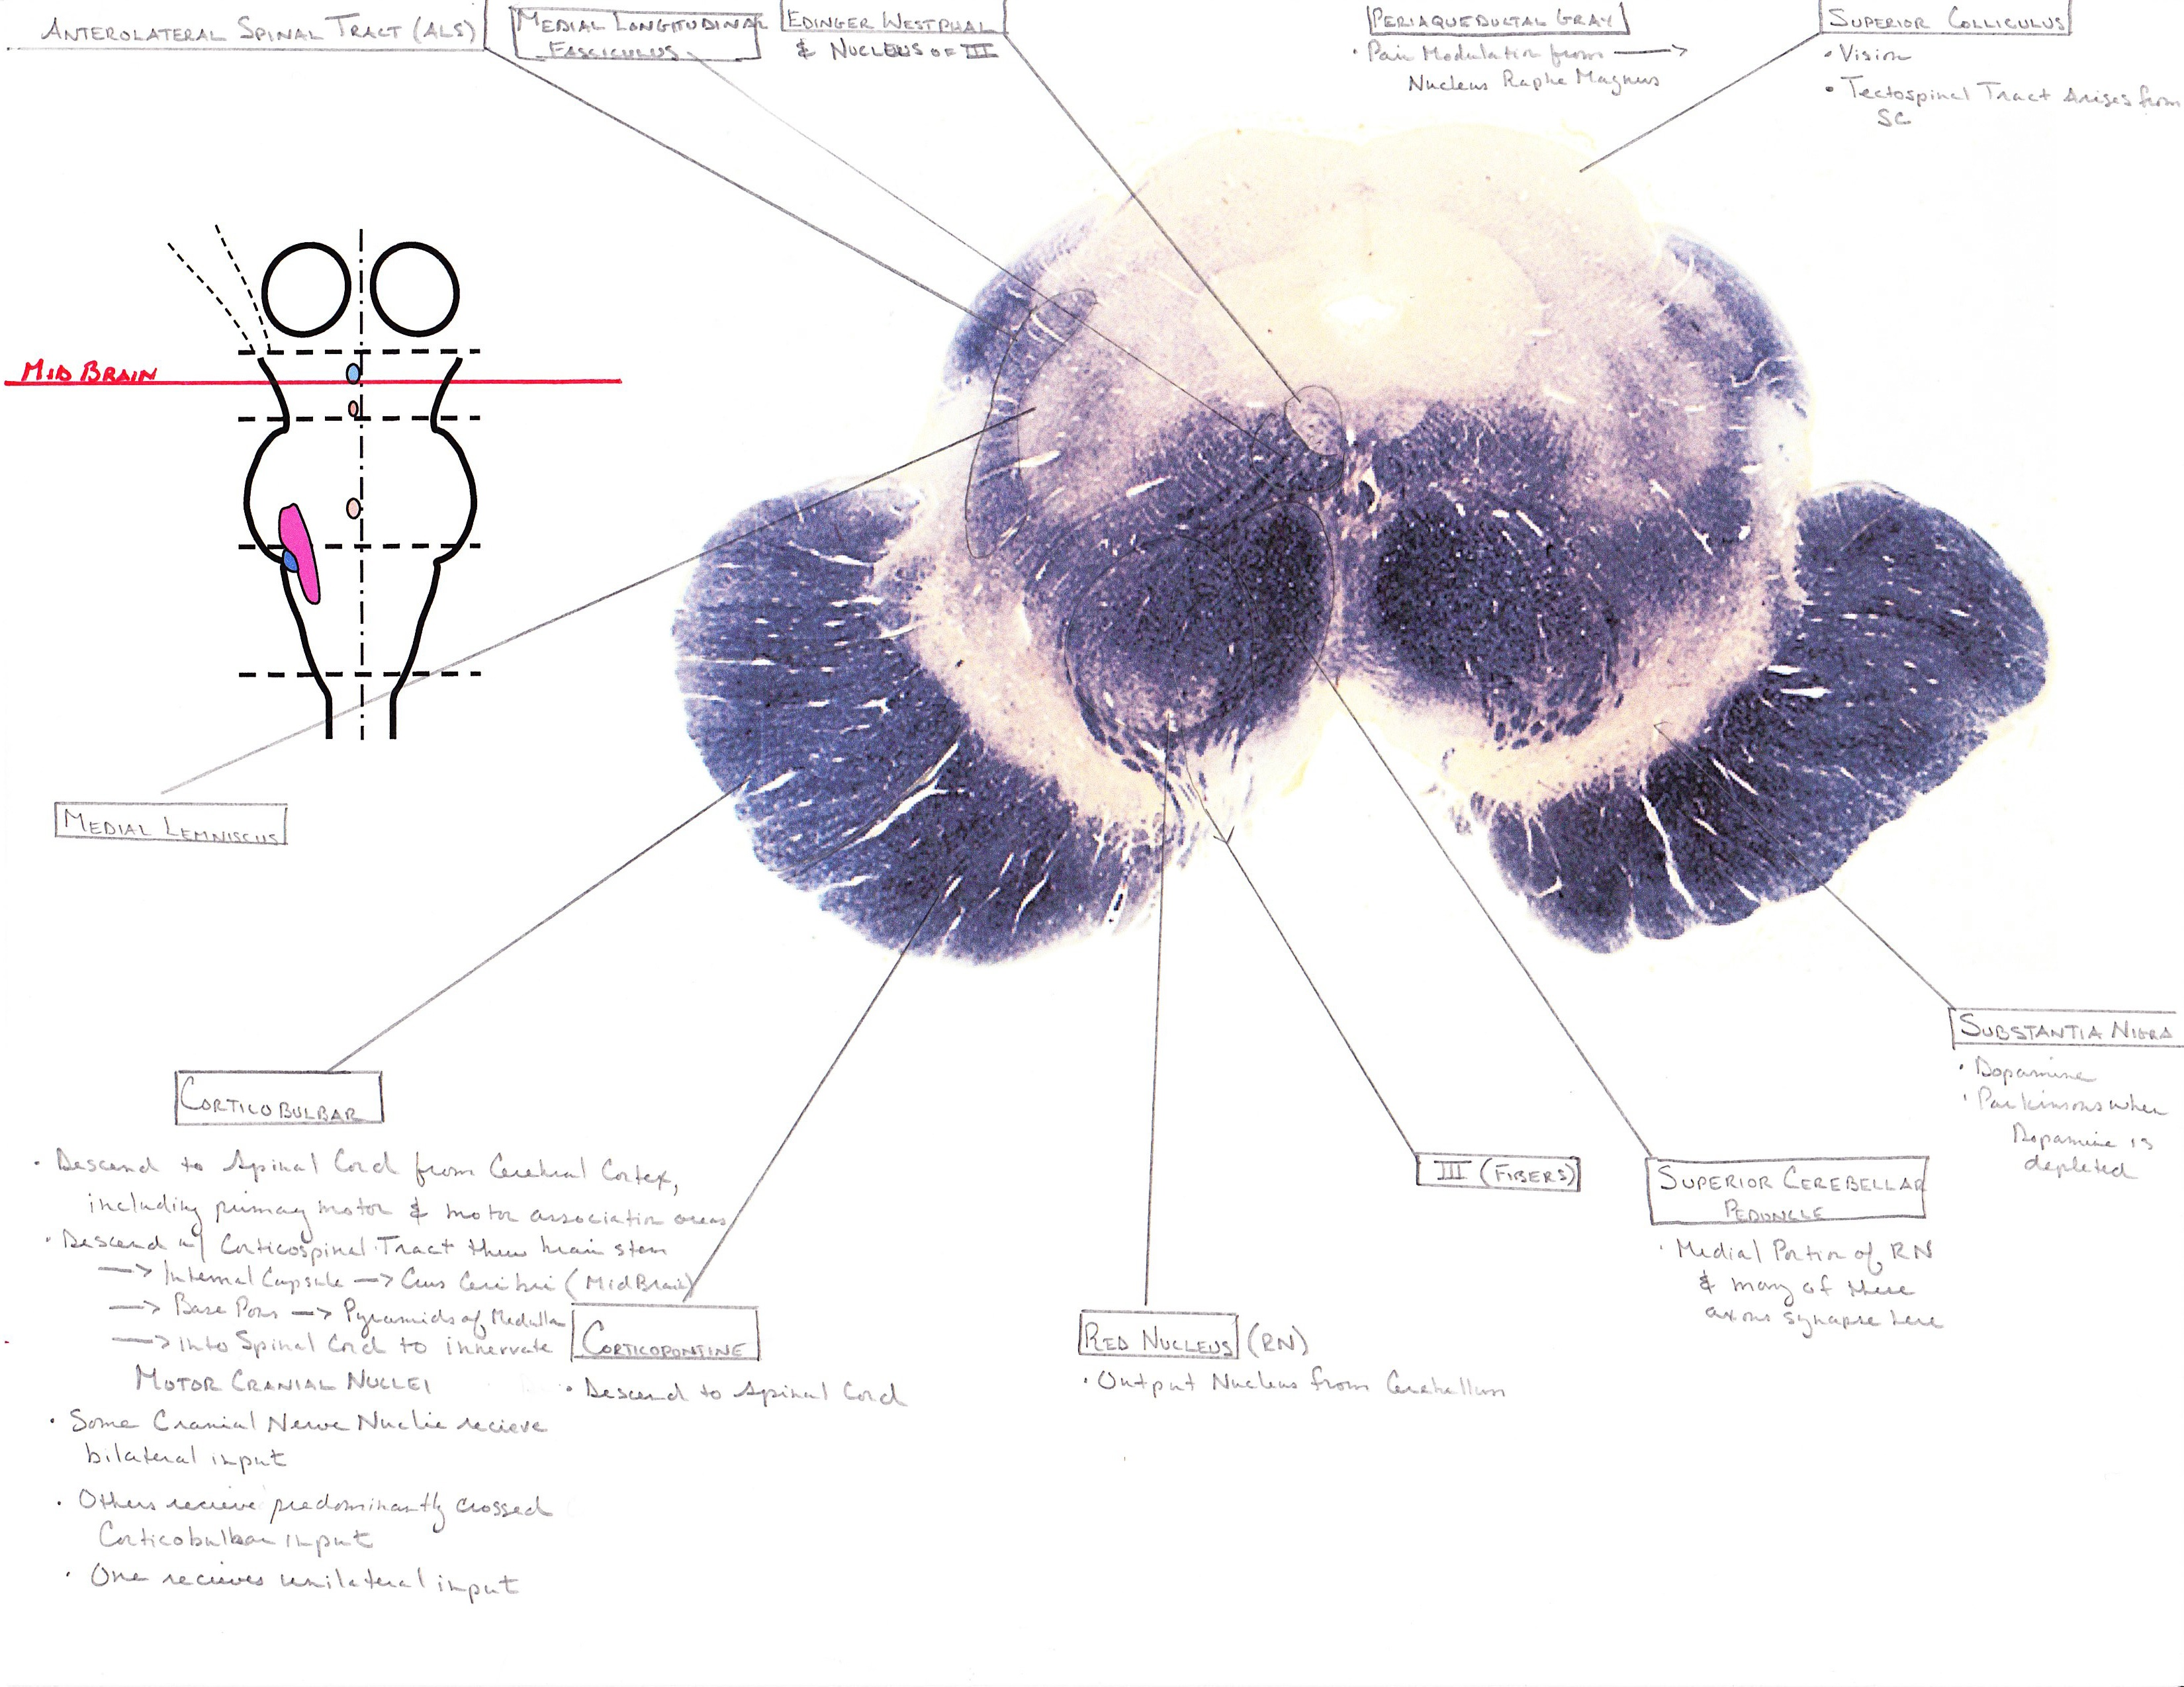

Slide 11
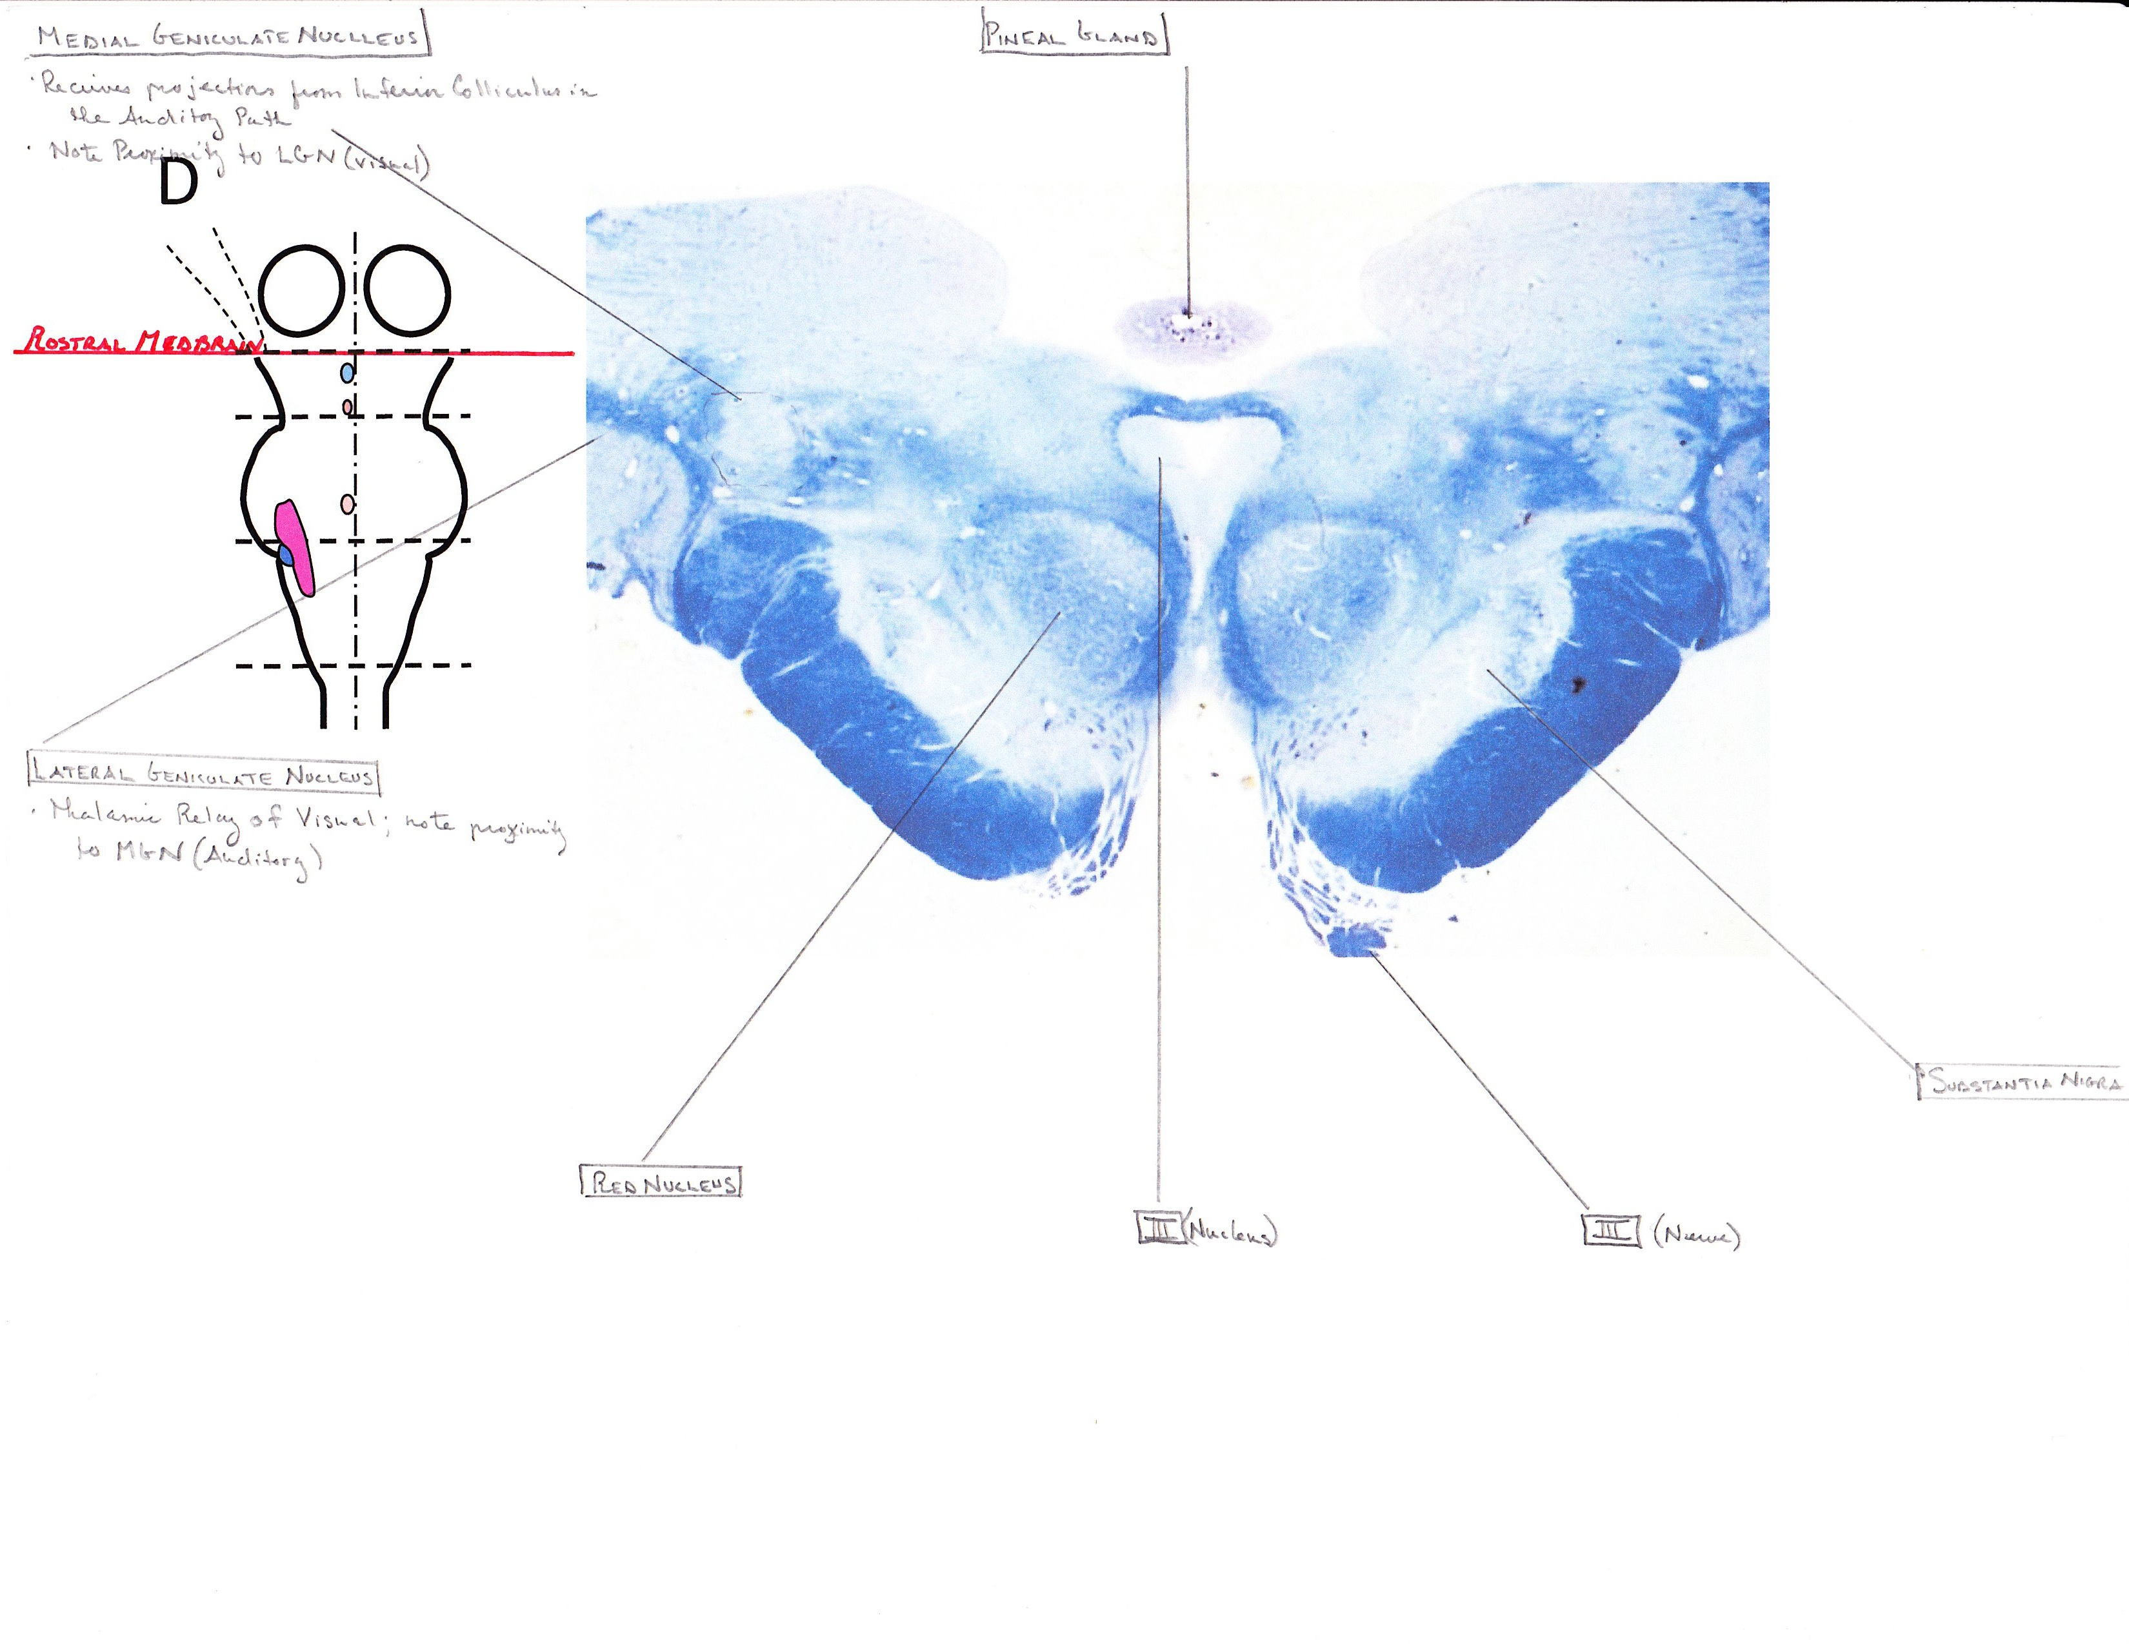

Slide 12
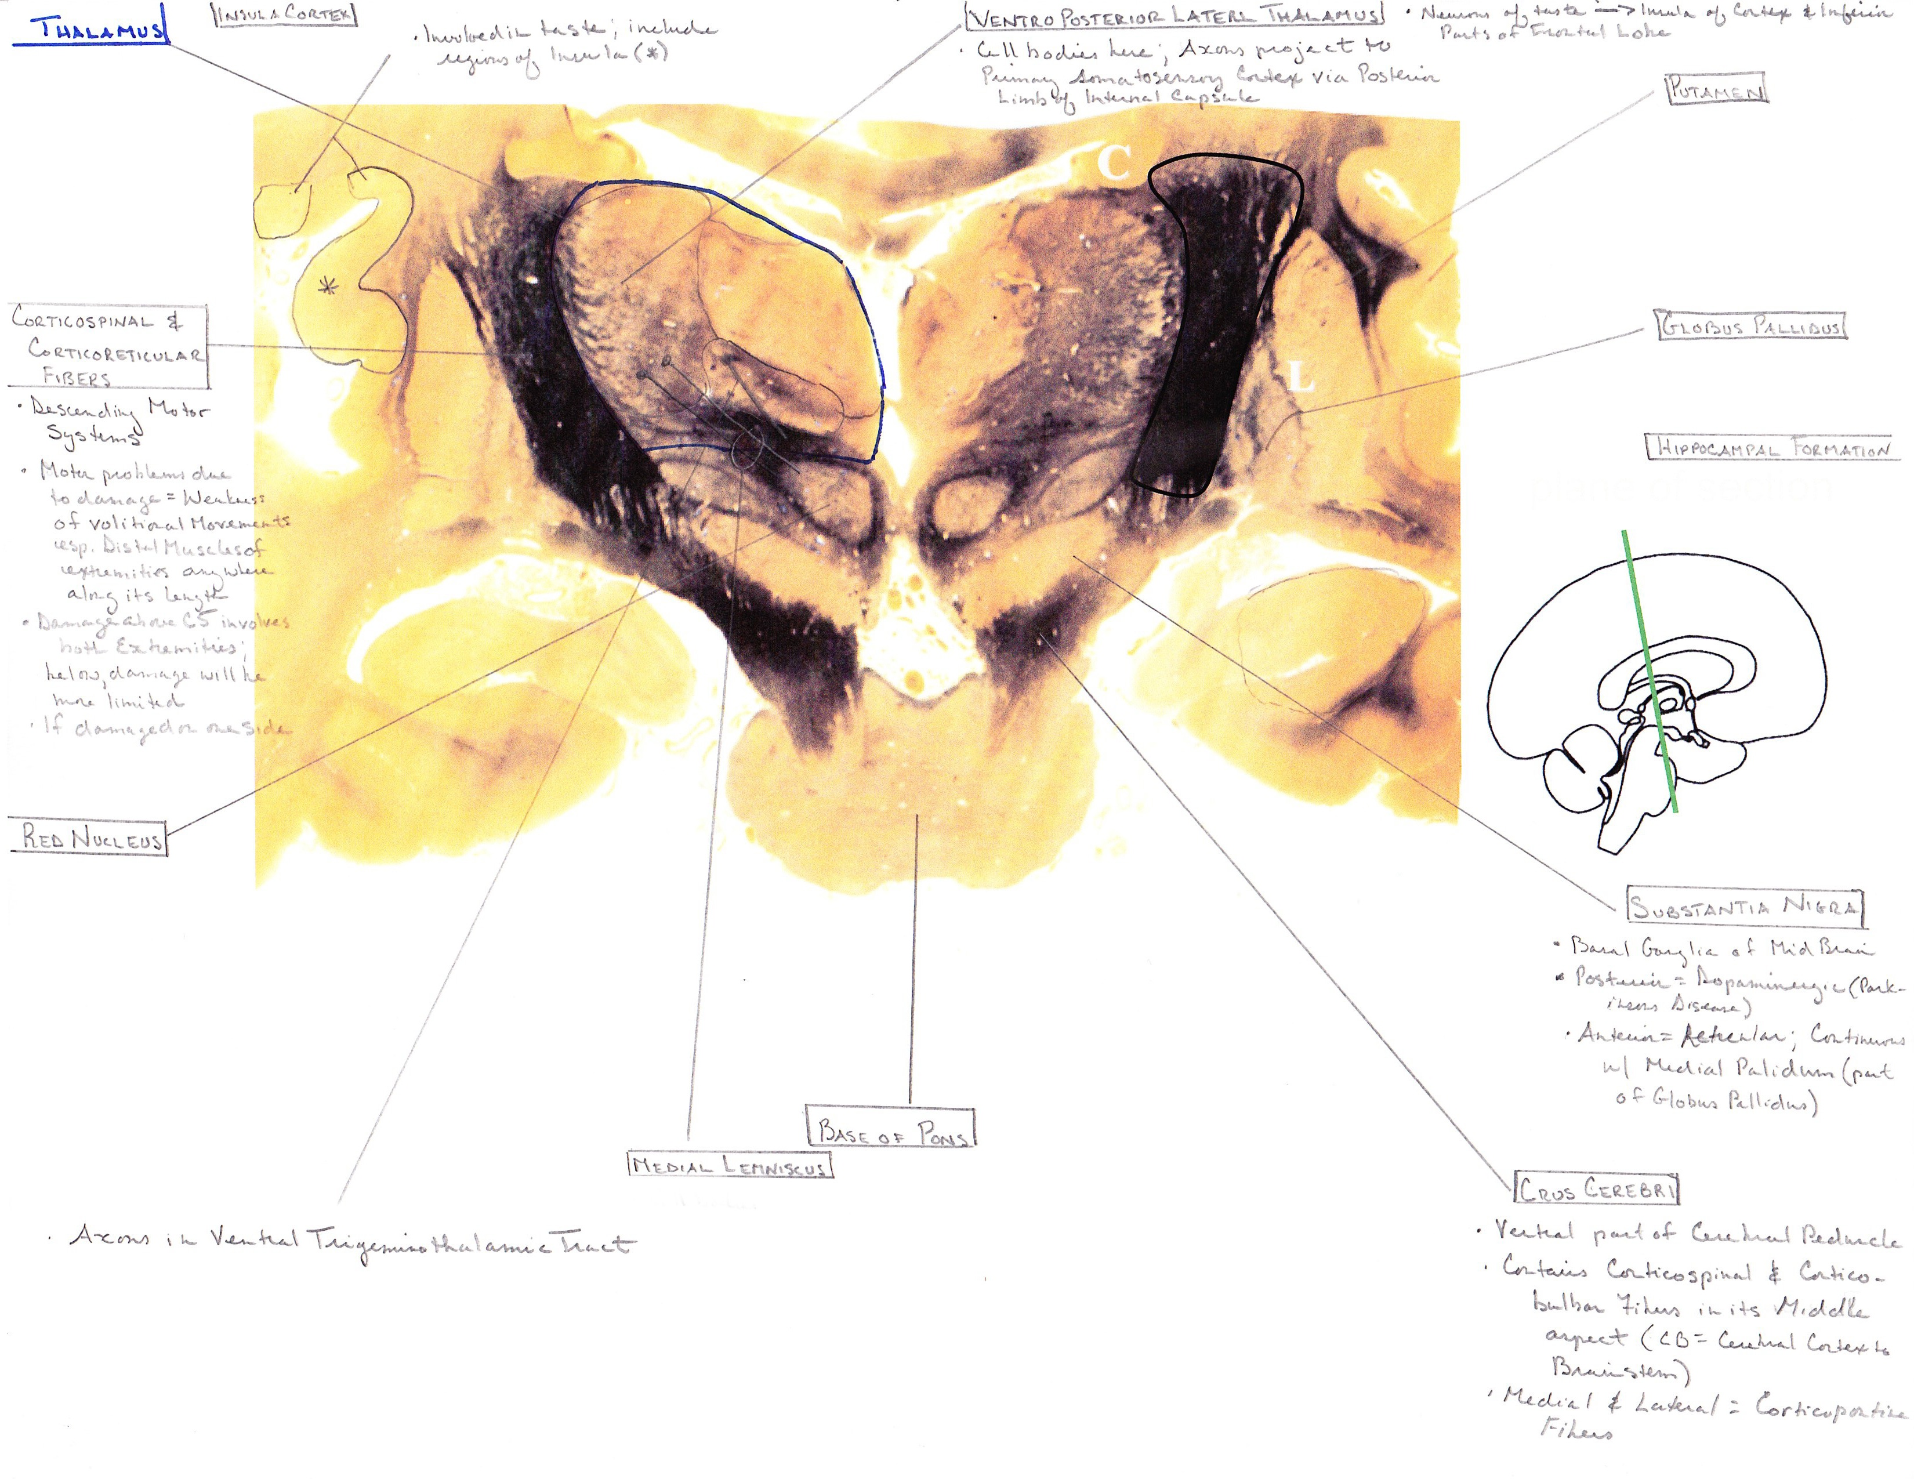

Slide 13
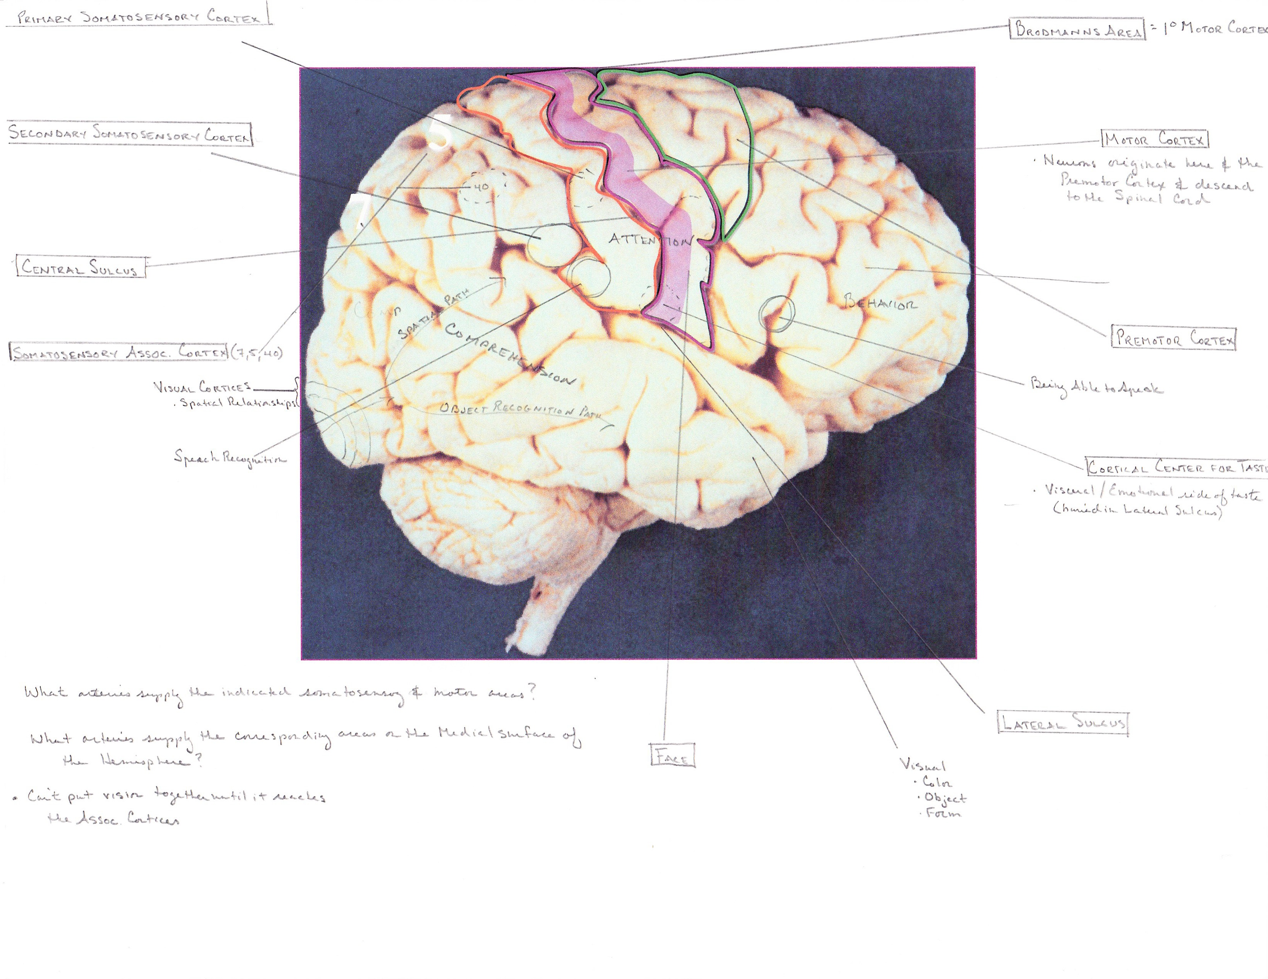

Slide 14
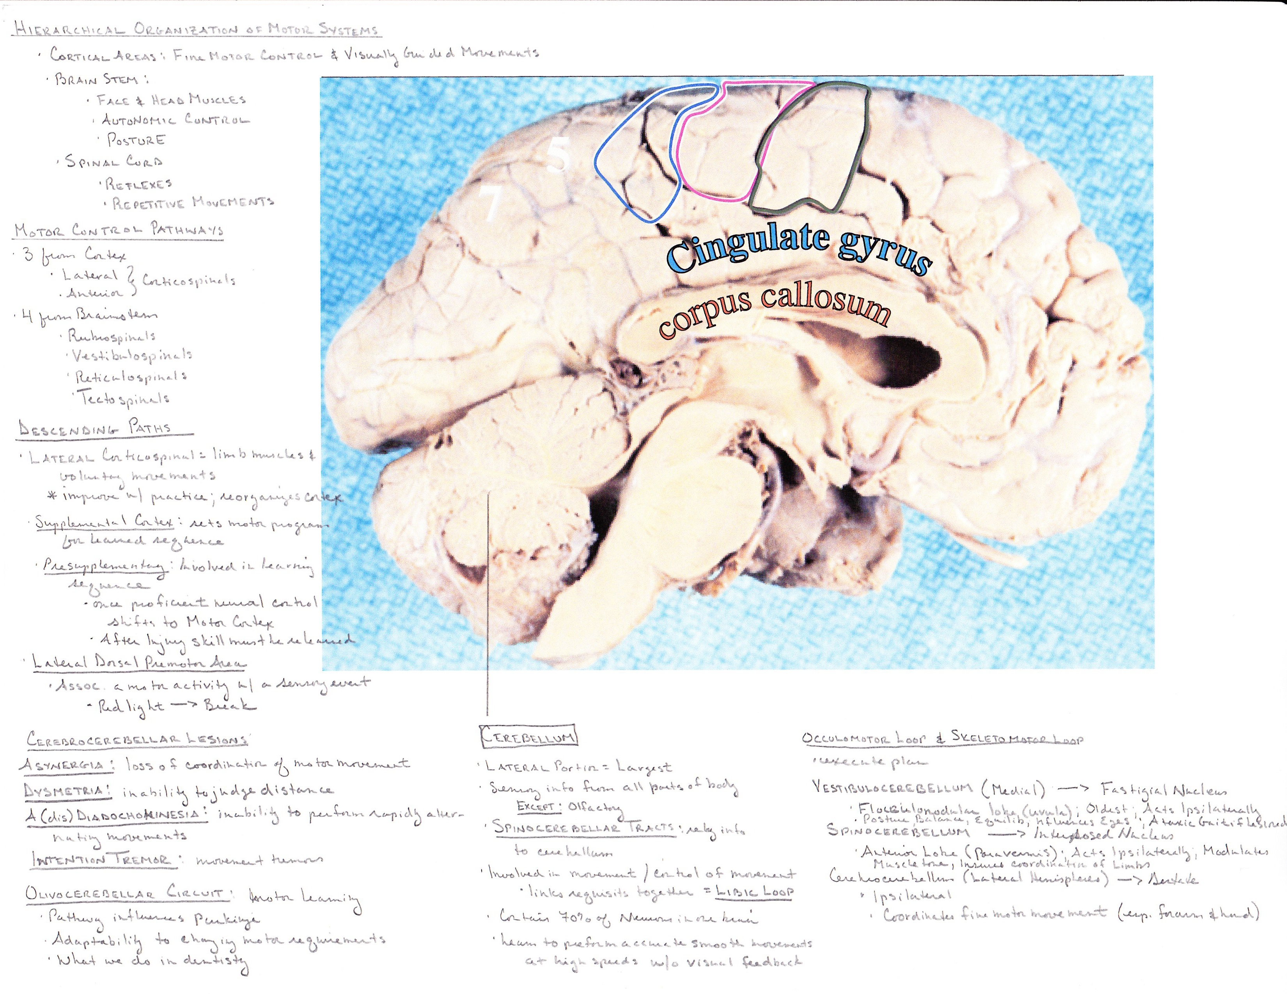

Slide 15
Quiz #1

Slide 16
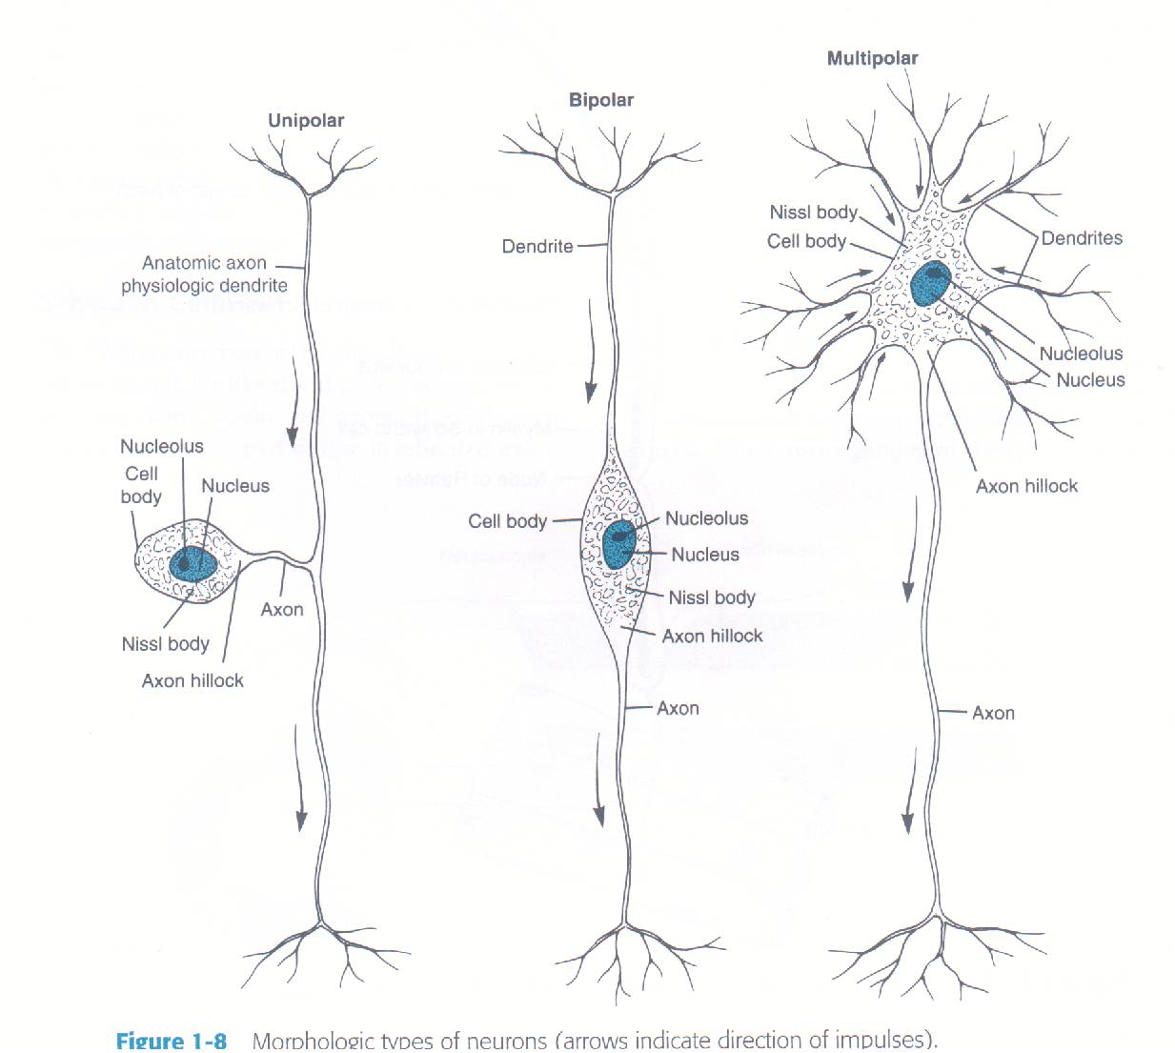
1. In the dorsal root ganglion, the neurons are:
Pseudo = no dendrites, 1 axon; endocrine secretion, smooth muscle contraction
Bi = 2 processes, 1 like a dendrite, 1 like an axon; process sensory information
Multi = long axon type communicate between nervous system regions; short axon type (interneurons) process and integrate information
Pseudounipolar.
Bipolar
Multipolar.

Slide 17
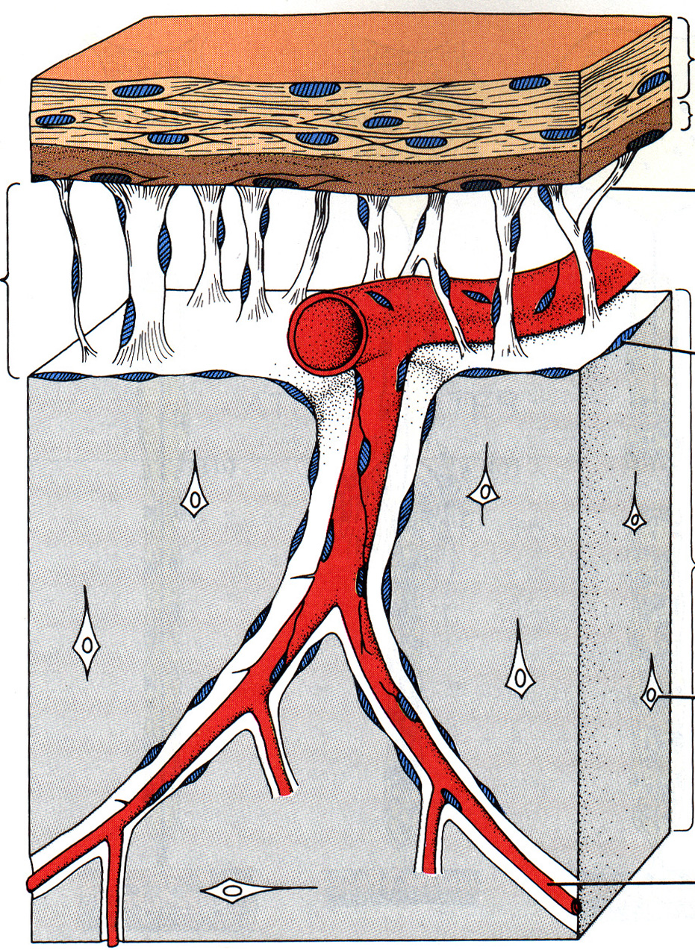
2. The spinal cord is surrounded by meninges and the innermost membrane is the:
Dura mater
Arachnoid
Pia mater
Subarachnoid space
Arachnoid trabecula
Cerebrospinal fluid

Slide 18
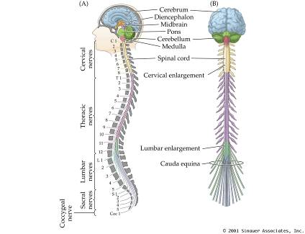
3. The C8 spinal nerve emerges between which of the following vertebrae?
C7 and C8
C8 and T1
C7 and T1
T1 and T2
Cervical = spinal nerve above respective vertebra
with spinal nerve 8 between C7/T1
Thoracic = spinal nerve below respective vertebra
Lumbar = spinal nerve below respective vertebra
Sacral = spinal nerve below respective vertebra

Slide 19
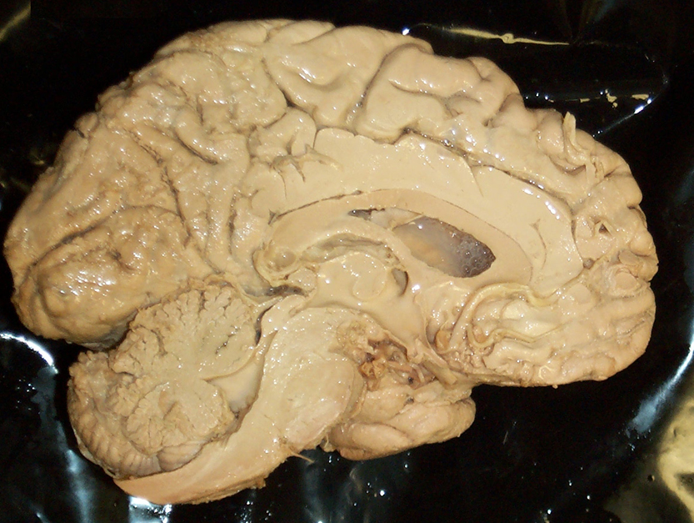
4. The region at the tip of the arrow is the:
Medulla
Pons
Midbrain
Diencephalon
Medulla/Pons = blood pressure,
respiratory function
Midbrain = control of eye
movements
Diencephalon = (thalamus) transmits sensory
information to cortex; (hypothalamus) integrates
ANS function, controls endocrine hormones

Slide 20
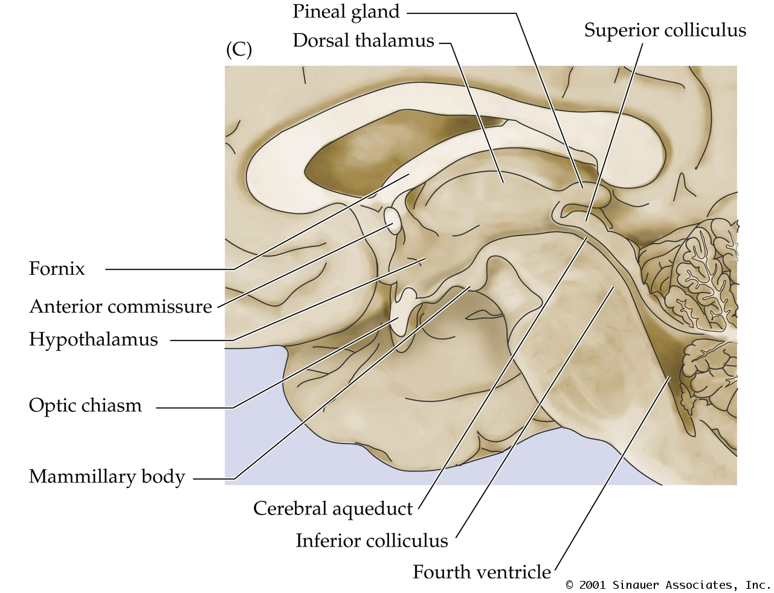
5. The fourth ventricle lies above the:
Spinal cord and medulla.
Medulla and pons.
Pons and midbrain.
Diencephalon.
* Arrows point to structure above answers
1-4
Above spinal cord and medulla = cerebellum
Above pons and midbrain = cerebral aqueduct
Above diencephalon = lateral ventricles

Slide 21
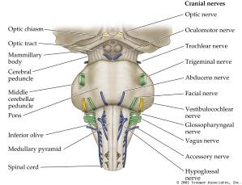
6. At which specific brainstem level is the trigeminal nerve?
Medulla
Pons
Midbrain
Diencephalon
Midbrain = CN 3, 4
Pons = CN 5, 6, 7, 8
Medulla = CN 9, 10, 11, 12

Slide 22
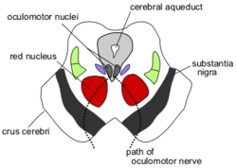
7. The cerebral crus, substantia nigra and the adjacent tegmentum are located in the:
Tectum
Cerebellar peduncles
Pons
Cerebral peduncles.
* Cerebral crus, substantia nigra, and adjacent tectum
are parts of the midbrain
Tectum = dorsal part of midbrain, ventral part is tegmentum; visual and auditory involvement
Cerebellar peduncles = carry information from cerebellum to midbrain, pons, and medulla
Pons = ventral part is base, dorsal part if tegmentum
Cerebral peduncles = all of midbrain except tectum; project (corticispinals/corticobulbars, etc.) to various thalamic nuclei

Slide 23
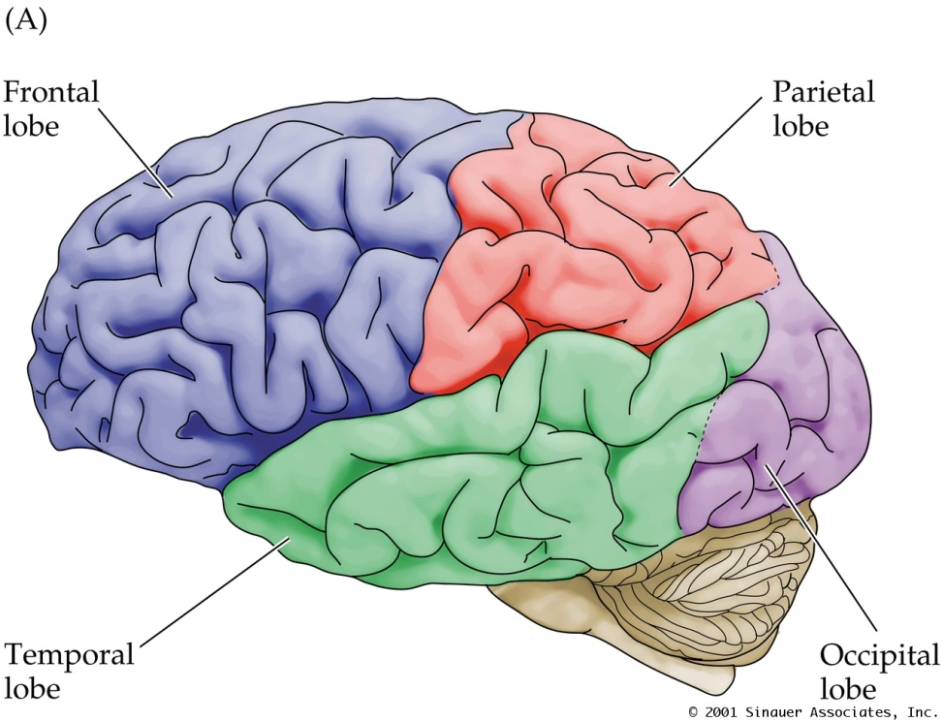
8. The most posterior lobe of the cerebral hemisphere is the:
Parietal
Occipital
Temporal
Parietal = integration of sensory information,
3D place in space, self image, perception of
touch, pain, and body position (“Where”)
Occipital = vision (form, color, movement)
Temporal = hearing, speech recognition,
object recognition, emotions (“What”)

Slide 24
9. The lateral fissure separates the:
Temporal and frontal lobes.
Temporal and occipital lobes.
Parietal and occipital lobes
Parietal and frontal lobes.
Preoccipital notch = division of temporal
and occipital lobes
Parieto-occipital sulcus = division of parietal
and occipital lobes
Central sulcus = division of parietal and
frontal lobes

Slide 25
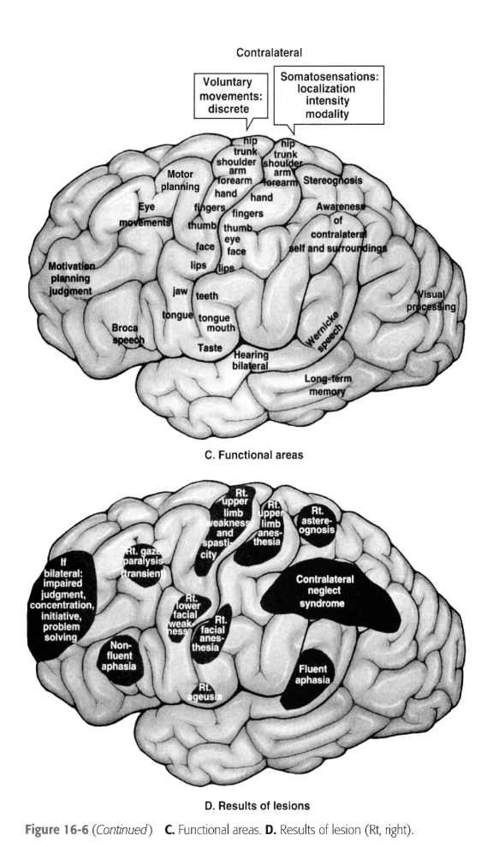
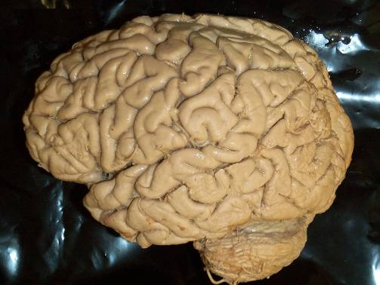
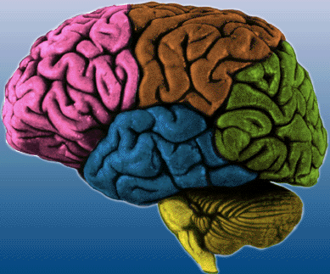
10. Which region of the cortex is most involved in behavior and movement?
A = frontal (prefrontal association cortex/motor cortex)
B = parietal (integration of sensory information,
3D place in space, self image, perception of
touch, pain, and body position)
C = occipital (vision; form, color, movement)
D = temporal (hearing, speech recognition,
object recognition, emotions)
A
B
C
D
B
A
C
D

Slide 26
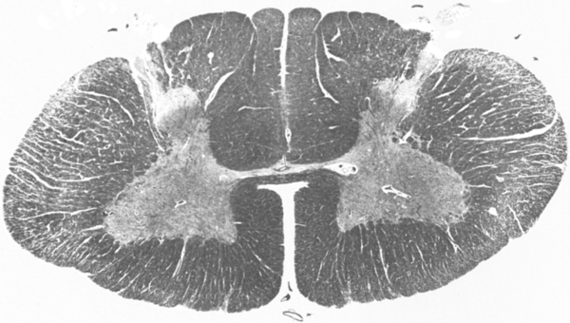
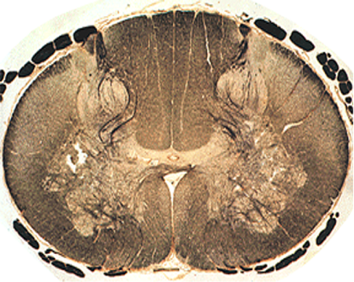
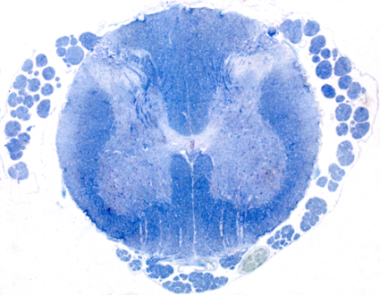
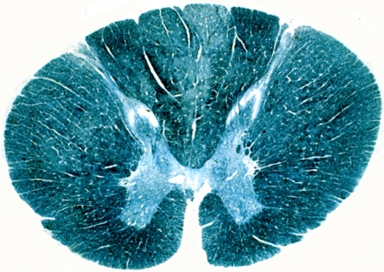
1. Where would you find lateral motor nuclei?
C1 – 5
C5 – T1
T1 – T5
T8 – L1
Lateral motor nuclei = distal musculature
Medial motor nuclei = axial musculature
* Lateral motor nuclei enlargements = C5-T1 (cervical) and L2-S2 (lumbosacral)
* Thoracic spinal cord segment does not have lateral motor nuclei and no lateral enlargement

Slide 27
2. The structure at the tip of the arrow is the:
Tegmentum of the pons.
Tegmentum of the midbrain
Tectum
Diencephalon
Anterior
Tegmentum of pons = involved with REM sleep and behind base of pons
Tegmentum of midbrain = extends from sunstantia nigra to cerebral aqueduct
Tectum = dorsal midbrain responsible flor visual and auditory reflexes
Diencephalon = (thalamus) transmits sensory
information to cortex; (hypothalamus) integrates
ANS function, controls endocrine hormones

Slide 28
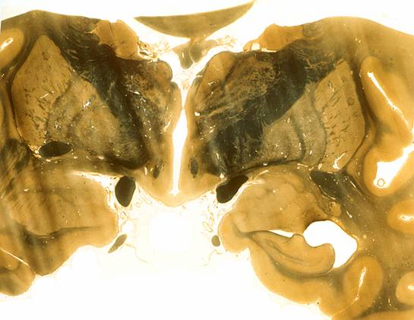

3. The cerebrospinal fluid-filled cavity found in the middle of the diencepahalon is the
3rd ventricle
4th ventricle
Cerebral aqueduct
Lateral ventricle
Diencephalon = (thalamus) transmits sensory
information to cortex; (hypothalamus) integrates
ANS function, controls endocrine hormones

Slide 29
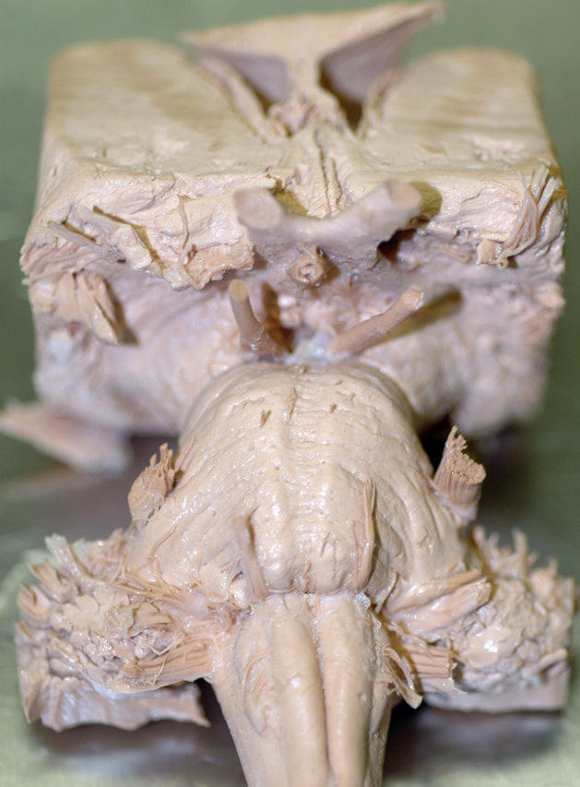
4. Identify the trigeminal nerve.
A
B
C
D
A = Trigeminal (CN V)
B = Occulomotor (CN III)
C = Abducens (CN VI)
D = Hypoglossal (CN XII)
B
A
C
D

Slide 30
5. Which nerves both arise from the medulla?
Abducens and trigeminal.
Trigeminal and Vagus.
Oculomotor and Abducens.
Vagus and Hypoglossal

Slide 31
Quiz #2a
Notes:
3131

Slide 32
1. The structure at the tip of the arrow is the:
Tegmentum of the pons. - This is actually the upper/dorsal part of the pons, below which is the base. The pontine tegmentum controls REM sleep.
Tegmentum of the midbrain – aka FLOOR of the midbrain, surrounds the cerebral aqueduct. Forms part of the Cerebral Peduncle (other parts are the Substantia Nigra and Cerebral Crus.)
Tectum – aka ROOF of the midbrain. Composed of superior & inferior colliculi. Superior does eye movements and allows you to orient/direct movements based on visual input. Inferior controls your auditory startle reflex, sound localization, and the vestibulo-occular reflex (stabilizing an image on your retina during tiny head movements.)
Diencephalon – Contains thalamus, hypothalamus, and pretectum (area b/w thalamus & midbrain.)

Slide 33
2. Identify the abucens nerve.
A – Trigeminal (CN 5)
B – Optic (CN 2)
**C – Abducen's (CN 6)
D – Hypoglossal (CN 12)
Note: See next slide for full diagram of cranial nerves.
B
A
C
D

Slide 34
CN3
Identify:
Cranial Nerves
    Optic nerve (ON), optic chiasm & optic tract
    Oculomotor Nerve
    Trigemminal Nerve
    Abducens Nerve
    Facial and Vestibulocochlear Nerves
    Glossopharyngeal, Vagus and Cranial Accessory Nerves
    Hypogglossal Nerve
ON
*
Notes:
34

Slide 35
3. Which nerve arises from the midbrain?
Abducens. - Arises from the junction between pons and medulla.
Trigeminal. - Arises at the lateral aspect of the midpons. Huge, can't miss it.
**Oculomotor. - Arises from the midbrain, just rostral to the pons, and caudal to the optic nerve/chiasm/tract.
Vagus. - Arises with CN 9 & 11 on the lateral aspect of the rostral medulla.

Slide 36
4. The arrow points to:
Pons – Big dome thing, caudal & ventral to the midbrain.
Midbrain – Lies between the diencephalon & pons.
**Diencephalon – Sits rostral and dorsal to the midbrain.
Olive – Little bulges caudal to the pons, immediately lateral to the medulla pyramids (the longitudinal prominences along the midline of the medulla.)
Notes:
3636

Slide 37
5. The red star lies over the:
Frontal lobe
**Parietal lobe
Occipital lobe
Temporal lobe.
Notes:
3737

Slide 38
6. With a loss of lower motor neurons a patient would have:
**Flaccid paralysis. - Happens because lower motor neurons (aka Alpha's, or LMN's) constantly send small stimulations to the muscles they innervate, giving them their tone. Knocking out LMN's causes the muscles they innervate to be flaccid (no tone), paralyzed (no movement), and possibly show small fasciculations (involuntary twitches). The muscle innervated by the lesioned LMN will also have no myotactic (stretch) reflex. This combo of signs is known as Lower Motor Neuron Syndrome.
Spastic paralysis. - Seen in the loss of upper motor neurons (aka Upper Motor Neuron Syndrome.) Lesioning UMN's causes spastic paralysis (no voluntary movement, and resistance to being moved by an external force), and exaggerated myotactic (stretch) reflexes. This happens because the LMN's aren't controlled by the UMN's anymore, so no voluntary movements can be made and only the reflex loops remain intact. The neurons in these reflex loops (afferents, interneurons, and LMN's) become more sensitive and hyperactive, to the point where the overactive stretch reflex resists all externally applies forces.
Sensory deficiets.
Notes:
3838

Slide 39
7. In the diagram the arrow points to the region where the lower motor neurons would innervate the:
Neck muscles.
Trunk muscles
**Upper limb muscles
Note: The arrow points to the lateral cell column, which has cell bodies of neurons that innervate the limbs. The lateral cell column is only found at the cervical and lumbosacral spinal cord enlargements. Medial to the arrow is the medial cell column, which has the bodies of neurons controlling neck and trunk muscles. The medial column is found all along the cord.
Notes:
3939

Slide 40
8. The CONTRACTION of muscle when it’s tendon is stretched is the:
**Myotatic reflex. - This is a CONTRACTION reflex that occurs in response to MUSCLE/TENDON STRETCH. It is detected by the intrafusal muscle fibers of the Muscle Spindle, which are innervated by IA afferent nerve fibers. When the muscle or its tendon are tapped, the muscle (both intra- and extrafusal muscle fibers) are stretched. Stretching the intrafusal fibers excites their IA afferents, which carry the excitation back to the cord through the dorsal spinal nerve root. In the cord, they synapse on that muscle's lower motor neurons, forming a reflex loop with 1 synapse (monosynaptic loop.) This synapse excites the LMN's, which carry the excitation back to the muscle and cause CONTRACTION of the extrafusal muscle fibers.
Inverse motatic reflex. - This is a RELAXATION reflex that occurs in response to TENDON TENSION, as detected by the Golgi Tendon Organ and the IB afferents that innervate it. Contraction of a muscle tenses its tendon, causing excitation in its IB afferent neurons which carry the signal back to the cord through the dorsal spinal nerve root. In the cord, the IB excites an inhibitory interneuron, which thus INHIBITS the corresponding LMN's for that muscle. This reflex loop has 2 synapses and results in the relaxation of the muscle to prevent tendon tear.
Gamma loop. - This is more of a modulatory mechanism in the intrafusal muscle fibers. Gamma motor neurons (as opposed to alpha motor neurons, the normal LMN's) control the tone of the intrafusal muscle fibers of the muscle spindle, thus regulating their excitability and the sensitivity of the myotactic reflex.
Notes:
4040

Slide 41
9. The neurons that originate in the cortex and descend to the spinal cord are part of the
**Corticospinal tract. - These fibers originate in the primary motor cortex located in the precentral gyrus. Some fibers also come from premotor and even primary somatosensory cortices. They descend to the posterior part of the internal capsule, through the pons, and down the medulla through the pyramids. Most fibers cross over (decussate) in the caudal medulla, and descend the spinal cord in the lateral funiculus (white matter between the anterior and posterior grey horns.)
Vestibulospinal tract. - These fibers originate in the vestibular nuclei of the medulla and descend in the ventromedial white matter. These fibers function to allow reflexive postural adjustments of the head and body, and also influence muscle tone.
Reticulospinal tract. - These fibers originate at various levels of the Reticular Formation (the core of the brainstem), and runs down the white matter of the cord in two places: between the anterior and posterior grey matter (horns), and between the anterior horn and intermediate grey matter zone. These nerve fibers have many functions, including: coordination of locomotive and postural movements (basically integration of motor info), and mediation of voluntary movement, pain, and autonomic info.
Rubrospinal tract. - These fibers originate in the Red Nucleus of the midbrain. They cross to the other side of the midbrain, begin to descend in the lateral part of the brainstem tegmentum, and continue down the spinal cord in the lateral funiculus (accompanying the lateral corticospinal tract.) These nerve fibers modulate voluntary movements and help provide fine motor control.
Notes:
4141

Slide 42
10. Which would give you pronounced atrophy if lesioned?
Pyramidal tract. - Lesions here would give you Upper Motor Neuron Syndrome, which produces spastic paralysis (due to hypertonia), and exaggerated reflexes.
**Lower motor neurons. - Lesioning LMN's would give you Lower Motor Neuron Syndrome, which produces flaccid paralysis (due to loss of muscle tone) and loss of reflexes. Prolonged loss of muscle tone results in atrophy, the degeneration/wasting of muscle tissue.
Vestibulospinal tract.
Notes:
4242

Slide 43
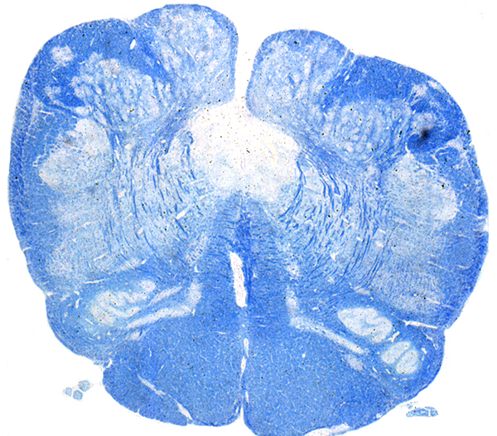
1. Where is the 12th nucleus?
**A – Hypoglossal nucleus. Location of cell bodies of neurons contributing fibers to CN 12.
B – Gracile nucleus (a dorsal column nucleus of the caudal medulla.) Location of cell bodies of secondary neurons carrying touch/proprioception info from the ipsilateral lower body and limbs up to the contralateral sensory areas of the cortex. Fibers cross over in the rostral medulla and ascend in the medial lemniscus.
C – Spinal trigeminal nucleus. Location of cell bodies of secondary neurons carrying pain/temperature info from the ipsilateral face up to the brain. Fibers cross over immediately and ascend in the contralateral trigeminothalamic tract.
D – Inferior olivary nucleus. Location of cell bodies of neurons involved in coordination/control of movement. Fibers contribute to the contralateral inferior cerebellar peduncle.
B
A
C
D
Notes:
4343

Slide 44
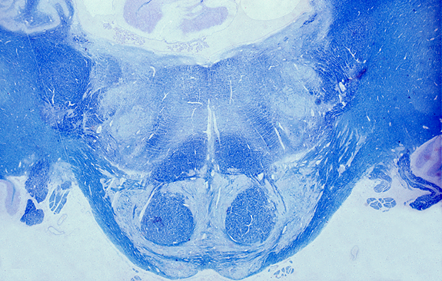
2. The seventh cranial nerve nucleus is:
A – Corticospinal tract.
B – Abducen's nucleus (CN 6)
**C – Facial nucleus (CN 7)
D – Medial vestibular nucleus (CN 8)
D
B
6
C
A
Notes:
4444

Slide 45
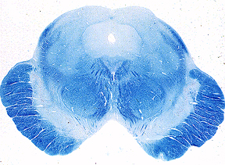
3. What tracts are found in the red box?
Corticospinals and corticobulbars.
Corticobulbars and corticoreticulars.
**Corticospinals and corticoreticulars. - NOTE: Fibers in these paths run together in the area indicated for the corticospinal tract. There was no red box on this picture, so I'm just assuming this was the right answer because these two run together.
Notes:
4545

Slide 46

4. The area in yellow would not contain the
Corticospinal tract.
Vestibulospinal tract
Medial Reticulospinal tract
Notes:
4646

Slide 47

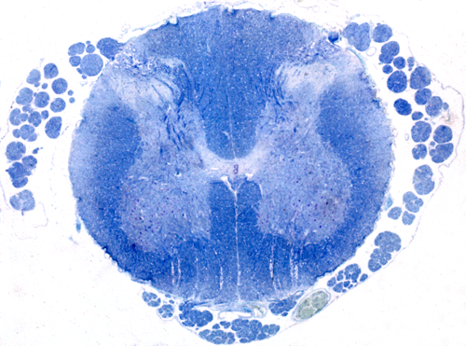
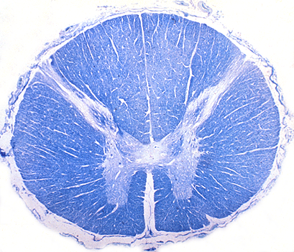
Which of these is located in the upper thoracic region?
A – C7, note fat/wide overall area, huge ant/post grey horns, lots of white matter.
**B – T2, note small ant/post grey horns, and POSTERIOR FUNICULUS DIVIDED BY A SEPTUM (separates gracile & cuneate tracts.)
C – T12, note small ant/post grey horns, and no division of posterior funiculus.
D – S1, note huge ant/post grey horns, not a lot of white matter.
A
B
C
D
Notes:
4747

Slide 48
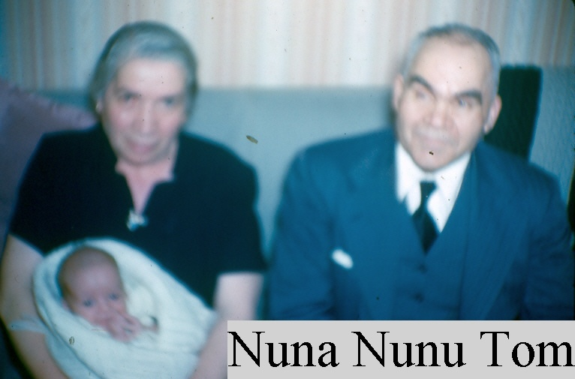
Quiz 3a
Brought to you by Chris Hill
Hope This helps
You tell ‘em Nuna
I’m gonna fail you all!!!!!!!!

Slide 49
1. A lower motor neuron and the muscles it innervates is called a:
Muscle spindle.
Neuromuscular spindle. (Synonym for 1)
Motor unit
Gamma loop.

Slide 50
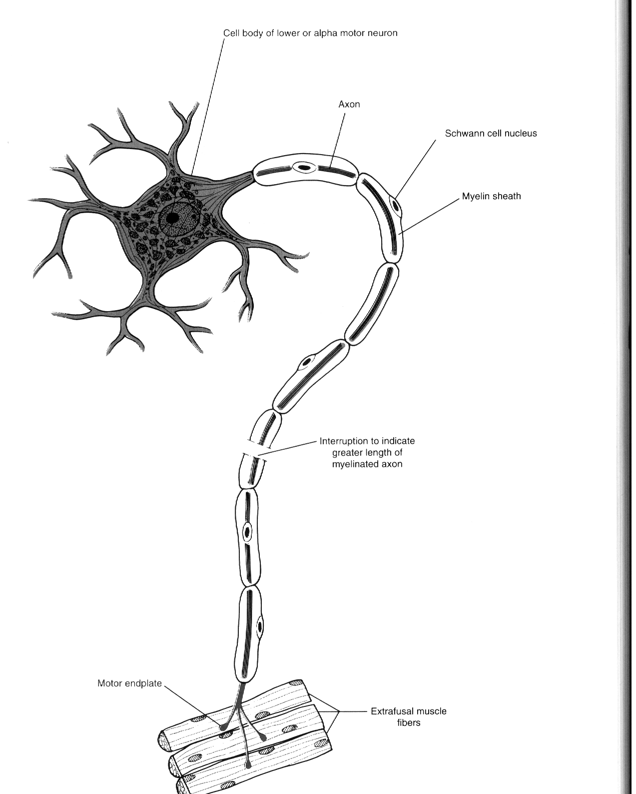
Motor Unit

Slide 51
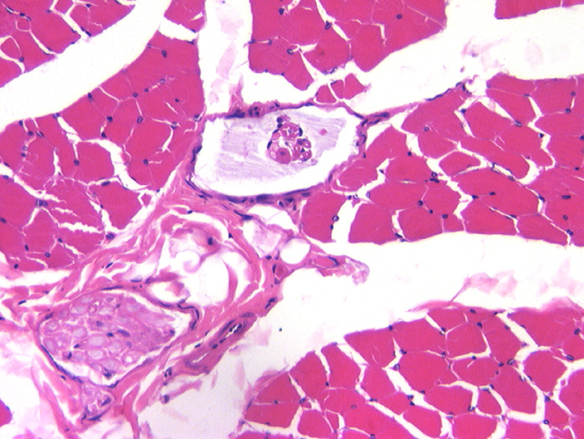
Skeletal Muscle
Regulation of Muscle Contraction
  The stretch reflex
  Muscle spindles as a sensory receptor.
  Provides feedback on the state of a muscle.

Slide 52
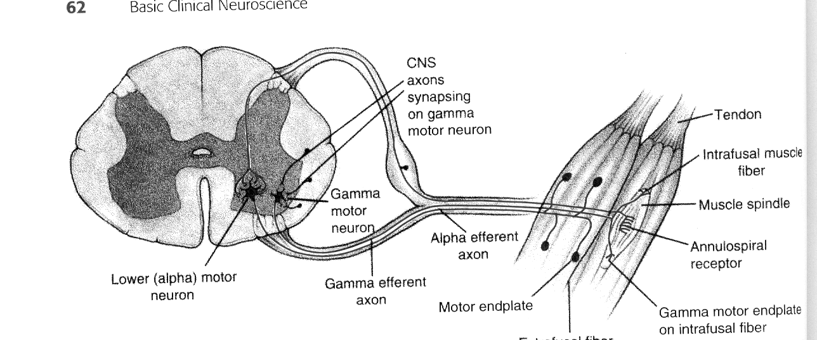
The gamma loop

Slide 53
2. Which symptom is not found in Lower Motor Neuron Syndrome?
Spastic paralysis – Upper Motor symptom
Hypotonia – Due to loss of passive stretch
Rapid atrophy – 70-80% atrophy
Decreased or absent reflexes.

Slide 54
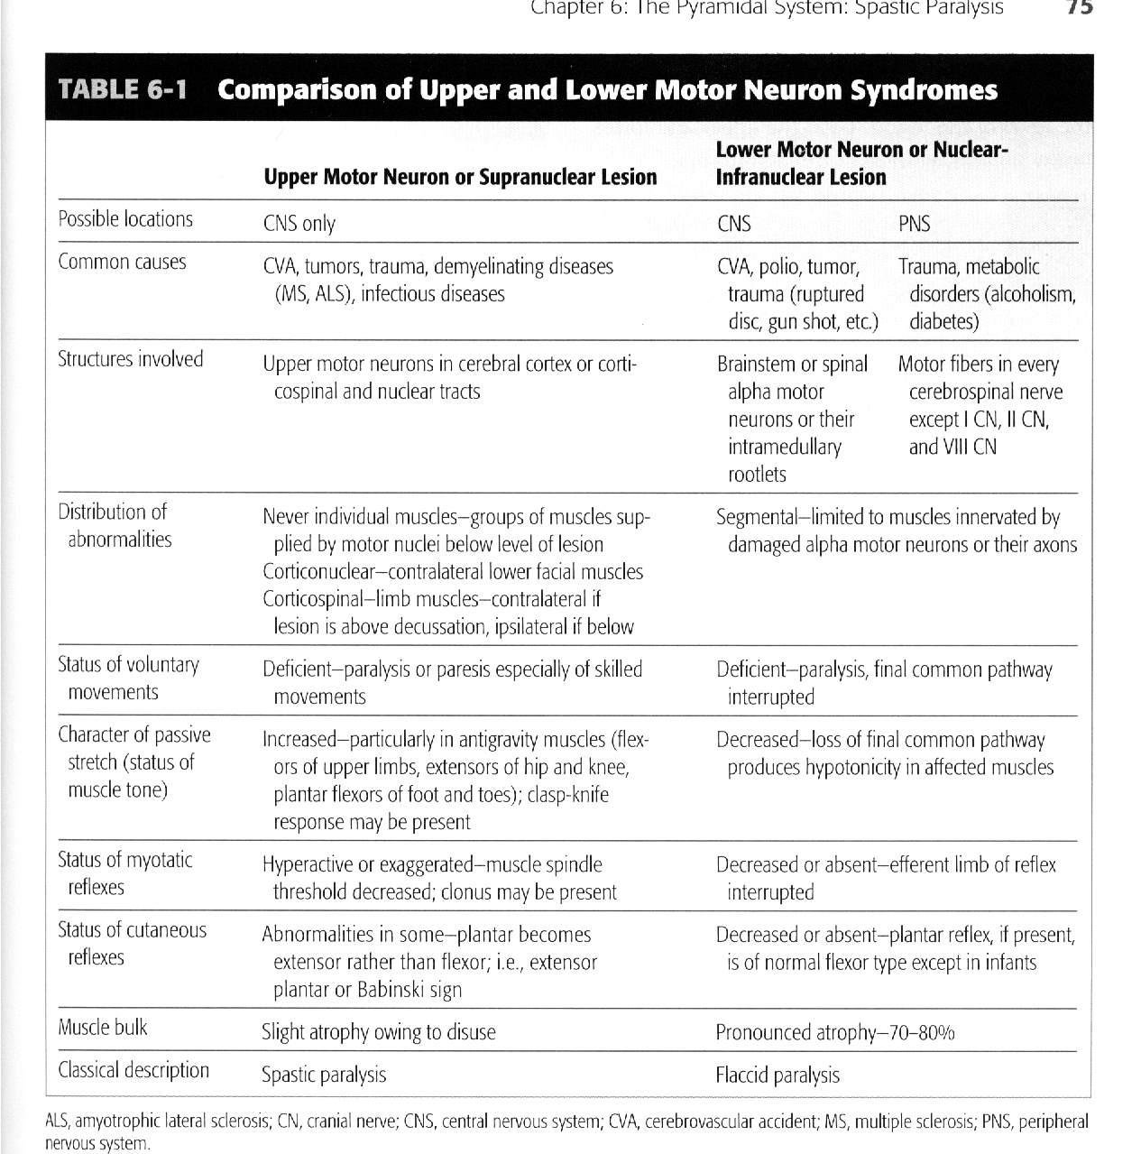
UMN lesions

Slide 55
3. Which of the following descending pathways is found in the lateral spinal cord?
Corticospinals.
Corticobulbars
Vestibulospinals
Medial reticulospinals.

Slide 56
Motor Control Pathways
Seven descending motor pathways
  3 from cortex
    Lateral corticospinals
    Anterior corticospinals
    Corticobulbars
  4 from brainstem
    Rubrospinals
    Vestibulospinals
    Reticulospinals
    Tectospinals

Slide 57
4. Which of the following is not found in Upper Motor Neuron Syndrome?
Hyperactive reflexes
Spastic paralysis
Babinski sign
Pronounced atrophy – Lower motor syndrome.

Slide 58
UMN lesions

Slide 59
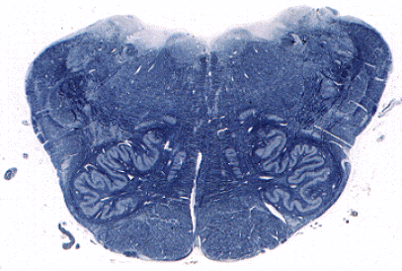
5. Which pathway would be found in the area surrounded by the red circle?
Vestibulospinal tract
Medial reticulospinal tract
Lateral reticulospinal tract
Corticospinal tract

Slide 60
Slide 2
CS
CS
Note: This is at the level of decussation.
Descending motor systems. In each image, outline the general location of the corticospinal tract, medial (pontine) reticulospinal tract, lateral vestibulospinal tract, & the lateral (medullary) reticulospinal tract.

Slide 61
6. Which is not a part of the basal ganglia?
Caudate nucleus - participates in eye movement control and cognition
Putamen - participates in limb and trunk movements.
Globus pallidus
Red nucleus

Slide 62
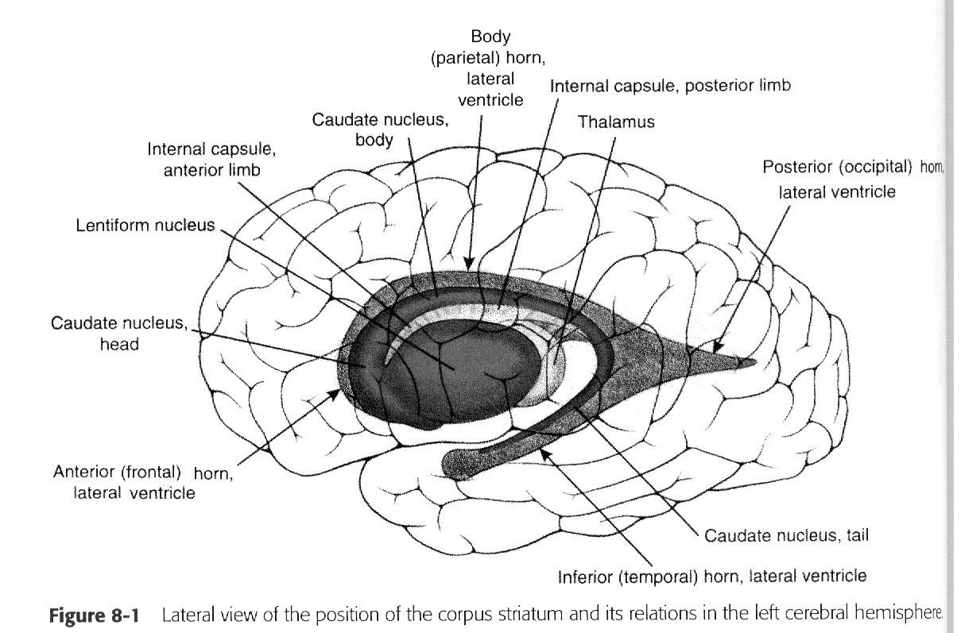
Caudate
Putamen
Globus Pallidus
Amygdala
Striatum
Corpus Striatum
Lenticular Nucleus
Pallidum

Slide 63
7. Substantia nigra is found in the:
Cerebral cortex
Diencephalon
Midbrain
Pons

Slide 64
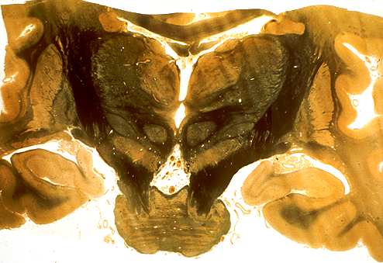
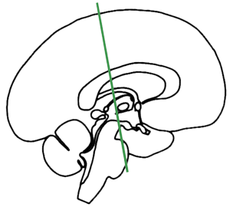
Caudate
Putamen
plane of section
RN
Globus pallidus
Subthalamic nuc.
Substania nigra
Basal ganglia and associated structures. Subthalamic nucleus. Substantia nigra. Caudate (body). Putamen & globus pallidus. | Other structures. Identify: Midbrain, with crus cerebri. Pons (base). Posteior limb of internal capsule. | Cerebellum & associated structures. Red nucleus (RN) Superior cerebellar peduncle - the darkly stained axons medial to the red nucleus (these are often referred to as dentato-thalamic fibers because many originate in the dentate nucleus of the cerebellum and project to the thalamus (mainly VL [ventrolateral nuc of thalamus]).

Slide 65
8. How many peduncles connect the cerebellum to the brainstem?
2
3 – Connected via the inferior, middle, and superior cerebeller peduncle.
4

Slide 66
9. Truncal ataxia and standing on a wide base reeling from side to side indicates:
Flocculonodular lobe syndrome.
  See question.
Anterior lobe syndrome
  Commonly results from chronic alcoholism.
  Marked lower limb instability and clumsy movements.
Posterior lobe syndrome.
  Charaterized by intention tremor
    Only happens during volitional movement.
  Dysmetria
    Over or undershooting when attempting to touch a target.
  Dysdiadochokinesia
    The inability to perform rapid alternating movements.

Slide 67
10. An intention tremor would indicate:
Basal Ganglia disease
  Parkinson’s Disease
  Huntington disease
  Hemiballismus
Posterior lobe syndrome
Anterior lobe syndrome
Flocculonodular lobe syndrome

Slide 68
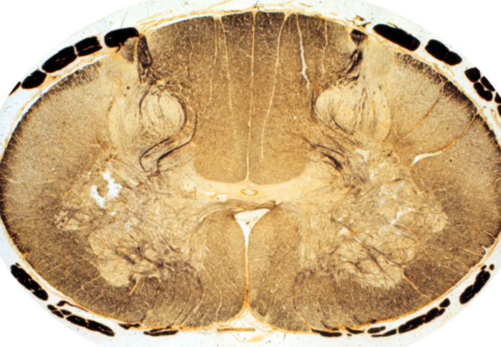
1. The posterior spinocerebellar tract would be found at:
A- Posterior Funiculus
Fasciculus Gracilis (G) - present at all cord levels
Fasciculus Cuneatus (C) - only at T6-C1
B – Both B and C are the Ventromedial pathway.
C
D
D
A
C
B

Slide 69
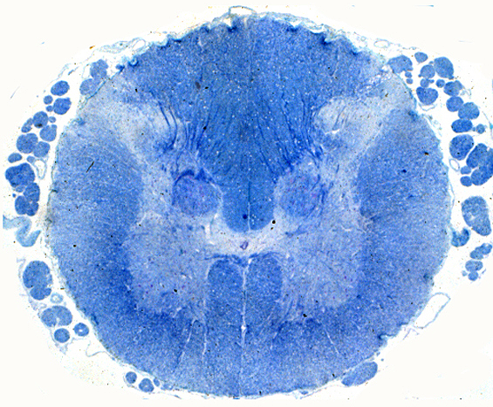
Dorsal root entry zone
L3 level of spinal cord.
Posterior spino-cerebellar tract
As you go through these sections, you should review the major systems covered previously in the course, including the descending motor systems. | Cerebellum and associated structures. Spinocerebellar Tracts - a system for relaying proprioceptive information to the cerebellum. Neuron #1. Axons at Dorsal Root entry zone. The green line illustrates schematically the path of primary afferents into the nucleus dorsalis, which contains neuron #2. Neuron #2. Nucleus dorsalis, outlined in yellow. This nucleus contains the second neuron in a pathway from proprioceptors of the lower extremity and trunk to the cerebellum. Posterior (or dorsal) spinocerebellar tract (also outlined in yellow), an uncrossed tract from nucleus dorsalis to the spinocerebellum (vermis + anterior lobe). There is also an anterior (or ventral) spinocerebellar tract that we are not considering in this course.

Slide 70
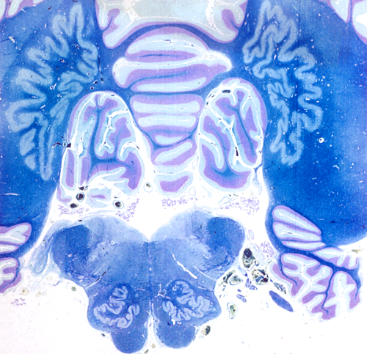
2. The dentate nucleus is
A – Vermis
B - Dentate
C – Olivary nucleus
D - flocculus
B
A
D
C

Slide 71
3. Substantia nigra is located at
A - VL nucleus of the thalamus
B - Putamen
C - Substantia Nigra
D - Globus Pallidus
A
D
B
C

Slide 72
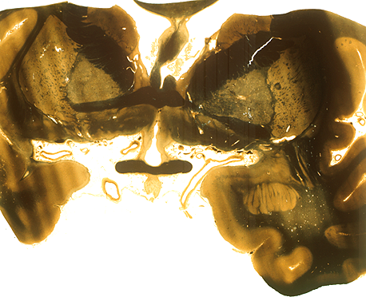
4. The caudate nucleus is found at:
A
A
B – Putamen
C – Globus Pallidus
D – Amygdala
B
C
D

Slide 73
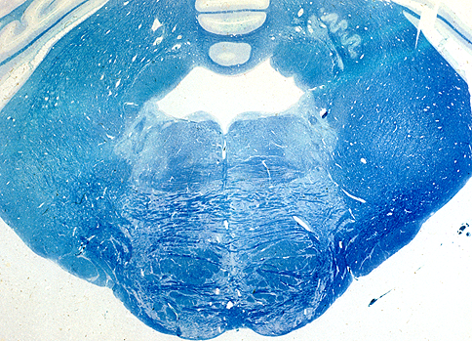
5. The yellow asterick lies over the:
Inferior cerebellar peduncle.
Middle cerebellar peduncle
superior cerebellar peduncle
*

Slide 74
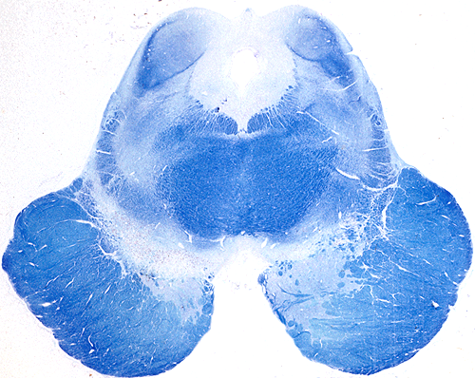
Mibrain, level of inferior colliculus
Review components of descending motor systems seen in this section including the corticospinal tract, and MLF. Also identify the tegmentum, substantia nigra, and crus cerebri of the midbrain. | Superior cerebellar peduncle (outlined in red), | Basal ganglia and associated structures. Substantia nigra (outlined in blue-green). This cell group separates the crus cerebri from the tegmentum of the midbrain, and it is interconnected with the caudate and putamen of the basal ganglia.

Slide 75
*
High open medulla
Review components of descending motor systems seen in this section including the pyramids, MLF, vestibular nuclei & vestibulospinal tracts. | Inferior olivary nucleus (outlined in orange). The orange arrow identifies the general path of the olivocerebellar fibers. Inferior cerebellar peduncle (outline in yellow + purple). This structure contains axons projecting to the cerebellum, and includes the posterior spinocerebellar and cuneocerebellar tract axons, axons from the vestibular nuclei and vestibular receptors, and from the inferior olivary nucleus. Vermis and flocculus (*) of the cerebellum. Dentate nucleus of the cerebellum (outlined in red); one of the deep nuclei of the cerebellum.

Slide 76
Quiz #4a

Slide 77
1. Which is not a part of the basal ganglia?
Caudate – Comma shaped part of the basal ganglia, located in the wall of the lateral ventricle. Divided into head, body, and tail. Tail loops posteriorly, inferiorly, and then anteriorly to extend into the temporal lobe, becoming continuous with the amygdaloid nucleus. Along with the putamen, it forms the striatum.
Putamen – Lateral most part of the lentiform nucleus of the basal ganglia. Lies lateral to the external globus pallidus, and medial to the external capsule. Separated from the thalamus by the posterior limb of the internal capsule. Separated from the head of the caudate by the anterior limb of the internal capsule.
**Dentate – Not part of the basal ganglia. The dentate nucleus is a deep cerebellar nucleus (the largest)
Globus pallidus – Medial portion of the lentiform nucleus of the basal ganglia. Divided into external and internal portions. Morphologically and functionally different from the caudate and putamen, so it forms the pallidum rather than being a part of the striatum. Separated from the thalamus by the posterior limb of the internal capsule.

Slide 78
2. Which is not a deep nucleus of the cerebellum?
Interposed – Deep cerebellar nuc found in the roof of the 4th ventricle. Gets afferents from anterior cerebellum, and sends output through the superior cerebellar peduncle to the red nucleus. Controls muscle stretch reflexes of distal muscles.
Fastigial – Deep cerebellar nuc at the anterior end of the superior cerebellar vermis (above the roof of the 4th ventricle.) Gets input from flocculonodular lobe and vermis, sends output through inferior cerebellar peduncle to the vestibular nucleus (between the pons and medulla.) Functions in standing and walking.
Dentate – Biggest deep cerebellar nuc. Functions in planning, initiation, and control of voluntary movements. Gets input from premotor and supplementary motor cortices via pontocerebellar pathway. Sends output to VL thalamus via the superior cerebellar peduncle and red nucleus.
**Subthalamic – Part of the basal ganglia. Located inferior to the thalamus, and superior to the crus cerebri. Acts to modulate the activity in the pallidum of the basal ganglia. Gets inhibitory input from external globus pallidus, and excitatory input from cerebral cortex. Send excitatory output to the internal globus pallidus.

Slide 79
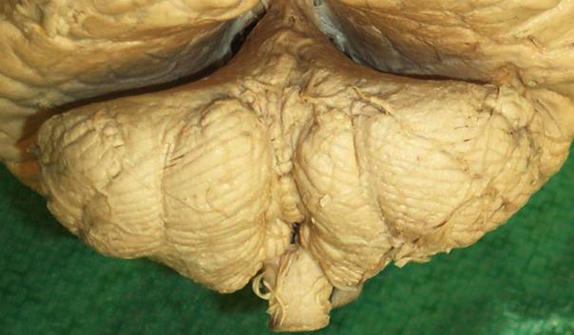
3. Identify the part of the cerebellum at the tip of the pointer.
**Vermis
Paravermis
Anterior lobe
Flocculonodular lobe.

Slide 80
4. Most axons enter the cerebellum through the:
Inferior and superior cerebellar peduncles
**Inferior and middle cerebellar peduncles.
Middle and superior cerebellar peduncles.
Explanation: Inferior peduncles are mostly input fibers from the dorsolateral surface of the medulla. Middle peduncles are all input fibers from the basilar part of the pons. Superior peduncles are mostly output to the midbrain.

Slide 81
5. Which is an input nucleus of the basal ganglia?
**Caudate – Part of the striatum, which receives input from the cerebral cortex as corticostriate fibers of the anterior limb of the internal capsule. Other input nuclei of the basal ganglia include the putamen (corticostriatal projections from motor, premotor, and somatosensory cortex), intralaminar nuclei (from thalamus), and subthalamic nucleus (from motor and premotor cortex.)
Globus pallidus – External division interconnects the striatum and subthalamic nucleus. Internal division is the major output of the basal ganglia. Gets input from STN and striatum, sends output to VA thalamus. Output fibers to thalamus are grouped as Lenticular Fasciculus, and Ansa Lenticularis.
Substantia nigra – Interconnections and output. Pars compacta gives both inhibitory and excitatory connections to striatum (effect determined by dopamine receptors in striatum. D1 receptors are excitatory, D2 are inhibitory.) Pars reticulata is inhibited by striatum, and gives inhibitory output to VA thalamus.
Subthalamic nucleus – Does receive some excitatory input from cortex. Mostly has interconnections to pallidum, though. Receives inhibition from external pallidum, and sends excitatory output to internal pallidum.

Slide 82
6. The somatosensory pathways consists of three neurons. The second neuron is found in the
Sensory ganglion. - Contains the first order sensory neuron. Transmits it from the periphery to the dorsal root and into the dorsal funiculus to ascend in either the gracile (ipsilateral lower body info) or cuneate (ipsilateral upper body info) tract..
**Spinal cord or brainstem – Contains the second order sensory neuron, specifically in the gracile or cuneate nuclei (aka the dorsal column nuclei) in the caudal medulla. Axons from these nuclei form bundles called internal arcuate fibers. They cross over (sensory decussation) and ascend in a big bundle called the medial lemniscus. Gracile nucleus fibers (contralateral lower limb info) make up the anterior half of the medial lemniscus, and cuneate nucleus fibers (contralateral upper limb info) make up the posterior half.
Thalamus – Contains the third order sensory neuron, specifically in VPL thalamus. Contralateral limb info comes in (lower limb laterally, upper limb medially), and synapses on thalamocortical fibers destined for cortex. The third order neurons end in primary somatosensory cortex in the postcentral gyrus (contralateral upper limb info comes in dorsally) and posterior part of the paracentral lobe (contralateral lower limb info.)
Cortex.

Slide 83
7. Which of the following modalities ascends the spinal cord in the posterior funiculus?
**Vibratory sense – Ascends in the dorsal/posterior funiculus along with tactile and proprioceptive info.
Pain – Ascends with temperature info in the anterior part of the lateral funiculus (spinothalamic tract.)
Temperature

Slide 84
8. Where is the pain pathway for the right little toe located?
Right cervical spinal cord.
Left medial lemniscus.
Right VPL nucleus of the Thalamus
**Left postcentral gyrus.
Explanation: Pain/temp info from your right little toe is carried on first order neurons into the cord via the lateral part of the dorsal root, and into the dorsolateral fasciculus to immediately synapse on a second order neuron. The second order neuron runs ventromedially, crossing over in the spinal cord before ascending. After crossing, it ascends in the anterolateral quadrant (anterior part of the lateral funiculus, aka the spinothalamic tract.) Generally, lower limb info travels laterally, and upper limb info travels medially. The second order neuron ascends into the brain to synapse on the third order neuron in the VPL thalamus (just like general sensory info running in the medial lemniscus.) The third order neuron goes to the cortex via the posterior internal capsule to end in the postcentral gyrus (lower limb info) and paracentral lobe (upper limb info.)

Slide 85
9. The ability to distinguish stimulation by one or two points applied to the skin is called:
Stereognosis – Ability to identify object by touch alone.
Graphesthesia – Ability to recognize letters/numbers drawn on your skin.
**Two-point sense

Slide 86
10. Which of the mechanoreceptors is most sensitive and senses vibration?
**Pacinian corpuscles – Senses vibration. Large receptive fields.
Merkels discs – Senses indentations in the skin. Wrapped in a single epithelial cell.
Meissners corpuscles. - Senses shapes & surfaces. Wrapped in multiple flattened epithelial cells.
Ruffini endings. - Senses stretching of the skin & shape identification.

Slide 87
1. The sensory neurons for proprioception from the big toe ascend in the spinal cord in the:
**Fasciculus gracilis – Ipsilateral lower limb touch/proprio info.
Fasciculus cuneatus – Ipsilateral upper limb touch/proprio info.
Anterolateral funiculus. - Contralateral pain/temp info.

Slide 88

2. The structure at the pointer is the:
Nucleus gracilis
Nucleus cuneatus
Accessory cuneate nucleus
**Spinal nuc of 5

Slide 89

3. The arrow points to:
**Axon #2 for vibratory sense from the legs.
Axon #2 for pain and temperature legs.
Axon #2 for vibratory sense from the face. - Not shown, section is too low. 2nd order vib/proprio/touch neurons from face start in the principal sensory nuc of midpons.
Axon #2 for proprioception for the face.

Slide 90

4. The arrow points to the tract carrying pressure sense from the:
**Right leg
Left leg
Right face
Left face
R
L

Slide 91

5. The area circled in red is the:
Precentral gyrus
Primary somatosensory cortex
Somatosensory association cortex

Slide 92
Quiz 5a

Slide 93

1. Which sensory modality travels through the Anterolateral (Spinothalamic) tract
**Pain
Pressure
Two point touch
Vibratory sense.
Pain AND TEMP (body) = Spinothalamic tract
Pressure = PWC/ML
Two point = PWC/ML
Vibratory = PWC/ML

Slide 94
2. Which sensory modality travels through the posterior white column/medial lemniscus pathway?
Hot
Cold
Pain
**Two point touch
Hot = ALS pathway
Cold = ALS
Pain = ALS
Two-point touch (from the body) = PWC/ML

Slide 95

3. Third order sensory neurons are located in the:
Spinal cord
Brainstem
**Thalamus
Cerebral cortex
Spinal cord = 1º order (technically in the dorsal root ganglia
Brainstem = 2º order
Thalamus = 3º order
Cerebral cortex = Termination of the 3º in the primary somatosensory cortex

Slide 96

4. Pain fibers from the teeth will synapse in the:
Trigeminal ganglion
**Spinal nucleus of 5
Mains sensory nucleus of 5.
Mesencephalic nucleus of 5.
Trigeminal ganglion = nope, pain fibers pass through it
Spinal nucleus of V = 2º pain synapse
Main sensory nuc. of V = 2º TOUCH synapse
Mesencephalic nuc of V = only for proprioception of V

Slide 97


5. The region marked by the star would be most involved in sensory information from the:
Legs
Waist
**Head
Knee

Slide 98

6. Where in the auditory pathway does a unilateral lesion produce total deafness?
**Cochlear nerve
Inferior colliculus
Medial geniculate
Transverse temporal gyri.
**Once sounds reach the cochlear nuclei: impulses cross back and forth so unilateral lesions after this point don't affect hearing too much. If the cochlear nerve is lesioned: no sound can reach the cochlear nuclei and the result is total deafness in that ear.

Slide 99
7. Equilibrium depends of input from all of the following except:
Somatosensory system
Visual system
Vestibular system
**Auditory system
**Aside from this generally making sense, an excerpt from the Neuroscience book reads:
“Equilibrium depends on input from three sources: visual, proprioceptive (somatosensory), and vestibular.”
-Pg. 167
And interestingly enough:
“Equilibrium can be maintained by any two of these inputs, but not by only one.”

Slide 100

8. The first order neurons for taste are in all of the following ganglia except:
Geniculate ganglion (7th nerve)
Inferior ganglion of 9th cranial nerve
Inferior ganglion of 10th cranial nerve
**Hypoglossal ganglion
X

Slide 101

9. Olfactory neurons synapse in the:
**Olfactory bulb
Olfactory tract
Olfactory cortex
Synapse
Olfactory bulb = the first synapse occurs here
Olfactory tract = carries smells to the brain
Olfactory cortex = located in the uncus in the anterior part of the hippocampal gyrus on the medial surface of the temporal lobe

Slide 102



10. Which sensory modality does not synapse in the thalamus?
Taste
Hearing
**Smell
Balance

Slide 103

1. You would find the 8th cranial nerve at the:
Spinal cord – medulla junction.
**Pons- medulla junction
Pons – midbrain junction
*This is a picture of the pontomedullary junction. See pg. 384 in the book for a similar figure.
CN VII and VIII

Slide 104

2. Identify the structure at the arrow.
Cerebral
aqueduct
**Inferior colliculus
Superior colliculus
Medial geniculate
Lateral geniculate
Trochlear
nucleus
Inferior colliculus = Yep, that's here. Note the trochlear nuclei just below the cerebral aqueduct.
Superior colliculus = nope, a little higher in the midbrain
Medial geniculate = found even higher in the midbrain at the pretectal region
Lateral geniculate = found at the same level as the medial geniculate
This picture shows a x-section of the lower part of the midbrain. See pg. 387, figure D-14 in the book

Slide 105

3. Identify the nucleus at the tip of the pointer.
**Cochlear
Vestibular
Solitary
Olive
See pg. 383, figure D-9
:60

Slide 106
4.Identify the nuclear complex at the tip of the pointer.
Cochlear
**Vestibular
Spinal nucleus of 5
Spinal nucleus of V – The picture here is too high up in the medulla to see this nucleus. Descend the medulla into the level of the pyramids and the nuclei will be seen in the outermost 10:00 and 2:00 positions on a cross section. Going back to question 1, cranial pain fibers head downward from the pons to have their first synapse in the spinal nucleus of V.

Slide 107

5. Identify the structure at the tip of the pointer.
Optic nerve
Optic tract
Olfactory nerve
**Olfactory tract
See pg. 198, figure 15-5

Slide 108
Quiz #6

Slide 109
1. The main auditory nucleus in the thalamus that receives auditory input is the:
Medial geniculate
Lateral geniculate
Ventral posterior nucleus.
Ventral lateral nucleus.
The thalamic nucleus for visual info coming from the retina.
The thalamic nucleus for sensory info, mainly related to
touch, body position, pain, taste, arousal and temperature.
The thalamic nucleus that receives info from basal ganglia,
substantia nigra, and cerebellum and helps in coordination and
planning of movement.
*Basically, all these nuclei are in the thalamus but they’re each responsible for receiving input from different
places.

Slide 110
2. A lesion in what nerve would cause a patient to feel a sense of vertigo, falling to one side, nausea, and abnormal, rhythmic eye movements (nystagmus).
Vagus
Glossopharyngeal
Trigeminal
Vestibulocochlear
A lesion here would result in a loss of gag reflex, hoarseness, and problems with
swallowing. There would be uvula deviation to the side of the lesion and a loss of
taste in epiglottic/palatal portions of the oral cavity.
A lesion here would result in a loss of taste and sensation on the posterior third of the tongue and potential problems with
the parotid gland.
A lesion here would affect the muscles of mastication and
primary sensation to the face (remember: the three areas of sensation
provided by V1, V2, and V3 from anatomy).
*Also worth noting: a lesion to the facial nerve (specifically the chorda tympani) would cause a loss of
taste to the anterior 2/3 of the tongue, problems with muscles of facial expression, the lacrimal glands,
hyperacusis, salivary glands, and a small loss of feeling at the mastoid process.

Slide 111
3. The olfactory bipolar neurons synapse:
In the gustatory nucleus.
With mitral cells.
In the olfactory cortex.
In the olfactory tract.
The rostral part of the solitary nucleus where the unipolar cells
carrying taste from facial, glossopharyngeal, or vagal nerves meet.
Composed of 2nd order neurons.
Olfactory neurons synapse in the olfactory bulb. The synapse
occurs between olfactory nerve fibers and mitral cells (which
are located in the bulb) whose fibers then go into the olfactory
tract.
The primary olfactory cortex is a destination in the uncus for
efferent olfactory fibers coming from the lateral olfactory stria terminae.
*This exchange occurs without thalamic relay!!*
The route for nerve fibers traveling from the olfactory bulb to the
olfactory trigone. At that point, the route splits into medial and
lateral striae.

Slide 112
4. As you are tasting a glass of wine you know the taste bud cells synapse:
On neurons from cranial nerves 7, 9 and 10.
In ganglia associated with cranial nerves 7, 9, and 10.
The gustatory nucleus.
ATP-dependent synapse takes place on neurons directly
posterior to the taste bud.
The ganglia of nerves 7, 9, and 10 contain first order neurons
that then travel to the solitary tract to synapse again in the
gustatory nucleus.
Located in the solitary nucleus. Receives first-order neurons input from
taste fibers of nerves 7, 9, and 10. Fibers traveling from this nucleus
are second order and are on their way to the
the ventral postero-medial nucleus.
*This is a tricky question because it’s based solely on a picture from lecture depicting the synapse on neurons.
It’s worth knowing that facial nerve taste (chorda tympani) runs through the geniculate ganglion,
the glossopharyngeal goes to the inferior petrosal ganglion, and the vagus goes to the inferior nodose ganglion.

Slide 113


5. The cells at the tip of the pointer synapse in the:
Cochlear nuclei
Vestibular nuclei
This is spiral ganglia. It’s part of the auditory
system and synapses in the cochlear nuclei.
This is where vestibular cells synapse. Cells from
this pic synapse in the vestibular nuclei:
A: scala vestibuli B: scala media C:scala tympani D: spiral ganglion (same as arrow)
E: body modiolus F: helicotrema
Geniculate Ganglion
Receives facial nerve fibers that go to the tongue and salivary
glands.

Slide 114
6. The visual pathways:
Extend from the front to the back of the head.
Are entirely infratentorial.
Are entirely crossed.
Nope. The visual pathway is entirely supratentorial (all of it lies
above the tentorium cerebelli).
Visual information lies in both crossed and uncrossed
pathways.
*Nasal fields are crossed. Temporal fields are uncrossed.

Slide 115

7. Visual pathways cross in the:
Optic nerve.
Optic chiasm.
Optic radiations.
Lateral geniculate nucleus.
Receives visual info from the retina and carries it to the optic chiasm.
This is the route for visual info going from the lateral geniculate
nucleus to the primary visual cortex.
*Where ganglion cells in the visual system synapse.
KNOW THIS!!!*

Slide 116
8. What vitamin may be involved in night blindness?
Vitamin A.
Vitamin B
Vitamin C
Vitamin D.
Rhodopsin in the rods depends on Vitamin A to be restored after
absorbing light. Rhodopsin is important in dim vision and therefore,
Vitamin A deficiency can cause night blindness.

Slide 117
9. Which cranial nerve nucleus is involved in moving the eyes laterally.
Innervates all other eye muscles, and therefore can affect intorsion,
extorsion, depression, elevation, abduction, and adduction. *Associated
with the accommodation reflex and the E.W. nucleus that causes
pupillary constriction and convergence of the eyes.*
Occulomotor.
Trochlear.
Abducens.
Innervates superior oblique, which is responsible for depression, intorsion,
and abduction.
Lateral rectus is innervated by the abducens nerve. It moves eye laterally.
*Useful pneumonic: LR6SO4R3.
Lateral rectus-6
Superior oblique-4
Rest-3

Slide 118
Which cranial nerve is located in the pons?
Occulomotor.
Trochlear
Abducens
Oculomotor (III) and trochlear (IV) nerves are found in the midbrain.
The pons contains the trigeminal (V), abducens (VI), facial (VII) and
vestibulocochlear (VIII) nerves.
The glossopharyngeal nerve (IX), vagus nerve(X), accessory nerve (XI), and hypoglossal nerve
(XII) are found in the medulla.

Slide 119

1. Identify the layer of rods and cones.
A
B
C
D.
choroid
Inner plexiform
Nerve fiber layer
E: Ganglion cell layer
F: Inner nuclear
G: Outer plexiform
H: Outer nuclear
I: melanocyte layer
J: Sclera

Slide 120

2. The red circle is the:
Abducens nucleus*
Facial nucleus
Trigeminal nucleus
Spinal nucleus of 5
http://isc.temple.edu/neuroanatomy/lab/atlas/panfc/
Green in this slide
is the vestibular nuclei.

Slide 121

3. Identify the lateral geniculate.
A
B
C
D
B
Optic tract
D
C
Superior colliculus
Medial geniculate nucleus
A

Slide 122
4. Identify the superior colliculus.
A.
B.
C.
D.
B
D
C
http://isc.temple.edu/neuroanatomy/lab/atlas/rsccd/
A

Slide 123



5. The blue arrow points to the.
Optic nerve seen below with green arrows
Optic tract
Optic radiations seen below with red arrows

Slide 124
Quiz #6 another version for comparison

Slide 125

1. The main auditory nucleus in the thalamus that receives auditory input is the:
Medial geniculate
Lateral geniculate
Ventral posterior nucleus
Ventral lateral nucleus

Slide 126
2. A lesion in what nerve would cause a patient to feel a sense of vertigo, falling to one side, nausea, and abnormal, rhythmic eye movements (nystagmus).
Vagus
  General sensation from skin of central part of auricle, mastoid region and posterior wall of ext aud meatus, visceral sensation from many organs, taste from the epiglottis, parasympathetic fibers to heart, pulmonary system, esophagus, and the muscle and glands of the G.I., motor to all skeletal muscles of the larynx, pharynx, palate and upper esophagus except the tensor veli palatini and the stylopharyngeus muscles
Glossopharyngeal
  The glossopharyngeal nerve is responsible for motor to the stylopharyngeus muscle, parotid gland secretion, visceral sensation from the inner ear/parotid gland/pharynx/post 1/3 of the tongue/carotid body and sinus, and general sensation from skin of central part of auricle/mastoid region/ post wall of ext auditory meatus
Trigeminal
  Lesions of the trigeminal would cause deficiencies in touch/ proprioception and pain/temperature in the head
Vestibulocochlear
  Lesions of inner ear, nerve or nuclei = functional imbalance one side is more ‘active’ than the other.
  Results in patient feeling a sense of vertigo, falling to one side, nausea, abnormal, rhythmic eye movements (nystagmus).

Slide 127

3. The olfactory bipolar neurons synapse:
In the gustatory nucleus.
With mitral cells.
In the olfactory cortex.
In the olfactory tract.
Mitral cell
Bipolar cell

Slide 128
4. As you are tasting a glass of wine you know the taste bud cells synapse:
On neurons from cranial nerves 7, 9 and 10
  primary afferents for taste are in CN 7, 9 and 10 which taste buds synapse on
In ganglia associated with cranial nerves 7, 9, and 10
  nuclei are located at ganglia
The gustatory nucleus (solitary nucleus)
  Primary afferents from CN 7, 9 and 10 synapse on second order neurons in the rostral part of the solitary nucleus

Slide 129


5. The cells at the tip of the pointer synapse in the:
Cochlear nuclei
  spiral ganglia goes to the cochlear nuclei
Vestibular nuclei
Geniculate ganglion.

Slide 130
6. The visual pathways:
Extend from the front to the back of the head.
Are entirely infratentorial.
Are entirely crossed.

Slide 131

7. Visual pathways cross in the:
Optic nerve.
Optic chiasm.
Optic radiations.
Lateral geniculate nucleus.
Visual Pathway: optic nerve → optic chiasm → optic tract → lateral geniculate (thalamus)→
optic radiations → visual cortex

Slide 132
8. What vitamin may be involved in night blindness?
Vitamin A
Vitamin B
Vitamin C
Vitamin D

Slide 133
9. Which cranial nerve nucleus is involved in moving the eyes laterally.
Occulomotor
  Innervates inferior and medial rectus, inferior oblique and levator palpebrae superioris
Trochlear
  Innervates superior oblique
Abducens
  Innervates lateral rectus

Slide 134
Which cranial nerve is located in the pons?
Oculomotor
  Comes from midbrain
Trochlear
  Comes from midbrain
Abducens
  Comes from pons with trigeminal, facial, vestibulocochlear

Slide 135

1. Identify the layer of rods and cones.
D
A- choroid
B
C- internal plexiform layer
D- sclera
C
B
A

Slide 136

2. The arrow points to:
Abducens nucleus
Facial nucleus
Trigeminal nucleus
Spinal nucleus of 5

Slide 137
3. Identify the lateral geniculate.
A- optic tract
B- superior colliculus
C- medial geniculate
D- lateral geniculate
B
D
C
A

Slide 138
4. Identify the superior colliculus.
B
D
A- optic tract
B- superior colliculus
C- medial geniculate
D- lateral geniculate
C
A

Slide 139
5. The arrow points to the.
Optic nerve
Optic tract
Optic radiations

Slide 140
Quiz #7a
1. 3
2. (optic tract)
3. (where)
4. 1
5. 2
6. 3
7. 1
8. 2
9. 3
10. 4

Slide 141
1. Synapses in the visual pathway can occur in all of the following EXCEPT:
Lateral geniculate.
Retina
Optic radiations.
Primary visual cortex.
The visual pathway: First-order neurons starts from the rods and cones to the bipolar cells → synapses on retinal ganglion cells (second order neuron) → continues toward optic disc where they become myelinated and out of optic nerve, continues as optic tract and synapses on the lateral geniculate nucleus (tertiary visual path neurons) → give rise to optic radiation that eventually ends up in the primary visual cortex.
Answers is 3 Optic Radiations. Tertiary neurons after leaving lateral geniculate nucleus goes straight to

Slide 142

2. The arrow points to the:
Optic nerve.
Optic tract
Olfactory tract.
Optic radiations
Visual system goes from
  Optic nerve → optic chiasm → optic tract → lateral geniculate nucleus → optic radiations → visual cortex
  The arrow points to the optic tract which is before lateral geniculate nucleus and after the optic chiasm.
Answer is 2. Optic tract

Slide 143

3. The purple arrow indicates the:
What pathway.
The area for object identification.
The where pathway.
Primary visual cortex.
The purple pathway goes to the parietal lobe which give you the “where” pathway.
The green pathway goes to the temporal lobe which gives you the “what” pathway.
The answer is 3. The where pathway

Slide 144

4. Parasympathetic preganglionic fibers to the ciliary ganglion travel with cranial nerve:
Three
Four
Five
Six
The parasympathetic fibers arises from the cranial sacral network which all have long preganglionic fibers until synapsing on or near the organ itself.
From the chart, occulomotor Nerve innervates the ciliary ganglion.
The answer is 1. Three

Slide 145
5. The arrow points to the:
Oculomotor nucleus.
Trochlear nucleus.
Abducens nucleus.
PPRF
The section is at low midbrain. Look up the Neuroatlas organized by Ryan Tuman. It is very clear.
  The arrow is pointing at the trochlear nucleus
Answer is 2. Trochlear nucleus

Slide 146
6. Commissural fibers connect:
Gyrus to gyrus.
Cells within a gyrus.
Homologous areas between the two cerebral hemispheres.
The cortex to subcortical nuclei.
Commissural means connecting two sides of the hemispheres.
Gyrus to Gyrus is arcuate loop
Cells within a gyrus… dendrites?
Cortex to subcortical nuclei is via cortical columns
The answer is 3. Homologus areas between the two cerebral hemispheres

Slide 147
7. The inability to produce purposeful movements even though there is no paralysis is:
Apraxia.
Aphasia.
Agnosia.
From the book: From wikipedia:
Apraxia: characterized by loss of the ability to execute or carry out learned purposeful movements, despite having the desire and the physical ability to perform the movements
Aphasia: acquired language disorder in which there is an impairment of any language modality
Agnosia: loss of ability to recognize objects, persons, sounds, shapes, or smells while the specific sense is not defective nor is there any significant memory loss
Answer is: 1. apraxia

Slide 148
8. The inability to communicate would be:
Apraxia
Aphasia.
Agnosia
From the book: From wikipedia:
Apraxia: characterized by loss of the ability to execute or carry out learned purposeful movements, despite having the desire and the physical ability to perform the movements
Aphasia: acquired language disorder in which there is an impairment of any language modality
Agnosia: loss of ability to recognize objects, persons, sounds, shapes, or smells while the specific sense is not defective nor is there any significant memory loss
Answer is: 2. aphasia

Slide 149
9. The inability to recognize sensory stimuli is:
Apraxia
Aphasia
Agnosia
From the book: From wikipedia:
Apraxia: characterized by loss of the ability to execute or carry out learned purposeful movements, despite having the desire and the physical ability to perform the movements
Aphasia: acquired language disorder in which there is an impairment of any language modality
Agnosia: loss of ability to recognize objects, persons, sounds, shapes, or smells while the specific sense is not defective nor is there any significant memory loss
Answer is: 3. agnosia

Slide 150

10. How many cell layers are there in the neocortex?
3
4
5
6
Page 203 of the book
I count 6 layers, how about you? 6? Ok. 6.
Primary input is 4th layer. Primary output is 5th and 6th layer. Layers 1,2,and 3 are communications between other cortical columns.
Answer is 4. 6 layers

Slide 151
Quiz #7b
Nick “Swapmeet” Christianson

Slide 152

1. The area in blue is:
Broca’s area
Wernicke’s area
Somatosensory cortex
Primary Auditory cortex

Slide 153

Broca’s area
Wernicke’s area
Somatosensory cortex
Primary Auditory cortex

Slide 154

2. The area important for detection of motion and location.
1
2
3
4
3
1
4
2

Slide 155
2. The area important for detection of motion and location.
3
1 <-
2
3
4
1
4
2
In this area you will find the Primary Visual Cortex, the Extrastriate Cortex (a.k.a. the Secondary or Associate Cortex) and tertiary/higher order visual cortices. From these cortices to the posterior parietal lobe (dorsally) you will find the Spatial Vision Pwy (the “where” pwy – spatial vision) and from these cortices to the temporal lobe (ventrally) you will find the Object Recognition Pwy (the “what” pwy – form, color and object vision). But you’re so smart that I bet you knew that already, big shot.

Slide 156
3. The arrow points to the:
Cingulate gyrus.
Cuneate gyrus.
Lateral frontal gyrus.
Orbitofrontal cortex

Slide 157


3. The arrow points to the:
Cingulate gyrus.
Cuneate gyrus.
Lateral frontal gyrus.
Orbitofrontal cortex
Lateral frontal can not be seen with this medial view of the brain

Slide 158
4. The area in red is the
Motor cortex
Premotor cortex
Supplementary motor cortex

Slide 159


4. The area in red is the
Motor cortex
Premotor cortex
Supplementary motor cortex
Motor cortex is just posterior to the highlighted area, the premotor cortex. Supplementary motor cortex is in the relative right spot, but it is best seen with a medial view of the brain and does not go as far inferiorly.

Slide 160

5. The area outlined in red is the:
Orbital frontal cortex.
Lateral prefrontal cortex.
Visual cortex.
Inferior temporal cortex.

Slide 161

5. The area outlined in red is the:
Orbital frontal cortex.
Lateral prefrontal cortex.
Visual cortex.
Inferior temporal cortex.

Slide 162
Quiz 8A
CORRECTED☺
From: Week 9
Cerebral Cortex / Limbic System
Individual Quiz

Slide 163
1. The part of the brain that is most involved in behavioral choice is the:
Frontal lobe
Parietal lobe
Temporal lobe
Occipital lobe
Frontal lobe – This is the part involved in Behavioral Choice and Attention Span
Parietal lobe – Involved with Attention Span
Temporal lobe – Involved with Comprehension Systems
Occipital lobe – Also Comprehension Systems
“From Week 8 Cerebral Cortex Lecture– Slide 4”

Slide 164
Attentional Systems
Behavioral Choice Systems
Comprehension Systems
Parietal
POSTERIOR
ANTERIOR
Frontal
Occipital
Temporal
Notes:
164

Slide 165
2. Projections from the thalamus synapse on which layer of the cortex?
3
4
5
6
The internal Granular Layer (IV) is the Chief Input Layer and receives afferent fibers from the thalamic nuclei. The infragranular Layers (V and VI) are for output. Layer V gives rise to fibers destined for the corpus striatum, brainstem, and spinal cord. Layer VI projects fibers to the thalamus as well. The supragranular layers (I, II, and III are associated and connected with other parts of the cerebral cortex.
“From Page 203, Figure 16-2 in the book – on next slide”

Slide 166
Notes:
166

Slide 167
3. When intermediary processing is shallow:
Intermediary processing is the synaptic relays between the stimulus and response. A shallow intermediary response occurs in simpler brains with few synaptic connections. Therefore the stimulus and response become linked or the response becomes automatic. Therefore “preprogrammed behavior” makes the most sense. The same thing happens in preclinic when you are stressed out…no matter how many times I practiced the #14 DOL MO practical, I still revert back to my first time drilling a tooth ever – which right now is my preprogrammed response. Or that I have a very simple brain…you decide. ☺ The examples he gave in lecture was the hen turkey and the Stickleback (next two slides).
“From: Week 8 Cerebral Cortex Lecture – Slides 16-27”
The stimulus and response are not linked.
The stimulus leads to preprogrammed behaviors.
Context is always taken into account.
Behavior is guided by context.

Slide 168

Shallow Intermediary Processing
Hen turkey kills all around brood except chicks with specific peeps. If hen is deaf will kill chicks too.
Notes:
168

Slide 169

Shallow Intermediary Processing
For an interesting discussion of these behaviors go to;
http://salmon.psy.plym.ac.uk/year1/psy128ethology_experiments/ethexpt.htm
Notes:
169

Slide 170
4. The face and object recognition network is largely associated with the:
There are five major Brain Networks:
The Spatial attention network is right hemisphere dominant and mainly in the FRONTAL LOBE
The Language Network is left hemisphere dominant and found in the Wernicke’s area (sensory) - TEMPORAL LOBE and the Broca’s area (motor) - FRONTAL LOBE
The Memory- emotion network is found in the medial TEMPORAL LOBE (hippocampus and amygdala) and FRONTAL LOBE (the prefrontal cortex)
The Executive function-comportment network is found in the FRONTAL LOBE and POSTERIOR PARIETAL LOBE.
The Face and object recognition network is in the TEMPORAL LOBE.
“From Week 8 Cerebral Cortex Lecture – Slides 29-42”
Frontal lobe
Parietal lobe.
Occipital lobe.
Temporal lobe.

Slide 171
5. For language:
Wernicke’s area is the motor area.
Broca’s area is the sensory area.
The left hemisphere is dominant.
The right hemisphere is dominant.
Wernicke’s area is Sensory not motor- involved in the understanding of written and spoken language and is part of the Language Network
Broca’s area is motor not sensory – Part of Language Network
Language Network is Left Hemisphere Dominant
Wrong – Right Hemisphere is the Spatial Attention Network
“From Week 8 Cerebral Cortex Lecture – Slide 34”

Slide 172
Language Network
B
W
B = Broca’s Area
(Frontal Lobe)
W = Wernicke’s Area
(Temporal Lobe)
Notes:
172

Slide 173
6. A key role in memory and learning is played by the:
Hippocampus.
Amygdala
Cingulate gyrus.
Nucleus accumbens
Hippocampus. – Involved in explicit memories (declarative memories) having to deal with conscious of facts, new learning, and spatial memory. Works with entorhinal cortex. Resides in higher order association areas of the cerebral cortex. Plays role in long term memory.
Amygdala – deals with emotions and behavioral expressions
Cingulate gyrus. – Amygdala and hippocampal formation get input from Cingulate gyrus. Its part of the limbic association cortex.
Nucleus accumbens – associated with reward mechanisms and pleasure (page 227 in book).
“From Week 9 Limbic System Lecture – Slide 20 and others throughout lecture”

Slide 174

7. Which nucleus is most involved in behavior and emotions?
Hippocampus
Amygdala
Nucleus accumbens
Cingulate gyrus
Hippocampus
Amygdala – I remember that Amy is emotional
    Emotional experiences
      What stimuli are responded to.
      How overt responses to stimuli are organized.
      Internal responses of the body’s organs.
    Damage
      Inability to recognize facial expressions especially fear.
      Inability to recognize the emotional content of speech.
Nucleus accumbens
Cingulate gyrus

Slide 175

Amygdala and fear: functional imaging studies
Neutral
Fearful
Fearful
Happy or Neutral
Breiter et al. (1996)
Neuron, 17: 875-87
Notes:
175

Slide 176
8. Alzheimer’s disease and other dementias are often associated with a loss of neurons in the:
Hippocampus – Has to do with long term memory – from the glossary in the book pg 359:
  “This disease is associated with neuronal degeneration in the hippocampus and parahippocampal gyrus and decrease cortical levels of choline acetyl transferase owing to degeneration of neurons in such basal forebrain structures as the basal nucleus of Meynert and the diagonal band nuclei.”
Amygdala – Lesions would effect emotions and behavioral responses
  Damage to Amygdala causes:
    Inability to recognize facial expressions especially fear.
    Inability to recognize the emotional content of speech.
Cingulate gyrus – is an integral part of the limbic system, which is involved with emotion formation and processing, learning, and memory, and is also important for executive function and respiratory control. Damage would have major effect on learning capability
Nucleus accumbens – Pleasure center would be effected if lesioned

Slide 177
9. Anterograde amnesia is the
Loss of memory about places visited as a child.
Loss of memory about childhood events.
Loss of memory about anything that happened after the first episode of amnesia. – Anterograde Amnesia is the loss of Semantic memory. Knowledge of facts, people, objects, and new work meaning.
Loss of memory about anything that happened before the first episode of amnesia. – is Retrograde Amnesia
“From Week 9 Limbic System Lecture – Slide 25”

Slide 178

Limbic Association Cortex:
Orbitofrontal
Cingulate
Temporal pole
Parahippocampal
X
Entorhinal
Hippocampal formation
Anterograde amnesia
Loss of semantic memory
Knowledge of: facts
people
objects
new word meaning
Notes:
178

Slide 179
10. The accumbens nucleus is associated with:
Fear
Anxiety
Pleasure
Pain
Fear is associated with the Amygdala (Emotion) (Week 9 Lecture slide 33)
Anxiety is associated with hippocampus and amygdala (Wikipedia)
3. Pleasure is associated with the accumbens nucleus.
(Page 227 in book)
4. Pain – Slow pain is associated with the phylogenetically older Paleospinothalamic and spinoreticulothalamic systems
Fast pain- Neospinothalamic pathway association - “newer pathway”
(Pg 152 and Table 11-4 on page 153 in book)

Slide 180

1. You are looking at a section through the:
lab quiz 9
posterior
Anterior hypothalamus: the optic chiasm would be present
Middle hypothalamus: the pituitary stalk and optic tracts would be present
Posterior hypothalamus: the presence of the mammillary bodies tell us that we are in the posterior hypothalamus.
Mammillary bodies
Anterior
middle
optic chiasm
optic tracts

Slide 181
2. Identify the structure at the tip of the pointer.
Corpus callosum: usually seen in cross sections of the gross brain
Fornix
Anterior commisure
Hypothalamus (anterior)

Slide 182
3. You are looking at a section through the:
Anterior hypothalamus
Posterior hypothalamus
Middle hypothalamus
refer to question one for explanation

Slide 183
4. Identify the structure at the tip of the pointer.
Olfactory tract.
Olfactory nerve.
Optic nerve
Optic tract
CN III
Anterior extent of hippocampal formation

Slide 184
5. Identify the structure at the tip of the pointer.
Anterior Hypothalamus
Hippocampus (see questions 4)
Amygdala
Hypothalamus (anterior)
Basal forebrain
Basal forebrain

Slide 185
Week 8
Cerebral Cortex
Group Quiz

Slide 186
1. The area in blue is:
Broca’s area
Wernicke’s area
Somatosensory cortex
Primary Auditory cortex

Slide 187

Large territories in the temporal, parietal and frontal lobes are involved in language. Two key areas involved in comprehension and expression of language in the language dominant (usually left) hemisphere are -
Broca’s area (44,45 - posterior part of inferior frontal gyrus) - involved in expression of language
Wernicke’s areas (22 - posterior part of superior temporal gyrus) - involved in comprehension of language.
Primary somesthetic area is the same as the somatosensory cortex (see next slide)
Primary auditory area is in the temporal lobe (area 41) in the transverse temporal gyri of Heschl which are buried in the floor of the lateral fissure (see figure 16-6)
Anterior

Slide 188
5
7
Primary somatosensory cortex is outlined in red

Slide 189
2. The area important for detection of motion and location.
1
2
3
4
3
1
4
2

Slide 190
Motion
Form
color
posterior parietal lobe (parvocellular pathways): detection of motion and location
inferior temporal cortex (magnocellular pathways): comprehension of form & color.

Slide 191
3. The arrow points to the:
Cingulate gyrus.
Cuneate gyrus.
Lateral frontal gyrus.
Orbitofrontal cortex

Slide 192

Central sulcus - approximate location, obscured by the overlapof red and purple lines
5
7
Cingulate gyrus
corpus callosum
In the image above you can see the cingulate gyrus and corpus callosum. I don’t think there is a structure called the lateral frontal gyrus but there is a lateral fissure which separates the frontal lobe and parietal lobe above from the temporal lobe below. The orbitofrontal cortex is a part of the frontal lobe. It has strong limbic system connections and is associated with social behavior.
OF

Slide 193
4. The area in red is the
Motor cortex
Premotor cortex
Supplementary motor cortex

Slide 194
Central sulcus - it is obscured by the overlap of red and purple lines
5
7
What arteries supply the indicated somatosensory and motor areas?
lateral sulcus (parts are obscured by the red & purple, lines)
Motor cortical territories; lateral hemisphere. Primary motor cortex (Brodmann's area 4); outlined in purple. (note - the entire precentral gyrus is outlined, whereas the posterior half [shaded purple] is area 4; the rest is part of the premotor area = Brodmann’s area 6) Premotor area (Brodmann's area 6 [the unshaded portion of the precentral gyrus + the area outlined in green]). | Somesthetic cortical territories; lateral hemisphere. Primary (SI, outlined in red) Somatosensory Cortex Somatosensory association cortex (Brodmann's areas 5 & 7).

Slide 195
5. The area outlined in red is the:
Orbital frontal cortex.
Lateral prefrontal cortex.
Visual cortex.
Inferior temporal cortex.

Slide 196


Post. parietal cortex
Extrastriate cortex
Striate
cortex
Extrastriate
cortex
Striate
cortex
inferior
temporal cortex
Primary visual cortex (area 17, striate cortex), including cuneus and lingula gyri (mostly located on medial surface).
Lateral prefrontal
Inferior Temporal Cortex

Slide 197
Quiz #10
Corrected and explained

Slide 198

1. Acidophils produce:
Prolactin – Acidophil- produced in the Anterior Pituitary and targets the mammary glands for lactation.
TSH- Basophil- targets the thyroid gland
LH- Basophil- goes to the testis in men (androgen secretion) and the ovaries in women (progesterone)
ACTH- Basophil- targets the Adrenal Glands
:60

Slide 199

2. The secretory products of basophils act on the:
Mammary gland- mammary gland is acted on by Prolactin and Oxytocin. Oxytocin is produced in the Hypothalamus and released through the Posterior Pituitary, Prolactin is an Acidophile released through the Anterior.
Kidney- the kidney is acted on by vasopressin (ADH) created in the Hypothalamus and released through the Posterior Pituitary, it is also acted on by hormones created in the Adrenal glands
Thyroid- The thyroid Gland is acted on by the hormone TSH, which is created by the basophils in the Anterior Pituitary
Uterus- the uterus is acted on by Oxytocin, which is produced in the Hypothalamus and released through the Posterior Pituitary.
:60

Slide 200
3. Secretory products that act on the mammary gland arise from cells in the: The correct answer is what makes both Oxytocin and Prolactin
Hypothalamus only- Hypothalamus produces stimulating hormones for the anterior pituitary that either stimulate production or inhibit production. Also produces Oxytocin (mammary glands and uterus) and Vasopressin (ADH) (kidneys and water sorption)
Pars nervosa only- releases but does not produce ADH (vasopressin) and oxytocin (mammary glands)
Pars distalis only- this is the anterior pituitary, it produces Basophils ( TSH (thyroid), ACTH (adrenals), FSH (follicular cells), LH ( ovaries/testis) and Acidophils (Prolactin (mammary gland), GH (muscle, bone, and adipose)
Hypothalamus and pars nervosa- these two have been described above, and do not produce both necessary hormones that act on the mammary glands.
Hypothalamus and Pars distalis – both the hypothalamus (oxytocin) and Pars distalis (prolactin) make the hormones that act on the mammary glands
:60

Slide 201

4. Heat loss is regulated in the:
Anterior hypothalamus- takes care of heat loss (preoptic), thirst (preoptic), water balance, milk ejection, uterary conractions (supraoptic and paraventricular), circadian rhythm (suprachiasmatic), sleep (anterior or preoptic), parasympathomimetic
Intermediate hypothalamus- endocrine activity (tuberal and arcuate), satiety (ventromedial), feeding (lateral), emotions (dorsomedial)
3. Posterior hypothalamus- Heat conservation (posterolateral), Arousal (posterolateral) Aggressive behavior (posterolateral), Analgesia (periventricular), Consolidation of memory (mamillary), Sympathomimetic
:60

Slide 202

5. In the hypothalamus satiety is regulated by the:
Lateral intermediate portion- satiety is regulated by the ventromedial intermediate
Medial intermediate portion
Lateral anterior portion- satiety is regulated by the intermediate
Medial anterior portion- satiety is regulated by the intermediate
:60

Slide 203

6. The cranial nerve that innervates the pupillary constrictor is:
Occulomotor- this cranial nerve carries parasympathetics to the eye, including the pupillary constrictors
Trochlear- this nerve innervates the superior oblique muscle of the eye
Abducens- the abducens nerve innervates the lateral rectus muscle of the eye
Vagus- this cranial nerve carries parasympathetics, but not to the eye

Slide 204

7. The cranial nerve that causes the parotid gland to secrete is the:
Oculomotor- goes to the muscles of the eye
Facial- the facial nerve does carry parasympathetics to lacrimal gland and others, but not the parotid gland
Glossopharyngeal- this is cranial nerve 9 and it carries parasympathetics to the parotid gland via the otic ganglion
Vagus- not to the parotid gland
:60

Slide 205

8. The cranial nerve that innervates the lacrimal gland is the:
Occulomotor- supplies the muscles of the eye
Facial- through the greater petrosal nerve, parasympathetics to the lacrimal gland
Glossopharyngeal- parasympathetics to the parotid gland
Vagus- parasympathetics but not to the lacrimal gland
:60

Slide 206
9. The sympathetic preganglionic nerve fibers arise from the:
Upper cervical spinal cord- cranial nerves, not cervical
Upper thoracic spinal cord- sympathetics
Lower lumbar spinal cord- not sympathetics
Lower sacral spinal cord- parasympathetics

Slide 207

10. Parasympathetic preganglionic neurons arise from the:
Cervical spinal cord
Thoracic spinal cord- sympathetics
Lumbar spinal cord- upper has some sympathetics
Sacral spinal cord- parasympathetics
:60

Slide 208
Quiz #10
Lab Portion

Slide 209

1. What cranial nerve nucleus would not be found in the medulla?
Dorsal motor nucleus → Mid Medulla
Nuc. Ambiguous → Mid Medulla
Facial nucleus → Mid Pons
Spinal nucleus of 5 → Caudal Medulla

Slide 210

2. What nucleus is found in the midbrain?
Edinger-Westphal → Located in the midbrain
Abducens → Caudal portion of Pons
Mains sensory nucleus of 5 → Dorsal Pons
Globus pallidus → Basal Ganglia (Corpus Striatum)

Slide 211


3.Which nucleus does not span the medulla and pons?
Spinal nucleus of 5
Main sensory nucleus of 5
Facial motor nucleus
Vestibular nuclei

Slide 212

4. Identify the nucleus.
CN XII Nucleus
Dorsal Motor nucleus.
Nuc. Ambiguous
Olive
Spinal nucleus of 5
Spinal Nucleus of CN V
Nucleus Ambiguous
Section of Middle Medulla

Slide 213
5. Identify the nucleus.
Abducens Nucleus & Fibers
Facial.
Motor nucleus of 5
Sensory nucleus of 5
Abducens
Sensory Nucleus of CN V
Motor Nucleus of CN V
Section of Middle Pons

Slide 214
Week 12, Quiz 10B
Another perspective for comparison
Autonomic Nervous System
(Y,Y,&T pp. 235 – 251)
http://isc.temple.edu/neuroanatomy/lab/index.htm
This link is to the website with the sectional atlas.

Slide 215
1. What cranial nerve nucleus would not be found in the medulla?
Dorsal motor nucleus
Nuc. Ambiguous
Facial nucleus
Spinal nucleus of 5
1. Dorsal motor nucleus of X is located in medulla.
2. Nucleus Ambiguus is an elongated column of alpha motor neurons in the ventrolateral part of the reticular formation of the medulla (pg. 54)
3. The facial nucleus lies in the lateral part of the tegmentum of the caudal pons. (pg. 54) For transverse section see D-11 on pg 284
4 Spinal nucleus of V is located in the medulla.
The medulla contains nuclei related to the vestibulocochlear (VIII), glossopharyngeal (IX), vagus (X), cranial part of the accessory (XI), and hypoglossal (XII) cranial nerves (Pg. 27). For Transverse sections through the medulla see pgs. 50, 382-383.

Slide 216

Visceral Motor Component of the Vagus Nerve
This is slide #10 from the Autonomic Nervous System Lecture.

Slide 217
2. What nucleus is found in the midbrain?
Edinger-Westphal.
Abducens
Mains sensory nucleus of 5
Globus pallidus
-Midbrain Transverse sections on pg. 34, 35, 387-389.
-The Midbrain contains the nuclei of the oculomotor (III) and trochlear (IV) cranial nerves as well as centers associated with auditory, visual, and pupillary reflexes (pg. 27).
Edinger-Westphal nucleus is a visceral motor nucleus in the oculomotor complex; gives rise to preganglionic parasympathetic fibers of oculomotor nerves, plays a role in pupillary constriction and accomodation.
Abducens nucleus is located beneath the facial colliculus in the floor of the 4th ventricle in the caudal pons (pg 52, 384 D-11)
Main sensory nucleus of 5 is located at midpons (Pg. 385)
Globus pallidua is the inner part of the lentiform nucleus found between the putamen and the internal capsule. It is one of the basal ganglia (pg 43 fig 4-7)

Slide 218
3.Which nucleus does not span the medulla and pons?
1. Spinal nucleus of 5 2. Main sensory nucleus of 5
3. Facial motor nucleus 4. Vestibular nuclei
1. At the midpontine levels, where the trigeminal nerve enters, the principal trigeminal nucleus is located. Extending caudally from this nucleus is the spinal trigeminal nucleus, which becomes continuous with the dorsal horn of the spinal cord. (Pg. 144, 145 fig. 11-10)
2. The main sensory nucleus of 5 is located in the midpons.
3. The facial nucleus lies in the lateral part of the tegmentum of the caudal pons. The facial root fibers, on emerging from the nucleus, stream dorsomedially as individal fibers or in small groups to the floor of the 4th ventricle where they form the ascending root of the ascending root of the facial nerve, a compact bundle directed rostrally for about 2mm. The ascending root is located medial to the abducent nucleus, and at the rostral border of this nucleus the fibers of the ascending root arch over it as the genu of the facial nerve. The fibers then course ventrolaterally, passing lateral to the facial nucleus before emerging in the lateral part of the pontomedullary junction in the cerebellar angle (pg 54).
4. The vestibular nuclear complex consists of four nuclei (medial, lateral, inferior, and superior) located beneath the vestibular area in the floor and wall of the fourth ventricle in the rostral medulla and caudal pons (pg. 81).
Reference the Pons/Medulla Junction Sectional Atlas on Website/.

Slide 219

4. Identify the nucleus.
Dorsal Motor nucleus.
Nuc. Ambiguous
Olive
Spinal nucleus of 5
Red Circle: Dorsal Motor nucleus of X
Green: Olive
Pink: Spinal Nucleus of 5

Slide 220
5. Identify the nucleus.
Facial.
Motor nucleus of 5
Sensory nucleus of 5
Abducens
Red: Facial
Green: Motor nucleus of 5 and Sensory Nucleus of 5. Motor is more lateral and sensory is more medial (near facial nucleus)

Slide 221
Quiz 11a

Slide 222
1. Dilation of the iris is caused by:
***Sympathetic neurons from the superior cervical gangion.***
Sympathetic neurons from the middle cervical ganglion (we never learned anything about the middle cervical ganglion)
Parasympathetic neurons from the ciliary ganglion. (causes constriction of pupil)
Parasympathetic neurons from the otic ganglion. (causes increased watery secretion of the parotid gland)
LEARN THE NEXT SLIDE

Slide 223
Table 19-2 Examples of Visceral Innervation
Organ | Sympathetic |  |  | Parasympathetic
 | Preganglionic | Postganglionic | Function | Preganglionic | Postganglionic | Function
Iris Parotid gland Heart Coronary vessels Bronchi Stomach Sex organs Urinary bladder | C8–T3 T1–T3 T1–T5 T1–T5 T2–T5 T6–T10 T10–L2 T12–L2 | Superior cervical ganglion Superior cervical ganglion Cervical and upper thoracic ganglia Cervical and upper thoracic ganglia Upper thoracic ganglia Celiac ganglion Inferior hypogastric ganglia Hypogastric ganglia | Dilation of pupil Secretion reduced and viscid Increased rate Dilation or constriction Dilation Inhibition of peristalsis and secretion Ejaculation Contraction of trigone muscle | EdingerWestphal nucleus Inferior salivatory nucleus Dorsal vagal nucleus Dorsal vagal nucleus Dorsal vagal nucleus Dorsal vagal nucleus S2–S4 S2–S4 | Ciliary ganglion Otic ganglion Intracardiac ganglia Intracardiac ganglia Pulmonary ganglia Myenteric and submucosal ganglia Cavernous ganglia Vesical ganglion | Constriction of pupil Secretion increased and watery Decreased rate Constriction Constriction Increased peristalsis and secretion Erection Contraction of detrusor muscle

Slide 224
2. Preganglionic fibers that cause dilation of the bronchi arise from the:
***Thoracic spinal cord.*** (T2-T5 and would synapse in the upper thoracic ganglia)
Sympathetic chain ganglia T1- T5. (from T2-T5 would be postglanglionic)
Dorsal motor nucleus of the vagus. (dorsal vagal nucleus is parasympathetic and would cause constriction of the bronchi and coronary vessels, decreased heart ratej, and increased peristalsis and secretion
S2 – 4 (parasympathetics to the sex organs and bladder)
SEE PREVIOUS SLIDE

Slide 225
3. Decreased heart rate is caused by preganglionic nerve cell bodies located in the:
Sympathetic trunk. (no, causes increased heart rate, tachycardia)
***Brainstem*** (bradycardia, preganglionic fibers travel in the vagus nerves and synapse on ganglion cells in the cardiac plexus and epicardium and along the conducting system of the heart)
Spinal cord.
Heart

Slide 226
4. The vagus nerve innervates all of these structures EXCEPT
Heart – decreases heart rate & constricts coronary vessels
Lungs – constriction of bronchi
Stomach
***Bladder***
Visceral Motor Component of the Vagus Nerve
Innervate vessels to lung & heart
Cardiac muscle
Bronchial muscles
Smooth muscle of GI tract
Gastric secretions
Bladder is under sympathetic control from T12-L2 and parasympathetic control from S2-S4

Slide 227
5. Postganglionic parasympathetic neurons to the parotid gland arise in the:
Brainstem
Submandibular ganglion.
***Otic ganglion***- glossopharyngeal nerve take preganglionic parasympathetics to the otic ganglion, then the postganglionics go to the parotid gland.
Pterygopalatine ganglion.
*KNOW NEXT SLIDE*

Slide 228

Splanchnic n- find their ganglion in front of the aorta- celiac, sup and in mesenteric

Slide 229
6. Alterations in which basal forebrain nucleus are associated with decreased cerebral cortical cholinergic activity in Alzheimer disease?
Nucleus accumbens –part of limbic system associated with reward and pleasure. Related to euphoria assoc w/the use of psychostimulants like amphetamine and cocaine.
Septal nuclei –also part of limbic lobe associated with reward and pleasure. Septal region contains dopaminergic fibers and region is also related to sexual feelings.
***Basal nucleus of Meynert.*** - Here, cholinergic neurons project to widespread areas of the cerebral cortex and play a major role in cortical excitability, memory, and learning. Degeneration of the neurons = impaired cognitive function in Alzheimer disease.
Hippocampus – deals with learning and making new memories. If lesioned, the person would be unable to make new memories.

Slide 230
More important stuff related to #6
DIFFUSE MODULATING SYSTEMS - regulate the excitability of vast numbers of neurons, making them more or less excitable
Locus ceruleus
  melanin containing neurons.
  has noradrenergic projections involved in the sleep-wake cycle, learning, memory, anxiety, and mood.
  Responsible for norepinephrine = increases brain responsiveness and speed information processing
  Raphe nuclei
  In midline of medulla, pons, and midbrain
  Involved in modulation of slow pain
  Has serotonergic projections involved in sleep-wake cycle, control of mood, and certain emotional behaviors such as aggression.
  Substantia Nigra and Ventral Tegmental Area
  Compact nigra has lots of dopaminergic projections to caudate nucleus and putamen
  -degeneration of dopaminergic neurons = Parkinson’s disease
  Ventral tegmental area sends dopaminergic neurons to accumbens, amygdala, and prefrontal cortex.

Slide 231
7. The pleasure induced by psychostimulants such as amphetamine or cocaine is associated with increased activity of what neurotransmitter:
Acetylcholine – primary postganglionic neurotransmitter for parasympathetic system. (exception is sweat glands, which is sympathetic are cholinergic, or use acetylcholine.)
***Dopamine*** see previous slides
Serotonin
Norepinephrine -primary postganlionic neurotransmitter for the sympathetic system.

Slide 232
Bilateral lesions at which CNS levels result in respiratory arrest
***Medulla*** - at the ventrolateral medulla = level of respiratory centers
Middle pons
Upper pons
Midbrain
SEE NEXT SLIDE

Slide 233

IF LESIONED:
Deep forebrain—Cheyne-Stokes = hyperpnea alternates with apnea
2. Midbrain—central neurogenic hyperventilation = sustained, rapid, deep hyperpnea
3. Rostral pons—apneustic breathing = prolonged inspiration alternating with prolonged expiration
4. Midpons—cluster breathing = 3 or 4 rapid breaths alternating with periods of apnea
5. Caudal pons or rostral medulla—ataxic breathing = respiration is irregular and of uneven depths
6. Respiratory centers in mid-medulla—respiratory arrest

Slide 234

Which part of the brain is chiefly associated with REM sleep?
Medulla
***Pons***
Midbrain
Hypothalamus
REM
NREM
wakefulness

Slide 235
10. Dopaminergic neurons would most likely be found in the:
Medulla
Mid pons
Upper pons
***Midbrain*** - from substantia nigra and ventral tegmental areas
-noradrenergic locus ceruleus would be located rostral pons in the lateral floor of the fourth ventrical
-serotonergic raphe nuclei – midline of medulla, pons, and midbrain

Slide 236

1. Information about what modality lies in this region?
Pain from the leg.
Temperature from the face.
Pressure from the buttocks (CORRECT ANSWER)
Vibrations from the lips.
:60

Slide 237
This cross section is of the mid medulla (open). Distinguished by olive (green circle) and presence of CN XII (red circle)
The arrow is pointing to the lower limb fibers of the Medial Lemniscus which includes the buttock. The Medial Lemniscus is responsible for touch/vibration and position sense and is divided into upper and lower limbs. The green arrow is pointing to upper limb fibers, which would be responsible for vibrations in the lips.
Pain and temperature is detected by the ALS, the pink arrow.

Slide 238

2. Identify the tract located at the tip of the pointer.
Reticulospinal.
Corticobulbar (CORRECT ANSWER)
Vestibulospinal.
Spinal tract of 5.
:60

Slide 239
This cross section is located at the low pons. Distinguished by CN 7(red) and 8(green).
The arrow is pointing to pyramidal tract which includes corticospinal, corticobulbar and corticoreticular fibers.
Reticulospinal fibers can be found in the MLF which is marked by the yellow circle.
The spinal tract of 5 (spinal trigeminal tract) is located at the black arrow [pg 384] related to the spinal trigeminal nucleus (black circle)
The vestibular nucleus is located in the pink circle with its fibers leading to the nerve (pink arrow)

Slide 240

3. Identify the cranial nerve at the tip of the pointer.
5th (CORRECT ANSWER)
6th
7th
9th
:60

Slide 241
This cross section is located at the mid pons level, distinguished by the presence of the trigeminal nerves.
CN 7 nucleus is only found in the low pons, while its fibers are traced in red wrapping around the nucleus of CN 6 (green circle).
CN 9 is located in the medulla so it cannot be seen in this cross section

Slide 242

4. What modality is associated with the structure at the tip of the pointer.
Vision
Balance
Hearing (CORRECT ANSWER)
Pain
:60

Slide 243
This cross section is at the level of the low mid-brain. Distinguished by shape of crus cerebri (green arrow) and Inferior Colliculi (red arrow). CN 4 located at this level (pink circle).
Hearing is mediated by the inferior colliculi.
Vision is mediated by the superior colliculi, which is only seen in the upper midbrain.
Balance (vestibular) is conducted through the MLF (yellow circle)
Pain is conducted via the ALS (black circle)

Slide 244


5. Which pathway would NOT be found in the region at the tip of the pointer:
Corticospinal tract.
Reticulospinal tract. (CORRECT ANSWER)
Medial lemniscus/PWC.
ALS
:60

Slide 245
This section is taken through the middle diencephalon. The arrow is pointing to the internal capsule which is a major connection route containing myelinated axons.
Corticobulbars connect the cortex with the brain stem. Corticofugals connect the frontal cortex with the pons. Thalamocorticals connect the thalamus to the frontal lobes.
It also carries significant corticospinal fibers, which are sensory fibers and include ALS and ML/PWC.

Slide 246
Thanks to everyone who contributed. You’re heroes.
Mad Love
From Jay Justison

