Slide 1
Quiz 8A
CORRECTED☺
From: Week 9
Cerebral Cortex / Limbic System
Individual Quiz

Slide 2
1. The part of the brain that is most involved in behavioral choice is the:
Frontal lobe
Parietal lobe
Temporal lobe
Occipital lobe
Frontal lobe – This is the part involved in Behavioral Choice and Attention Span
Parietal lobe – Involved with Attention Span
Temporal lobe – Involved with Comprehension Systems
Occipital lobe – Also Comprehension Systems
“From Week 8 Cerebral Cortex Lecture– Slide 4”

Slide 3
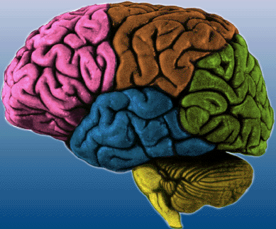
Attentional Systems
Behavioral Choice Systems
Comprehension Systems
Parietal
POSTERIOR
ANTERIOR
Frontal
Occipital
Temporal
Notes:
3

Slide 4
2. Projections from the thalamus synapse on which layer of the cortex?
3
4
5
6
The internal Granular Layer (IV) is the Chief Input Layer and receives afferent fibers from the thalamic nuclei. The infragranular Layers (V and VI) are for output. Layer V gives rise to fibers destined for the corpus striatum, brainstem, and spinal cord. Layer VI projects fibers to the thalamus as well. The supragranular layers (I, II, and III are associated and connected with other parts of the cerebral cortex.
“From Page 203, Figure 16-2 in the book – on next slide”

Slide 5
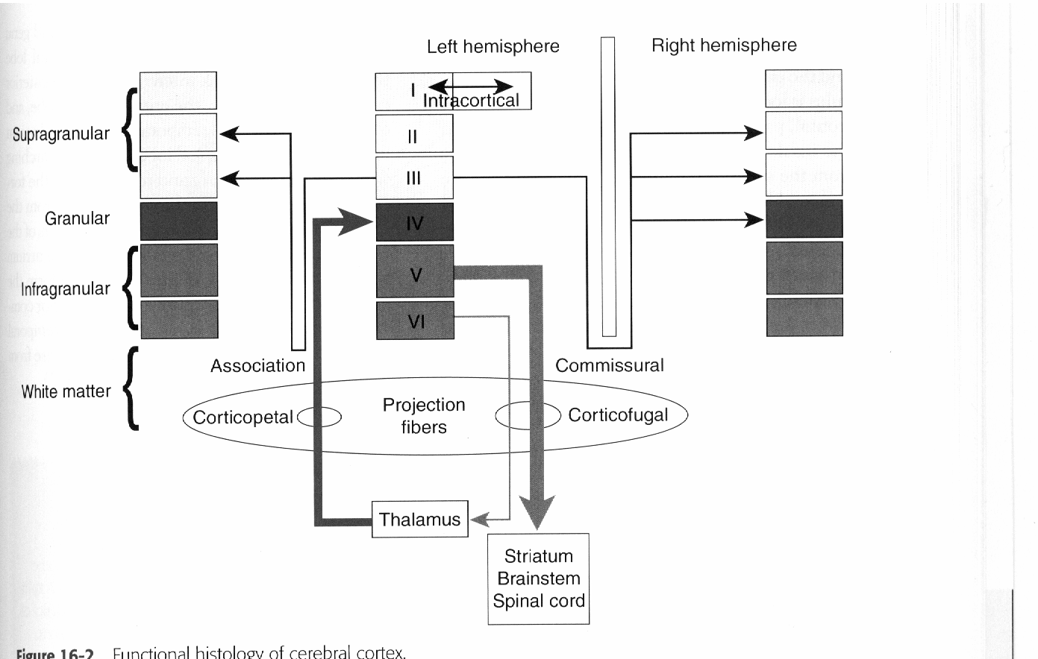
Notes:
5

Slide 6
3. When intermediary processing is shallow:
Intermediary processing is the synaptic relays between the stimulus and response. A shallow intermediary response occurs in simpler brains with few synaptic connections. Therefore the stimulus and response become linked or the response becomes automatic. Therefore “preprogrammed behavior” makes the most sense. The same thing happens in preclinic when you are stressed out…no matter how many times I practiced the #14 DOL MO practical, I still revert back to my first time drilling a tooth ever – which right now is my preprogrammed response. Or that I have a very simple brain…you decide. ☺ The examples he gave in lecture was the hen turkey and the Stickleback (next two slides).
“From: Week 8 Cerebral Cortex Lecture – Slides 16-27”
The stimulus and response are not linked.
The stimulus leads to preprogrammed behaviors.
Context is always taken into account.
Behavior is guided by context.

Slide 7
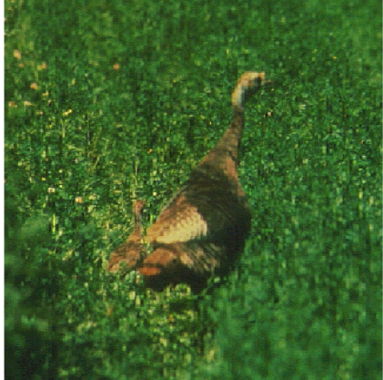
Shallow Intermediary Processing
Hen turkey kills all around brood except chicks with specific peeps. If hen is deaf will kill chicks too.
Notes:
7

Slide 8
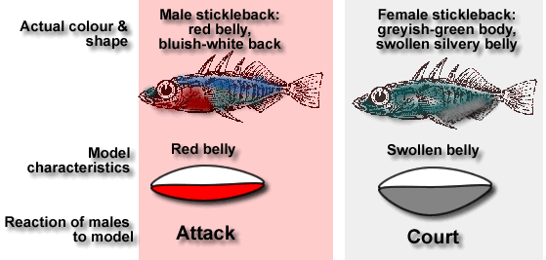
Shallow Intermediary Processing
For an interesting discussion of these behaviors go to;
http://salmon.psy.plym.ac.uk/year1/psy128ethology_experiments/ethexpt.htm
Notes:
8

Slide 9
4. The face and object recognition network is largely associated with the:
There are five major Brain Networks:
The Spatial attention network is right hemisphere dominant and mainly in the FRONTAL LOBE
The Language Network is left hemisphere dominant and found in the Wernicke’s area (sensory) - TEMPORAL LOBE and the Broca’s area (motor) - FRONTAL LOBE
The Memory- emotion network is found in the medial TEMPORAL LOBE (hippocampus and amygdala) and FRONTAL LOBE (the prefrontal cortex)
The Executive function-comportment network is found in the FRONTAL LOBE and POSTERIOR PARIETAL LOBE.
The Face and object recognition network is in the TEMPORAL LOBE.
“From Week 8 Cerebral Cortex Lecture – Slides 29-42”
Frontal lobe
Parietal lobe.
Occipital lobe.
Temporal lobe.

Slide 10
5. For language:
Wernicke’s area is the motor area.
Broca’s area is the sensory area.
The left hemisphere is dominant.
The right hemisphere is dominant.
Wernicke’s area is Sensory not motor- involved in the understanding of written and spoken language and is part of the Language Network
Broca’s area is motor not sensory – Part of Language Network
Language Network is Left Hemisphere Dominant
Wrong – Right Hemisphere is the Spatial Attention Network
“From Week 8 Cerebral Cortex Lecture – Slide 34”

Slide 11
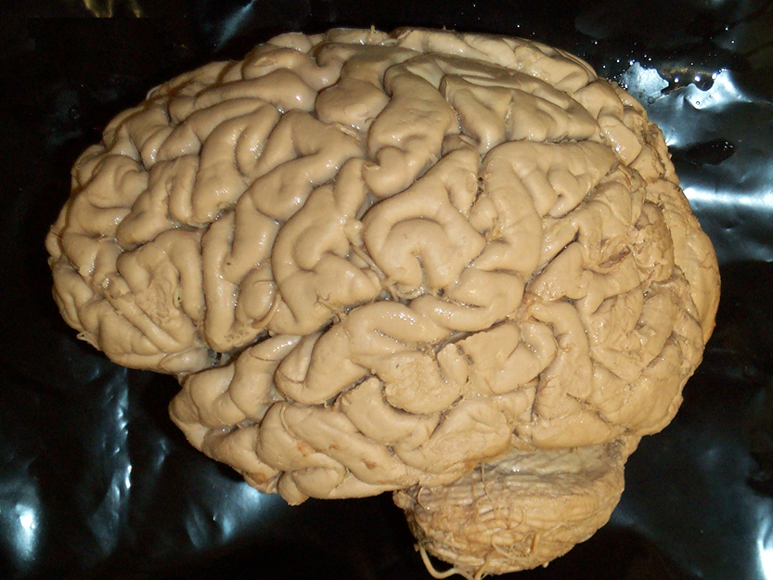
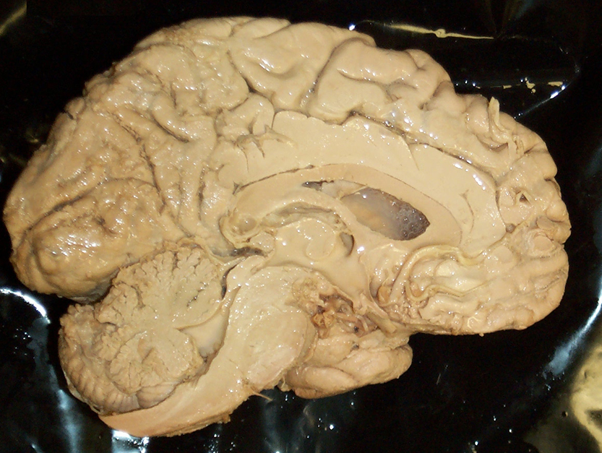
Language Network
B
W
B = Broca’s Area
(Frontal Lobe)
W = Wernicke’s Area
(Temporal Lobe)
Notes:
11

Slide 12
6. A key role in memory and learning is played by the:
Hippocampus.
Amygdala
Cingulate gyrus.
Nucleus accumbens
Hippocampus. – Involved in explicit memories (declarative memories) having to deal with conscious of facts, new learning, and spatial memory. Works with entorhinal cortex. Resides in higher order association areas of the cerebral cortex. Plays role in long term memory.
Amygdala – deals with emotions and behavioral expressions
Cingulate gyrus. – Amygdala and hippocampal formation get input from Cingulate gyrus. Its part of the limbic association cortex.
Nucleus accumbens – associated with reward mechanisms and pleasure (page 227 in book).
“From Week 9 Limbic System Lecture – Slide 20 and others throughout lecture”

Slide 13

7. Which nucleus is most involved in behavior and emotions?
Hippocampus
Amygdala
Nucleus accumbens
Cingulate gyrus
Hippocampus
Amygdala – I remember that Amy is emotional
    Emotional experiences
      What stimuli are responded to.
      How overt responses to stimuli are organized.
      Internal responses of the body’s organs.
    Damage
      Inability to recognize facial expressions especially fear.
      Inability to recognize the emotional content of speech.
Nucleus accumbens
Cingulate gyrus

Slide 14
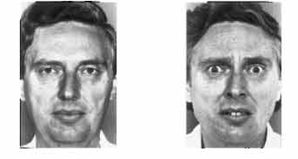
Amygdala and fear: functional imaging studies
Neutral
Fearful
Fearful
Happy or Neutral
Breiter et al. (1996)
Neuron, 17: 875-87
Notes:
14

Slide 15
8. Alzheimer’s disease and other dementias are often associated with a loss of neurons in the:
Hippocampus – Has to do with long term memory – from the glossary in the book pg 359:
  “This disease is associated with neuronal degeneration in the hippocampus and parahippocampal gyrus and decrease cortical levels of choline acetyl transferase owing to degeneration of neurons in such basal forebrain structures as the basal nucleus of Meynert and the diagonal band nuclei.”
Amygdala – Lesions would effect emotions and behavioral responses
  Damage to Amygdala causes:
    Inability to recognize facial expressions especially fear.
    Inability to recognize the emotional content of speech.
Cingulate gyrus – is an integral part of the limbic system, which is involved with emotion formation and processing, learning, and memory, and is also important for executive function and respiratory control. Damage would have major effect on learning capability
Nucleus accumbens – Pleasure center would be effected if lesioned

Slide 16
9. Anterograde amnesia is the
Loss of memory about places visited as a child.
Loss of memory about childhood events.
Loss of memory about anything that happened after the first episode of amnesia. – Anterograde Amnesia is the loss of Semantic memory. Knowledge of facts, people, objects, and new work meaning.
Loss of memory about anything that happened before the first episode of amnesia. – is Retrograde Amnesia
“From Week 9 Limbic System Lecture – Slide 25”

Slide 17

Limbic Association Cortex:
Orbitofrontal
Cingulate
Temporal pole
Parahippocampal
X
Entorhinal
Hippocampal formation
Anterograde amnesia
Loss of semantic memory
Knowledge of: facts
people
objects
new word meaning
Notes:
17

Slide 18
10. The accumbens nucleus is associated with:
Fear
Anxiety
Pleasure
Pain
Fear is associated with the Amygdala (Emotion) (Week 9 Lecture slide 33)
Anxiety is associated with hippocampus and amygdala (Wikipedia)
3. Pleasure is associated with the accumbens nucleus.
(Page 227 in book)
4. Pain – Slow pain is associated with the phylogenetically older Paleospinothalamic and spinoreticulothalamic systems
Fast pain- Neospinothalamic pathway association - “newer pathway”
(Pg 152 and Table 11-4 on page 153 in book)

