Slide 1
Quiz #7a
1. 3 2. (optic tract) 3. (where) 4. 1 5. 2 6. 3 7. 1 8. 2 9. 3 10. 4

Slide 2
1. Synapses in the visual pathway can occur in all of the following EXCEPT:
Lateral geniculate.
Retina
Optic radiations.
Primary visual cortex.
The visual pathway: First-order neurons starts from the rods and cones to the bipolar cells → synapses on retinal ganglion cells (second order neuron) → continues toward optic disc where they become myelinated and out of optic nerve, continues as optic tract and synapses on the lateral geniculate nucleus (tertiary visual path neurons) → give rise to optic radiation that eventually ends up in the primary visual cortex.
Answers is 3 Optic Radiations. Tertiary neurons after leaving lateral geniculate nucleus goes straight to

Slide 3
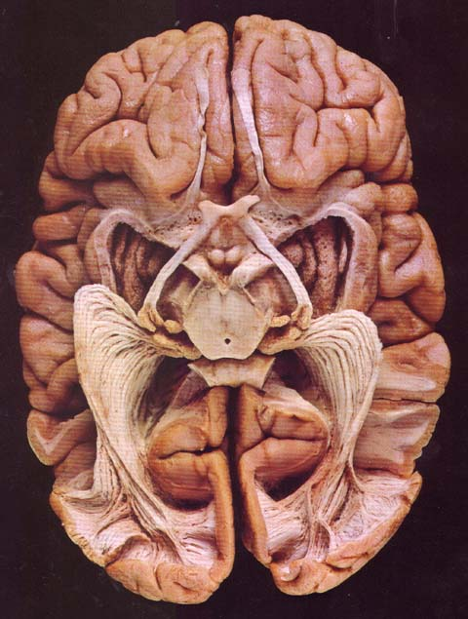
2. The arrow points to the:
Optic nerve.
Optic tract
Olfactory tract.
Optic radiations
Visual system goes from
Optic nerve → optic chiasm → optic tract → lateral geniculate nucleus → optic radiations → visual cortex
The arrow points to the optic tract which is before lateral geniculate nucleus and after the optic chiasm.
Answer is 2. Optic tract

Slide 4
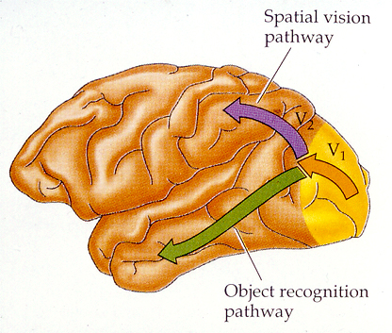
3. The purple arrow indicates the:
What pathway.
The area for object identification.
The where pathway.
Primary visual cortex.
The purple pathway goes to the parietal lobe which give you the “where” pathway.
The green pathway goes to the temporal lobe which gives you the “what” pathway.
The answer is 3. The where pathway

Slide 5
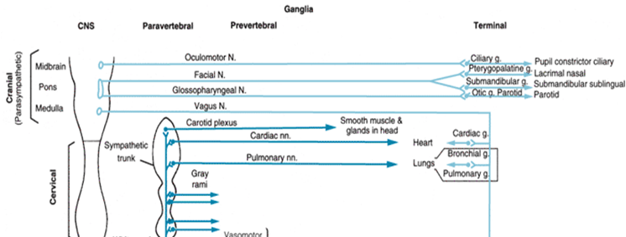
4. Parasympathetic preganglionic fibers to the ciliary ganglion travel with cranial nerve:
Three
Four
Five
Six
The parasympathetic fibers arises from the cranial sacral network which all have long preganglionic fibers until synapsing on or near the organ itself.
From the chart, occulomotor Nerve innervates the ciliary ganglion.
The answer is 1. Three

Slide 6
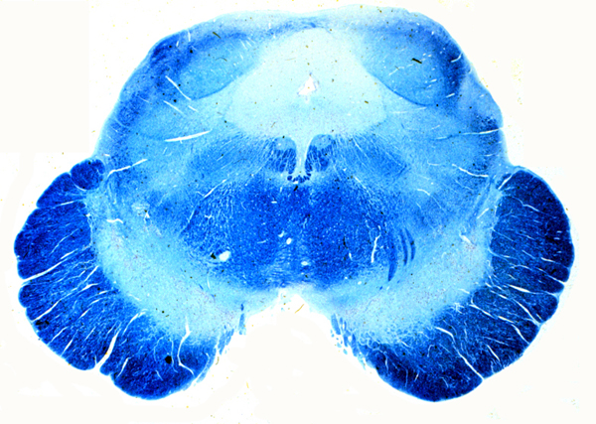
5. The arrow points to the:
Oculomotor nucleus.
Trochlear nucleus.
Abducens nucleus.
PPRF
The section is at low midbrain. Look up the Neuroatlas organized by Ryan Tuman. It is very clear.
The arrow is pointing at the trochlear nucleus
Answer is 2. Trochlear nucleus

Slide 7
6. Commissural fibers connect:
Gyrus to gyrus.
Cells within a gyrus.
Homologous areas between the two cerebral hemispheres.
The cortex to subcortical nuclei.
Commissural means connecting two sides of the hemispheres.
Gyrus to Gyrus is arcuate loop
Cells within a gyrus… dendrites?
Cortex to subcortical nuclei is via cortical columns
The answer is 3. Homologus areas between the two cerebral hemispheres

Slide 8
7. The inability to produce purposeful movements even though there is no paralysis is:
Apraxia.
Aphasia.
Agnosia.
From the book: From wikipedia:
Apraxia: characterized by loss of the ability to execute or carry out learned purposeful movements, despite having the desire and the physical ability to perform the movements
Aphasia: acquired language disorder in which there is an impairment of any language modality
Agnosia: loss of ability to recognize objects, persons, sounds, shapes, or smells while the specific sense is not defective nor is there any significant memory loss
Answer is: 1. apraxia

Slide 9
8. The inability to communicate would be:
Apraxia
Aphasia.
Agnosia
From the book: From wikipedia:
Apraxia: characterized by loss of the ability to execute or carry out learned purposeful movements, despite having the desire and the physical ability to perform the movements
Aphasia: acquired language disorder in which there is an impairment of any language modality
Agnosia: loss of ability to recognize objects, persons, sounds, shapes, or smells while the specific sense is not defective nor is there any significant memory loss
Answer is: 2. aphasia

Slide 10
9. The inability to recognize sensory stimuli is:
Apraxia
Aphasia
Agnosia
From the book: From wikipedia:
Apraxia: characterized by loss of the ability to execute or carry out learned purposeful movements, despite having the desire and the physical ability to perform the movements
Aphasia: acquired language disorder in which there is an impairment of any language modality
Agnosia: loss of ability to recognize objects, persons, sounds, shapes, or smells while the specific sense is not defective nor is there any significant memory loss
Answer is: 3. agnosia

Slide 11
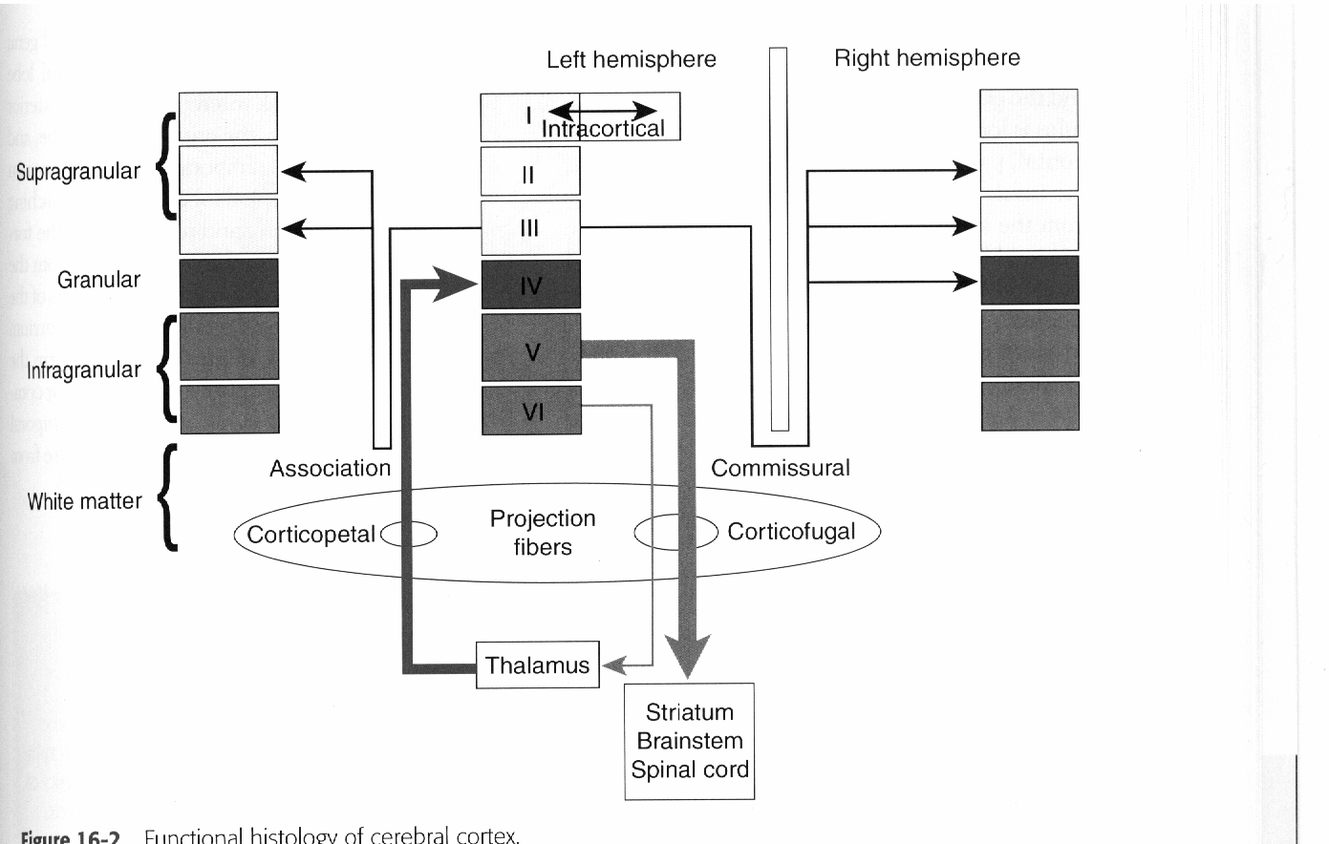
10. How many cell layers are there in the neocortex?
3
4
5
6
Page 203 of the book
I count 6 layers, how about you? 6? Ok. 6.
Primary input is 4th layer. Primary output is 5th and 6th layer. Layers 1,2,and 3 are communications between other cortical columns.
Answer is 4. 6 layers

