Slide 1
Quiz #6

Slide 2
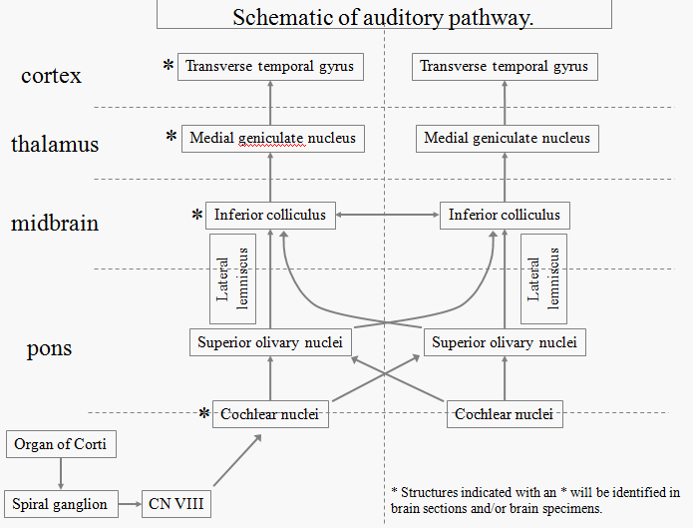
1. The main auditory nucleus in the thalamus that receives auditory input is the:
Medial geniculate
Lateral geniculate
Ventral posterior nucleus
Ventral lateral nucleus

Slide 3
2. A lesion in what nerve would cause a patient to feel a sense of vertigo, falling to one side, nausea, and abnormal, rhythmic eye movements (nystagmus).
Vagus
General sensation from skin of central part of auricle, mastoid region and posterior wall of ext aud meatus, visceral sensation from many organs, taste from the epiglottis, parasympathetic fibers to heart, pulmonary system, esophagus, and the muscle and glands of the G.I., motor to all skeletal muscles of the larynx, pharynx, palate and upper esophagus except the tensor veli palatini and the stylopharyngeus muscles
Glossopharyngeal
The glossopharyngeal nerve is responsible for motor to the stylopharyngeus muscle, parotid gland secretion, visceral sensation from the inner ear/parotid gland/pharynx/post 1/3 of the tongue/carotid body and sinus, and general sensation from skin of central part of auricle/mastoid region/ post wall of ext auditory meatus
Trigeminal
Lesions of the trigeminal would cause deficiencies in touch/ proprioception and pain/temperature in the head
Vestibulocochlear
Lesions of inner ear, nerve or nuclei = functional imbalance one side is more ‘active’ than the other.
Results in patient feeling a sense of vertigo, falling to one side, nausea, abnormal, rhythmic eye movements (nystagmus).

Slide 4
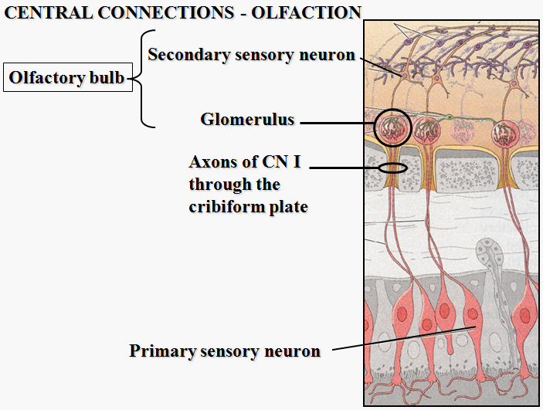
3. The olfactory bipolar neurons synapse:
In the gustatory nucleus.
With mitral cells.
In the olfactory cortex.
In the olfactory tract.
Mitral cell
Bipolar cell

Slide 5
4. As you are tasting a glass of wine you know the taste bud cells synapse:
On neurons from cranial nerves 7, 9 and 10
primary afferents for taste are in CN 7, 9 and 10 which taste buds synapse on
In ganglia associated with cranial nerves 7, 9, and 10
nuclei are located at ganglia
The gustatory nucleus (solitary nucleus)
Primary afferents from CN 7, 9 and 10 synapse on second order neurons in the rostral part of the solitary nucleus

Slide 6
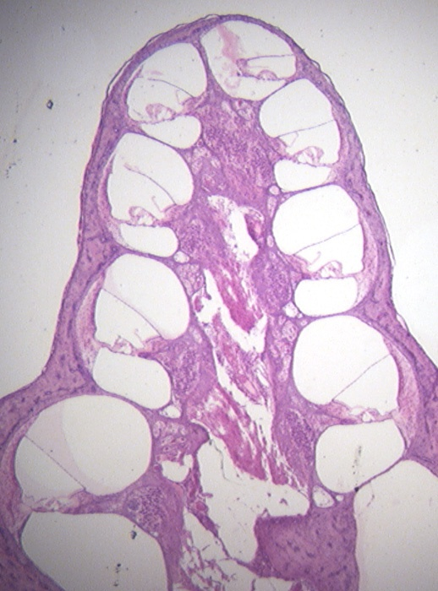
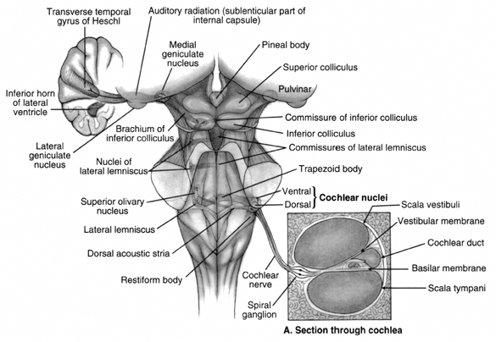
5. The cells at the tip of the pointer synapse in the:
Cochlear nuclei
spiral ganglia goes to the cochlear nuclei
Vestibular nuclei
Geniculate ganglion.

Slide 7
6. The visual pathways:
Extend from the front to the back of the head.
Are entirely infratentorial.
Are entirely crossed.

Slide 8
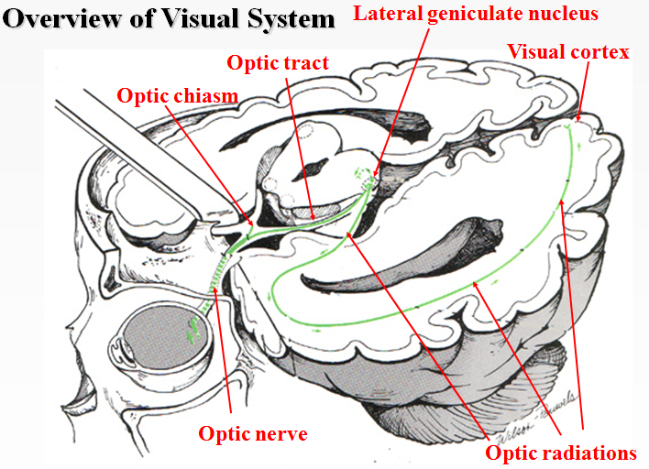
7. Visual pathways cross in the:
Optic nerve.
Optic chiasm.
Optic radiations.
Lateral geniculate nucleus.
Visual Pathway: optic nerve → optic chiasm → optic tract → lateral geniculate (thalamus)→
optic radiations → visual cortex

Slide 9
8. What vitamin may be involved in night blindness?
Vitamin A
Vitamin B
Vitamin C
Vitamin D

Slide 10
9. Which cranial nerve nucleus is involved in moving the eyes laterally.
Occulomotor
Innervates inferior and medial rectus, inferior oblique and levator palpebrae superioris
Trochlear
Innervates superior oblique
Abducens
Innervates lateral rectus

Slide 11
Which cranial nerve is located in the pons?
Oculomotor
Comes from midbrain
Trochlear
Comes from midbrain
Abducens
Comes from pons with trigeminal, facial, vestibulocochlear

Slide 12
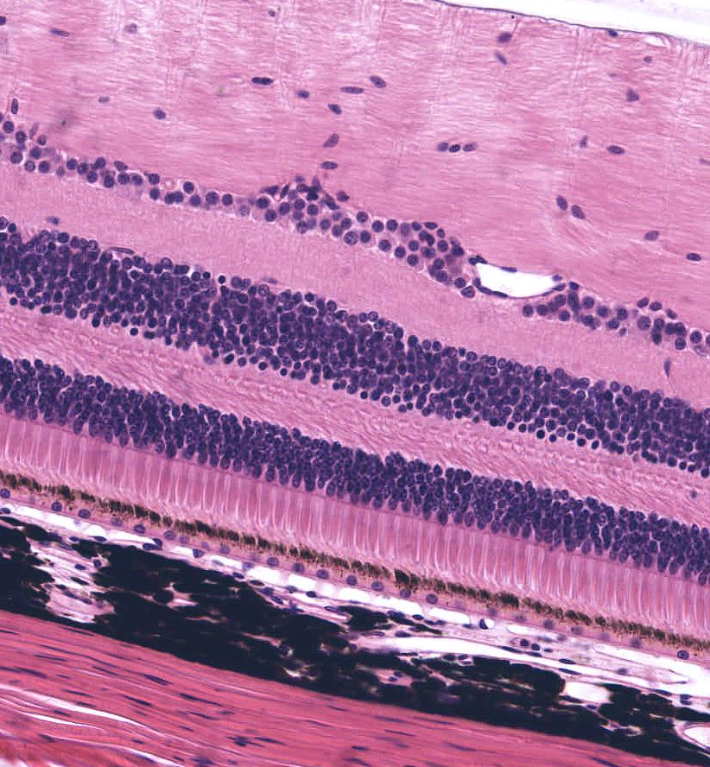
1. Identify the layer of rods and cones.
D
A- choroid
B
C- internal plexiform layer
D- sclera
C
B
A

Slide 13
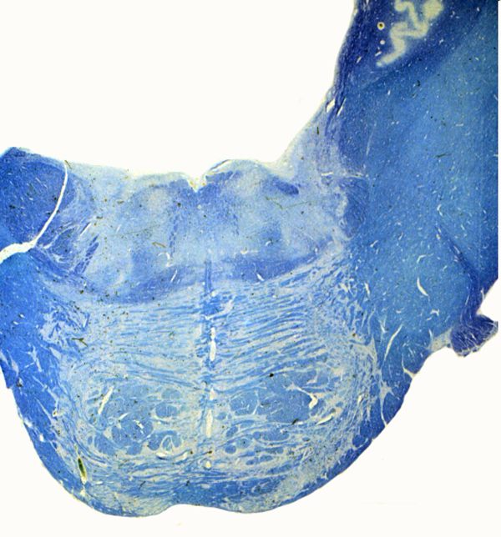
2. The arrow points to:
Abducens nucleus
Facial nucleus
Trigeminal nucleus
Spinal nucleus of 5

Slide 14
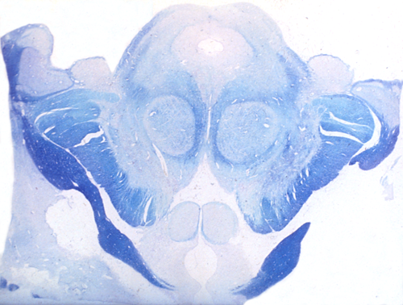
3. Identify the lateral geniculate.
A- optic tract
B- superior colliculus
C- medial geniculate
D- lateral geniculate
B
D
C
A

Slide 15
4. Identify the superior colliculus.
B
D
A- optic tract
B- superior colliculus
C- medial geniculate
D- lateral geniculate
C
A

Slide 16
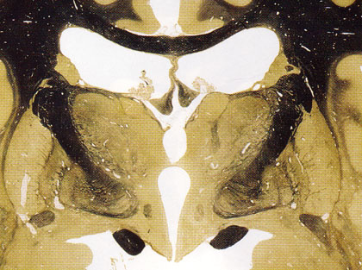
5. The arrow points to the.
Optic nerve
Optic tract
Optic radiations

