Slide 1
Quiz 5a

Slide 2
1. Which sensory modality travels through the Anterolateral (Spinothalamic) tract
Pain
Pressure
Two point touch
Vibratory sense.

Slide 3
2. Which sensory modality travels through the posterior white column/medial lemniscus pathway?
Hot
Cold
Pain
Two point touch

Slide 4
3. Third order sensory neurons are located in the:
Spinal cord
Brainstem
Thalamus
Cerebral cortex

Slide 5
4. Pain fibers from the teeth will synapse in the:
Trigeminal ganglion
Spinal nucleus of 5.
Mains sensory nucleus of 5.
Mesencephalic nucleus of 5.

Slide 6
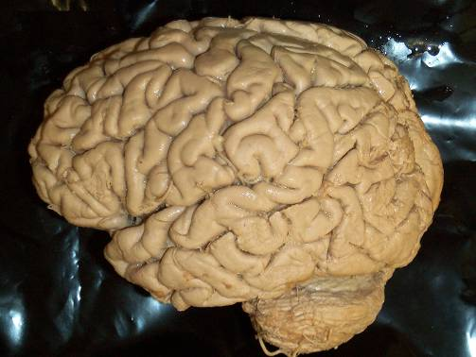
5. The region marked by the star would be most involved in sensory information from the:
Legs
Waist
Head
Knee

Slide 7
6. Where in the auditory pathway does a unilateral lesion produce total deafness?
Cochlear nerve
Inferior colliculus
Medial geniculate
Transverse temporal gyri.

Slide 8
7. Equilibrium depends of input from all of the following except:
Somatosensory system.
Visual system.
Vestibular system.
Auditory system.

Slide 9
8. The first order neurons for taste are in all of the following ganglia except:
Geniculate ganglion (7th nerve)
Inferior ganglion of 9th cranial nerve.
Inferior ganglion of 10th cranial nerve.
Hypoglossal ganglion.

Slide 10
9. Olfactory neurons synapse in the:
Olfactory bulb.
Olfactory tract.
Olfactory cortex.

Slide 11
10. Which sensory modality does not synapse in the thalamus?
Taste
Hearing
Smell
Balance

Slide 12
1. You would find the 8th cranial nerve at the:
Spinal cord – medulla junction.
Pons- medulla junction
Pons – midbrain junction

Slide 13
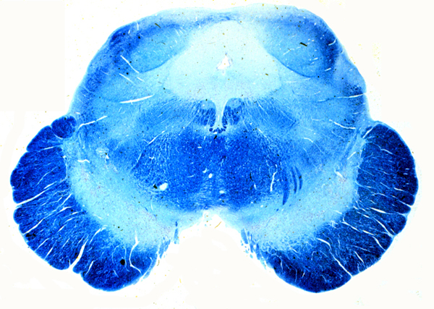
2. Identify the structure at the arrow.
Inferior colliculus
Superior colliculus
Medial geniculate
Lateral geniculate

Slide 14
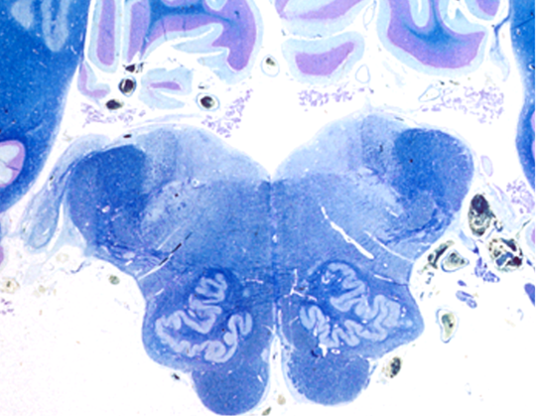
3. Identify the nucleus at the tip of the pointer.
Cochlear.
Vestibular
Solitary
Olive
:60

Slide 15
4.Identify the nuclear complex at the tip of the pointer.
Cochlear
Vestibular
Spinal nucleus of 5

Slide 16
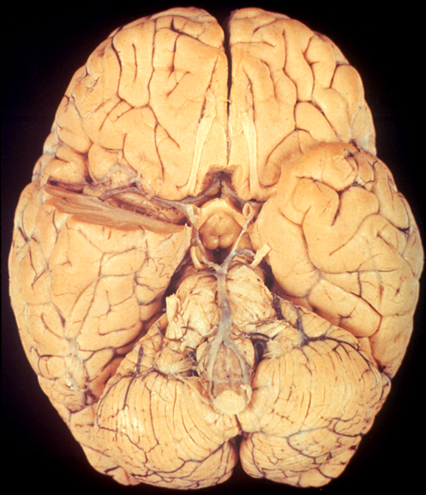
5. Identify the structure at the tip of the pointer.
Optic nerve.
Optic tract.
Olfactory nerve
Olfactory tract.

