Slide 1
First 5quizzes

Slide 2
Quiz #1

Slide 3

1. The epithelium at the tip of the pointer is:
Transitional
Pseudostratified
Ciliated
Stratified columnar
60

Slide 4
2. The structure at the tip of the pointer is a:
Microvillus
Stereocilia
Cilia
Hemidesmosome
60

Slide 5
3. Which of the following would not be found in an adhering junction?
Claudin
E-cadherin
Desmocollin
Desmoglein
60

Slide 6
4. A molecule involved in cell-to-cell communication is
Occludin.
Catenin.
Plakoglobin
Connexin.
60

Slide 7
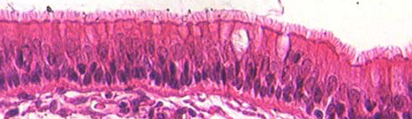
5. The structure at the tip of the pointer is the:
Terminal web
Basement membrane
Actin filaments
Centrioles
60

Slide 8
6. The hydrophobic region of the plasma membrane would contain:
  Nitrogen compound
  Phosphate bridge
  Glycerol
  Two long-chain fatty acids.
60

Slide 9
7. Mitochondria are involved in:
  Synthesis of phospholipids
  Glycogen breakdown
  Steroid biosynthesis
  Calcium sequestration for muscle contraction.
60

Slide 10
8. The most important factor in determining that the ribosome attaches to the RER is the:
Signal protein or leader sequence.
Size of the ribosome.
The folding of the protein.
The cleaving of the protein.
60

Slide 11
9. You would expect to find catalases and oxidases in:
Rough Endoplasmic Reticulum
Smooth Endoplasmic reticulum
The Golgi
Peroxisomes
60

Slide 12
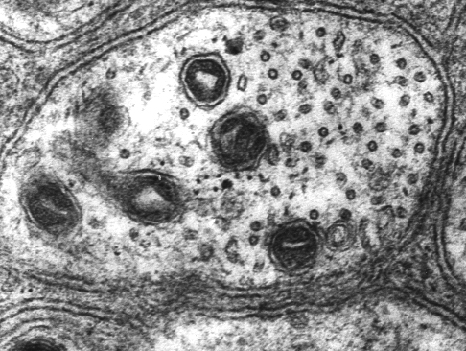
10. The structure at the tip of the pointer is a(n):
Actin filament
Intermediate filament
Microtubule
60

Slide 13
Quiz #2

Slide 14
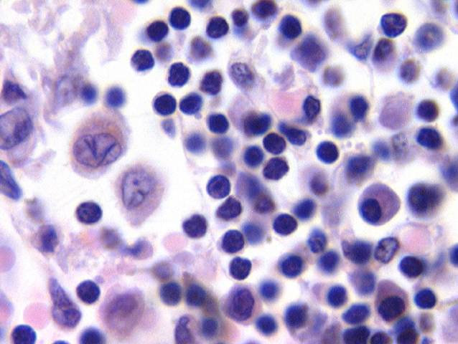
Identify the cell at the tip of the pointer.
Mast cell
Macrophage
Plasma cell
Lymphocyte
60

Slide 15
What type of collagen is found in hyaline cartilage?
Type I
Type II
Type III
Type IV
60

Slide 16
What cell secretes histamine?
Lymphocyte
Monocyte
Plasma cell
Mast cell
60

Slide 17
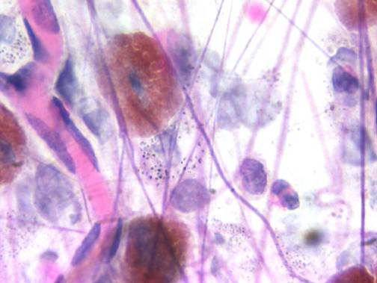
The structure at the tip of the blue arrow is a(n):
Collagen fiber.
Elastic fiber.
Fibronectin
Reticular fiber
60

Slide 18
Vitamin C dependent hydroxylation of proline and lysine in preprocollagen occurs in:
The rough endoplasmic reticulum
The smooth endoplasmic reticulum
The Golgi
The extracellular matrix.
60

Slide 19
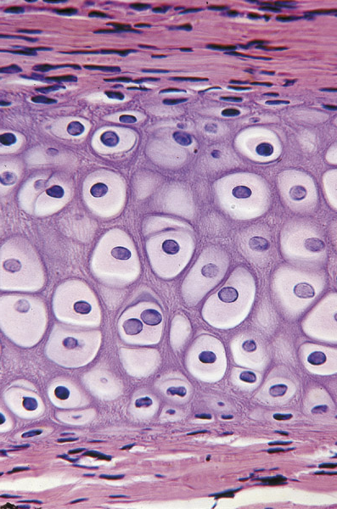
The image on the right is:
Fibrocartilage
Growing hyaline cartilage
Dense regular C.T.
Fibrous articluar layer of the TMJ
60

Slide 20
Which of the following contain Type I collagen?
Hyaline cartilage.
Elastic cartilage.
Fibrocartilage.
None of the above.
60

Slide 21
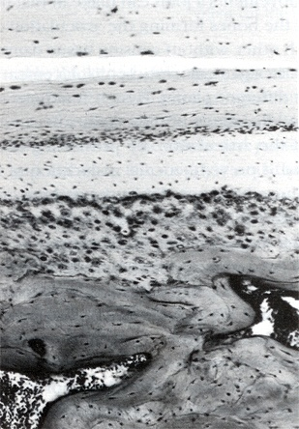
Which is the fibrous articular layer of the TMJ?
1
1
2
3
4
2
3
4
60
0 of 5

Slide 22
Which is the disk in the TMJ?
1
1
2
3
4
2
3
4
60

Slide 23
Which of the following would increase glycosaminoglycan synthesis in cartilage?
Testosterone
Estradiol
Cortisone
Hydrocortisone
60

Slide 24
Quiz #3

Slide 25
1. The percentage of bone made up by collagen is:
5%
28%
40%
68%
60

Slide 26
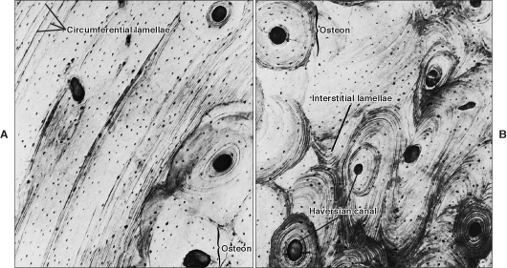
2. Circumferential lamellae are found at:
A
B
C
D
A
B
C
D
B
60

Slide 27
3. Which cells would have a sealing zone and a ruffled border?
Osteoblasts
Osteocytes
Osteoclasts
Chondrocytes
60

Slide 28
4. The Rank Ligand RANKL is found on:
Osteocytes
Osteoblasts
Osteoclasts
All of the above
60

Slide 29
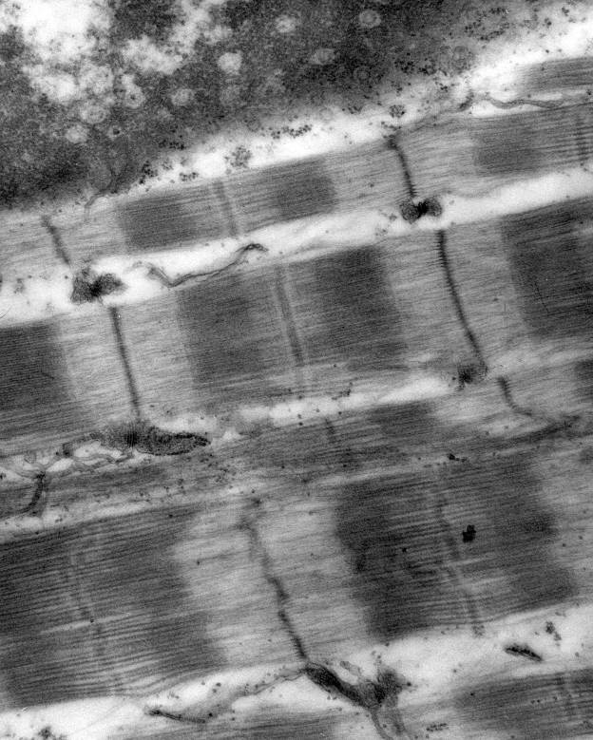
5. The sarcomere is found at:
1
2
3
4
60

Slide 30
6. Cardiac muscle has:
Gap junctions
Triads
T tubules located at the A/I junction.
Multiple peripherally located nuclei
60

Slide 31
7. Smooth muscle cells do not have:
Actin
Myosin
Tropomyosin
Troponin
60

Slide 32
8. The neurotransmitter found at the motor end plate is:
Acetylcholine
Substance P
Epinephrine
β-Endorphin
60

Slide 33
9. Where would you find the cell bodies of pseudounipolar neurons?
Dorsal horn
Ventral horn
Sympathetic ganglia
Dorsal root ganglia
60

Slide 34
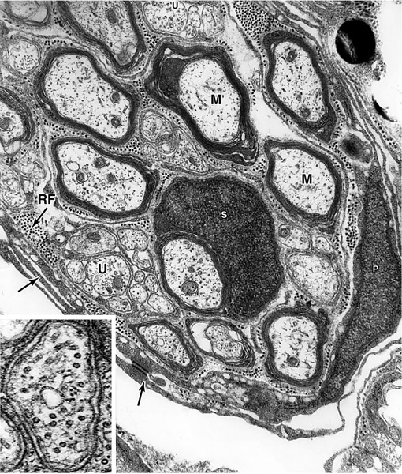
10. An unmyelinated axon is found at:
1
3
2
4
60

Slide 35
Quiz #4

Slide 36
1. You have an anemic or hypoxic patient you know that normally erythropoietin will be synthesized in the
Liver
Bone marrow
Spleen
Kidney
60

Slide 37
2. Primary or azurophilic granules in neutrophils are essentially:
Peroxisomes
Lysosomes
Histamine granules
Secretory granules
60

Slide 38
3. A cell that has granules with a crystalline core that contain major basic protein is a(n):
Basophil
Eosinophil
Neutrophil
Monocyte
60

Slide 39
4. Platelets:
Have an outer zone that contains granules.
Has an inner zone that contains cytoskeletal elements.
Can be stimulated by thrombopoietin made in the liver.
Bud off megakaryocytes located in the spleen.
60

Slide 40
5. Which antibody binds to mast cells and basophils?
IgA
IgG
IgE
IgM
60

Slide 41
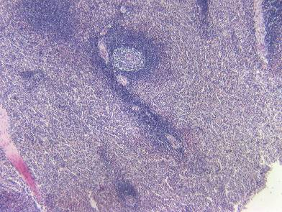
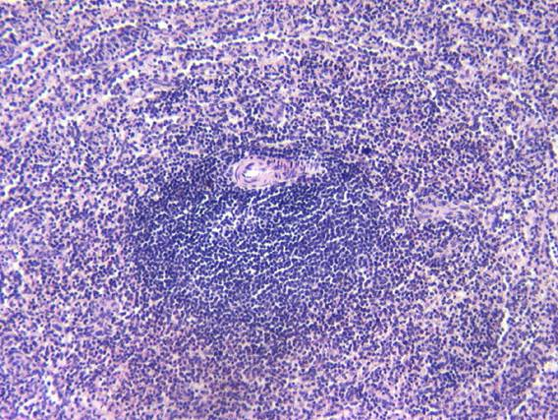
6. The organ in the images below :
Filters blood
Filters lymph
Does not have a capsule
Has only T cells.
60

Slide 42
7. Adaptive immunity:
Is non specific.
Has memory.
Responds to self antigens.
Does not demonstrate diversity.
60

Slide 43
8. Which capillaries have a continuous basal lamina?
Continuous only.
Continuous and fenestrated.
Fenestrated and discontinuous.
Fenestrated only
60

Slide 44
9. You would find continuous capillaries in the:
Heart.
Thymus
Spleen
Lymph node
60

Slide 45
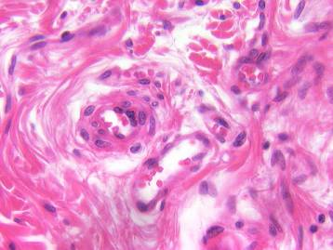
10. The blood vessel at the tip of the pointer is a:
Medium sized vein
Small vein or venule
Medium sized artery
Arteriole
60

Slide 46
Quiz #5

Slide 47
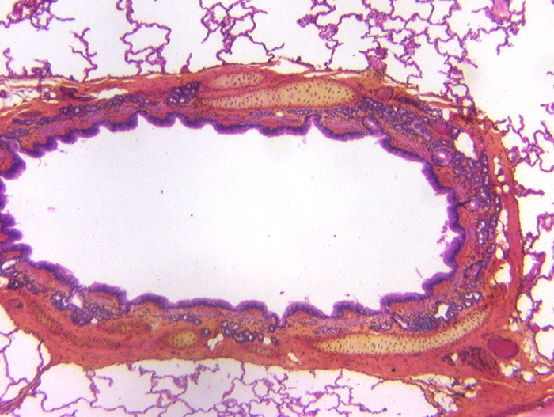
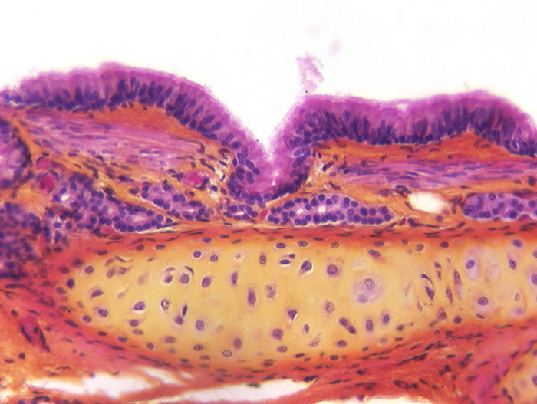
1. The organ with a star in the lumen is a:
Trachea
Bronchus
Bronchiole
Pulmonary artery
60

Slide 48
2. In the lung, elastic fibers are found in
Bronchi only.
Bronchi and bronchioles only
Bronchi, bronchioles and alveolar ducts only.
Bronchi, bronchioles, alveolar ducts and alveoli.
60

Slide 49
3. Which of the following structures would be found in a terminal bronchiole?
Goblet cells.
Cartilage
Smooth muscle
Glands
60

Slide 50
4. You have a patient with asthma. You know that histamine release is part of the problem. Histamine is made in:
Macrophages
Mast cells
Eosinophils
Natural killer cells.
60

Slide 51
5. Dr. Fornatora talked about the Ring of Waldeyer. This consists of all the following except:
Lingual tonsils
Palatine tonsils
Pharyngeal tonsils
Submandibular lymph nodes.
60

Slide 52
6. Which of the following structures contains smooth and skeletal muscle.
Upper 1/3rd of the esophagus.
Middle 1/3rd of the esophagus.
Rectum
Upper part of the anal canal.
60

Slide 53
7. Which cell secretes intrinsic factor?
Parietal cells
Chief cells
Enteroendocrine I cells in the small intestine.
Paneth cells
60

Slide 54
8. Pepsinogen is synthesized by:
Parietal cells
Chief cells
Enteroendocrine G cells of the small intestine
Paneth cells.
60

Slide 55
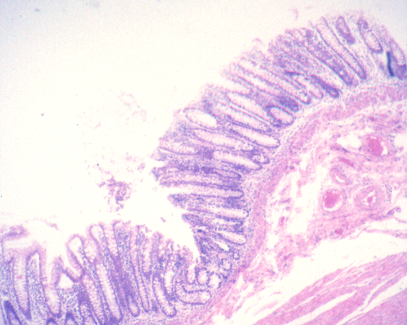
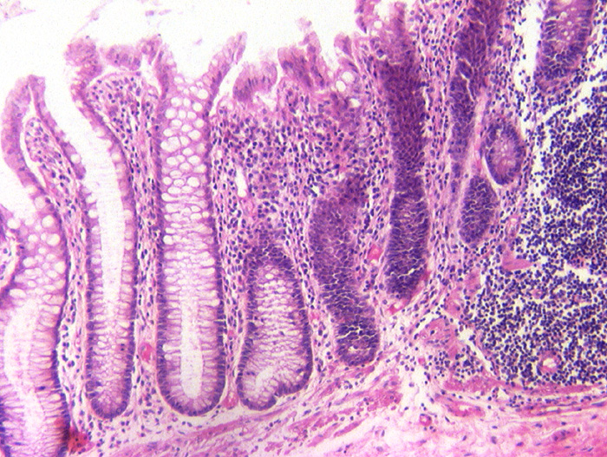
9. The organ on the right is the:
Stomach
Jejunum
Ileum
Colon
60

Slide 56
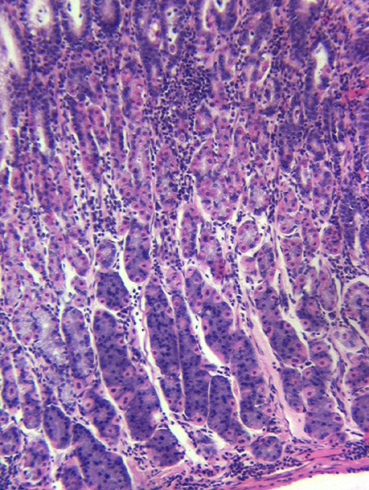
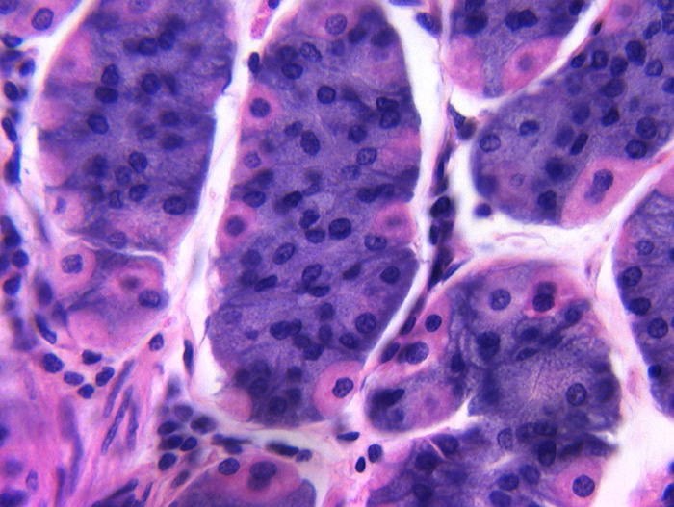
10. The cell at the tip of the red arrow is a:
Parietal cell
Chief cell
Paneth cell
Mucous neck cell
60

