Slide 1
2009 Histology Final Review
Temple Dental Class of 2013
Contributors:
Jason Justison
Dan Caban
Chris Green
Chris Hill
Brandon Wolf
Garrett Kolber
David Body
Steve Hassler
Sarah Simmons
Brian Leeson
Eric Turner
Dain Hubley
Andrew Verona
Stay up, player

Slide 2
Quiz #1
The Cell/ The Nucleus/Epithelium
Explanations provided by the man, the legend, Student Doctor Andrew Vorona
Correct Answer
My explanation
Any outside information to make explanation clearer (meaning we won’t be tested on it)

Slide 3
In steroid secreting cells, conversion of cholesterol to pregnenolone takes place in:
The Golgi complex.
Smooth endoplasmic reticulum.
Mitochondria.
The nucleus
Firstly, pregnenolone should now sound extremely familiar thanks to our time spent in biochemistry (I had to throw in that reference).
The golgi complex modifies and packages proteins, lipids, and sugars received from the RER whose destination is extracellular.
The SER secretes steroids, neutralizes and detoxifies certain drugs, makes phospholipids for the cell membrane,and breaks down glycogen.
Outer membrane has porin, inner membrane has cristae (respiration). This is where conversion of cholesterol to progenolone takes place. In matrix: krebs cycle/fatty acid beta oxidation. Arise from preexisting mitochondria.
Information encompasses an entire powerpoint. No biochemical rxn’s take place there. Site of transcription. See later questions for more info.

Slide 4
During protein synthesis the signal sequence interacts with:
The ribosome receptor.
The SRP receptor
The signal recognition particle.
The docking protein
Here are a few keypoints about general ribosomes.. They may be attached to the outer membrane of the RER, polyribosomes may be attached to outer surface of nucleus, and the granular region within the nucleus is where you may find maturing ribosomes.

Slide 5
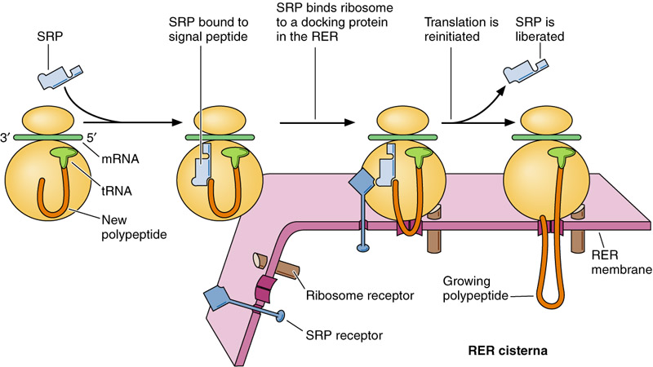

Slide 6
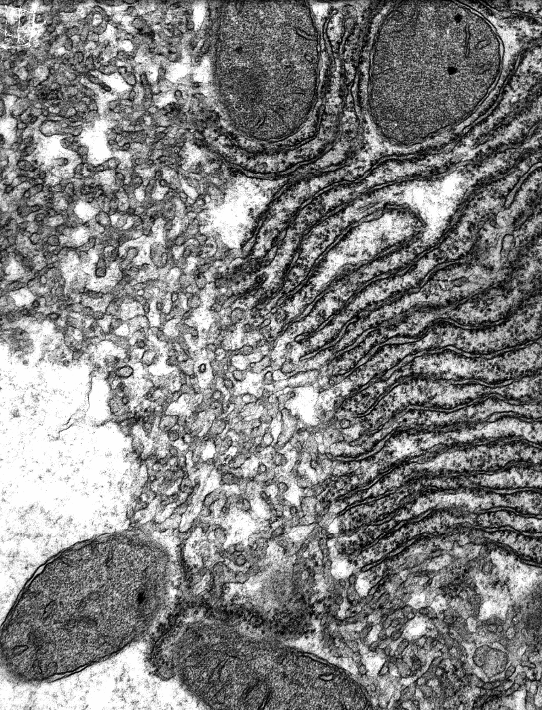
The asterisk lies over:
Smooth endoplasmic reticulum
Rough endoplasmic reticulum.
The Golgi complex
Glycogen
RER
SER
*
Taken directly from the lab.
mitochondria

Slide 7
Lysosomes contain:
Catalase
Proteases
Oxidases
Actin filaments
Lysosomes are small single membrane bound organelles that contain hydrolytic enzymes synthesized in the RER and packaged in the golgi.
There are two primary types of cells that contain lysosomes…
1. Heterophagosomes = bacteria destroyed
2. Autophagosomes = have RER and mitochondria and aid in digestion
They are acidic and contain numerous enzymes including acid hydrolases, acid phosphatase, ribonuclease, deoxyribonucleas, proteases, sulfatases, lipases, beta-glucuronidase.
Catalase are components of peroxisomes that break down hydrogen peroxide to water and oxygen.
Are containted in lysosomes. Breaks down proteins.
Break down fatty acids
Actin Filaments are organized in double stranded helixes to form microfilaments.
G-Actin = Globular F-Actin = Filamentous

Slide 8
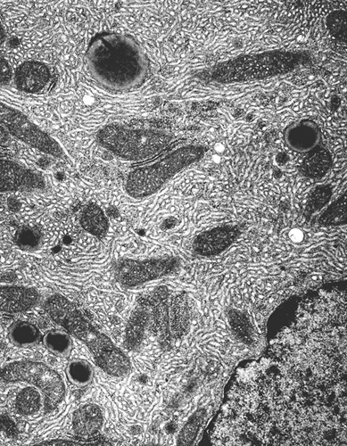
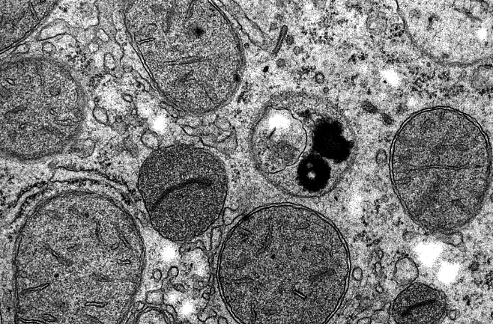
Endosome
Endolysosome
(phagosome)
Secondary Lysosome
(phagolysosome)
Secondary Lysosome
Primary Lysosome

Slide 9
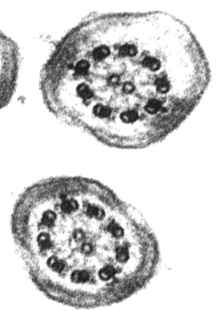
This picture shows:
Cilia
Actin
Microvilli
Centrioles
Taken directly from lab. See next slide for further info.
dynein
arm
Cilia are motile processes covered by the cell membrane and usually arranged in rows. At the base of each is a basal body whose structure is like the centriole. Its core is an axoneme, 2 single microtubules centrally surrounded by nine doublet mictotubules. Each doublet has 2 arms (dynein) which protrude toward the next doublet; radial fibers connect the doublet to the central pair of tubules.
radial
fiber
cell
membrane
central
microtubules
doublet

Slide 10
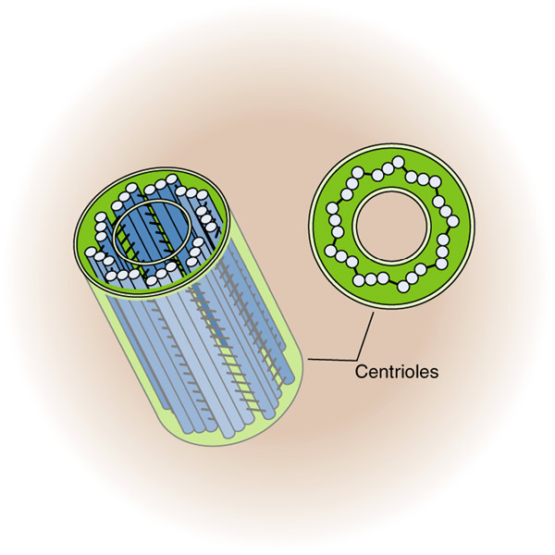
2. There are no lab images from this lecture of actin. See previous question for description.
3. Microvilli are microscopic cellular membrane protrusions that increase the surface area of cells, and are involved in a wide variety of functions, including absorption, secretion, cellular adhesion, and mechanotransduction. The only thing mentioned about them in this section is that they are comprised of microfilaments.
4. A pair of centrioles found in each cell. Prior to cell division centrioles duplicate and move to opposite poles of the cell, becoming organizing centers for mitotic spindles

Slide 11
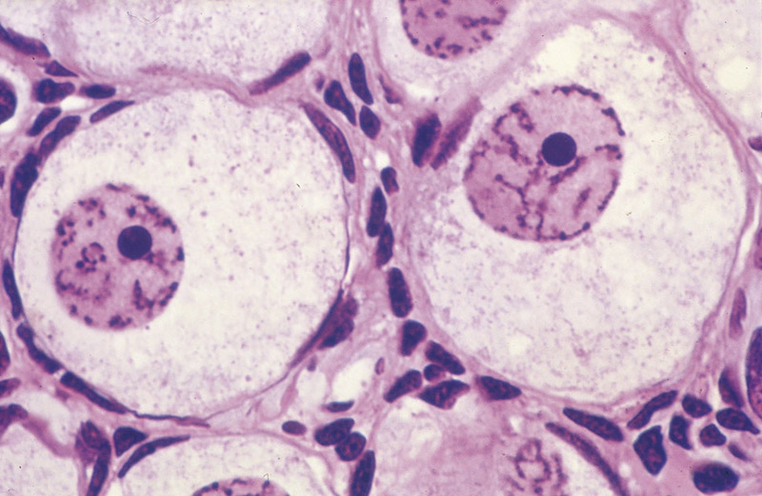
The tip of the arrow lies on the:
Nucleolus
Heterochromatin
Lysosome
Secretory granule
  Picture taken directly from Nucleus Lecture.
  The nucleolus is the nucleolar organizing region containing the DNA that codes for ribosomal RNA Humans chromosomes.
  2. Heterochromatin is tightly packed and coiled DNA that is found at the periphery of the nucleus and around the nucleolus.
  3. Lysosomes are small single membrane bound organelles.
  Contain hydrolytic enzymes (discussed further in another question, also not even found in the nucleus).
  4. See next slide for secretory granule description.

Slide 12
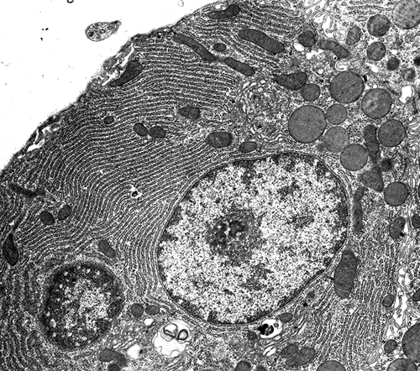
mc
GC
4. Secretory Granules (S) are products of the Golgi (GC), as seen in this picture taken from the cell lab.
S
Nucleus

Slide 13
A surface specialization that promotes absorption:
Cilia
Microvilli
Tight junctions
Basal infoldings

Slide 14
Arrow :Terminal web.
The microvillous brush border of these simple columnar absorptive cells sends its actin microfilaments to the subsurface where they insert into the zonula adherens.

Slide 15
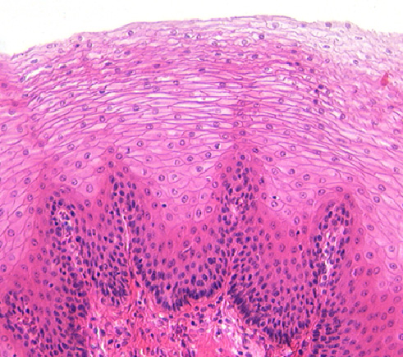
The epithelium in the image is:
Stratified squamous wet.
Keratinized stratified squamous.
Transitional
Pseudostratified.- would look keratinized, except still have nuclei in that top layer

Slide 16
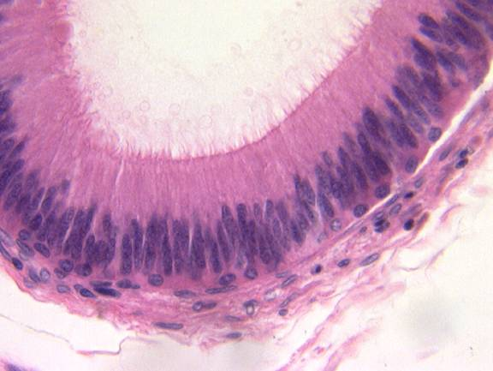
The epithelium in the image is:
Stratified squamous
Stratified columnar
Transitional
Simple cuboidal.
Examples of the other 3 are given on the next slide. Remember…pseudostratisfied columnar is typically seen, but is more bunched together as seen in the small picture below.

Slide 17
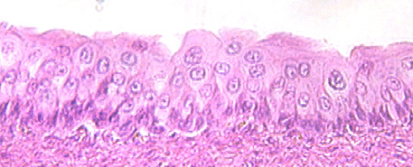
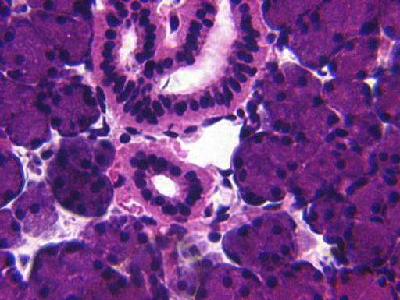
Stratified squamous (top)
Transitional (middle) .. Remember that is characteristic of the bladder and ureter!
Simple Cuboidal (bottom) ..Remember.. Usually forms ducts and glands! As seen with the black arrow pointing to the small duct.

Slide 18
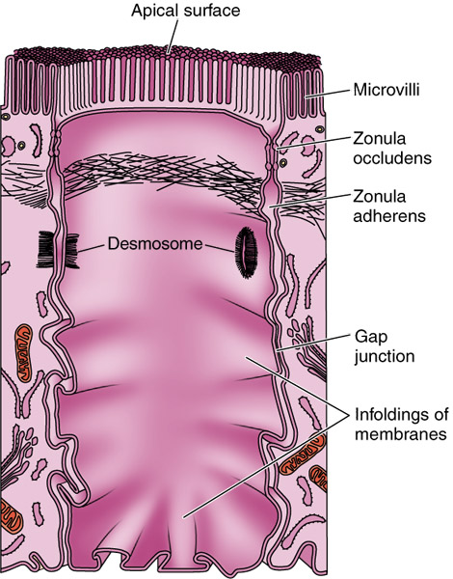
Cell to cell communication occurs via:
Desmosomes
Fascia adherens
Tight junctions
Gap junctions
Fascia adherens are similar to Zona adherens, but I can not find the term brought up anywhere in the labs or lectures for this quize. Fascia Adherens is a ribbon like structure that stabilizes non-epithelial tissue. It ss similar to the Zonula Adherens of epithelial cells but it's not belt-like. (Picture above taken from epithelium lecture.)
See next slide for explanations for 1, 3, and 4.

Slide 19
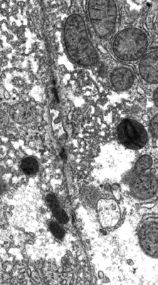
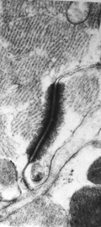
Taken from Cell Lab:
On the left tight junctions (arrow) can be seen on either side of a bile canaliculus found between two liver cells. The tight junction prevents the passage of molecules into intracellular spaces.
On the right a gap junction (G) and a desmosome (D) are observed. A desmosome functions to hold two adjacent cells together. A gap junction permits and regulates intercellullar communicaiton.
D
G

Slide 20
Quiz #2

Slide 21
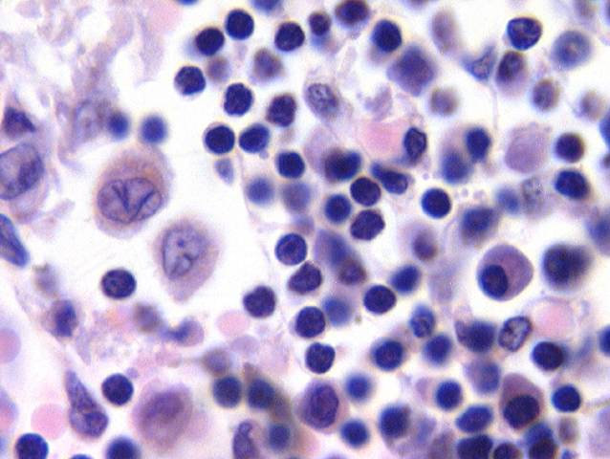
1.Identify the cell at the tip of the pointer.
Mast cell
    Large round cells with ovoid nucleus and secretory granules (red)
Macrophage
    Kidney shaped nucleus+
    Vacuole (blue)
*Plasma cell*
    -Golgi ghost
lymphocyte
2
4
3
- small, with round, dark nuclei

Slide 22
2.What type of collagen is found in a ligament?
*Type I* - loose and dense CT (Ligaments/Tendons = Dense CT)
Type II – Hyaline and Elastic cartilage
Type III – Reticular fibers,CT Organs of the body (sm. Muscle, around nerves, spleen, lymph node, bone marrow, liver, endocrine glands)
Type IV – Basal lamina

Slide 23
3.What cell leaves the blood to become a macrophage?
Lymphocyte – develops into Natural Killer Cells as well as T (cell-mediated immunity) and B cells (humoral response)
*Monocyte* - develop into MACROPHAGES and dendritic cells
Plasma cell – becomes white blood cells that produce antibodies
Mast cell – granule rich cells involved in the allergic response

Slide 24
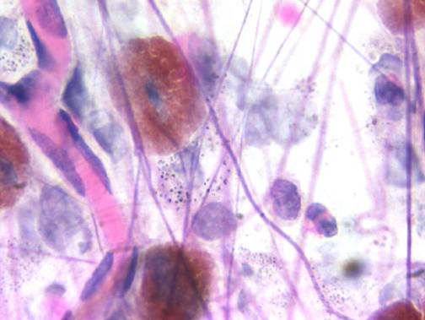
4.The structure at the tip of the blue arrow is a(n):
Mast Cell
Collagen fiber. Present in this slide, but poorly stained
*Elastic fiber.*
    Thin, straight and branched
Fibronectin
    Adhesion protein w/ 3 domains, binds heparin, collagen, and cell surface receptor
Reticular fiber
    Smaller than collagen fibers, needs special stain
Blood Vessel

Slide 25
5.Vitamin C dependent hydroxylation of proline and lysine in preprocollagen occurs in:
*The rough endoplasmic reticulum*
The smooth endoplasmic reticulum
- no function in collagen formation
The Golgi – packaging/secretion of procollagen
The extracellular matrix. – ends of procollagen peptides cleaved = transformation into insoluble tropocollagen

Slide 26
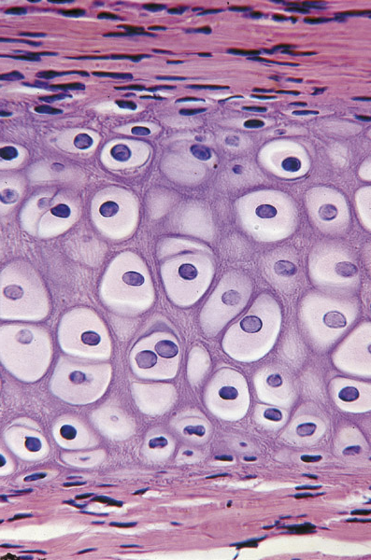
6.The image on the right is:
perichondrium
Fibrocartilage
*Growing hyaline cartilage*
    Territorial matrix – dark rim around chondrocyte = hyaluronic acid + condrotin sulfate
    Perichondrium
    Isogenous groups
Dense regular C.T.
Fibrous articluar layer of the TMJ

Slide 27
7.Which of the following contain hyaluronic acid?
Hyaline cartilage only.
    -hyaluronic acid, chondrotin-4-sulfate, chondrotin-6-sulfate, and keratan sulfate
Synovial fluid of the TMJ only.
    Plasma, protein, hyaluronic acid
*Both.*
Neither.

Slide 28
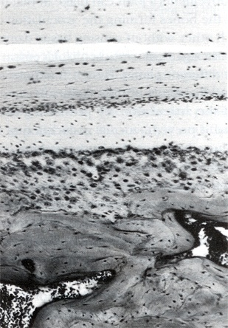
8.Which is the fibrous articular layer of the TMJ?
1
-articular disc
-*Articular layer*
-fibrocartilage
- Calcified cartilage
subarticular bone
Synovial cavity
“Apple Sauce Always Fills Craving Stomachs”
-Jimmy Schwartz, 2009
6
2
3
4
5

Slide 29
9.Which is the layer of fibrous cartilage of the TMJ?
1
-articular disc
-Articular layer
-*fibrocartilage*
-Calcified cartilage
subarticular bone
Synovial cavity
“Apple Sauce Always Fills Craving Stomachs”
-Jimmy Schwartz, 2009
6
2
3
4
5

Slide 30
10.Which is the articular disc of the TMJ?
-*articular disc*
-Articular layer
-fibrocartilage
-subarticular bone
Synovial cavity
Calcified cartilage
“Apple Sauce Always Fills Craving Stomachs”
-Jimmy Schwartz, 2009
1
5
2
3
6
4

Slide 31
Quiz #3

Slide 32
1. Which cells do not have gap junctions?
1)Cardiac muscle cells - Gap junctions are found in the intercalated discs. They allow propagation between myocardial cells and synchronous contractions (heart beats.)Skeletal muscle cells - No gap junctions. Muscle lecture slide #68.Simple columnar cells - Simple cuboidal cells.
Cardiac muscle cells
Skeletal muscle cells
Simple columnar cells.
Simple cuboidal cells.

Slide 33
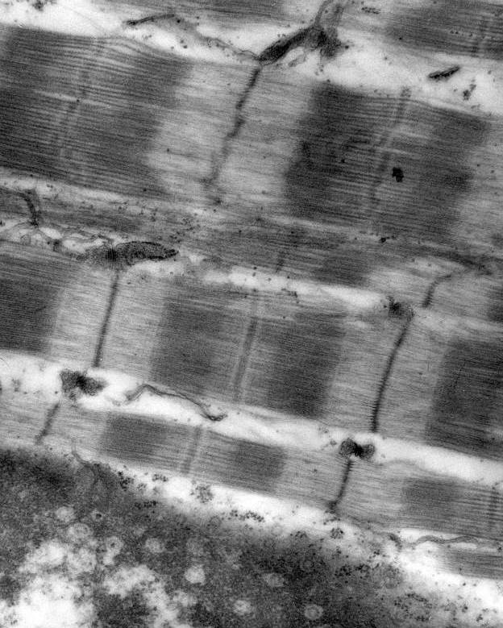
2. The actin is found at:
A but not B
B but not C
C but not A
B and C
2)Answer: “B but not C”.- A = two I bands separated by a Z line. Z lines separate sarcomeres and act as an anchoring point for ACTIN filaments. - B = the A-BAND, made of Myosin anchored in the middle by M line. The dark outer area is myosin overlapping with actin. The slightly lighter inner area is the H-ZONE, only M-line and myosin.-C = The H-ZONE, see above.-- Thus, while A is where most of the actin is found, it is also found in B and not C.
B
A
C

Slide 34
3. The osteoid surrounding an osteocyte does NOT contain:
Collagen Type I
Matrix vesicles
Gylcosaminoglycans
Elastic fibers
3)Collagen Type I - A main component of the osteoid (the organic matrix to be mineralized around an osteocyte.) Calcium hydroxyapatite crystals are laid down upon type 1 collagen fibers.Matrix vesicles - Secreted by osteocytes into the osteoid. They contain the crystallization materials to serve as the nucleating substance.Gylcosaminoglycans - Form the ground substance, lecture slide #3.Elastic fibers - Odd man out.

Slide 35
4. Cardiac muscle cells
4)Conduct impulses. - Hell yeah.Have triads. - Nope. SER forms dyads with the T Tubules. Do not have troponin - They do.Are part of a motor unit. - No. Cardiac muscle only has autonomic innervation, not somatic.
Conduct impulses.
Have triads.
Do not have troponin
Are part of a motor unit.

Slide 36
5. Which of the following occurs in the development of the mandible?
Osteoblasts deposit bony tissue on calcified cartilage
Zone of hypertrophy is evident
Mesenchymal cells differentiate into osteoblasts
The cartilaginous model is well vascularized
5)Osteoblasts deposit bony tissue on calcified cartilage - No. Mandible develops from Intramembranous ossification, and this describes Endochondral ossification. Cartilage framework is laid down, chondrocytes hypertrophy and cartilage calcifies. Blood vessels invade and bring in osteoprogenitor cells which become osteoblasts, which secrete osteoid on the calcified cartilage.Zone of hypertrophy is evident - No. Look above.Mesenchymal cells differentiate into osteoblasts - Bingo. Intramembranous ossification. No ossification centers, just mesenchyme forming a membrane and differentiating into bone blastema, then to osteoblasts.The cartilaginous model is well vascularized

Slide 37
6. Neurotubules in an axon:
6)Are involved in retrograde transport of material. - Yup. Kinesin proteins shuttle molecules/neurotransmitters/vesicles from the cell body to the axon terminal (anterograde transport.) Dynein does the same thing but in reverse (retrograde transport.)Are involved in anterograde transport of material. - YupAre the site of protein synthesis in a neuron. - Nope, protein synthesis is done at ribosomes (free or on the RER.)All of the above (1,2,3)Both 1 and 2. - BINGO.
Are involved in retrograde transport of material.
Are involved in anterograde transport of material.
Are the site of protein synthesis in a neuron.
All of the above (1,2,3)
Both 1 and 2.

Slide 38
7. Myelin in the peripheral nervous system (PNS):
Is composed of fused membranes of the rough endoplasmic reticulum.
Contains gap junctions between fused membranes.
Is made by Schwann cells.
Are processes of astrocytes.
7)Is composed of fused membranes of the rough endoplasmic reticulum. - Nope. Pretty sure that’s inside the cell. Myelination is on the outside.Contains gap junctions between fused membranes. - No. Myelination sections are not connected to eachother. Is made by Schwann cells. - Yes. Myelination in the PNS is done by Schwann cells wrapping themselves around the axons. The wrappings don’t have gaps between them. In the CNS, oligodendrocytes wrap their octopus-like tentacles around multiple cells’ axons. Myelinated sections have gaps, which are occupied by atrocyte feet.Are processes of astrocytes.

Slide 39
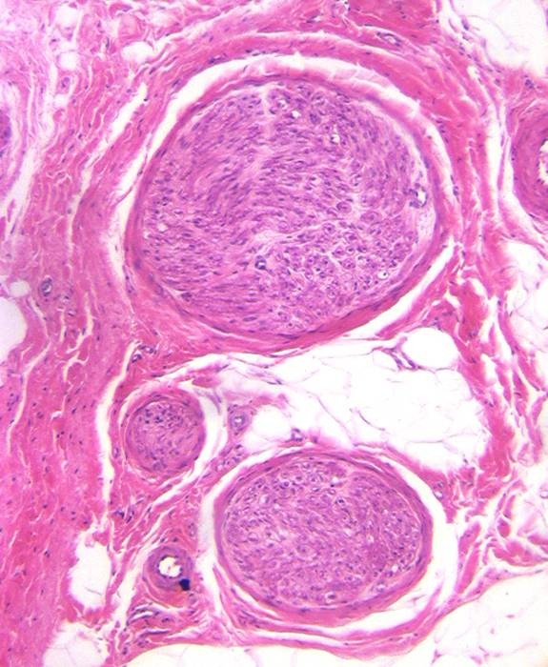
8. Cells making the protein collagen are found in:
A only.
B only.
Both A and B.
Neither A nor B.
A
8)A only.B only.Both A and B. - Bingo. Fibroblasts (and thus collagen) are found in both the endoneurium (A) and the epineurium (B.) The epineurium is connective tissue that surrounds the nerve, and the endoneurium has reticular collagen (lab image 10.)Neither A nor B.
B

Slide 40
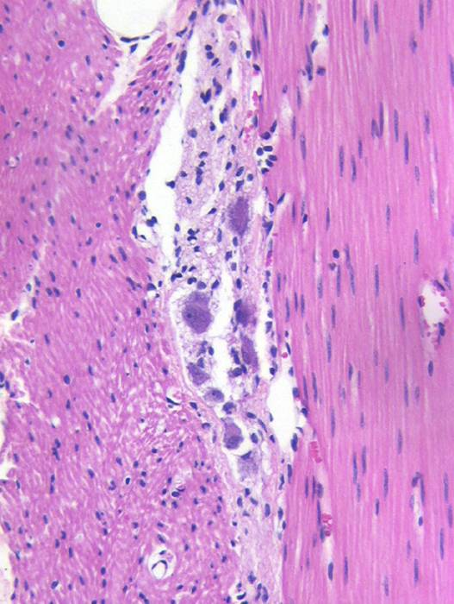
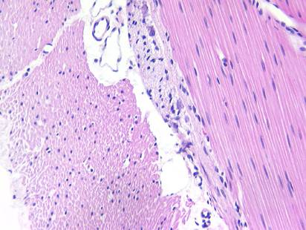
9. Sarcomeres are found in:
D
A.
B.
C.
D
None of the above.
This is Smooth muscle.
Slide 28
A
C
B
Smooth Muscle

Slide 41
10. The structure between the two pointers:
Is a node of Ranvier.
Is a region where sodium channels are found.
Is a region where action potentials occur.
All of the above are true.
10)Is a node of Ranvier. - Yes. This is a gap in the myelination of an axon, a break in the wire insulation.Is a region where sodium channels are found. - Yup. The sodium channels must be localized here, because... (see below.)Is a region where action potentials occur. - Again, yes. Myelination allows action potentials to not have to continuously occur all the way down the axon. That would be mad slow neurotransmission. Myelination insulation lets the depolarization slip all the way down until the insulation fails (Node of Ranvier.) At this point, there must be voltage gated sodium channels to let the action potential regenerate there. All of the above are true. - CORRECT.

Slide 42
Quiz #4

Slide 43
1. Erythropoietin
Is made in the liver.-------
Stimulates platelet -------production.
Is produced in response to anemia.
Does not stimulate the--- production of hemoglobin.
Produced in Kideny
  E-CFUs
  Primitive/mature progenitor
  Proerythroblast
DOES stimulate prod.
Erythropoietin – growth factor
Made by interstitial cells of the kidney
Stimulates
  E-CFUs
  Primitive/mature progenitor
  Proerythroblast
Stimulates maturation of red blood cells
Stimulates production of hemoglobin
Erythropoietin increases in response to hypoxia or anemia.

Slide 44
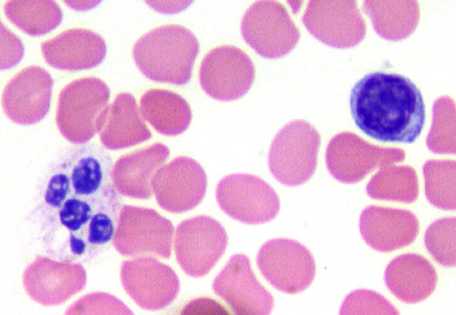
2. Neutrophils
Produce histamine
Have bright pink------ granules.
Decrease in response to---- infection.
Have lysosomes.
Blue granules
INCREASE
Two types of granules
  Primary or azurophilic granules -
  essentially lysosomes
    Acid phosphatases
    Acid hydrolases
    Myeloperoxidase
    Elastase
    other lysosomal enzymes
  Secondary or specific granules
    alkaline phosphatases
    collagenase
    lactoferrin
    Lysozyme
Involved in phagocytosis and
destruction of bacteria .
In an extended inflammatory reaction
neutrophils will die.
If this reaction is intense then the result is
the production of viscous fluid called pus.
The lifespan of the neutrophil is
  6 – 7 hours in the blood stream
  1 – 4 days in the connective tissue
An increase in neutrophils in the blood indicates an infection.

Slide 45
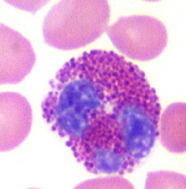
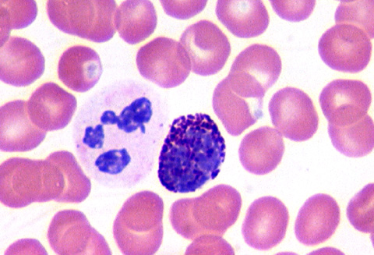
3. Which cell is a basophil?
A ----- eosinophil
B ----- neutrophil
C ----- basophil
A
C
B

Slide 46
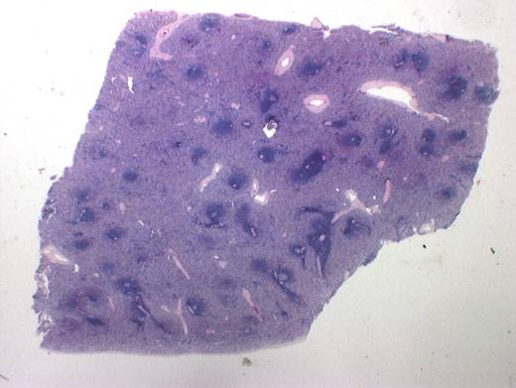
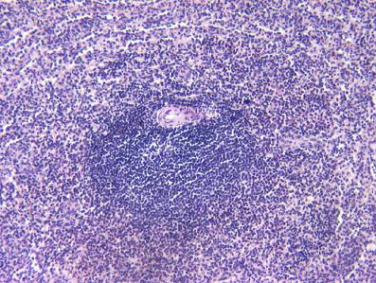
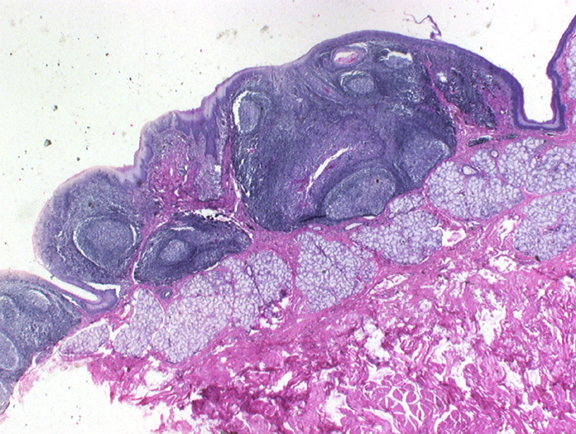
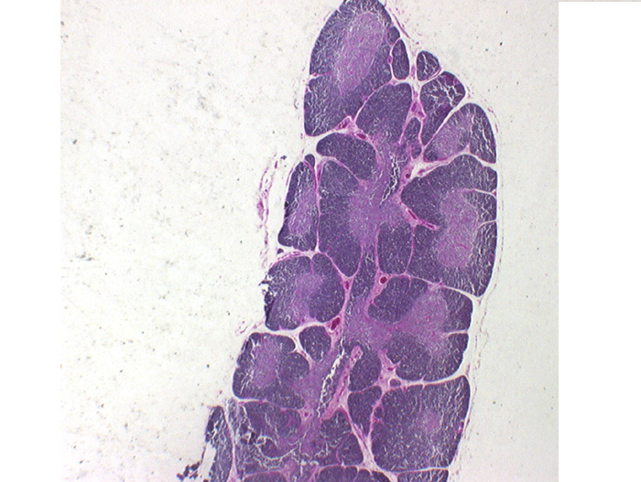
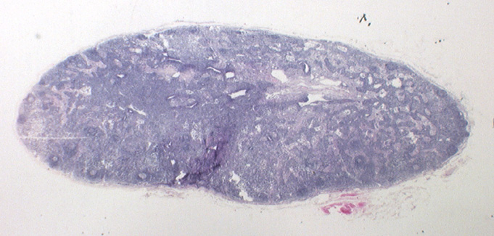
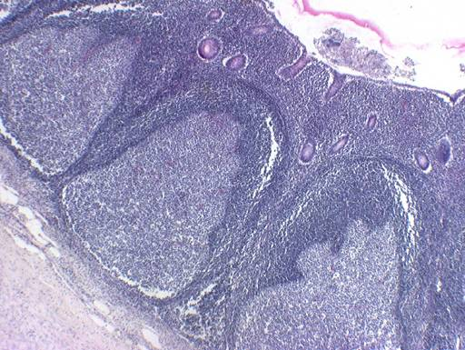
4. Identify the organ
Spleen
Lymph node
Thymus
Appendix
Lymphatic Nodules

Slide 47
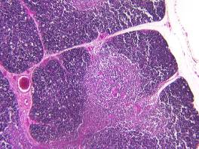
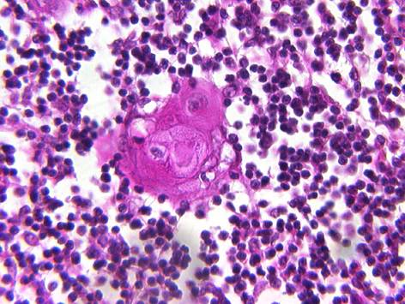
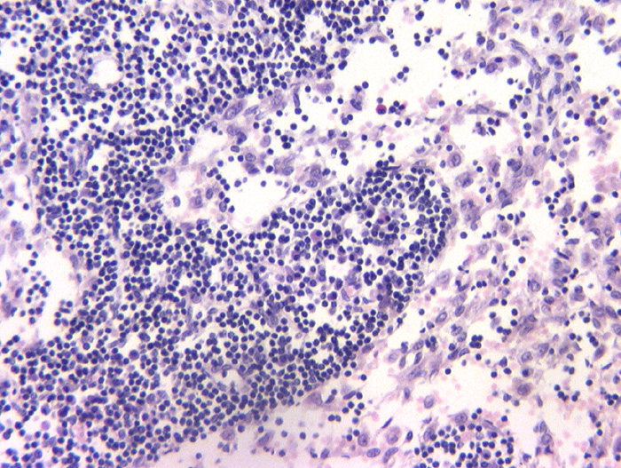
5. The arrow points to
The medulla of the thymus.
Red pulp of the spleen.
Sinusoids of the lymph node.
Medullary cord of the lymph node.
RED
PULP
WHITE
PULP

Slide 48
6. Which of the following regions would least likely contain T cells?
Cortex:
  Lymph nodules
    Primary = no germinal centers
      B cells
      B memory cells
    Secondary = germinal center
      B memory cells
      Plasma cells
Thymus
Periarteriolar lymphatic sheaths----
Germinal centers of lymphatic nodules.
Paracortex of a lymph node.
Paracortex
  Thymus dependent zone
  of lymph node
  APCs present epitope-
  MHC II to T helper cells.
  New T cells go to
  medullary sinuses
  Then leave
Aka- PALS
of the spleen
SS
Afferent lymphatics
TS
cortex
paracorteex
SS
Medullary sinuses
Efferent lymphatics

Slide 49
7. T cells have:
Self MHC on the plasma membrane.
The ability to interact with T Cell Receptors (TCR) on antigen presenting cells.
The ability to destroy self antigens.
CD molecules on the cells surface.
MHC- On antigens that the
surface protein recognizes
T Cell Receptor (TCR)
  Complexes with CD3
  CD3 found on all T lymphocytes
  Recognizes epitope if:
    Polypeptide
    Bound to self-MHC
T cells
  have T cell receptors (TCR)
    Recognize antigen
Two things happen in the cortex:
  T cells that can not recognize the self MHC
  are eliminated- positive selection.
  T cells that can recognize self peptides
  are eliminated – negative selection.
T cells are MHC-restricted
  Only react against antigen presented by self-MHC
T cells can not react against self antigens bound to self-MHC
  This is self tolerance.

Slide 50
8. Which of the following does not have a complete basal lamina?
Pseudostratified squamous epithelium.
Continuous capillary.
Fenestrated capillary
Sinusoid.
Discontinuous or Sinusoidal Capillaries
  Large openings
  No diaphragms
  Discontinuous basal lamina
  Found in:
    Liver
    Spleen
    Lymphatic organs
    Some endocrine glands

Slide 51
9. The sole connection between the atria and the ventricles across the annulus fibrosus normally occurs via the:
This is the only place where the atrial
musclulature connects with the
ventricular musculature.
AV Bundle-----------
Bundle branches.
SA node.----
Purkinje fibers.----
Impulses in the AV bundle travel to the
crest of the interventricular septum.
There they divide into left and
right bundle branches.
From the bundle branches the impulses
travel to Purkinje cells.
Where impulses start
These fibers are specialized myocardial fibers
that conduct an electrical stimulus or impulse
that enables the heart to contract in a
coordinated fashion.
- leave here and reach myocardial cells

Slide 52
10. You would expect to find the most elastic lamellae in:
Large arteries.
Medium sized arteries
Large veins.
Medium sized veins.
Vessel | Role | Adventitia | Media | Intima
Large Artery | Conveys blood | CT with blood vessels | Elastic laminae & smooth muscle cells | Endothelium and underlying CT
Muscular Artery | Supplies oxygenated blood | CT with blood vessels, nerves | 10 – 40 smooth muscle cells | Endothelium and underlying CT
Arteriole | Controls blood pressure | scant | 1 – 3 smooth muscle cells | endothelium
Capillary | Exchange with tissue | None | None | Endothelium and pericytes
Venule | Receives blood from capillaries | Slight CT | 1 –2 layers smooth muscle | Endothelium and pericytes
Medium Vein | Blood to the heart | Thick with collagen and elastic fibers | Smooth muscle and collagen | Endothelium and valves
Large vein | Blood to the heart | Thick with smooth muscle, vasa vasorum | Smooth muscle cells | Endothelium and CT

Slide 53
Quiz #5

Slide 54
1. The respiratory system as a whole does NOT contain:
Vascularized epithelia.
Smooth muscle.
Cartilage.
Ciliated cells.

Slide 55
Answer: A Vascularized Epithelia
No epithelium is vascularized, it is a defining characteristic.
Smooth muscle is incorrect as it is found throughout the respiratory system
Cartilage is found in 2 places: 1) C-shaped hyaline cartilage around trachea and 2) Intrapulmonary bronchus has plates or patches of hyaline cartilage
Ciliated cells can be found from the olfactory epithelium, all the way until the bronchiole, where the epithelium changes from pseudostratified/columanar to cuboidal/simple

Slide 56
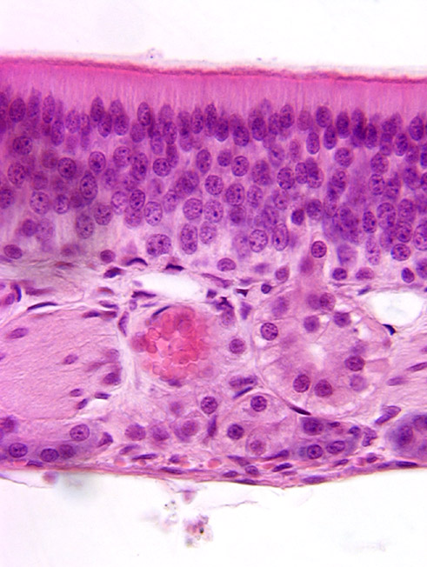
2. Nuclei of bipolar neurons are found in:
1
2
3
4
4
2
1
3

Slide 57
Answer: 4
OLFACTORY EPITHELIUM
1: Sebaceous Gland
2: pink-staining axon with flat dark staining nuclei of Schwann cells ( these contain unmyelinated axons of the bipolar neurons).
3: Vein
4: Bipolar Olfactory Neurons
5: Basal Cells: give rise to new supportive cells and olfactory neurons
6: Supportive Cells: form a brush border
6
4
5
2
1
3

Slide 58
3. Respiratory bronchioles are characterized by:
Pseudostratified ciliated columnar epithelium with goblet cells.
Alveolar outpocketings.
Simple columnar epithelium
The lack of smooth muscle

Slide 59
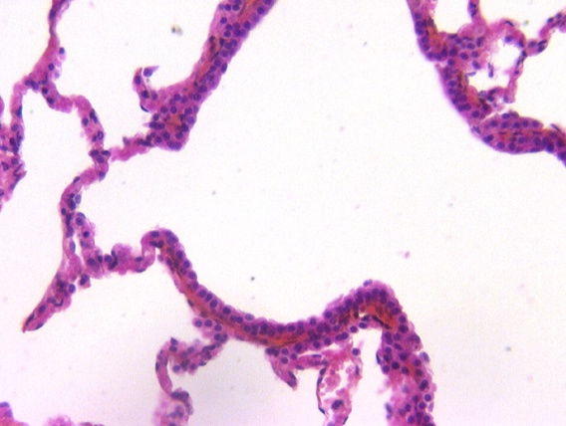
Answer: 2 Alveolar Outpockets
-Respiratory bronchioles have simple cuboidal epithelium, with simple squamous in the alveolar pockets
- Pseudostratified ciliated columnar epithelium found in olfactory epithelium, trachea, and intrapulmonary bronchus. There is tall columnar epithelium in the bronchiole
-Spiraling smooth muscle can be seen in the walls
Alveolar Outpocket

Slide 60
4. The blood-air barrier does NOT include:
Course collagen bundles.
Type I alveolar cells.
Endothelial cells.
Basal lamina.

Slide 61
Answer: 1 Coarse Collagen Bundles
Alveolar cappilaries are closely apposed to the alveolar lumen, allowing gas exchange by passive diffusion
Blood-air barrier consists of
  Cytoplasmic extensions of type I alveolar cells
  A dual basal lamina synthesized by type I alveolar cells and endothelial cells
  Cytoplasmic extensions of endothelial cells
  Plasma membrane of RBC
  Type II alveolar cells (indirectly) by secreting surfactant, which reduces surface tension and prevents alveolar collapse

Slide 62
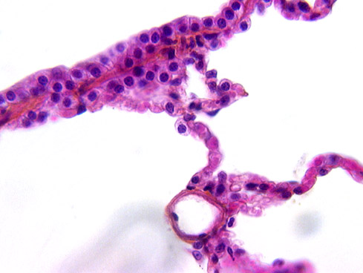
5. A Type II surfactant producing cell is found at:
1
2
3
4
4
3
2
1

Slide 63
Answer: 2
1: I am unsure. Could be some kind of small alveolar pocket??
2: Type II Alveolar Cell: Large cell with pale granular cytoplasm suggest that this is a surfactant producing cell in the lung alveolus.
3: I’m not positive but I believe that is a macrophage: clean the alveoli of particulate matter and are seen filled with debris. These cells can be found on the lining of the alveolus, in the alveolar wall, in the lymphatic channels draining the lung and in the adjacent lymph nodes.
4: Type I Alveolar Cell: simple sqamous cell
3
2
1
4

Slide 64
6. Which of the following would not be broken down in the liver?
IgA made by plasma cells in the GI tract.
Alcohol
Drugs.
Steroid hormones.

Slide 65
Answer: A; IgA made by plasma cells in the GI tract
    Alcohol broken down to acetaldehyde and acetate
    Barbituates and antibiotics inactivated.
      Occurs in SER by methylation
      Also in peroxisomes
      Tolerance
        Increased efficiency of hepatocytes to detoxify
        Therefore more drug needed for the effect.
        Decreases effectiveness of drug.
    Steroid hormones
      Excreted into bile duct and then into GI tract.
      Broken down by hepatocytes into amino acids.
    -IgA made by plasma cells in GI tract transported to the liver.
    -Released into the bile
    -Transported to bile duct.
    -Transported to the GI tract.

Slide 66
7. The Space of Disse contains:
A continuous basal lamina
Type I but not Type III collagen.
Fat storing (Ito) cells.
Cilia from hepatocytes.

Slide 67
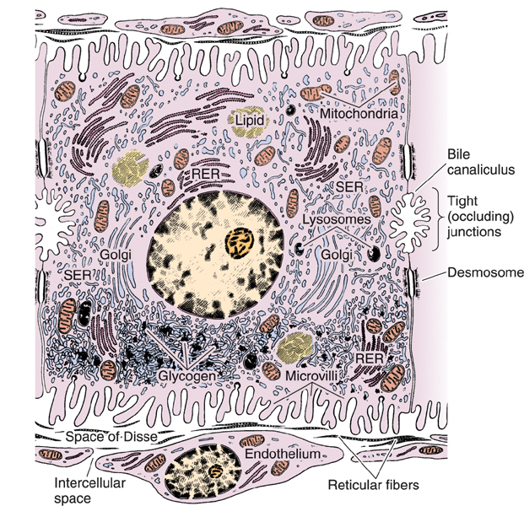
Answer: 3; Fat storing (Ito) cells
Space of Disse: Endothelial cells separated from hepatocytes
No basal lamina
Type III Collagen
Fat storing cells
  Ito cells
  Store Vitamin A
Space of Disse: area between hepatocytes and endothelial cells

Slide 68
8. Bile is released from the gall bladder in response to:
Cholecystokinin.
Enterokinase.
Secretin.
Gastrin.

Slide 69
Answer: 1; Cholecystokinin
  - Cholecystokinin in released from cells of duodenum in response to fats.
    Causes contraction of smooth muscle of gall bladder
    Causes relaxation of the sphincter of Oddi so bile enters the duodenum
- Enterokinase: It is produced by cells in the duodenum wall, and is secreted from duodenum's glands, the crypts of Lieberkuhn whenever ingested food enters the duodenum from the stomach. Enteropeptidase has the critical job of turning trysinogen(a zzymogen) to ttrypsin, indirectly activating a number of pancreatic digestive enzymes.
- Secretin: Its effect is to regulate the pH of the duodenal contents via the control of gastric acid secretion and buffering with bicarbonate
- Gastrin: In humans, gastrin is a hormone that stimulates secretion of gastric acid (HCl) by the parietal cells of the stomach and aids in gastric motility

Slide 70
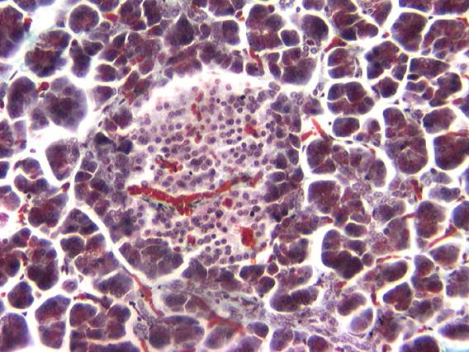
9. Identify the organ.
Liver.
Pancreas.
Spleen.
Lymph node.

Slide 71
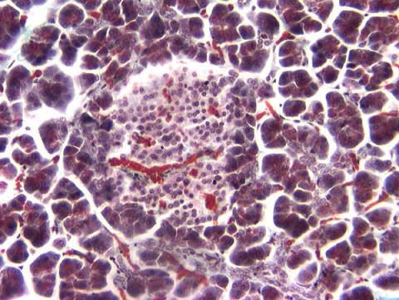
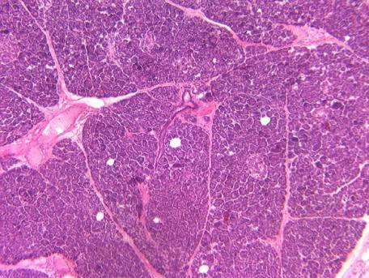
Answer: 2; Pancreas
High Mag of Pancreas
Islet of Langerhans
Low Mag of Pancreas
serous secretory acini of the exocrine pancreas. Surround Islet of Langerhans

Slide 72
10. Which of the following cell types secrete insulin?
Α (α) cell
Β (β) cell
D (δ) cell
F cell

Slide 73
Answer: 2; B (β) cell
Cell | Hormone | Function
β cell | Insulin | Decreases blood glucose levels
α cell | Glucagon | Increases blood glucose levels
δ cell | Somatostatin | Inhibits hormone release. Reduces contractions of GI smooth muscle
δ cell | Gastrin | Stimulates parietal cells to secrete HCl
F cell | Pancreatic polypeptide | Inhibits contraction of gall bladder and secretion of somatostatin

Slide 74
Quiz #6
Notes:
74

Slide 75
1. The intestinal villus does NOT contain:
Smooth muscle.
  muscularis interna, externa, and muscularis mucosa are smooth muscle
Lymphatic capillaries
  called lacteals, these absorb chylomicrons
Loose connective tissue.
  The lamina propria is made of loose CT and is found within the mucosal layer (the layer closest to the lumen)
**Ciliated cells**.
  intestine contains villi, not cilia
  From the lumen, the layers go: mucosa (epithelum, lamina propria, muscularis mucosa) -> submucosa -> muscularis interna & externa -> serosa
Notes:
75

Slide 76
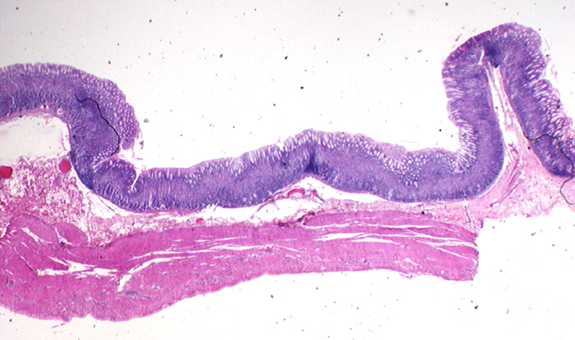
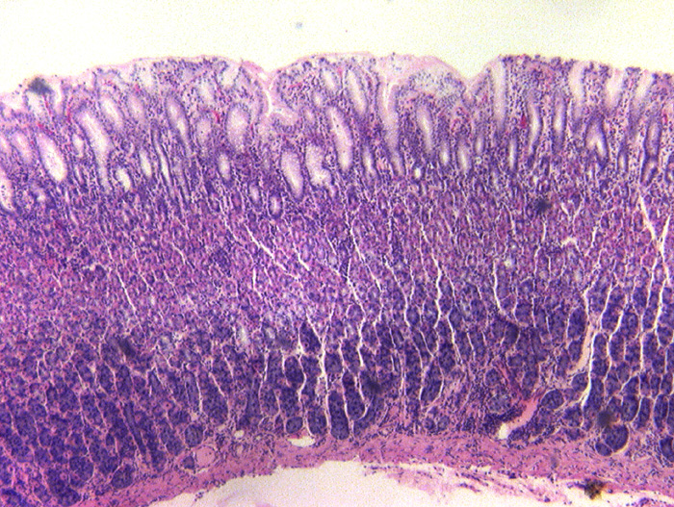
2. Cells producing pepsinogen are predominately found in:
Fundic stomach
mucosa
1-gastric pits
Pit
Submuscosa & muscularis...
2-neck
Gland
Pits = gland: cardiac
Glands taller: Fundus
Pits taller : Pylorus
*3-base*
4- LP
1- pits are where gland excretes products
2-neck contains parietal cells and mucous neck cells
**3**-base contains chief cells (pepsinogen and lipase) and parietal cells (HCl & intrinsic factor)
4- lamina propria of the mucosa
Notes:
76

Slide 77
3. Cells producing hydrogen and Cloride ions are predominately found in:
Fundic stomach
mucosa
1-gastric pits
Submuscosa & muscularis...
2-gland neck
Pits = gland: cardiac
Glands taller: Fundus
Pits taller : Pylorus
3- gland base
4- LP
1
2 but not 3
3 but not 2
**Both 2 and 3**
  parietal cells are found in neck and base of gastric glands, secrete HCl and intrinsic factor
Notes:
77

Slide 78
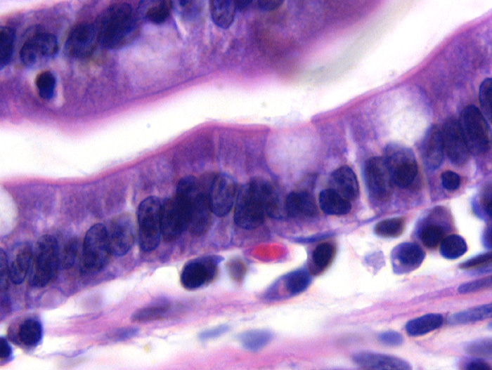
4. Cells with enzymes for digestion of lipids, carbohydrates and proteins:
**1
2
3
4
  Enzymes for digestion are on the microvilli of absorptive cells
2-goblet cell
Microvilli brush border
*1-absorptive cells*
4-capillary
3-plasma cell
lymphocytes
Notes:
78

Slide 79
5. Cell giving rise to renewal in the intestine:
Enteroendocrine cell
  secretin (triggers bicarbonate secretion from pancreas)
  cholecystokinin (triggers bile and pancreatic secretions)
Goblet cell
  secretes mucous
Absorptive cell
  absorbs nutrients
**Stem cell**
  found out bottom of mucosa, cells at the top slough off
Notes:
79

Slide 80
6. The capillaries found in the glomerulus are:
Continuous
**Fenestrated without diaphragms**
Fenestrated with diaphragms.
Discontinuous.
  Discontinuous (sinusoidal) capillaries have gaps in basal lamina while continuous capillaries do not.
  Fenestrated capillaries have endothelial pores AND have a continuous basal lamina.
  Most fenestrated capillaries have diaphragms covering their pores; the glomeruli do not.
Notes:
80

Slide 81
7. Most of the water is removed from the filtrate in the
***Proximal convoluted tubule***
  Absorbs 70% of the water in urine; its right after the glomerulus
Loop of Henle
  Loops down into the medulla
  Descending loop allows water resorption
  Ascending loop allows salt resorption
Distal convoluted tubule
  doesn’t have microvili, proximal CT does
Collecting duct.
  Water is reabsorbed (ADH increases water retention here), concentrates urine
Notes:
81

Slide 82
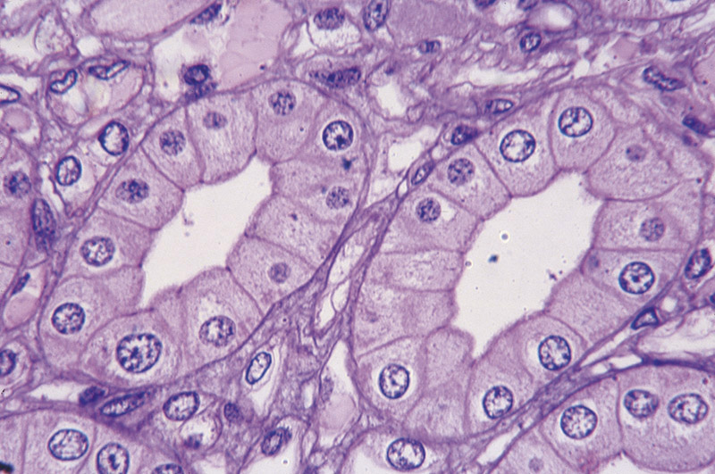
8. The cell at the tip of the point is in a:.
Proximal convoluted tubule
Loop of Henle
Distal convoluted tubule
**Collecting duct**
  Cells of collecting duct don’t interdigitate
  Hopefully just know that this picture is of the collecting duct
Collecting ducts are found in the medulla
Notes:
82

Slide 83
9. Which tubules are not permeable to water?
Proximal convoluted tubule.
  Absorbs 70% of water in urine
Descending thin limb of Henle
  allows water resorption only
***Ascending thick limb of Henle.***
  allows salt resorption only
Collecting duct.
  Allows water resorption only
Notes:
83

Slide 84
10. Angiotensin II causes:
Vasodialation
    You want vasoconstriction to raise blood pressure
Aldosterone to be released from the brain.
    from adrenal glands; salt and water retention
Antidiuretic hormone to be released from the adrenal
    From pituitary; water retention in collecting duct
**Sodium reabsorbtion in the proximal convoluted tubules.**
    Angiotensin II triggers all these to raise blood pressure: vasoconstriction, aldosterone, ADH, and sodium resorption in proximal CT
Notes:
84

Slide 85
Quiz #7

Slide 86
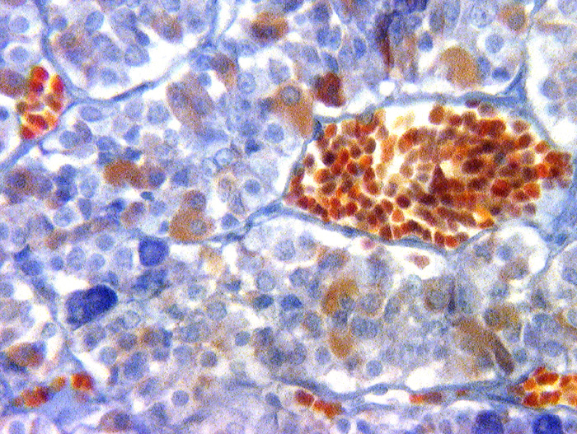
1. Which of the following may be found In the lumen of A?
Cord in Hypophysis (Pars Distalis)
Sinusoid
Platelets
Releasing hormones
Inhibiting hormones
TSH
All of the above
A
Basophil (dark blue)
Eosinophil
(Reddish)
Chromophobe
(Light blue)

Slide 87
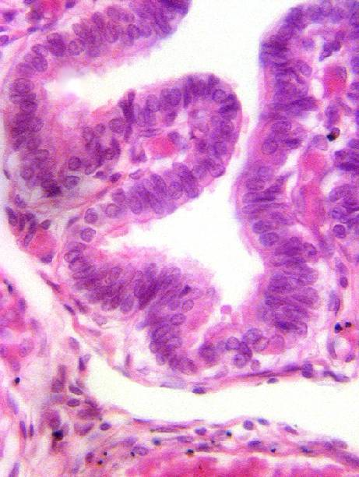
2. The cells at the arrows are:
Absorptive cells
Goblet cells
Ciliated cells
Secretory cells
Simple Columnar ciliated
(Peg Cells)
Lamina Propria

Slide 88
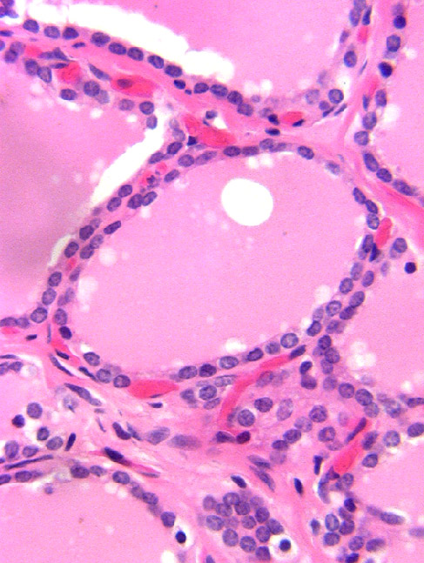
3. Which hormone is likely to be made by the cells indicated by the arrows?
Thyroid
Calcitonin
Estrogen
Prolactin
Thyroxine
Parafollicular Cells
Lowers Ca levels
Pituitary > GnRH > LH > Ovarian Follicle > Estrogen
Colloid
(Secretions of Follicular Cells)
Pituitary > PRL Releasing > Prolactin
Milk production in mammary glands
Thyroid Follicular Cells
TSH from Hypothalmus stimulates this
T3 and T4

Slide 89
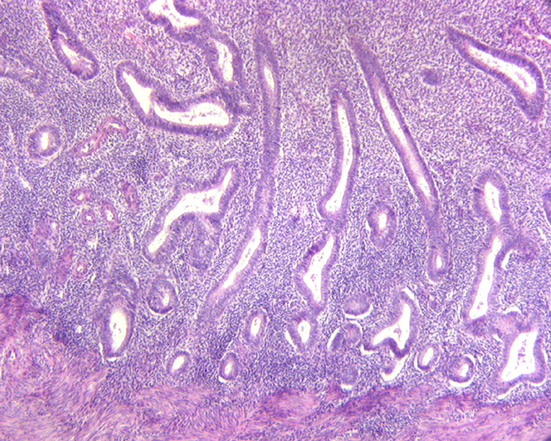

4. Identify the organ.
Funtional Layer
Straight Uterine Glands
Pars distalis of pituitary
Endometrium in proliferative stage of the cycle
Vagina
Kidney
Basal Layer
LOW
Uterus, Estrogenic, Days 6-14
Functional Layer
MED

Slide 90

5. Capillaries are found in:
B
A
A
B
C
D
Oocyte
C
Antrum
D
Granulosa Layer
Avascular
Helps with estrogen prod.
Theca Interna (Estrogen Production)
Vascularized
Theca Externa
Basement Membrane

Slide 91


6. The cells indicated by the arrow are stimulated by
Vein of medulla
Nerves
Releasing hormones
Inhibiting hormones
Hormones from pars distalis
Chromaffin Cells
postganglionic sympathetic neurons modified to secrete epinephrine and norepinephrine
Smooth Muscle
Adrenal Medulla

Slide 92

7. Maternal cells are found in:
2
1
2
3
4
3
Intervillous Space
Maternal Blood
1
Fetal vessels in syntiotrophoblast
Fetal Blood
4
Part of fetus
Part of fetus
Fetal Component of Placenta – Late
Cytotrophoblast layer gone (Only syntio.)

Slide 93

8. The cells surrounding the tip of the pointer are stimulated by:
Capsule
ACTH
LH
FSH
Prolactin
Independent of Pituitary
Renin Angiotensin Stimulates
Glomerlosa
(Aldosterone Rel.)
Stimulates Ovarian Follicle/Testis
Fasciculata
(Cortisol release)
Stimulates Ovarian Follicle/Testis
Stimulated by Pituitary ACTH
Reticularis
(Sex Steriods rel.)
Milk production in mammary
Medulla
(epineph/norep.)

Slide 94
9. Which of the following ovarian structures is NOT stimulated by the pituitary?
Granulosa cells of a maturing follicle
Corpus albicans
Corpus luteum
Theca interna cells of a maturing follicle
FSH/LH stimulates
Results if no fertilization or LH-like stimulation for Corpus Luteum
LH from pituitary stimulates to release estro/ prog
LH from pituitary stimulates this to produce androstenedion

Slide 95
10. Oxytocin is synthesized in the:
Pars distalis
Pars tuberalis
Hypothalamus
Kidney
ACTH, TSH, FSH, LH, GH, PRL
Nothing
Oxtytocin for milk release/ uterine contraction
ADH for vasoconstriction and water retention
Renin to control increase blood pressure/ Na in blood

Slide 96
Quiz #8

Slide 97
1. Sertoli cells make all of the following except:
Inhibin
Mullerian inhibiting substance (antimullerian hormone)
Androgen binding protein.
Progesterone.
Sertoli cells are cells located in the testes that functions to support germ cells and forms the blood-testis barrier. This cell makes:
androgen-binding protein- bind testosterone and increase concentrations of the hormone in testes
    Anti-mullerian hormone- inhibits the development of the mullerian ducts in the male embryo (aka Fallopian tubes)
    Inhibin- inhibit the production of follicle-stimulating hormone (FSH) by the pituitary gland
    -Progesterone is only produced in women.

Slide 98

2. Identify the primary spermatocyte.
Leydig Cell
A
B
C
D
A
B
C
D
Seminiferous Epithelium
Sertoli Cells
A- spermatid-
B- unknown
C- Spermatagonia- Still in contact with the basement membrane
D- Primary Spermatocyte- large round nuclei with a tangle of dark chromosomes

Slide 99
3. Leydig cells:
Are stimulated by FSH
Are inhibited by FSH.
Inhibit basophils from secreting LH.
Secrete inhibin.
1/2. Leydig cells are stimulated by LH. FSH functions to stimulate sertoli cells.
3. Leydig cells inhibit LH secretion by secreting testosterone, which inhibits LH releasing hormone, and LH secretion directly (feedback inhibition)
4. Inhibin is secreted by sertoli cells. Refer to Question 1 for function,

Slide 100
4. Capacitation occurs in the:
Seminifeous tubules.
Epididymis.
Uterus.
Uterine tube.
Capacitation- the final stage of maturation in sperm that allows a sperm to fertilize the ovum. This occurs in the female reproductive tract after a sperm has been ejaculated. Therefore it could not occur anywhere in the male reproductive tract (1-3)

Slide 101


5. In the prostate, cancer is most often found in:
A
A
A
B
C
D
B
B
C
C
D
Prostate gland- in male reproductive tract, secretes an alkaline fluid with ejaculate intended to neutralize the acidity of the vaginal tract. Cancer is most often found in the peripheral area of the gland because it makes up about 80% of the gland volume and is also the main glandular area. Also he said so in class.

Slide 102

6. Hair cells are:
A - spiral limbus- contains acoustic nerve – attaches tectorial membrane
B - Outer Hair Cells
C - Basilar membrane
D – Supporting cell of outer hair cell
T - tectorial membrane
I - Inner Hair Cell
T
A
B
I
D
C

Slide 103

7. Tectorial membrane:
A vestibular membrane
B tectorial membrane
C basilar membrane
D cell bodies of neurons of the spiral ganglion
A
B
D
C
Tectorial membrane covers the organ of corti

Slide 104

Cochlear Duct - med. mag
Separating the scala vestibuli (SV)
from the scala media (SM)
is the vestibular membrane (VM).
The scala media is separated from the scala tympani (ST)
by the basilar membrane (BM).
VM
SV
m
SM
OC
n
BM
ST
Resting on the basilar membrane and projecting into the scala media is the organ of Corti (OC).
Note the cell bodies of the neurons (n) of the spiral ganglion within the modiolus (m).

Slide 106

muscular ciliary body -CB
the iris - I
Lens - L
CB
L
L
I
The vascuoid layer is continuous anteriorly with the muscular ciliary body (CB).
The anterior continuation of the ciliary body is the iris (I).
The central free margin of the iris rests on the anterior surface of the lens (L)
forming a central opening called the pupil.

Slide 107
Retina
⇧

Slide 108


8. Axonal layer of the retina:
Nerve Fiber Layer
Ganglion cell layer
Inner plexiform layer
A
Inner nuclear layer
Outer plexiform layer
Outer nuclear layer
Layer of rods & cones
B
Pigment cell layer
C
D
The full thickness of the retina is seen in this slide.
The next slide presents a schematic.

Slide 109


Slide 110
Quick Quiz - ID These
A
B
C
D

Slide 111

9. The arrow is in which layer?
Sclera
Choroid
Choriocapillaris
Rods & Cones
P. Pigment Cell Layer
The next slide contains the other layers in better detail
D
P
C
B
A
60

Slide 112

Choroid -C
Sclera -S
choriocapillaris layer -CC
Retina -R
Bruch’s membrane -B
R
B
CC
C
choriocapillaris layer CC supplies blood
S
The middle vascular layer of the eye consists of the choroid posteriorly;
more anteriorly it contributes to the ciliary body and iris.
The choroid (C) contains pigmented cells and attaches to the sclera (S).
Externally, the choroid has large blood vessels which diminish in size becoming the inner choriocapillaris layer (CC) supplies blood.
The innermost layer of the choroid, between it and the retina (R),
is a complex “basement membrane” called Bruch’s membrane (B).
Retina revieves dual blood

Slide 114


10. This muscle:
Posterior
chamber
I
CP>
Moves the eyeball. See next slide^
Opens the pupil.
Closes the pupil.
Helps focus the lens.- blue arrow
CP- cilliary process
I- Iris
This is a picture of the ciliary process that manipulates the lens.
dilator (D) muscles of the pupil sympathetic control.------------→
Posterior chamber
D

Slide 115

Extraocular muscles control movements of the eye

Slide 116
Quiz 9
This quiz was on the integumentary system: the skin and its derivatives
The skin includes the hypodermis, the dermis, and the epidermis
There were 4 major layers of the epidermis:
From top to bottom:
Stratum corneum
Stratum granulosum
Stratum spinosum
Stratum basale
The dermis has a papillary layer

Slide 117
Question 1
Answer: 3 – Sebaceous gland.
You know this is a sebaceous gland because it is next to a hair follicle.
Sebaceous glands are appendages of the hair follicle that lie in the dermis

Slide 118

Question 1 (cont)

Slide 119
Question 2
Answer: 4 – A and B.
C is pointing to the stratum corneum which is just keratin – a layer of protection. There is no mitotic activity here. Mitotic activity occurs in the stratum basale and stratum spinosum.

Slide 120
Question 3 (cont)
Answer: 3 – Sweat duct

Slide 121

Question 3 (cont)
Sweat ducts start stratum corneum and the glands go through the dermis and into the hypodermis (pictured in purple)

Slide 122
Question 4
Answer: 3 – dermis
Sweat glands are involved in heat regulation – they are in the dermis and go up through the epidermis and out of the skin

Slide 123

Question 4 (cont)

Slide 124
Question 5
Answer: D
Melanocytes:
The cell body of melanocytes is located in the stratum basale (D). They are the first cells to arrive in the epidermis.

Slide 125

Question 5 (cont)

Slide 126
Question 6
Answer: 3 – Langerhan cell
Presents antigens to T cells in the dermis to initiate responses against foreign antibodies
Melanocytes secrete melanin
Keratocytes are for keratin
Merkel cells are touch receptors

Slide 127
Question 6 (cont)

Slide 128
Question 7
Answer: A – stratum corneum
No mitotic activity in s. corneum (the keratinized layer). Mitotic activity only occurs in the s. basale, and s. spinosum, as well as the hair and nail matrix and in glands.

Slide 129
Question 8
Answer: 1 – Dermis
The arrector pili (ap) is a band of smooth muscle attached from the papillary layer of the dermis to the ct surrounding the hair follicle trapping the sebaceous gland (sg) in between. Contraction moves the hair to a vertical position, squeezes sebum from the sebaceous gland and is responsible for “goose bumps”.

Slide 130
Question 9
Answer: 3 – Epithelial cells of the sweat duct

Slide 131

Question 9 (cont)

Slide 132
Question 10
Answer: A
Stratum corneum (A) does not have mitotic activity
B is the granulosum layer and C is the spinosum layer

Slide 133
Quiz 10

Slide 134
Quiz 10
1) Fertilization occurs on:
Day 1 of the menstrual cycle. No, this is when the ovarian follicle matures.
Day 8 of the menstrual cycle. This date corresponds to nothing.
Day 15 of the menstrual cycle. Yes! Egg is released on the 14, fertilization on the 15th.
Day 21 of the menstrual cycle. No, this is the blastocyst formation.

Slide 135
2) The embryo develops from:
The cytotrophoblast. No, this is the outer layer that forms the chorion.
The syncytiotrophoblast. No, this develops from the cytotrophoblast. Makes hCG and progesterone.
The epiblast. Yes. This is the layer above the hypoblast. It folds into the embryo.
The hypoblast. No, the hypoblast develops into the extraembryonic tissues, like the yolk sac.

Slide 136
3) Implantation occurs:
7 days after fertilization. Yes.
Day 7 of the menstrual cycle. No, this is the proliferative stage. Ovulation still hasn’t occurred.
Day 14 of the menstrual cycle. No, this is ovulation.
14 days after fertilization. No, this is the bilaminar disc (epiblast &hypoblast) nearing gastrulation.

Slide 137
4) Human chorionic gonadotropin is made by:
Cytotrophoblast. This layer anchors the embryonic chorion into the maternal endometrium.
Syncytiotrophoblast. Yes. It also produces progesterone.
Epiblast. No, this layer forms the embryo.
Hypoblast. No, this layer forms the yolk sac.

Slide 138
5) The percentage of fertilized eggs that make it to birth is approximately:
90%. Not even close to a good option.
70% No. This is the unsuccessful amount. 1/3 of these are lost before implantation ever occurs.
60% No. But 50-60% of spontaneous abortions are caused by chromosomal abnormalities.
30% Yes. Approximately 30% of fertilized eggs are carried to a successful term.

Slide 139
6) The mandible is formed from cells that arise from:
Paraxial mesoderm. No, forms floor of the brain case, some of occipital region, voluntary muscles of the craniofacial region, dermis and connective tissue in dorsal head, meninges.
Lateral plate mesoderm. No, forms laryngeal cartilages in 4th/ 6th arches and connective tissue in larynx.
Intermediate mesoderm. No, this forms part of the urogenital system.
Neural crest cells. Yes. Also forms bones of face, cartilage, dentin, tendon, dermis, sensory neurons.

Slide 140
7) First pharyngeal arch structures are innervated by the:
Oculomotor nerve (CNIII) No. Controls eye movements.
Trochlear nerve (CN IV) No. innervates the superior oblique muscle of the eye.
Trigeminal nerve (CN V) Yes.
Facial nerve (CNVII) No, innervates the muscles of facial expression, and the anterior 2/3 of the tongue.

Slide 141
8) As you examine a patient’s maxillary incisors you recall that they arise from:
Maxillary process. No, forms the palatine shelf.
Mandibular process. No, duh. This forms things in the mandible.
Medial nasal process. Yes. The medial nasal processes form the intermaxillary shelf, from which the maxillary incisors arise.
Lateral nasal process. No, forms alae of the nose.

Slide 142
9) The pharyngeal arch that contributes the least to the tongue is:
First pharyngeal arch.
Second pharyngeal arch. According to Eric, this is the right answer, but I found no conclusive evidence that directly states this in the notes, or on the arch tables.
Third pharyngeal arch.
Fourth pharyngeal arch.

Slide 143
10) The buccal cavity is innervated by cranial nerve:
Five (Trigeminal) Yes. This innervates the maxilla and mandible.
Seven (Facial) No. Controls muscles of facial expression.
Nine (Glossopharyngeal). No. Innervates the pharynx and posterior 1/3 of tongue.
Ten (Vagus) No. This is a parasympathetic nerve that innervates many things, including heart.

Slide 144
Quiz #11
Corrected and explained
Dr. Christopher H Hill II Esq. DMD PC

Slide 145

1. The arrows point to the:
Dental papilla
Stellate reticulum
Enamel organ
Neural crest
Enamel
Organ
Stellate
reticulum
The tooth develops from the
Neural crest
Dental papilla

Slide 146


2. The developing tooth below is in the:
Bud stage
Cap stage
Bell stage

Slide 147

3. The arrow is pointing to the:
Inner enamel epithelium.
Outer enamel epithelium
Hertwig’s root sheath.
Stellate reticulum

Slide 148

4. The successional lamina is
A
B
C
D
E
A
Oral epithelium
Outer dental lamina
B
Lateral dental lamina
C
Successional lamina
OEE
E
D

Slide 149
5. Which gene is expressed in the ectoderm at the site of tooth initiation?
SHH – Has a role in tooth initiaton
Msx2 – Initiates the incisor and canine
Lhx6 – upregulates the ectomesenchyme
PAX 9 – upregulates the ectomesenchyme

Slide 150
6. During tooth development the:
Odontoblasts appear before the inner enamel epithelium.
Ameloblasts appear before odontoblasts. (the least wrong) slide 23 “dentin” shows preameloblasts and then the differentiation of ectomesenchymal cells into preodontoblasts.
Enamel appears before dentin
Enamel appears before odontoblasts.
None of these answers are truly correct as written. Here is the
Correct info.
Enamel formation requires dentin.
Reciprocal induction:
  -internal dental epithelium induces
  the underlying dental papilla cells .
  -to become ondotoblasts.
  Dentin induces the internal dental
  epithelium to become ameloblasts.
60

Slide 151




7. Tome’s processes are seen during the:
Histodifferentiation stage
Initial secretory stage
Secretory stage
Maturation stage
Histodifferentiation phase:
  Nuclei shift toward stratum intermedium
  Golgi prominent and in center of cell.
  Abundant RER formed.
  Junctional complexes form around cell at both ends.
  Terminal web seen.
Secretory Stage:
  Initial Secretory Stage
    Production of Enamel proteins.
    Almost immediate production of mineralization.
    Rods not formed
The organic enamel matrix is secreted from the
Tomes processes during the secretory stage.
Maturation Stage
  Ameloblasts get shorter
  Ameloblasts then have two morphologies:
    -Ruffled cell border: adding inorganic material
    -Smooth ended border: removal
    of water and organic material.

Slide 152

8. During the maturation phase:
Ameloblasts get longer. They actually get shorter
Ruffled ameloblasts loose their junctional complexes
Smooth ameloblasts loose their junctional complexes.
Smooth ameloblasts:
  Leaky distal junctions.
  Tight proximal junctions
  Molecules withdrawn from enamel pass between ameloblasts and through the lateral borders of the cell.
4. Degraded polypeptide fragments must pass through the ruffled cell rather than between cells.
Ruffled ameloblasts
  proximal junctions leaky
  Distal junctions tight.
  Degraded polypeptide fragments must pass through the ruffled cell.

Slide 153


9. The tip of the arrow is on:
Lamella
Enamel lamella
2. Enamel tuft
3. Enamel spindle
Tuft
Enamel lamellae are a type of hypomineralized structure in teeth that extend either from the dentinoenamel junction (DEJ) to the surface of the enamel, or visa versa. In essence, they are prominent linear enamel defects, but are of no clinical consequence.^{[1]} These structures contain proteins, proteoglycans, and lipids.
Enamel lamellae should not be confused with two similar entities, enamel tufts and enamel spindles. Enamel tufts are small, branching defects that are found only at the DEJ, and so differ from lamellae which can be facing either direction and are strictly linear. Enamel spindles are also linear defects, but they too can be found only at the DEJ, because they are formed by entrapment of odontoblast processes between ameloblasts prior to and during amelogenesis.

Slide 154


10. The arrows are pointing to
Hunter Schrager bands.
Stria of Retzius
Dento-enamel junction
  optical pattern resulting from
  changes in rod direction
incremental lines of growth. Stria represent weekly
changes in enamel formation
Neonatal line is enlarged Stria.

Slide 155
Quiz #12

Slide 156

1. Nerve fibers (axons) are found in:
a. pulp core
b. cell-rich zone
c. cell-free zone
d. odontoblast layer
e. all of the about
A
D
C
B
:60

Slide 157


2. The lines between the arrows are:
a. lines of retzius: incremental growth lines of
enamel formed by enamel rods
b. contour lines of owen: reflect changes in nutritional status of the individual during the period of dentinogenesis (i.e. neonatal line)
c. Enamel Spindles: newly formed odontoblast processes caught between enamel formed by adjacent ameloblasts
d. incremental lines of cementum: the slide does not show cementum.
Enamel
DEJ
Dentin
:60

Slide 158
3. The Tomes granular layer is found in: (dentin slide #3) arrangement of proteins and collage (type I)
Dentin-Enamel Junction (DEJ)
Cementum
Dentin-Cementum Junction (DCJ)
Pulp

Slide 159

4. Interglobular dentin:
A. tomes granular layer
B. DEJ
C. Interglobular Dentin
D. Sclerotic Dentin
B
A
C
D

Slide 160
5. Predentin contains:
A. Fibroblasts:
B. Collagen Fibers: secretory odontoblasts secrete Type I collagen and ground substance in much the same way as fibroblasts
C. Mineralized: pre-dentin is unmineralized, mineralization of dentin tends to occur in small, round discrete areas called calcospherites

Slide 161

6. Incremental lines in cementum:
A
B: tomes granular lay
C: dentinal tubules
A
B
C

Slide 162
7. Cells with canaliculi can be found in:
A. enamel: cells that produce enamel are removed during tooth eruption
B. Alveolar Bone: osteocytes have canaliculi
C. Cementum: cementocytes have canaliculi
D. B & C
E. All of the Above
canaliculi: are small projections that extending from osteocytes and cementocytes
and are connected by gap junctions

Slide 163
8. Cementocytes differentiate from the:
A. Internal enamel epithelium: ameloblast and enamel
B. Dental Papillae: Dentin and Pulp
C. Dental Follicle: cementum, PDL, alveolar bone
cementum forms on the developing root only after the process of dentin
deposition begins along the (Hertwig’s_ epithelial root sheath. Transformation of undifferentiated cells from dental follicle into cementoblasts
D. Oral Epithelium

Slide 164
9. Sharpey’s fibers of the PDL are found in:
A. Alveolar Bone: sharpey’s fibers of PDL attached to lamina dura
B.Cementum: Sharpey’s fibers embedded in cementum
C. Both A & B
D. None of the above
The periodontal ligament develops from fibroblasts that develop
from the dental follicle (aka dental sac). The PDL fibers are made of collagen types I and III and elastic microfibrils

Slide 165

10. Inter-radicular bone:
A: alveolar bone
B: dentin (root)
C
D: Interdental Septi
D
Interdental and
interradicular septi
are attached to the
cementum of the roots
by the PDL
C
B
A

