Slide 1
Quiz #1

Slide 2

1. The epithelium at the tip of the pointer is:
Transitional
Pseudostratified
Ciliated
Stratified columnar
60

Slide 3
2. The structure at the tip of the pointer is a:
Microvillus
Stereocilia
Cilia
Hemidesmosome
60

Slide 4
3. Which of the following would not be found in an adhering junction?
Claudin
E-cadherin
Desmocollin
Desmoglein
60

Slide 5
4. A molecule involved in cell-to-cell communication is
Occludin.
Catenin.
Plakoglobin
Connexin.
60

Slide 6
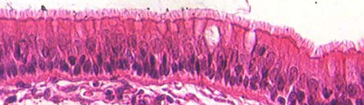
5. The structure at the tip of the pointer is the:
Terminal web
Basement membrane
Actin filaments
Centrioles
60

Slide 7
6. The hydrophobic region of the plasma membrane would contain:
  Nitrogen compound
  Phosphate bridge
  Glycerol
  Two long-chain fatty acids.
60

Slide 8
7. Mitochondria are involved in:
  Synthesis of phospholipids
  Glycogen breakdown
  Steroid biosynthesis
  Calcium sequestration for muscle contraction.
60

Slide 9
8. The most important factor in determining that the ribosome attaches to the RER is the:
Signal protein or leader sequence.
Size of the ribosome.
The folding of the protein.
The cleaving of the protein.
60

Slide 10
9. You would expect to find catalases and oxidases in:
Rough Endoplasmic Reticulum
Smooth Endoplasmic reticulum
The Golgi
Peroxisomes
60

Slide 11
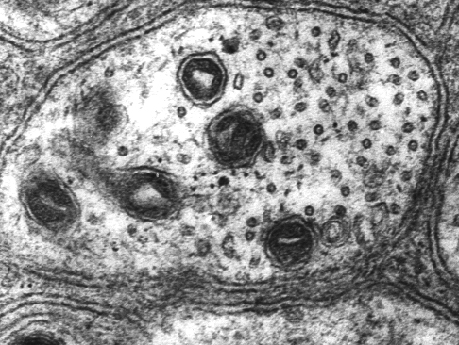
10. The structure at the tip of the pointer is a(n):
Actin filament
Intermediate filament
Microtubule
60

Slide 12
Quiz #2

Slide 13
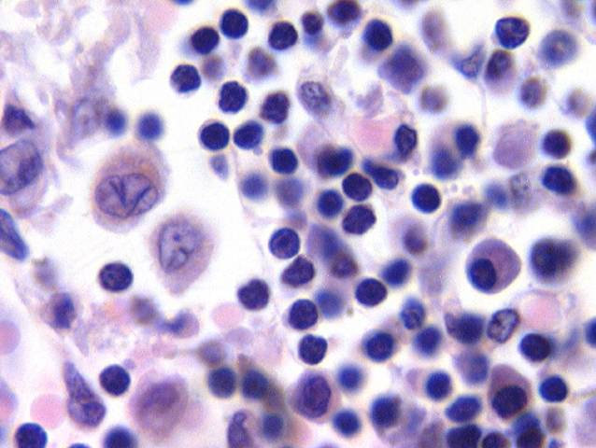
Identify the cell at the tip of the pointer.
Mast cell
Macrophage
Plasma cell
Lymphocyte
60

Slide 14
What type of collagen is found in hyaline cartilage?
Type I
Type II
Type III
Type IV
60

Slide 15
What cell secretes histamine?
Lymphocyte
Monocyte
Plasma cell
Mast cell
60

Slide 16
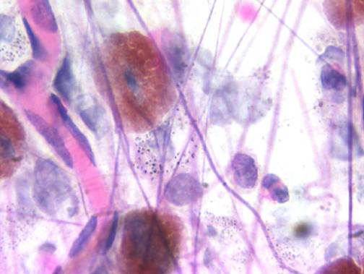
The structure at the tip of the blue arrow is a(n):
Collagen fiber.
Elastic fiber.
Fibronectin
Reticular fiber
60

Slide 17
Vitamin C dependent hydroxylation of proline and lysine in preprocollagen occurs in:
The rough endoplasmic reticulum
The smooth endoplasmic reticulum
The Golgi
The extracellular matrix.
60

Slide 18
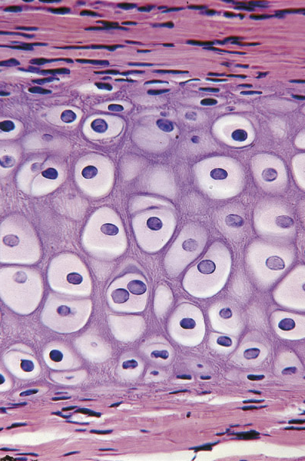
The image on the right is:
Fibrocartilage
Growing hyaline cartilage
Dense regular C.T.
Fibrous articluar layer of the TMJ
60

Slide 19
Which of the following contain Type I collagen?
Hyaline cartilage.
Elastic cartilage.
Fibrocartilage.
None of the above.
60

Slide 20
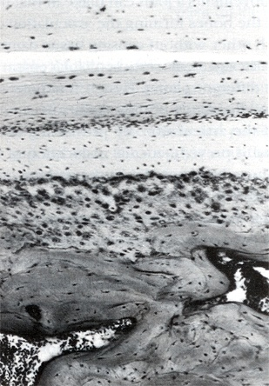
Which is the fibrous articular layer of the TMJ?
1
1
2
3
4
2
3
4
60
0 of 5

Slide 21
Which is the disk in the TMJ?
1
1
2
3
4
2
3
4
60

Slide 22
Which of the following would increase glycosaminoglycan synthesis in cartilage?
Testosterone
Estradiol
Cortisone
Hydrocortisone
60

Slide 23
Quiz #3

Slide 24
1. The percentage of bone made up by collagen is:
5%
28%
40%
68%
60

Slide 25
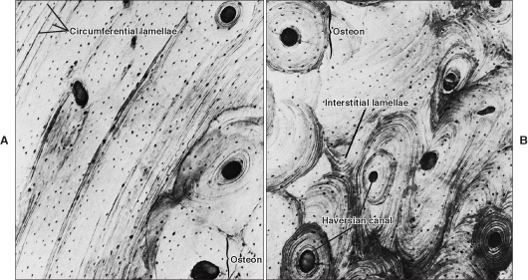
2. Circumferential lamellae are found at:
A
B
C
D
A
B
C
D
B
60

Slide 26
3. Which cells would have a sealing zone and a ruffled border?
Osteoblasts
Osteocytes
Osteoclasts
Chondrocytes
60

Slide 27
4. The Rank Ligand RANKL is found on:
Osteocytes
Osteoblasts
Osteoclasts
All of the above
60

Slide 28
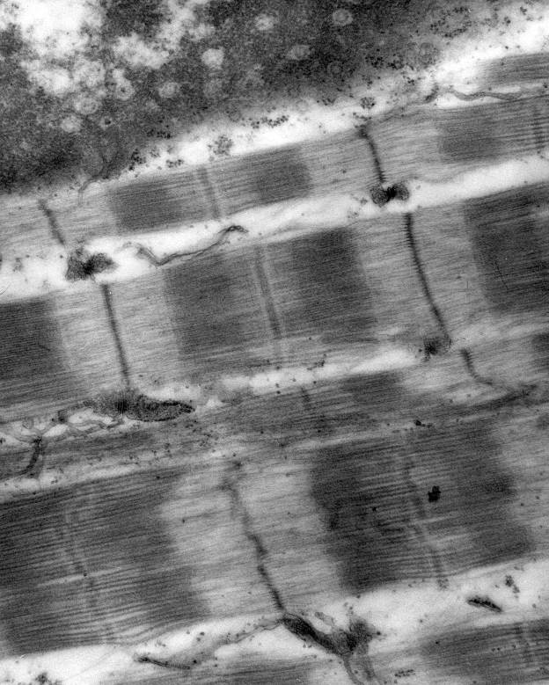
5. The sarcomere is found at:
1
2
3
4
60

Slide 29
6. Cardiac muscle has:
Gap junctions
Triads
T tubules located at the A/I junction.
Multiple peripherally located nuclei
60

Slide 30
7. Smooth muscle cells do not have:
Actin
Myosin
Tropomyosin
Troponin
60

Slide 31
8. The neurotransmitter found at the motor end plate is:
Acetylcholine
Substance P
Epinephrine
β-Endorphin
60

Slide 32
9. Where would you find the cell bodies of pseudounipolar neurons?
Dorsal horn
Ventral horn
Sympathetic ganglia
Dorsal root ganglia
60

Slide 33
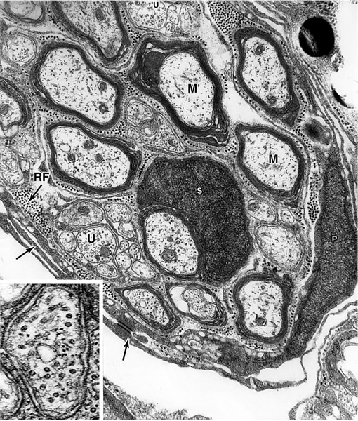
10. An unmyelinated axon is found at:
1
3
2
4
60

Slide 34
Quiz #4

Slide 35
1. You have an anemic or hypoxic patient you know that normally erythropoietin will be synthesized in the
Liver
Bone marrow
Spleen
Kidney
60

Slide 36
2. Primary or azurophilic granules in neutrophils are essentially:
Peroxisomes
Lysosomes
Histamine granules
Secretory granules
60

Slide 37
3. A cell that has granules with a crystalline core that contain major basic protein is a(n):
Basophil
Eosinophil
Neutrophil
Monocyte
60

Slide 38
4. Platelets:
Have an outer zone that contains granules.
Has an inner zone that contains cytoskeletal elements.
Can be stimulated by thrombopoietin made in the liver.
Bud off megakaryocytes located in the spleen.
60

Slide 39
5. Which antibody binds to mast cells and basophils?
IgA
IgG
IgE
IgM
60

Slide 40
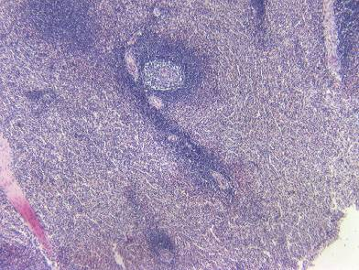
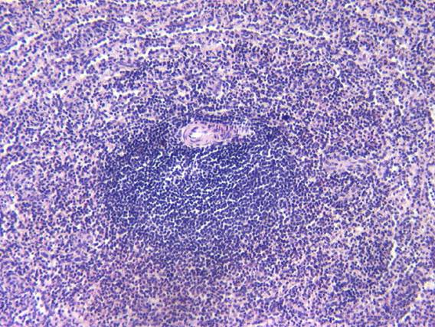
6. The organ in the images below :
Filters blood
Filters lymph
Does not have a capsule
Has only T cells.
60

Slide 41
7. Adaptive immunity:
Is non specific.
Has memory.
Responds to self antigens.
Does not demonstrate diversity.
60

Slide 42
8. Which capillaries have a continuous basal lamina?
Continuous only.
Continuous and fenestrated.
Fenestrated and discontinuous.
Fenestrated only
60

Slide 43
9. You would find continuous capillaries in the:
Heart.
Thymus
Spleen
Lymph node
60

Slide 44
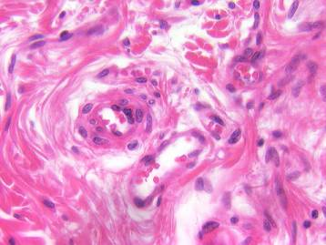
10. The blood vessel at the tip of the pointer is a:
Medium sized vein
Small vein or venule
Medium sized artery
Arteriole
60

Slide 45
Quiz #5

Slide 46
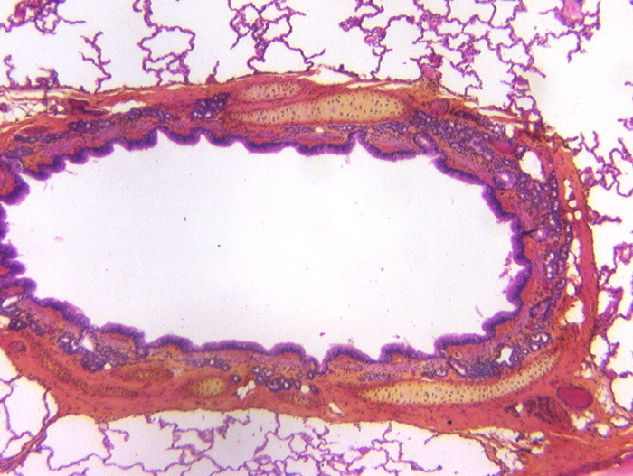
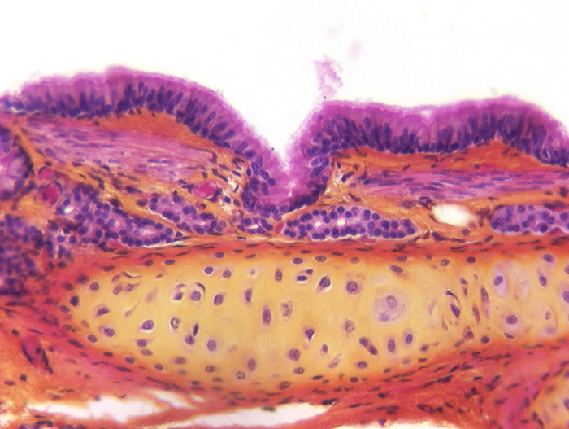
1. The organ with a star in the lumen is a:
Trachea
Bronchus
Bronchiole
Pulmonary artery
60

Slide 47
2. In the lung, elastic fibers are found in
Bronchi only.
Bronchi and bronchioles only
Bronchi, bronchioles and alveolar ducts only.
Bronchi, bronchioles, alveolar ducts and alveoli.
60

Slide 48
3. Which of the following structures would be found in a terminal bronchiole?
Goblet cells.
Cartilage
Smooth muscle
Glands
60

Slide 49
4. You have a patient with asthma. You know that histamine release is part of the problem. Histamine is made in:
Macrophages
Mast cells
Eosinophils
Natural killer cells.
60

Slide 50
5. Dr. Fornatora talked about the Ring of Waldeyer. This consists of all the following except:
Lingual tonsils
Palatine tonsils
Pharyngeal tonsils
Submandibular lymph nodes.
60

Slide 51
6. Which of the following structures contains smooth and skeletal muscle.
Upper 1/3rd of the esophagus.
Middle 1/3rd of the esophagus.
Rectum
Upper part of the anal canal.
60

Slide 52
7. Which cell secretes intrinsic factor?
Parietal cells
Chief cells
Enteroendocrine I cells in the small intestine.
Paneth cells
60

Slide 53
8. Pepsinogen is synthesized by:
Parietal cells
Chief cells
Enteroendocrine G cells of the small intestine
Paneth cells.
60

Slide 54
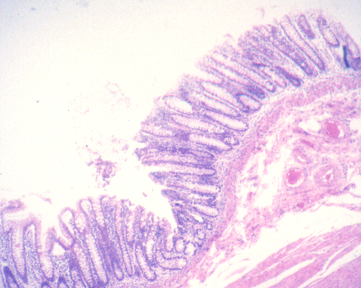
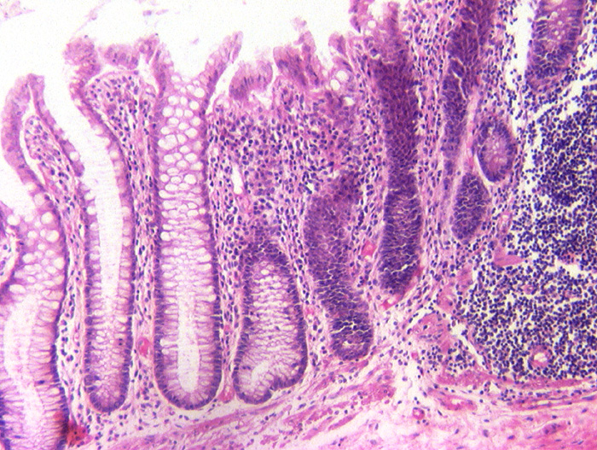
9. The organ on the right is the:
Stomach
Jejunum
Ileum
Colon
60

Slide 55
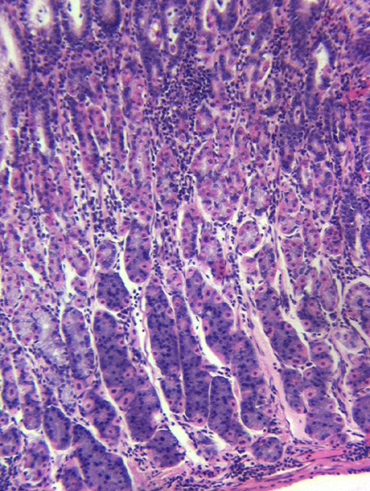
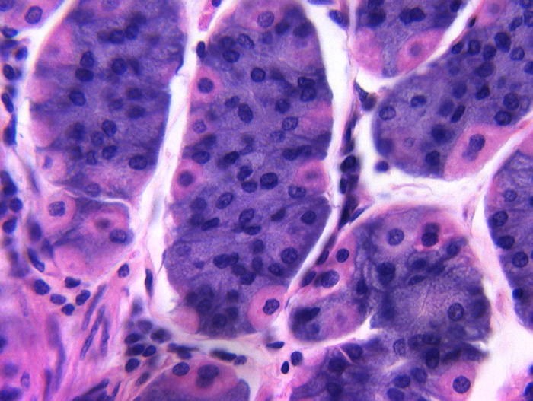
10. The cell at the tip of the red arrow is a:
Parietal cell
Chief cell
Paneth cell
Mucous neck cell
60

Slide 56
Quiz #6

Slide 57
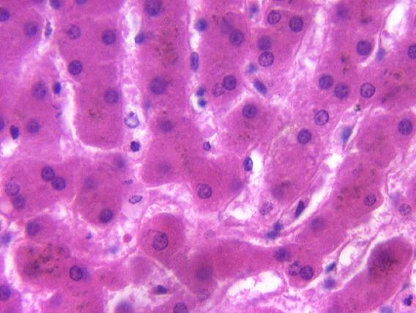
1. The tip of the red arrow is in a:
Sinusoid
Space of Disse
Bile canaliculus
Bile Duct
60

Slide 58
2. Barbiturates and antibiotics are inactivated by methylation in the:
Rough endoplasmic reticulum
Smooth endoplasmic reticulum
Lysosomes
Mitochondria.
60

Slide 59
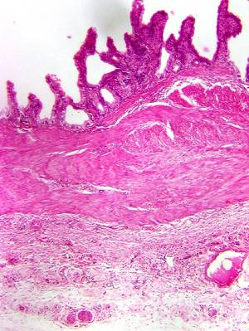
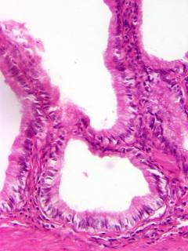
3. Identify the organ.
Jejunum
Gall bladder
Pharynx
Anal canal
60

Slide 60
  4. Which cells make a serous bicarbonate-rich alkaline fluid?
Chief cells of the stomach.
A (α) cells of the pancreas.
Enteroendocrine cells of the duodenum.
Intercalated duct cells of the pancreas.
60

Slide 61
5. The cell in the Islet of Langerhan that makes glucagon is the:
A (α) cell
B (β) cell
D (δ) cell
F cell
60

Slide 62
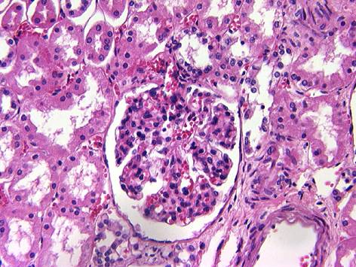
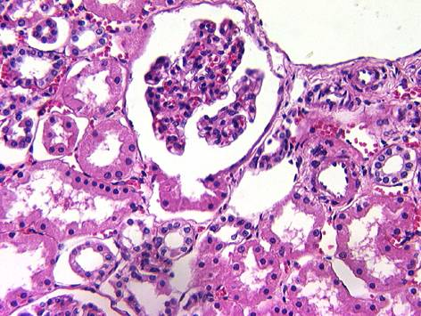
6. The tubule at the tip of the pointer is a:
Proximal convoluted tubule.
Descending thick tubule.
Ascending thick tubule
Collecting tubule
60

Slide 63
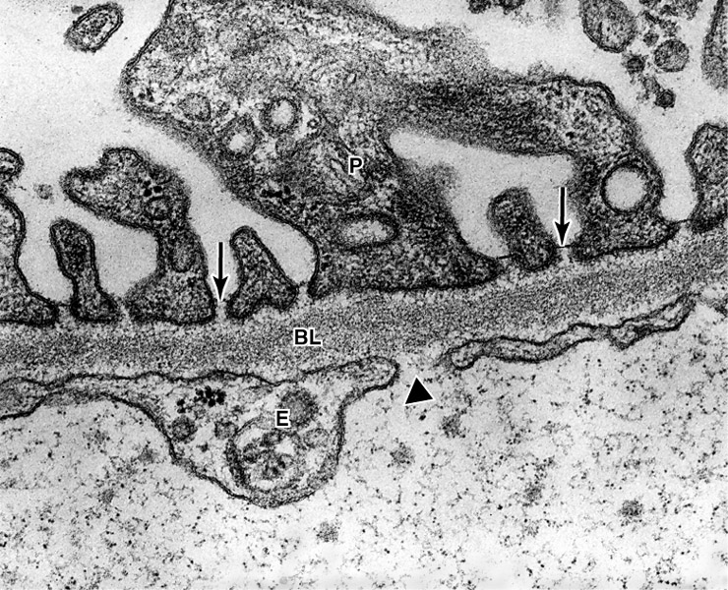
7. What type of capillary is seen in this slide?
Continuous.
Discontinuous.
Fenestrated with diaphragms.
Fenestrated without diaphragms .
60

Slide 64
8. What converts angiotensinogen to angiotensin I?
Converting enzyme in the lung.
Renin
Aldosterone
Trypsinogen
60

Slide 65
9. Most of the water reabsorbed by the nephron is taken up by the:
Proximal convoluted tubule.
Ascending thin limb of Henle
Distal convoluted tubule.
Collecting duct.
60

Slide 66
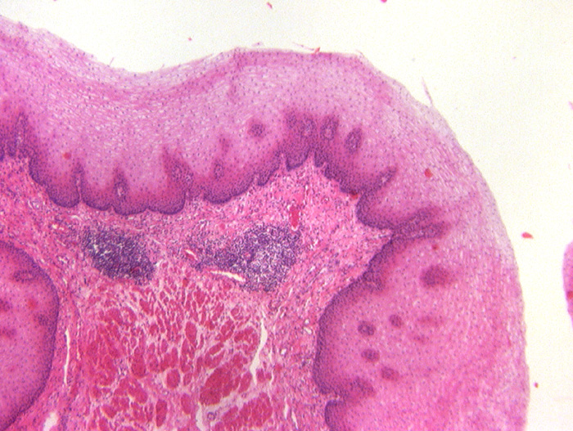
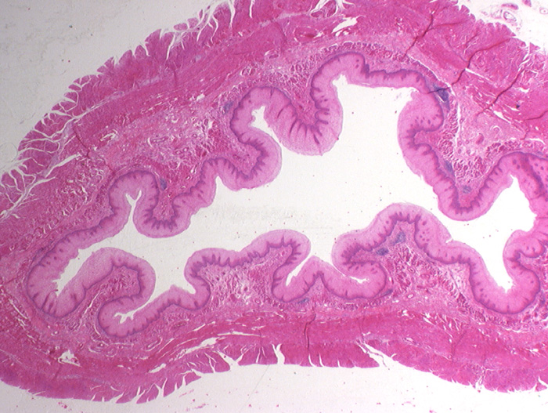
10. Identify the organ
Gall bladder.
Ureter.
Rectum
Esophagus
60

Slide 67
Quiz #7

Slide 68
1. Basophils in the pars distalis produce.
ADH
Oxytocin
FSH
Prolactin
60

Slide 69
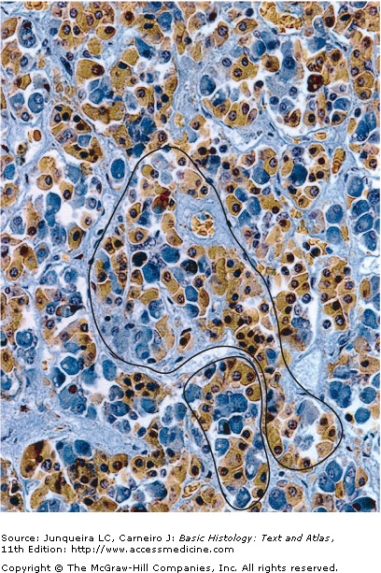
2. The cell at the tip of the pointer produces:
Growth hormone
LH
FSH
TSH
60

Slide 70
3. To lower calcium levels you would expect to see increased secretion from the:
Parathyroid gland.
Parafollicular cells of the thyroid gland.
Adrenal gland
Thyroid follicular cells.
60

Slide 71
4. What hormone stimulates the osteoblast to synthesize RANKL?
Thyroid hormone.
Parathyroid hormone.
Calcitonin
Aldosterone
60

Slide 72
5. Which region of the adrenal gland secretes aldosterone?
Zona glomerulosa
Zona reticularis
Zona fasciculata
Zona pellucida
60

Slide 73
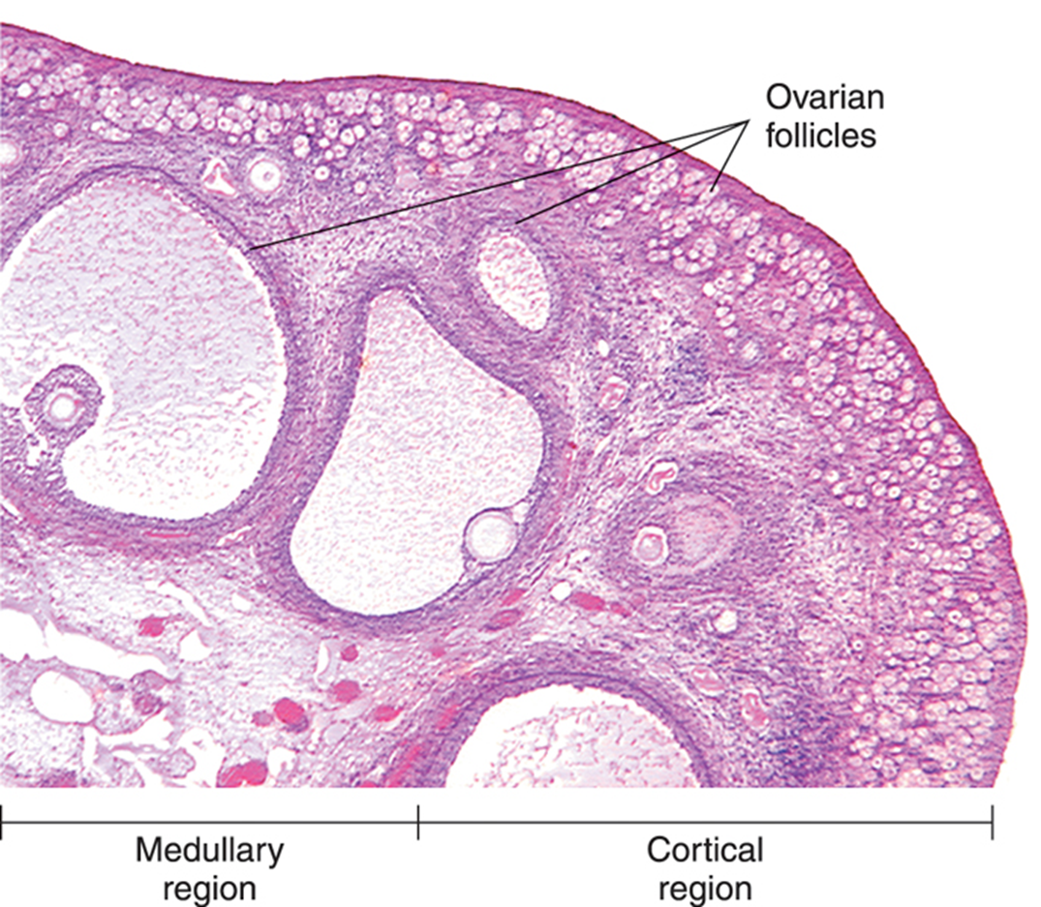
6. The follicle at the tip of the black pointer is a
Primordial follicle
Primary follicle
Secondary follicle
Mature Graffian follicle
60

Slide 74
7. A surge in which of the following induces ovulation?
Estrogen
Progesterone
LH
FSH
60

Slide 75
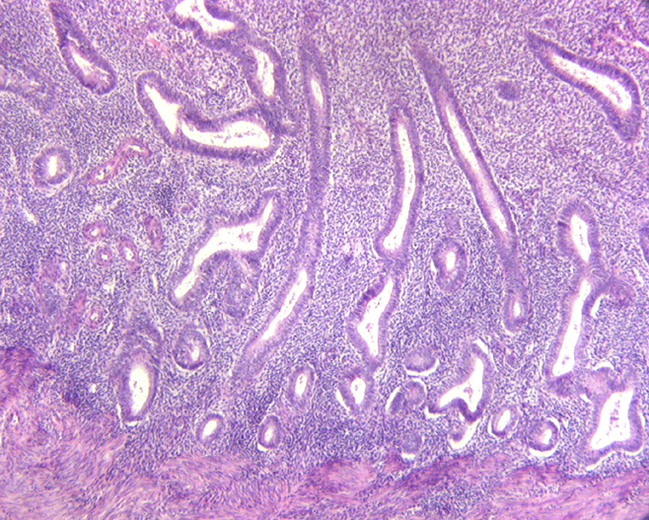
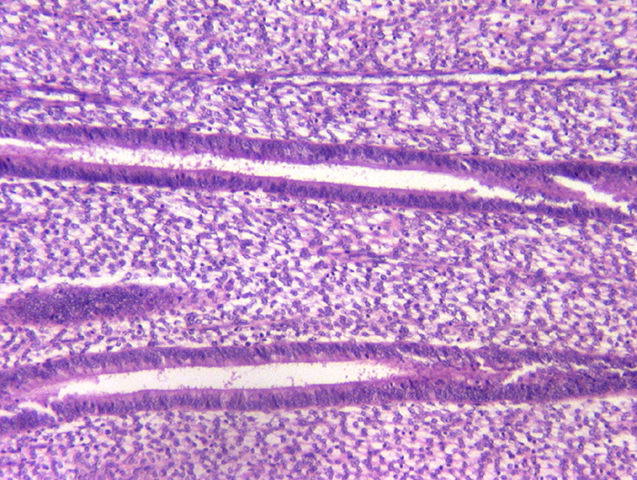
8. The organ on the right is at what day of the menstrual cycle?
4
10
18
25
60

Slide 76
9. Identify this organ.
Ureter
Isthmus of the uterine tube
Infundibulum of the uterine tube.
Esophagus.
60

Slide 77
10. The most eggs that a female will have is at:
6 – 9 months of gestation.
6 – 9 months after birth.
6 – 9 years after birth.
6 – 9 months after puberty.
60

Slide 78
Quiz #8

Slide 79
1. To increase testosterone production:
Acidophils would produce more FSH.
GNRH secretion would be reduced.
Sertoli cells would release androgen binding protein.
LH levels would increase.

Slide 80
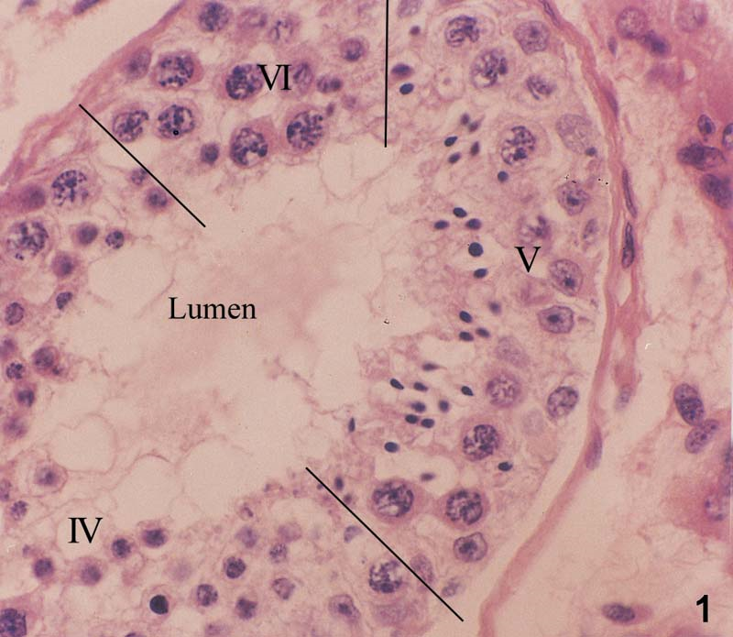
2. The cell at the tip of the pointer is a:
Sertoli cell
Spermatogonia
Primary spermatocyte
Spermatid

Slide 81
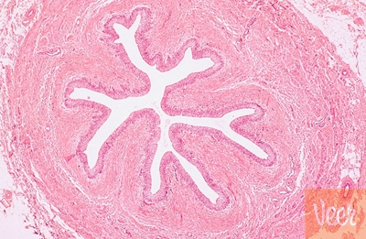
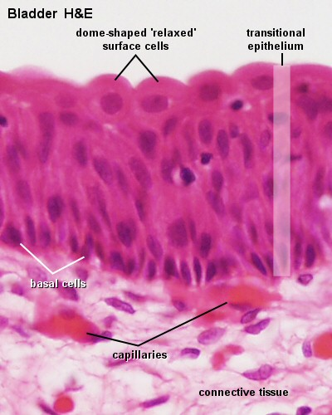
3. Identify the organ.
Vas deferens
Uterine tube
Ureter
Epididymis

Slide 82
4. For sperm to be motile they must travel through the:
Efferent ductules
Epididymis
Prostate
Uterine tube

Slide 83
5. Capacitation occurs in the.
Seminiferous tubules.
Epididymis
Vas deferens
Uterine tube

Slide 84
6. The auditory tube connects the:
Middle ear cavity and the mastoid air cells.
External auditory canal and the middle ear cavity.
The middle ear cavity and the nasopharynx.
The inner ear and the middle ear cavity.

Slide 85
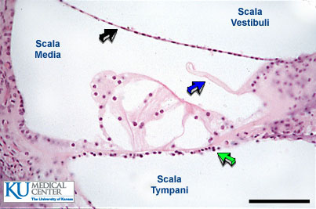
7. The basilar membrane is located at the:
Green arrow.
Blue arrow.
Black arrow.

Slide 86
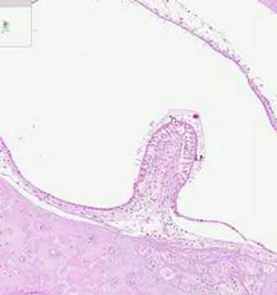
8.The structure in this image:
Is surrounded directly by perilymph.
Detects rotational movement.
Is found in the utricle.
Is found in the saccule.

Slide 87
9. Stereocilia would NOT be found in the:
Inner ear.
Epididymis
Vas Deferens
Uterine tube.

Slide 88
10. The stapes attaches to the:
Round window
Oval window
Tympanic membrane
None of the above.

Slide 89
Quiz #9

Slide 90
1. The anterior continuation of the sclera is the:
Cornea
Lens
Ciliary body
Iris
60

Slide 91
2. The flow of aqueous humor is from the:
Posterior chamber to the vitreous body.
Posterior chamber to the anterior chamber.
Anterior chamber to the vitreous body.
Anterior chamber to the posterior chamber
60

Slide 92
3. High quality vision is found in the:
Peripheral retina
Optic disk
Fovea centralis
Macula densa
60

Slide 93
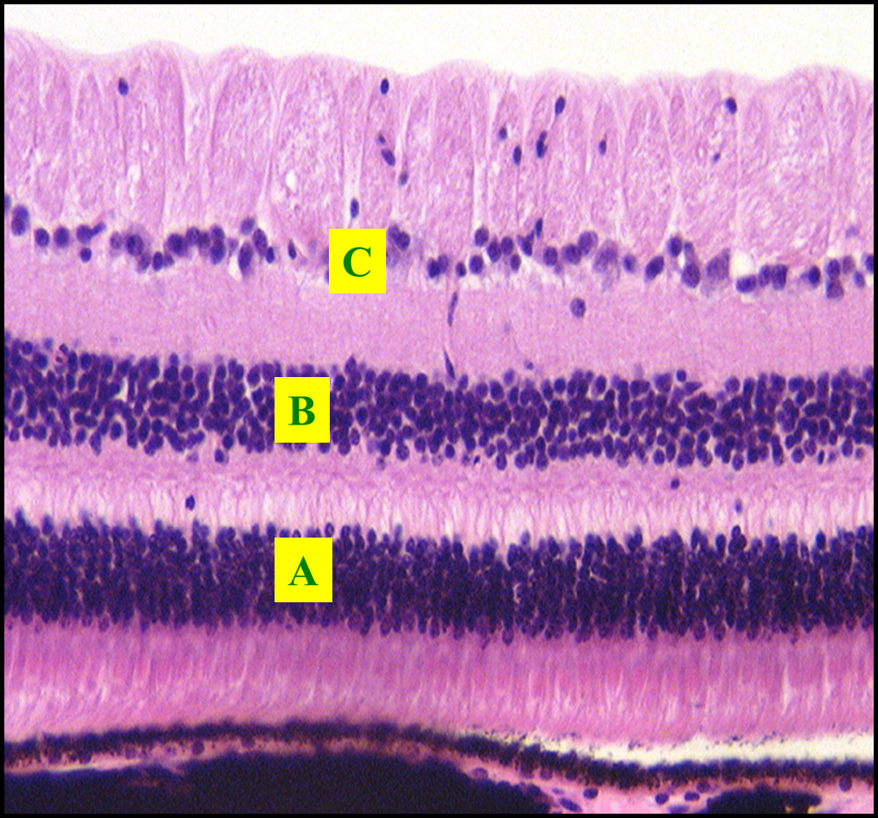
4. The layer where the ganglion cells are found:
A
B
C
D
60

Slide 94
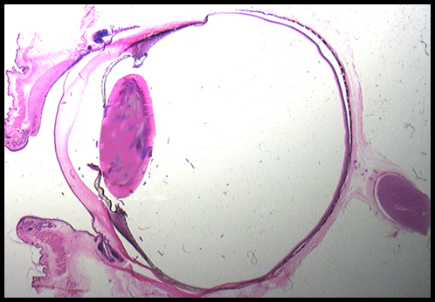
5. The sphincter pupillae muscle is located at:
A
B
C
D
B
A
C
D
60

Slide 95
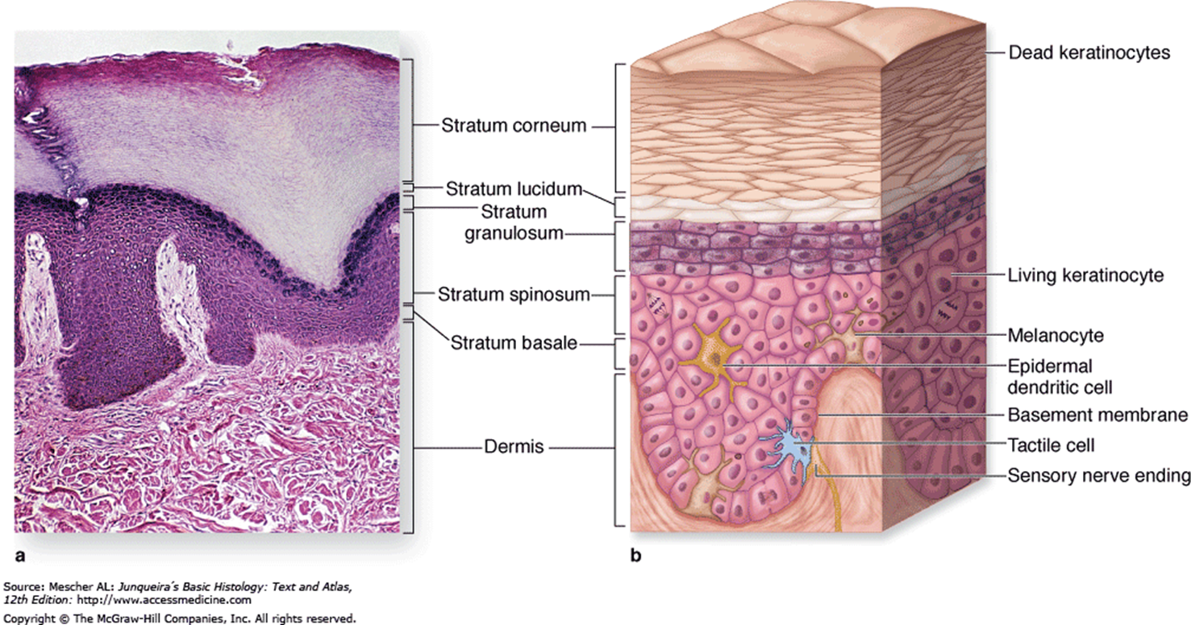
6. The layer at the tip of the pointer is the:
Stratum Basale
Stratum Spinosum
Stratum Granulosum
Stratum Corneum
60

Slide 96
7. Pressure is detected best by:
Meissner’s corpuscles
Merckel cell
Pacinian corpuscles
Free nerve endings.
60

Slide 97
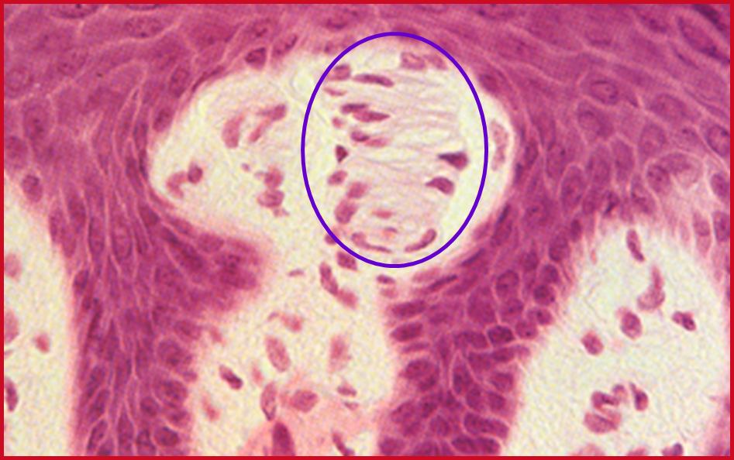
8. The circled structure is a:
Pacinian corpuscle
Meissner’s corpuscle
Merkel cell
Capillary plexus
60

Slide 98
9. The structure at the tip of the pointer is the:
Sebaceous gland
Sweat gland
Arrector pili
Hair follicle.
60

Slide 99
10. The structure at the tip of the pointer is a:
Duct of a sweat gland.
Secretory portion of a sweat gland.
Arteriole
Venule
60

Slide 100
Quiz #10

Slide 101
1. You have a patient with an embryo that is 14 days of gestation. You know that the embryo has :
Undergone gastrulation.
Implanted.
Established the vertebrate body plan
Three germ layers.

Slide 102
2. A woman in your dental chair is pregnant. Her last menstrual cycle began 21 days ago. You know that her embryo has.
An inner cell mass.
Three germ layers.
A beating heart.
A zona pellucida.

Slide 103
3. Neural crest cells are derived from:
Ectoderm
Mesoderm
Endoderm

Slide 104
4. The fetal component of the placenta comes from the:
Inner cell mass.
Trophoblast.
Ectoderm
Blastocyst cavity.

Slide 105
5. The percentage of fertilized eggs that make it to birth is:
90%
70%
30%
10%

Slide 106
6. The pharyngeal pouch that gives rise to the thymus is the:
1st
2nd
3rd
4th

Slide 107
7. The tip of the nose develops from the:
Frontonasal process
Maxillary process
Mandibular process
First pharyngeal arch.

Slide 108
8. The upper incisors develop from the
Medial nasal processes
Maxillary processes
Lateral nasal processes.
A and B
A, B and C

Slide 109
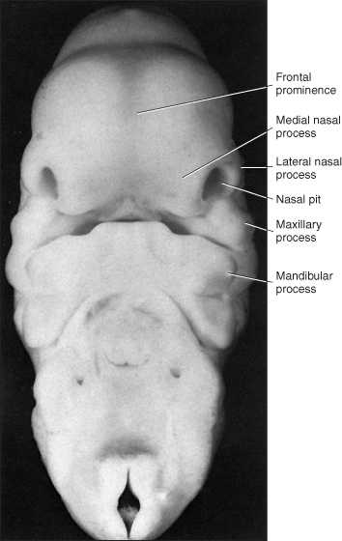
9. The mandibular process is found at the tip of pointer
A
B
C
D
E
A
B
C
D
E

Slide 110
10. An upper cleft jaw would occur between the:
Medial and lateral incisors.
Lateral incisor and the canine
Canine and first molar.

Slide 111
Quiz #11

Slide 112
1. The earliest development of the tooth is directed by the expression of:
FGF by the ectoderm
FGF by the endoderm
SHH by neural crest cells
BMP by neural crest cells.
60

Slide 113
2. Later tooth development and tooth patterning is directed by:
Ectoderm
Neural crest
Somites
Lateral plate mesoderm.
60

Slide 114
3. The dental follicle gives rise to:
Enamel
Dentin
Cementum
Enamel organ
60

Slide 115
4. Osteoblasts forming alveolar bone develop from:
Oral Ectoderm
Neural crest
Dental papilla
Enamel organ
60

Slide 116
5. The initiation of the primary dentition begins at:
6 – 8 weeks of gestation
20 weeks of gestation
6 – 8 weeks after birth.
6 months after birth.
60

Slide 117
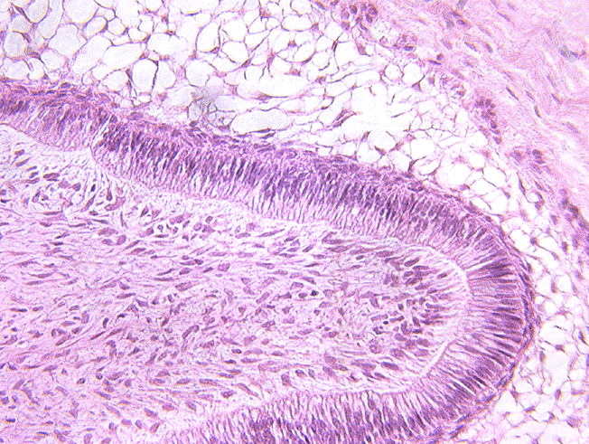
6. The cells at the tip of the pointer are:
Odontoblasts
Presecretory ameloblasts
Secretory ameloblasts
Ruffled ameloblasts
60

Slide 118
7. During the secretory phase the percentage of mineral in enamel is:
10%
30%
50 %
95%
60

Slide 119
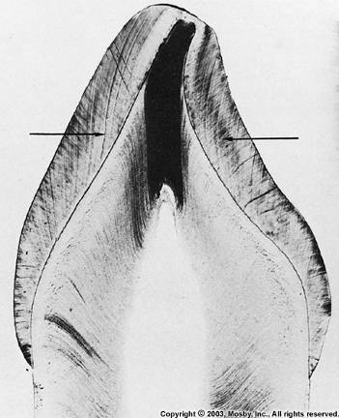
8. The arrows point to:
Enamel lamellae
Dentinal tubules
Incremental lines of Retzius
Enamel rods.
60

Slide 120
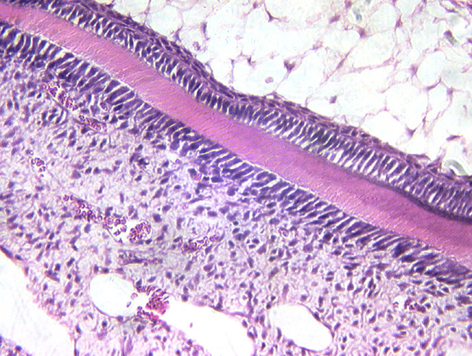
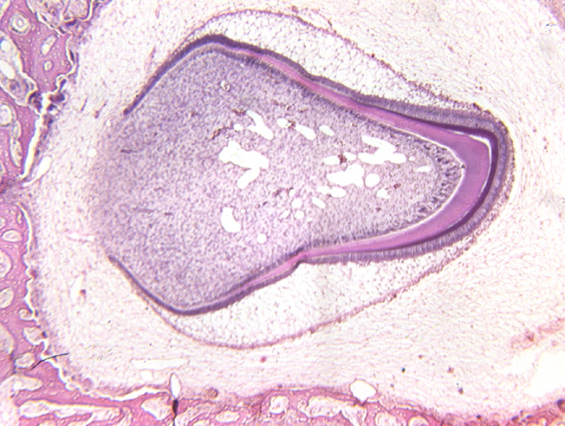
9. Secretory ameloblasts are found at:
A
B
C
D
A
B
C
D
60

Slide 121
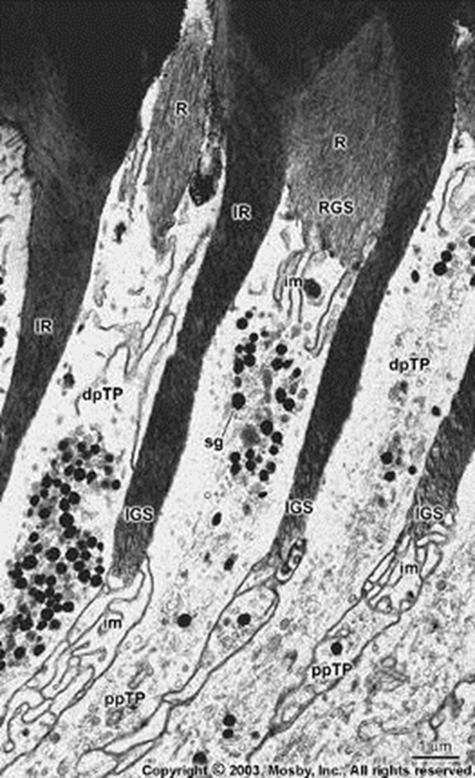
10. The structure at the tip of the pointer is a:
Ruffled border of an ameloblast
Enamel spindle
Tome’s process
Extra Credit quiz #4
60

Slide 122
Quiz #12

Slide 123
1. Which layer of dentin is closest to enamel?
Primary dentin
Secondary dentin
Reparative dentin
Mantle dentin
60

Slide 124
2. Which of the following is 70% inorganic material?
Enamel
Dentin
Cementum
Bone
60

Slide 125
3. Which of the following does not use collagen as a scaffolding for deposition of matrix?
Enamel
Dentin
Cementum
Bone
60

Slide 126
4. Mineralized matrix in dentin is nucleated upon what type of collagen?
Type I
Type II
Type III
Type XII
60

Slide 127
5. Where would you find pulp stones?
The periodontal ligament.
Reparative dentin
The pulp cavity
Tomes granular layer.
60

Slide 128
6. Which cells are most associated with Von Korff’s fibers?
Fibroblasts of the periodontal ligament.
Odontoblasts
Ameloblasts
Cementoblasts.
60

Slide 129
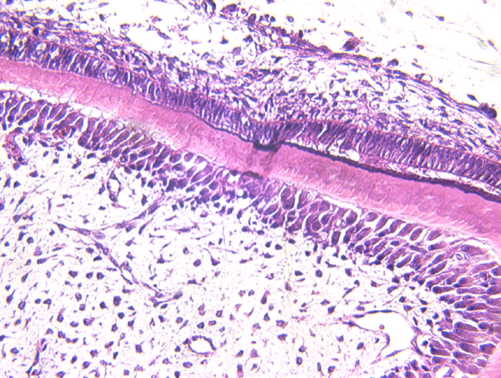
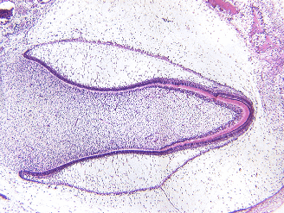
7. The cells at the tip of the pointer are:
Ameloblasts
Odontoblasts
Cementoblasts
60

Slide 130
8. Which is formed first.
Primary cementum
Secondary cementum
Dentin
Enamel
60

Slide 131
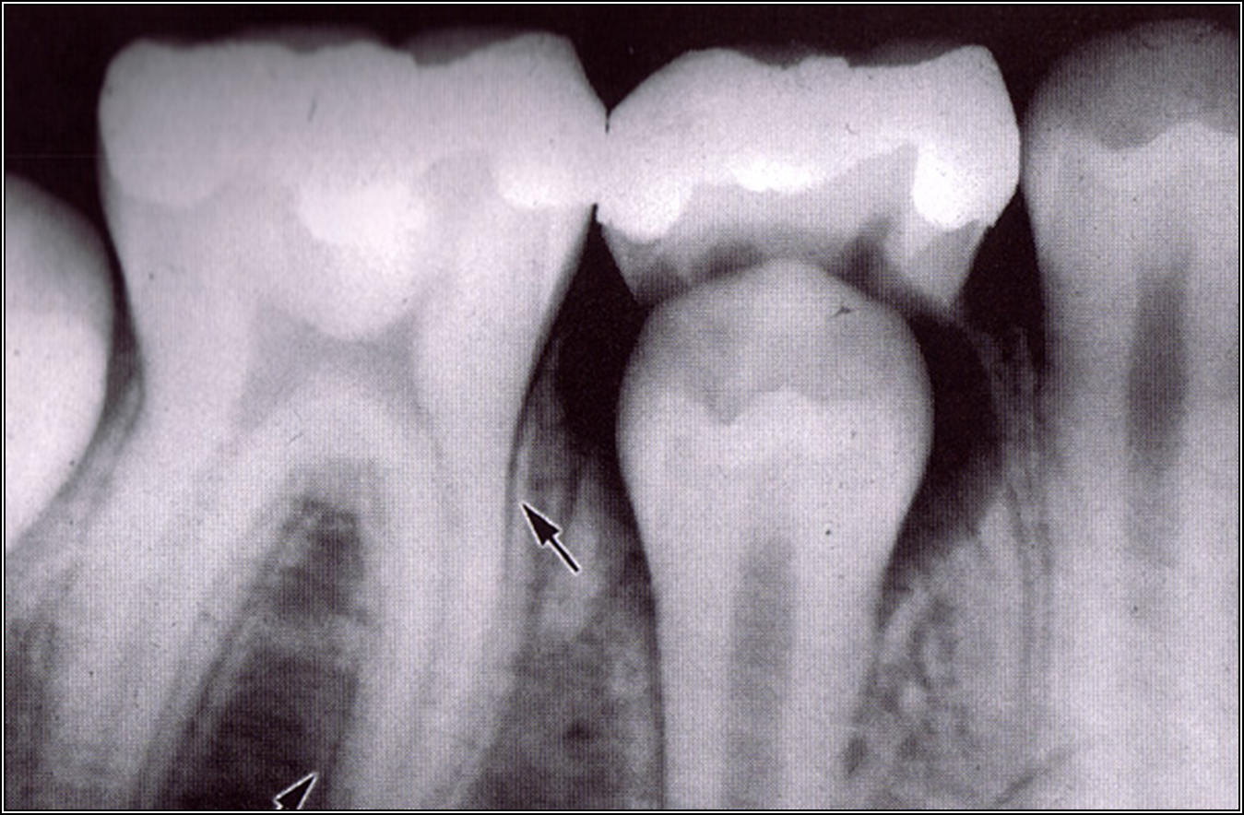
9. The arrow points to the:
Cementum.
Lamina dura.
Spongy bone.
Alveolar crest.
60

Slide 132
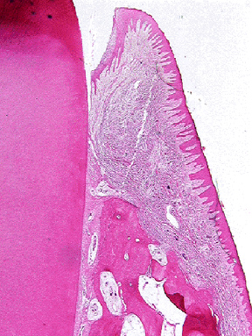
10. The fibers at the tip of the pointer are the:
Dentogingival fibers
Oblique fibers
Interradicular fibers
Alveolar crest fibers.
60

Slide 133
Quiz #13
Notes:
133

Slide 134
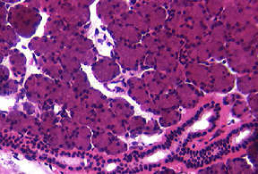
1. The tissue in the image is the
Sublingual gland
Submandibular gland
Parotid gland
Notes:
134

Slide 135
2. Serous cells produce.
Amyalase
Mucin
Inorganic salts.
Gastrin
Notes:
135

Slide 136
3. Which of the following is not involved in the protein production from serous secreting cells?
Norepinephrine
Muscarinic cholinergic receptor
G-protein
Protein kinase A
Notes:
136

Slide 137

4. Identify the structure at the tip of the pointer.
Intercalated duct
Striated duct.
Sweat duct
Proximal convoluted tubule
Notes:
137

Slide 138
5. Which of the following does not enter the interstitial tissue via the striated duct?
Sodium
Chloride
Water
Potassium
Notes:
138

Slide 139
6. Keratinized stratified epithelium would be found in all the regions below EXCEPT:
Tongue.
Gingiva.
Cheek.
Hard palate.
Notes:
139

Slide 140
7. A masticatory mucosa:
Is soft and pliable.
Inflammation is not that painful.
Injection of fluid is difficult.
Fluid disperses easily.
Notes:
140

Slide 141
8. Which of the following would not be found in the basal lamina?
Tonofilaments
Type IV collagen
Type VII collagen
Laminin
Notes:
141

Slide 142

9. The structure at the tip of the pointer is a:
Filiform papilla
Fungiform papilla
Circumvallate papilla
Notes:
142

Slide 143

10. The structure at the tip of the pointer is the:
Attacched gingiva
Free gingiva
Attached gingiva
Junctional epithelium.
Notes:
143

Slide 144
Extra Credit Quiz #1
Notes:
144

Slide 145

1. The tip of the arrow lies on the:
Nucleolus
Heterochromatin
Lysosome
Secretory granule
Notes:
145

Slide 146

2. The epithelium in the image is:
Stratified squamous wet.
Keratinized stratified squamous.
Transitional
Pseudostratified.
Notes:
146

Slide 147
3. Cell to cell communication occurs via:
Desosomes
Fascia adherens
Tight junctions
Gap junctions
Notes:
147

Slide 148
4. The tissue at the tip of the pointer is:
Dense regular
Dense irregular
Loose regular
Loose irregular
Notes:
148

Slide 149

5. The cell at the tip of the pointer is a(n):
Mast cell
Macrophage
Monocyte
Plasma cell
Notes:
149

Slide 150
Extra Credit Quiz #2
Notes:
150

Slide 151
1. In the lungs, elastic fibers are found in
Bronchi only.
Bronchi and bronchioles only
Bronchi, bronchioles and alveolar ducts only.
Bronchi, bronchioles, alveolar ducts and alveoli.
Notes:
151

Slide 152
2. Which of the following structures would be found in a terminal bronchiole?
Goblet cells.
Cartilage
Smooth muscle
Glands
Notes:
152

Slide 153
3. Dr. Fornatora talked about the Ring of Waldeyer. This consists of all the following except:
Lingual tonsils
Palatine tonsils
Pharyngeal tonsils
Submandibular lymph nodes.
Notes:
153

Slide 154
4. Which cell secrets intrinsic factor?
Parietal cells
Chief cells
Enteroendocrine I cells in the small intestine.
Paneth cells
Notes:
154

Slide 155
5. The organ on the right is the:
Stomach
Jejunum
Ileum
Colon
Notes:
155

Slide 156
Extra Credit Quiz #3

Slide 157


1. Which of these images comes from the most mature tooth?
A
B
C
60
A
B
C

Slide 158

2. The stellate reticulum is located at:
A
B
C
A
C
B
60

Slide 159

3. Cells derived from neural crest are found at:
A only
B only
C only
A and B
A, B, and C
60

Slide 160

4. Gnarled enamel is seen at:
A
B
C
D
A
B
C
D
60

Slide 161

5. The structure at the tip of the pointer is a(n):
Enamel lamella
Enamel tuft
Enamel spindle
Hunter Schrager band.
60

Slide 162
Extra Credit Quiz #4
Notes:
162

Slide 163

The image below is:
A Turkey
Thanksgiving dinner.
A histology professor.
All of the above
Notes:
163

Slide 164
Extra Credit Quiz #5
Notes:
164

Slide 165
1. During the synthesis of collagen, prolines and lysines are hydroxylated in the:
Nucleus
Rough endoplasmic reticulum
Smooth endoplasmic reticulum
Golgi
Notes:
165

Slide 166
2. A cell that secretes histamine is the
Macrophage
Neutrophil
Eosinophil
Mast cell
Notes:
166

Slide 167
3. A protein associated with desmosomes is:
Claudin
Connexin
Actin
Plakoglobin
Notes:
167

Slide 168
4. Intracellular canaliculi are found between cells in the:
Sublingual gland
Liver
Pancreas
Stomach
Notes:
168

Slide 169

5. The organ picture is the:
Parotid
Submandibular gland
Sublingual gland
Pancreas
Notes:
169

