Slide 1
Periapical Lesions of Endodontic Origin
Dr. Michael Gonsky
michaelgonsky@yahoo.com

Slide 2
Formation of Lesions of Endodontic Origin
Microorganisms
Chronic Inflammatory cells
Shifts to PMN’s
Necrosis Spreads
Apical Portals of Exit
Necrosis spreads to apices- via apical portals of exit.

Slide 3
Periapical Defenses
Superior to pulpal defenses
Rich blood supply and lymphatic's
Limitless source of undifferentiated cells
Extensive defense but locally destructive

Slide 4
Classification of Periapical Lesions
Normal PA tissue
Symptomatic Apical Periodontitis
Asymptomatic Apical Periodontitis
Condensing Osteitis
Acute Apical Abscess
Chronic Apical Abscess
Look for widening of the PDL,

Slide 5
Symptomatic Apical Periodontitis
First extension of pulpal inflammation into periradicular tissues
Causes are: bacterial, chemical, hyper-occluding restoration, over-instrumented canal, or overextended obturation
Be very thorough, b/c if a recent restoration is too high it can cause S.A.P.
The pulp may be vital or necrotic

Slide 6
Signs and Symptoms of Symptomatic Apical Periodontitis
Moderate to severe spontaneous pain
Pain to mastication and percussion
Most cases have an intact PDL but an area can be present (space where PDL is abscent)

Slide 7
Histology of Symptomatic Apical Periodontitis
PMN leucocytes and macrophages localized at apex
small area of liquefaction necrosis (abscess)
Bone and root resorption on histological level

Slide 8
Asymptomatic Apical Periodontitis
Results from a necrotic pulp
Usually a sequel to Symptomatic Apical Periodontitis
Granulomas, cysts, cholesteatoma and condensing osteitis
Cholesteatoma= have elements in Granuloma but a lot more cholesterol, basically a granuloma that is undergoing fatty degeneration

Slide 9
Treatment of Symptomatic Apical Periodontitis
Adjust the occlusion
Remove pathologic pulp
Drain periapical exudate
Complete endodontic therapy

Slide 10
Histology of Asymptomatic Apical Periodontitis
The Granuloma: vascular fibrous CT (granulomatous tissue) with mast cells, macrophages, lymphocytes, plasma cells and a small number of PMN’s
The Cyst: has a fluid filled central cavity lined by epithelium surrounded by CT containing all the elements of a granuloma
Stratified squamous epithelium from Rests of Malasez

Slide 11
Chronic inflammation and granulomatous tissue
Root canal
Cementum
Periapical granuloma
Notes:
In higher magnification of the periapical area.

Slide 12
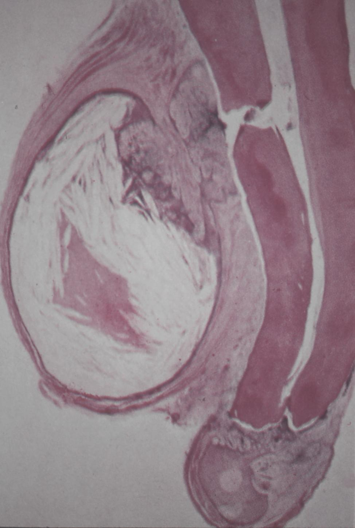
RADICULAR CYST
It is characterized by a central fluid-filled epithelium-lined cavity (histological section).
Root canal
Lateral canal
LUMEN
fluid / semi-fluid material
Epithelium
Apex

Slide 13
Treatment of Asymptomatic Apical Periodontitis
Removal of the irritants from necrotic root canal system
Complete obturation of the root canal system
There is no evidence that cysts resist resolution following endodontic therapy (non-surgical)

Slide 14
Condensing Osteitis
Variant of Asymptomatic Apical Periodontitis
Increased trabecular bone in response to persistent irritant
Usually found around the apices of mandibular posterior teeth
Response to inflamed or necrotic teeth

Slide 15
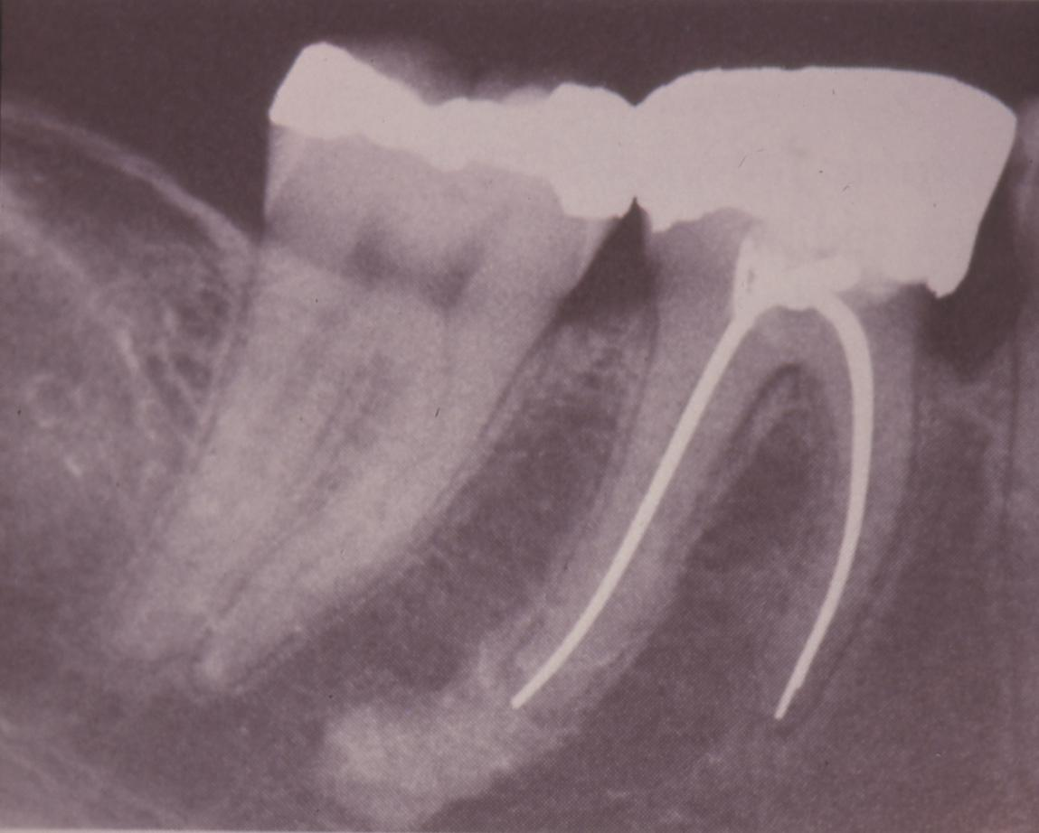
CONDENSING OSTEITIS
DIAGNOSIS
-Clinical vital / non-vital
-Radiographic
Condensing osteitis has been found in 4.5% patients.
T. P. Williams and S. L. Brooks. A longitudinal study of idiopathic osteosclerosis and condensing osteitis. Dentomaxillofacial Radiology, Vol 27, Issue 5 275-278, Copyright © 1998 by British Institute of Radiology
Notes:
Condensing osteitis has been found in 4.5% patients.
T. P. Williams and S. L. Brooks. A longitudinal study of idiopathic osteosclerosis and condensing osteitis. Dentomaxillofacial Radiology, Vol 27, Issue 5 275-278, Copyright © 1998 by British Institute of Radiology

Slide 16
Periapical Abscess
Acute Apical Abscess
Chronic Apical Abscess
Phoenix Abscess- a secondary abscess in response to chronic infection (acute exacerbation)
So granulomas are an organized collection of macrophages, while an abscess is like a pimple, its full of dead neutrophil.

Slide 17
Acute Apical Abscess
Signs and symptoms- rapid onset, spontaneous pain, temperature, malaise, leucocytosis (high WBC). Necrotic pulp, percussion and palpation positive.
Histological features- liquefaction necrosis, disintegrating PMN’s, cellular debris and a purulent exudate. Surrounding the abscess is granulation tissue.
Treatment- release exudates; endodontic therapy

Slide 18
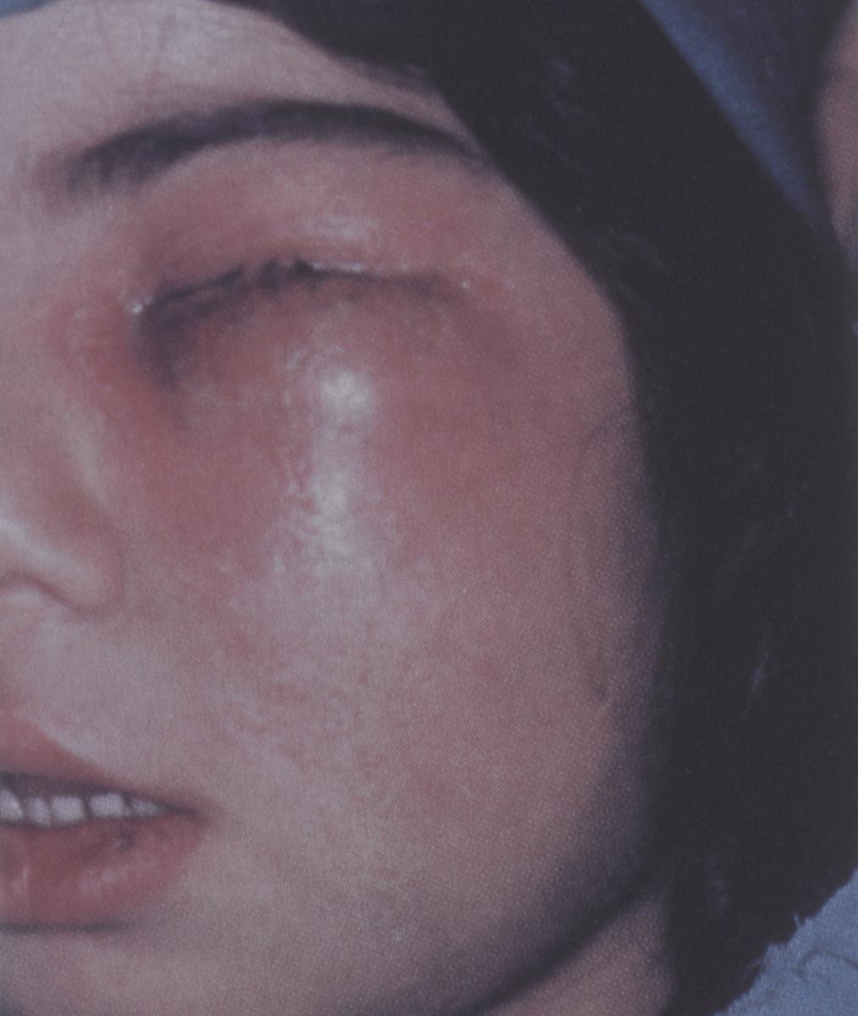
ACUTE APICAL ABSCESS
CLINICAL FEATURES
-Swelling
-Tooth feels elevated out of the socket
-Elevated temperature
-Malaise
Notes:
…and sometimes lymphoadenopathy…

Slide 19
Chronic Apical Abscess
Signs and symptoms- long standing lesion, has drainage to mucosal surface via sinus tract
Histology is similar to acute abscess
Treatment- no need to establish drainage, complete cleaning and obturation of the root canal system

Slide 20
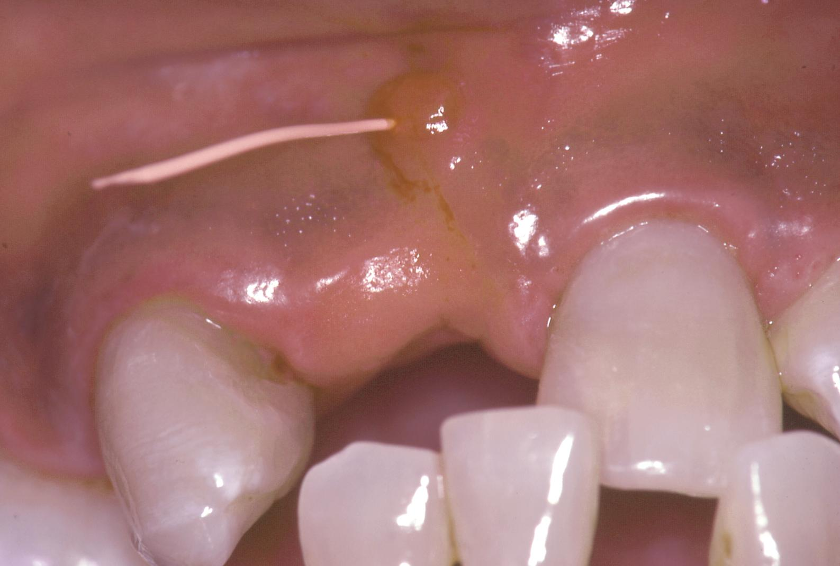
Tracing the fistula

Slide 21
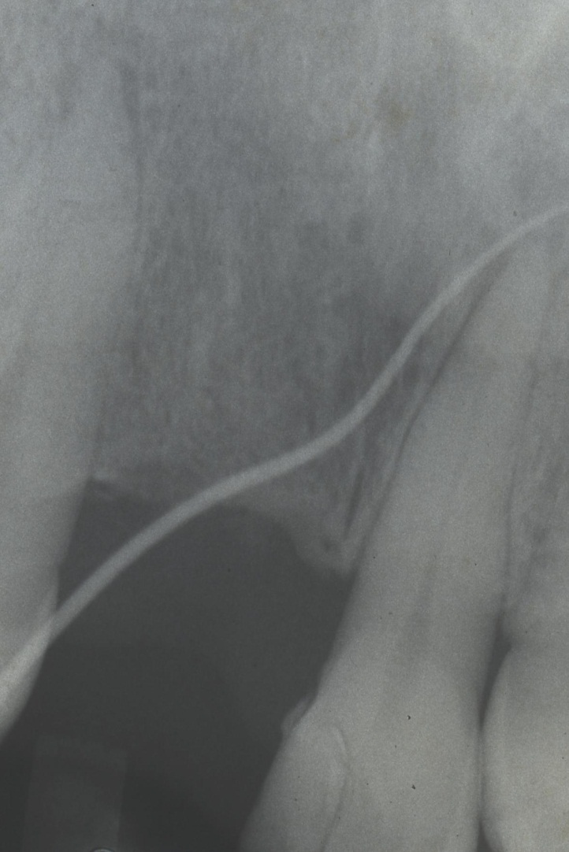
Tracing the fistula

Slide 22
Healing of Periapical Lesions
Regeneration- altered periapical tissues completely replaced by tissue forming the original architecture
Repair- altered tissue not completely restored to original structures (example, scar)
On a histological level most PA lesions heal by repair

Slide 23
Osteomyelitis
Severe osseous infection of bacterial origin
Diagnosis- difficult early because intact cortical plate (CBCT-cone beam=$100,000), malaise, febrile, joint pain.
Treatment- severe problem, IV antibiotics, extensive surgical excision, massive bone removal and the loss of several teeth.

Slide 24
Cellulitis
Infection will not localize
Extensive swelling
Dissects fascial planes
Treatment; antibiotics, I and D, Endodontic therapy

Slide 25
Periapical Radiolucencies of Non-Endodontic Origin
Benign Lesions
Malignant Lesions
Normal Anatomic Structures
Avoid grievous mistakes: Vitality tests, radiographic exam, clinical signs and symptoms, patient history

