Slide 1
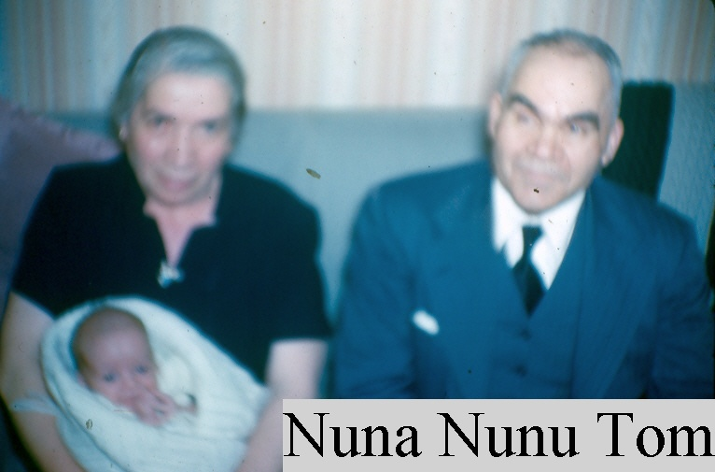
Quiz 3a Brought to you by Chris Hill
Hope This helps
You tell ‘em Nuna
I’m gonna fail you all!!!!!!!!

Slide 2
1. A lower motor neuron and the muscles it innervates is called a:
Muscle spindle.
Neuromuscular spindle. (Synonym for 1)
Motor unit
Gamma loop.

Slide 3
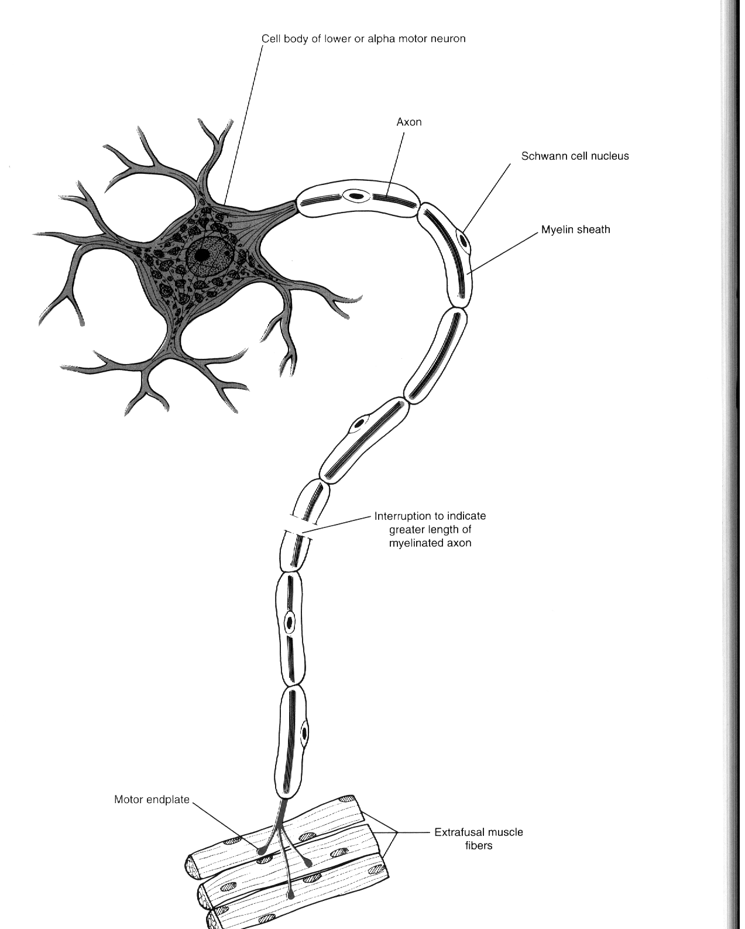
Motor Unit

Slide 4
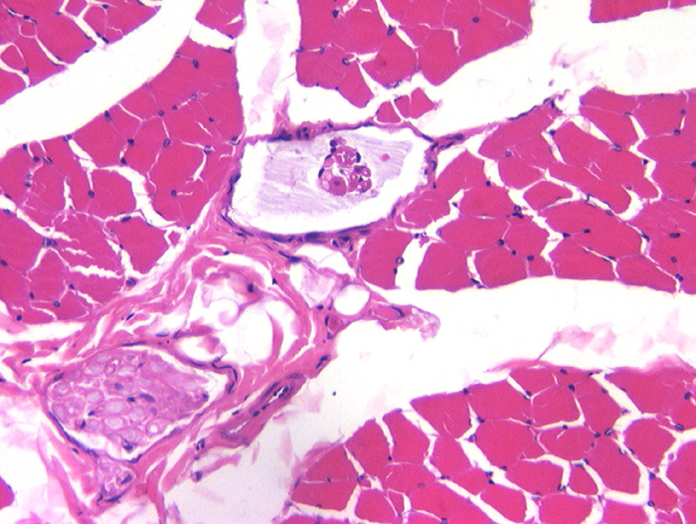
Skeletal Muscle
Regulation of Muscle Contraction
The stretch reflex
Muscle spindles as a sensory receptor.
Provides feedback on the state of a muscle.

Slide 5
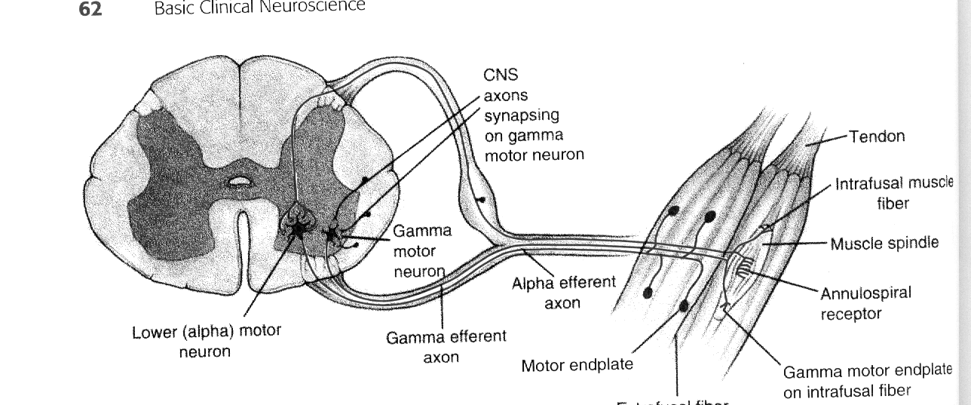
The gamma loop

Slide 6
2. Which symptom is not found in Lower Motor Neuron Syndrome?
Spastic paralysis – Upper Motor symptom
Hypotonia – Due to loss of passive stretch
Rapid atrophy – 70-80% atrophy
Decreased or absent reflexes.

Slide 7
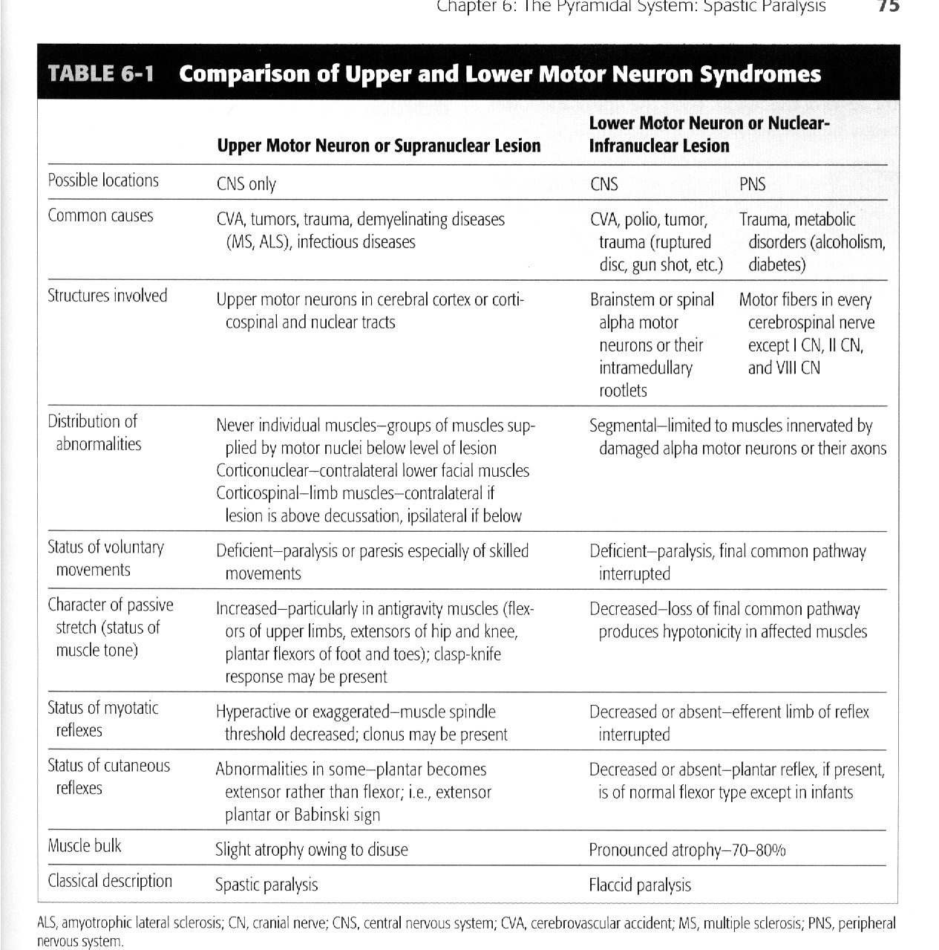
UMN lesions

Slide 8
3. Which of the following descending pathways is found in the lateral spinal cord?
Corticospinals.
Corticobulbars
Vestibulospinals
Medial reticulospinals.

Slide 9
Motor Control Pathways
Seven descending motor pathways
3 from cortex
Lateral corticospinals
Anterior corticospinals
Corticobulbars
4 from brainstem
Rubrospinals
Vestibulospinals
Reticulospinals
Tectospinals

Slide 10
4. Which of the following is not found in Upper Motor Neuron Syndrome?
Hyperactive reflexes
Spastic paralysis
Babinski sign
Pronounced atrophy – Lower motor syndrome.

Slide 11
UMN lesions

Slide 12
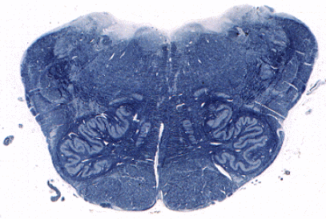
5. Which pathway would be found in the area surrounded by the red circle?
Vestibulospinal tract
Medial reticulospinal tract
Lateral reticulospinal tract
Corticospinal tract

Slide 13
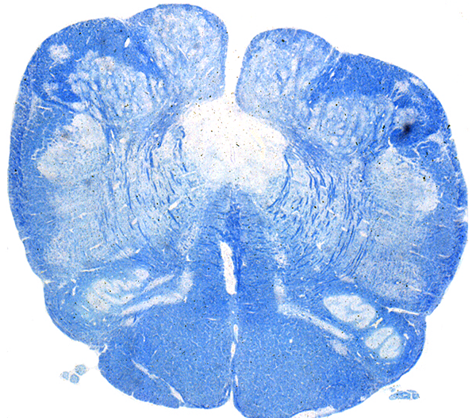
Slide 2
CS
CS
Note: This is at the level of decussation.
Descending motor systems. In each image, outline the general location of the corticospinal tract, medial (pontine) reticulospinal tract, lateral vestibulospinal tract, & the lateral (medullary) reticulospinal tract.

Slide 14
6. Which is not a part of the basal ganglia?
Caudate nucleus - participates in eye movement control and cognition
Putamen - participates in limb and trunk movements.
Globus pallidus
Red nucleus

Slide 15
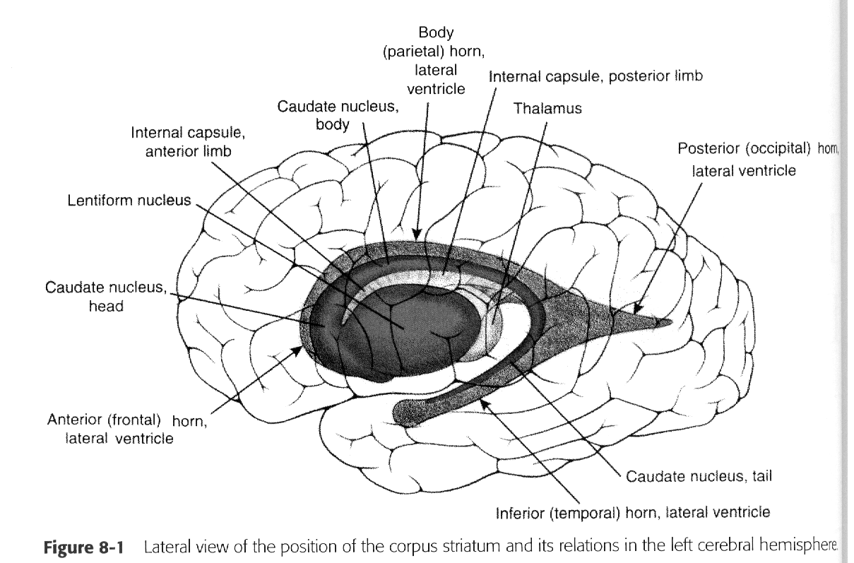
Caudate
Putamen
Globus Pallidus
Amygdala
Striatum
Corpus Striatum
Lenticular Nucleus
Pallidum

Slide 16
7. Substantia nigra is found in the:
Cerebral cortex
Diencephalon
Midbrain
Pons

Slide 17
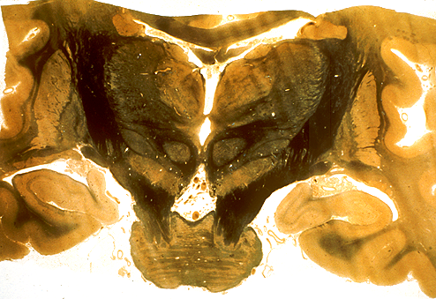
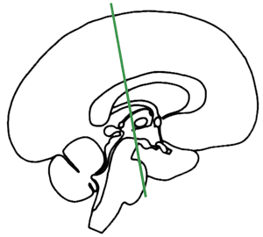
Caudate
Putamen
plane of section
RN
Globus pallidus
Subthalamic nuc.
Substania nigra
Basal ganglia and associated structures. Subthalamic nucleus. Substantia nigra. Caudate (body). Putamen & globus pallidus. | Other structures. Identify: Midbrain, with crus cerebri. Pons (base). Posteior limb of internal capsule. | Cerebellum & associated structures. Red nucleus (RN) Superior cerebellar peduncle - the darkly stained axons medial to the red nucleus (these are often referred to as dentato-thalamic fibers because many originate in the dentate nucleus of the cerebellum and project to the thalamus (mainly VL [ventrolateral nuc of thalamus]).

Slide 18
8. How many peduncles connect the cerebellum to the brainstem?
2
3 – Connected via the inferior, middle, and superior cerebeller peduncle.
4

Slide 19
9. Truncal ataxia and standing on a wide base reeling from side to side indicates:
Flocculonodular lobe syndrome.
See question.
Anterior lobe syndrome
Commonly results from chronic alcoholism.
Marked lower limb instability and clumsy movements.
Posterior lobe syndrome.
Charaterized by intention tremor
Only happens during volitional movement.
Dysmetria
Over or undershooting when attempting to touch a target.
Dysdiadochokinesia
The inability to perform rapid alternating movements.

Slide 20
10. An intention tremor would indicate:
Basal Ganglia disease
Parkinson’s Disease
Huntington disease
Hemiballismus
Posterior lobe syndrome
Anterior lobe syndrome
Flocculonodular lobe syndrome

Slide 21
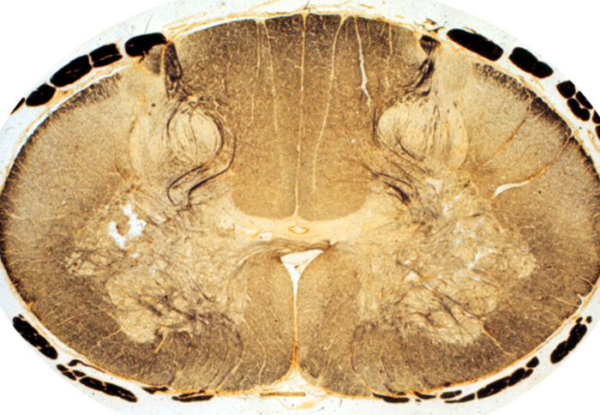
1. The posterior spinocerebellar tract would be found at:
A- Posterior Funiculus
Fasciculus Gracilis (G) - present at all cord levels
Fasciculus Cuneatus (C) - only at T6-C1
B – Both B and C are the Ventromedial pathway.
C
D
D
A
C
B

Slide 22
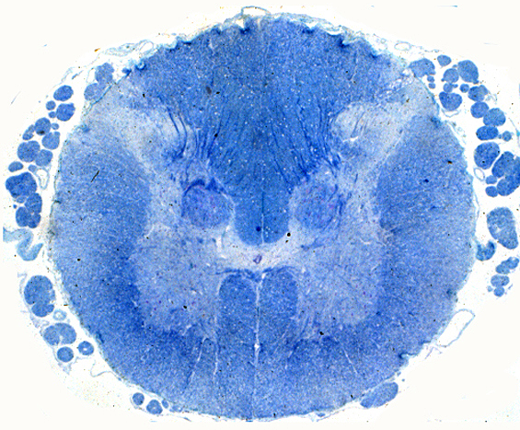
Dorsal root entry zone
L3 level of spinal cord.
Posterior spino-cerebellar tract
As you go through these sections, you should review the major systems covered previously in the course, including the descending motor systems. | Cerebellum and associated structures. Spinocerebellar Tracts - a system for relaying proprioceptive information to the cerebellum. Neuron #1. Axons at Dorsal Root entry zone. The green line illustrates schematically the path of primary afferents into the nucleus dorsalis, which contains neuron #2. Neuron #2. Nucleus dorsalis, outlined in yellow. This nucleus contains the second neuron in a pathway from proprioceptors of the lower extremity and trunk to the cerebellum. Posterior (or dorsal) spinocerebellar tract (also outlined in yellow), an uncrossed tract from nucleus dorsalis to the spinocerebellum (vermis + anterior lobe). There is also an anterior (or ventral) spinocerebellar tract that we are not considering in this course.

Slide 23
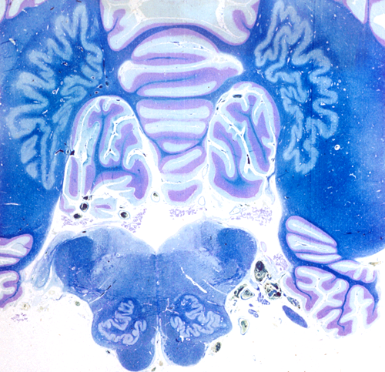
2. The dentate nucleus is
A – Vermis
B - Dentate
C – Olivary nucleus
D - flocculus
B
A
D
C

Slide 24
3. Substantia nigra is located at
A - VL nucleus of the thalamus
B - Putamen
C - Substantia Nigra
D - Globus Pallidus
A
D
B
C

Slide 25
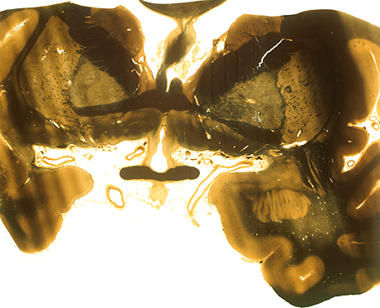
4. The caudate nucleus is found at:
A
A
B – Putamen
C – Globus Pallidus
D – Amygdala
B
C
D

Slide 26
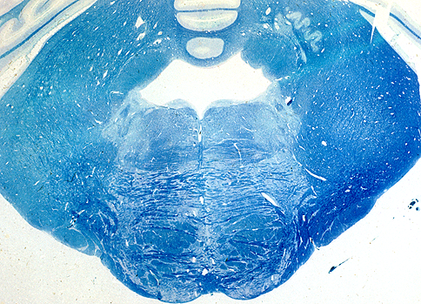
5. The yellow asterick lies over the:
Inferior cerebellar peduncle.
Middle cerebellar peduncle
superior cerebellar peduncle
*

Slide 27
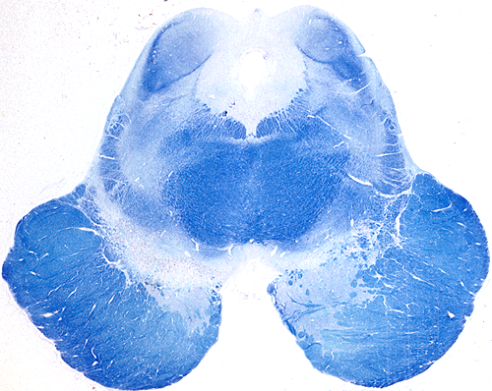
Mibrain, level of inferior colliculus
Review components of descending motor systems seen in this section including the corticospinal tract, and MLF. Also identify the tegmentum, substantia nigra, and crus cerebri of the midbrain. | Superior cerebellar peduncle (outlined in red), | Basal ganglia and associated structures. Substantia nigra (outlined in blue-green). This cell group separates the crus cerebri from the tegmentum of the midbrain, and it is interconnected with the caudate and putamen of the basal ganglia.

Slide 28
*
High open medulla
Review components of descending motor systems seen in this section including the pyramids, MLF, vestibular nuclei & vestibulospinal tracts. | Inferior olivary nucleus (outlined in orange). The orange arrow identifies the general path of the olivocerebellar fibers. Inferior cerebellar peduncle (outline in yellow + purple). This structure contains axons projecting to the cerebellum, and includes the posterior spinocerebellar and cuneocerebellar tract axons, axons from the vestibular nuclei and vestibular receptors, and from the inferior olivary nucleus. Vermis and flocculus (*) of the cerebellum. Dentate nucleus of the cerebellum (outlined in red); one of the deep nuclei of the cerebellum.

