Slide 1
1. In the dorsal root ganglion, the neurons are:
Pseudounipolar.
Bipolar
Multipolar.
Quiz #1 2010

Slide 2
2. The spinal cord is surrounded by meninges and the innermost membrane is the:
Dura mater
Arachnoid
Pia mater
Quiz #1 2010

Slide 3
3. The C8 spinal nerve emerges between which of the following vertebrae?
C7 and C8
C8 and T1
C7 and T1
T1 and T2
Quiz #1 2010

Slide 4
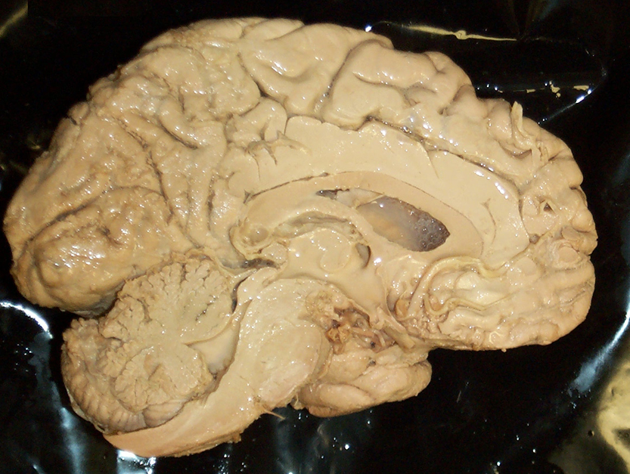
4. The region at the tip of the arrow is the:
Medulla
Pons
Midbrain
Diencephalon
Quiz #1 2010

Slide 5
5. The fourth ventricle lies above the:
Spinal cord and medulla.
Medulla and pons.
Pons and midbrain.
Diencephalon.
Quiz #1 2010

Slide 6
6. At which specific brainstem level is the trigeminal nerve?
Medulla
Pons
Midbrain
Diencephalon
Quiz #1 2010

Slide 7
7. The cerebral crus, substantia nigra and the adjacent tegmentum are located in the:
Tectum
Cerebellar peduncles
Pons
Cerebral peduncles.
Quiz #1 2010

Slide 8
8. The most posterior lobe of the cerebral hemisphere is the:
Parietal
Occipital
Temporal
Quiz #1 2010

Slide 9
9. The lateral fissure separates the:
Temporal and frontal lobes.
Temporal and occipital lobes.
Parietal and occipital lobes
Parietal and frontal lobes.
Quiz #1 2010

Slide 10
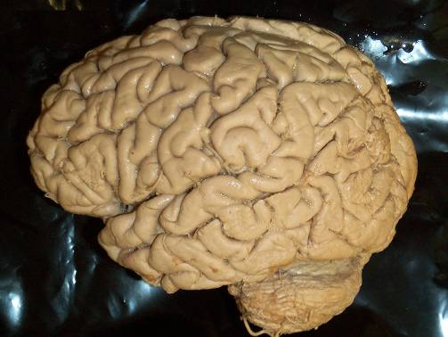
10. Which region of the cortex is most involved in behavior and movement?
A
B
C
D
B
A
C
D
Quiz #1 2010

Slide 11
1. Where would you find lateral motor nuclei?
C1 – 5
C5 – T1
T1 – T5
T8 – L1
Quiz #1 2010

Slide 12
2. The structure at the tip of the arrow is the:
Tegmentum of the pons.
Tegmentum of the midbrain
Tectum
Diencephalon
Quiz #1 2010

Slide 13
3. The cerebrospinal fluid-filled cavity found in the middle of the diencepahalon is the
3rd ventricle
4th ventricle
Cerebral aqueduct
Lateral ventricle
Quiz #1 2010

Slide 14
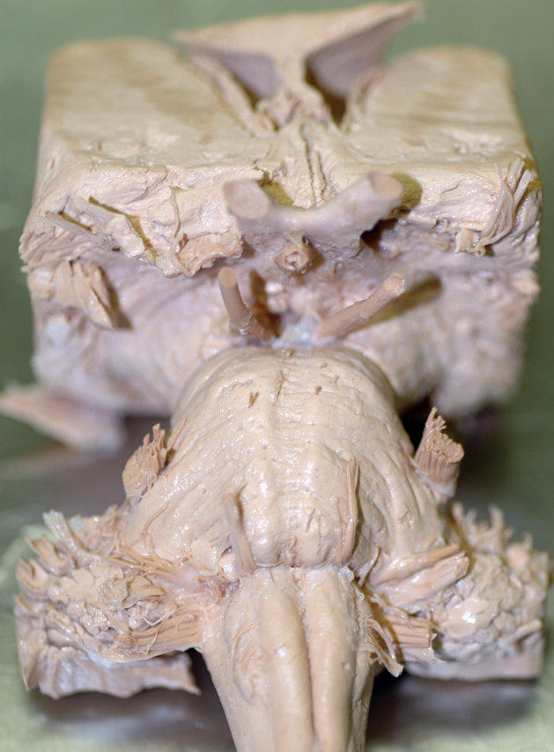
4. Identify the trigeminal nerve.
A
B
C
D
B
A
C
D
Quiz #1 2010

Slide 15
5. Which nerves both arise from the medulla?
Abducens and trigeminal.
Trigeminal and Vagus.
Oculomotor and Abducens.
Vagus and Hypoglossal
Quiz #1 2010

Slide 16
1. The structure at the tip of the arrow is the:
Tegmentum of the pons.
Tegmentum of the midbrain
Tectum
Diencephalon
Quiz #2 2010

Slide 17
2. Identify the abucens nerve.
A
B
C
D
B
A
C
D
Quiz #2 2010

Slide 18
3. Which nerve arises from the midbrain?
Abducens.
Trigeminal.
Oculomotor.
Vagus.
Quiz #2 2010

Slide 19
4. The arrow points to the:
Pons
Midbrain
Diencephalon
Olive
Quiz #2 2010

Slide 20
5. The red star lies over the:
Frontal lobe
Parietal lobe
Occipital lobe
Temporal lobe.
Quiz #2 2010

Slide 21
6. With a loss of lower motor neurons a patient would have:
Flaccid paralysis.
Spastic paralysis.
Sensory deficiets.
Quiz #2 2010

Slide 22
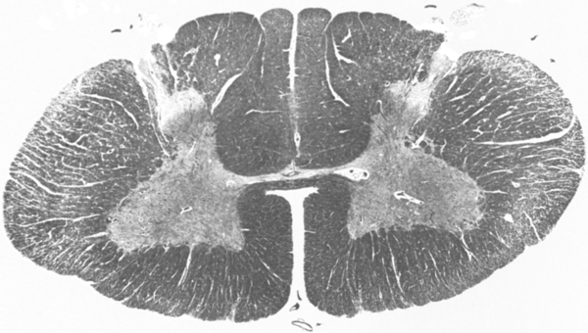
7. In the diagram the arrow points to the region where the lower motor neurons would innervate the:
Neck muscles.
Trunk muscles
Upper limb muscles
Quiz #2 2010

Slide 23
8. The contraction of muscle when it’s tendon is stretched is the:
Myotatic reflex.
Inverse motatic reflex.
Gamma loop.
Quiz #2 2010

Slide 24
9. The neurons that originate in the cortex and descend to the spinal cord are part of the
Corticospinal tract.
Vestibulospinal tract
Reticulspinal tract.
Rubrospinal tract.
Quiz #2 2010

Slide 25
10. Which would give you pronounced atrophy if lesioned?
Pyramidal tract.
Lower motor neurons.
Vestibulospinal tract.
Quiz #2 2010

Slide 26
1. Where is the 12th nucleus?
A
B
C
D
B
A
C
D
Quiz #2 2010

Slide 27
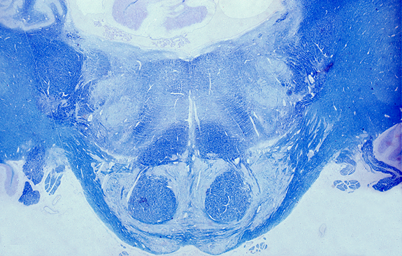
2. The seventh cranial nerve nucleus is:
A
B
C
D
D
B
6
C
A
Quiz #2 2010

Slide 28
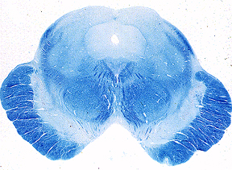
3. What tracts are found in the red box?
Corticospinals and corticobulbars.
Corticobulbars and corticoreticulars.
Corticospinals and corticoreticulars.
Quiz #2 2010

Slide 29
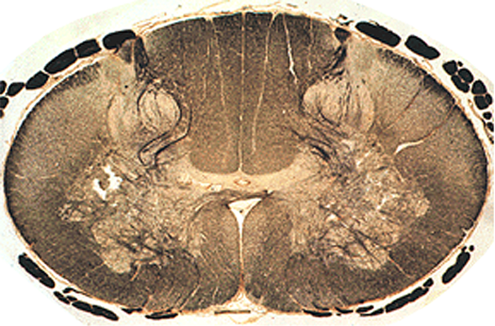
4. The area in yellow would not contain the
Corticospinal tract.
Vestibulospinal tract
Medial Reticulospinal tract
Quiz #2 2010

Slide 30
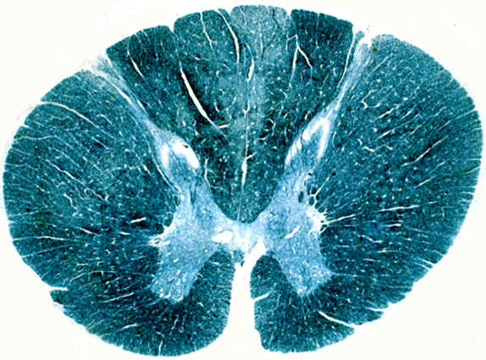
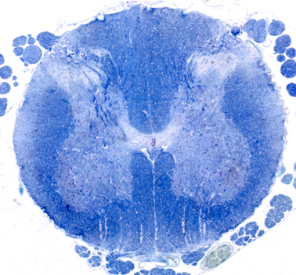
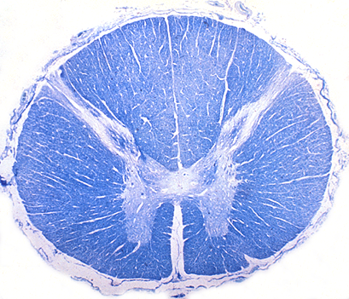
Which of these is located in the upper thoracic region?
A
B
C
D
B
A
Quiz #2 2010
C
D

Slide 31
1. A lower motor neuron and the muscles it innervates is called a:
Muscle spindle.
Neuromuscular spindle.
Motor unit.
Gamma loop.
Quiz #3 2010

Slide 32
2. Which symptom is not found in Lower Motor Neuron Syndrome?
Spastic paralysis
Hypotonia
Rapid atrophy
Decreased or absent reflexes.
Quiz #3 2010

Slide 33
3. Which of the following descending pathways is found in the lateral spinal cord?
Corticopinals.
Corticobulbars
Vestibulospinals
Medial reticulospinals.
Quiz #3 2010

Slide 34
4. Which of the following is not found in Upper Motor Neuron Syndrome?
Hyperactive reflexes
Spastic paralysis
Babinski sign
Pronounced atrophy
Quiz #3 2010

Slide 35
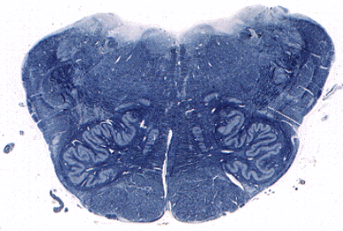
5. Which pathway would be found in the area surrounded by the red circle?
Vestibulospinal tract
Medial reticulospinal tract
Lateral reticulospinal tract
Corticospinal tract
Quiz #3 2010

Slide 36
6. Which is not a part of the basal ganglia?
Caudate nucleus
Putamen
Globus pallidus
Red nucleus
Quiz #3 2010

Slide 37
7. Substantia nigra is found in the:
Cerebral cortex
Diencephalon
Midbrain
Pons
Quiz #3 2010

Slide 38
8. How many peduncles connect the cerebellum to the brainstem?
2
3
4
Quiz #3 2010

Slide 39
9. Truncal ataxia and standing on a wide base reeling from side to side indicates:
Flocculonodular lobe syndrome.
Anterior lobe syndrome
Posterior lobe syndrome.
Quiz #3 2010

Slide 40
10. An intention tremor would indicate:
Basal Ganglia disease
Posterior lobe syndrome
Anterior lobe syndrome
Flocculonodular lobe syndrome
Quiz #3 2010

Slide 41
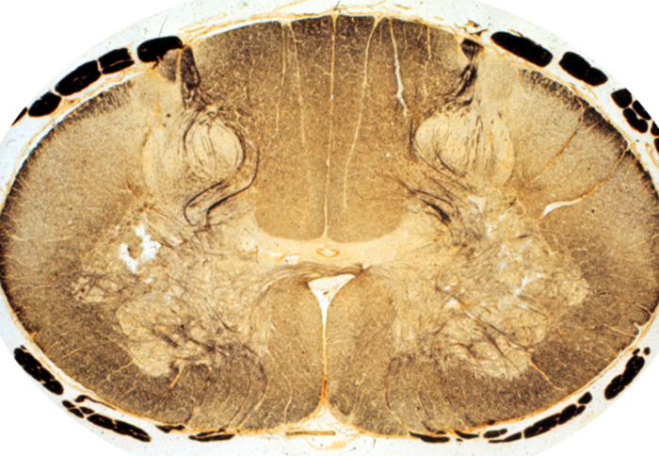
1. The posterior spinocerebellar tract would be found at:
A
B
C
D
D
A
C
B
Quiz #3 2010

Slide 42
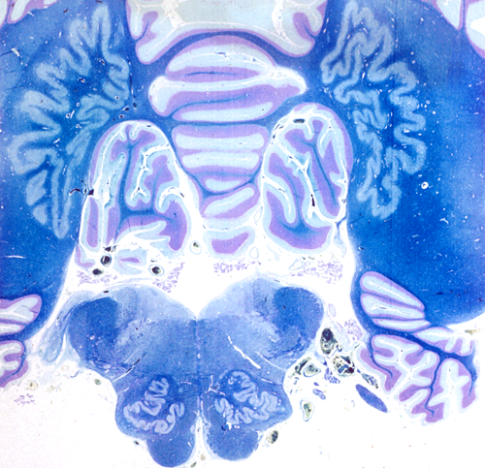
2. The dentate nucleus is
A
B
C
D
B
A
D
C
Quiz #3 2010

Slide 43
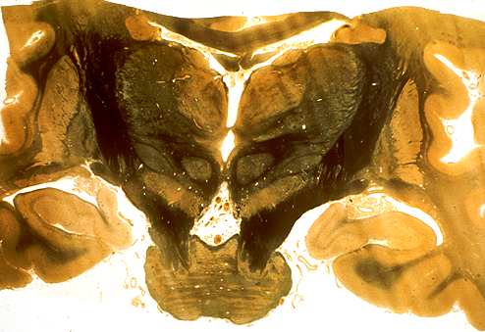
3. Substantia nigra is located at
A
B
C
D
A
D
B
C
Quiz #3 2010

Slide 44
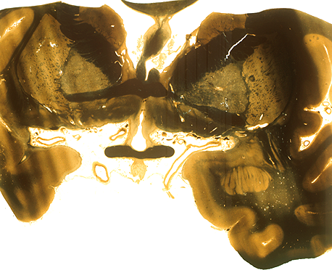
4. The caudate nucleus is found at:
A
A
B
C
D
B
C
D
Quiz #3 2010

Slide 45
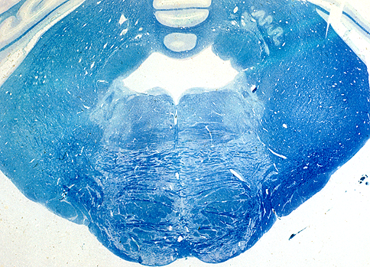
5. The yellow asterick lies over the:
Inferior cerebellar peduncle.
Middle cerebellar peduncle
Inferior cerebellar peduncle
*
Quiz #3 2010

Slide 46
1. Which is not a part of the basal ganglia?
Caudate
Putamen
Dentate
Globus pallidus
Quiz #4 2010

Slide 47
2. Which is not a deep nucleus of the cerebellum?
Interposed
Fastigial
Dentate
Subthalamic.
Quiz #4 2010

Slide 48
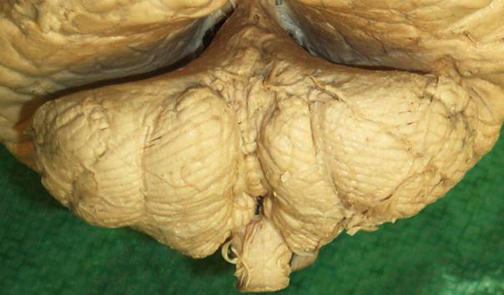
3. Identify the part of the cerebellum at the tip of the pointer.
Vermis
Paravermis
Anterior lobe
Flocculonodular lobe.
Quiz #4 2010

Slide 53
8. Where is the pain pathway for the right little toe located?
Right cervical spinal cord.
Left medial lemniscus.
Right VPL nucleus of the Thalamus
Left postcentral gyrus.
Quiz #4 2010

Slide 54
9. The ability to distinguish stimulation by one or two points applied to the skin is called:
Stereognosis
Graphesthesia
Two-point sense
Quiz #4 2010

Slide 55
10. Which of the mechanoreceptors is most sensitive and senses vibration?
Pacinian corpuscles
Merkels discs
Meissners corpuscles.
Ruffini endings.
Quiz #4 2010

Slide 56
1. The sensory neurons for proprioception from the big toe ascend in the spinal cord in the:
Fasciculus gracilis
Fasciculus cuneatus
Anterolateral funiculus.
Quiz #4 2010

Slide 57
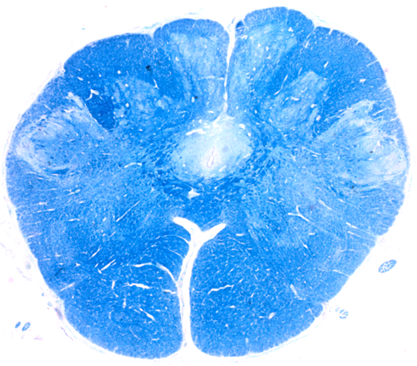
2. The structure at the pointer is the:
Nucleus gracilis
Nucleus cuneatus
Accessory cuneate nucleus
Spinal nucleus of 5
Quiz #4 2010

Slide 58
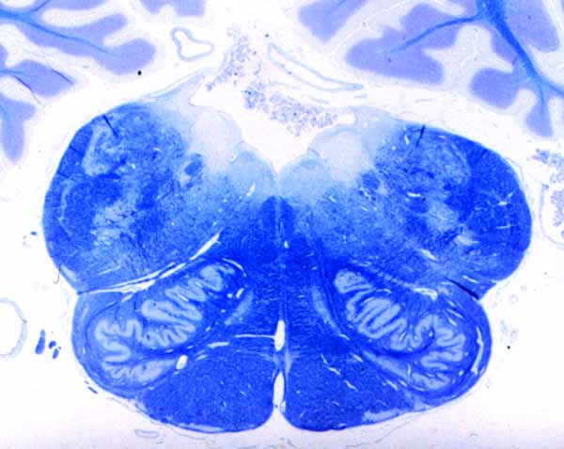
3. The arrow points to:
Axon #2 for vibratory sense from the legs.
Axon #2 for pain and temperature legs.
Axon #2 for vibratory sense from the face.
Axon #2 for proprioception for the face.
Quiz #4 2010

Slide 59
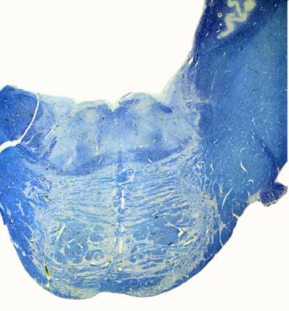
4. The arrow points to the tract carrying pressure sense from the:
Right leg
Left leg
Right face
Left face
R
L
Quiz #4 2010

Slide 60
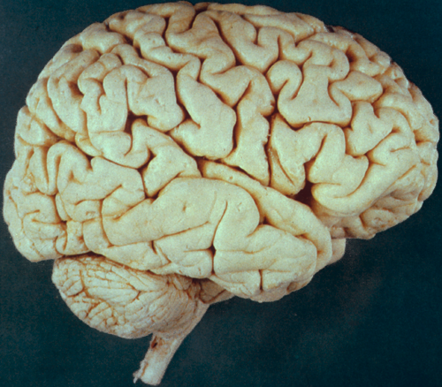
5. The area circled in red is the:
Precentral gyrus
Primary somatosensory cortex
Somatosensory association cortex
Quiz #4 2010

Slide 61
1. Which sensory modality travels through the Anterolateral (Spinothalamic) tract
Pain
Pressure
Two point touch
Vibratory sense.
Quiz #5 2010

Slide 62
2. Which sensory modality travels through the posterior white column/medial lemniscus pathway?
Hot
Cold
Pain
Two point touch
Quiz #5 2010

Slide 63
3. Third order sensory neurons are located in the:
Spinal cord
Brainstem
Thalamus
Cerebral cortex
Quiz #5 2010

Slide 64
4. Pain fibers from the teeth will synapse in the:
Trigeminal ganglion
Spinal nucleus of 5.
Mains sensory nucleus of 5.
Mesencephalic nucleus of 5.
Quiz #5 2010

Slide 65
5. The region marked by the star would be most involved in sensory information from the:
Legs
Waist
Head
Knee
Quiz #5 2010

Slide 66
6. Where in the auditory pathway does a unilateral lesion produce total deafness?
Cochlear nerve
Inferior colliculus
Medial geniculate
Transverse temporal gyri.
Quiz #5 2010

Slide 67
7. Equilibrium depends of input from all of the following except:
Somatosensory system.
Visual system.
Vestibular system.
Auditory system.
Quiz #5 2010

Slide 68
8. The first order neurons for taste are in all of the following ganglia except:
Geniculate ganglion (7th nerve)
Inferior ganglion of 9th cranial nerve.
Inferior ganglion of 10th cranial nerve.
Hypoglossal ganglion.
Quiz #5 2010

Slide 69
9. Olfactory neurons synapse in the:
Olfactory bulb.
Olfactory tract.
Olfactory cortex.
Quiz #5 2010

Slide 70
10. Which sensory modality does not synapse in the thalamus?
Taste
Hearing
Smell
Balance
Quiz #5 2010

Slide 71
1. You would find the 8th cranial nerve at the:
Spinal cord – medulla junction.
Pons- medulla junction
Pons – midbrain junction
Quiz #5 2010

Slide 72
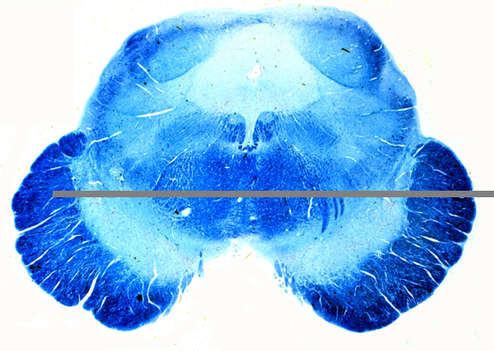
2. Identify the structure at the arrow.
Inferior colliculus
Superior colliculus
Medial geniculate
Lateral geniculate
Quiz #5 2010

Slide 73
3. Identify the nucleus at the tip of the pointer.
Cochlear.
Vestibular
Solitary
Olive
Quiz #5 2010
:60

Slide 74
4.Identify the nuclear complex at the tip of the pointer.
Cochlear
Vestibular
Spinal nucleus of 5
Quiz #5 2010

Slide 75
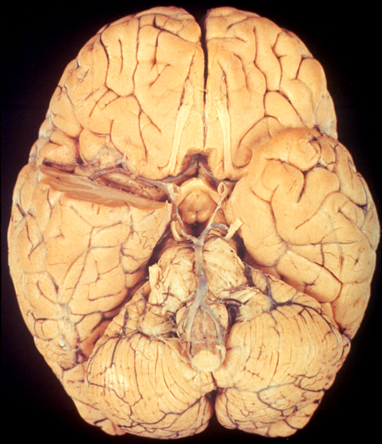
5. Identify the structure at the tip of the pointer.
Optic nerve.
Optic tract.
Olfactory nerve
Olfactory tract.
Quiz #5 2010

Slide 76
1. The main auditory nucleus in the thalamus that receives auditory input is the:
Medial geniculate
Lateral geniculate
Ventral posterior nucleus.
Ventral lateral nucleus.
Quiz #6 2010

Slide 77
2. A lesion in what nerve would cause a patient to feel a sense of vertigo, falling to one side, nausea, and abnormal, rhythmic eye movements (nystagmus).
Vagus
Glossopharyngeal
Trigemminal
Vestibulocochlear.
Quiz #6 2010

Slide 78
3. The olfactory bipolar neurons synapse:
In the gustatory nucleus.
With mitral cells.
In the olfactory cortex.
In the olfactory tract.
Quiz #6 2010

Slide 79
4. As you are tasting a glass of wine you know the taste bud cells synapse:
On neurons from cranial nerves 7, 9 and 10.
In ganglia associated with cranial nerves 7, 9, and 10.
The gustatory nucleus.
Quiz #6 2010

Slide 80
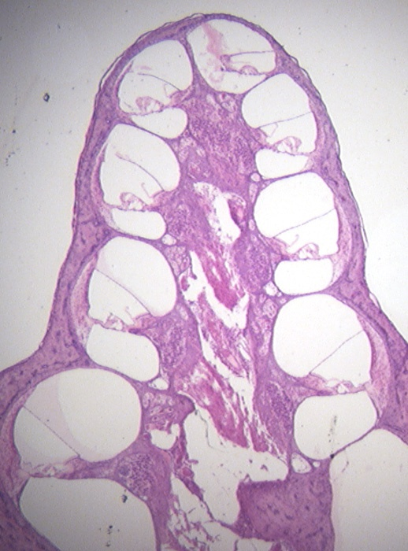
5. The cells at the tip of the pointer synapse in the:
Cochlear nuclei
Vestibular nuclei
Geniculate ganglion.
Quiz #6 2010

Slide 81
6. The visual pathways:
Extend from the front to the back of the head.
Are entirely infratentorial.
Are entirely crossed.
Quiz #6 2010

Slide 82
7. Visual pathways cross in the:
Optic nerve.
Optic chiasm.
Optic radiations.
Lateral geniculate nucleus.
Quiz #6 2010

Slide 83
8. What vitamin may be involved in night blindness?
Vitamin A.
Vitamin B
Vitamin C
Vitamin D.
Quiz #6 2010

Slide 84
9. Which cranial nerve nucleus is involved in moving the eyes laterally.
Occulomotor.
Trochlear.
Abducens.
Quiz #6 2010

Slide 85
Which cranial nerve is located in the pons?
Occulomotor.
Trochlear
Abducens
Quiz #6 2010

Slide 86
1. Identify the layer of rods and cones.
D
A
B
C
D.
C
B
A

Slide 87
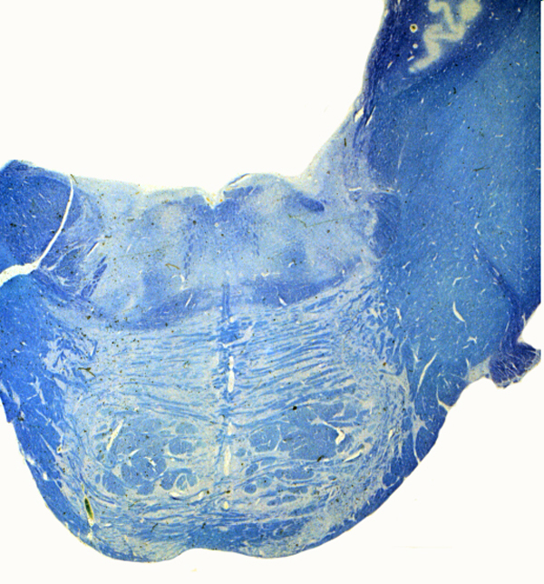
2. The arrow points to:
Abducens nucleus
Facial nucleus
Trigeminal nucleus
Spinal nucleus of 5

Slide 88
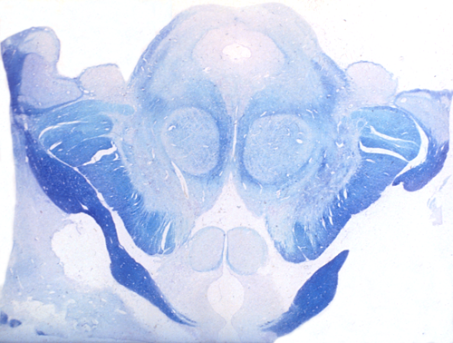
3. Identify the lateral geniculate.
A
B
C
D
B
D
C
A

Slide 89
4. Identify the superior colliculus.
A.
B.
C.
D.
B
D
C
A

Slide 90
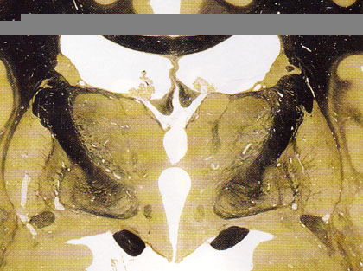
5. The arrow points to the.
Optic nerve
Optic tract
Optic radiations.

Slide 91
1. Synapses in the visual pathway can occur in all of the following EXCEPT:
Lateral geniculate.
Retina
Optic radiations.
Primary visual cortex.
Quiz #7 2010

Slide 92
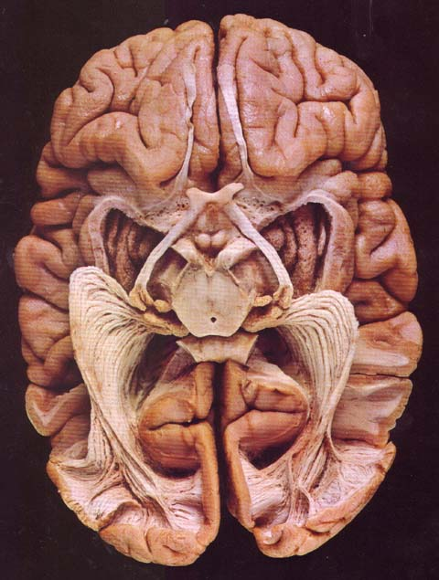
2. The arrow points to the:
Optic nerve.
Optic tract
Olfactory tract.
Optic radiations
Quiz #7 2010

Slide 93
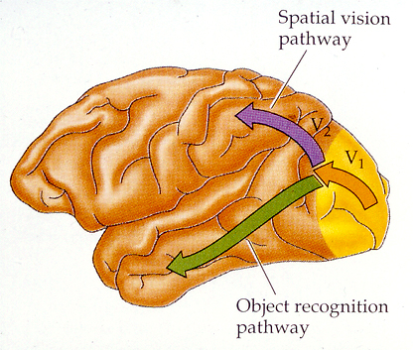
3. The purple arrow indicates the:
What pathway.
The area for object identification.
The where pathway.
Primary visual cortex.
Quiz #7 2010

Slide 94
4. Parasympathetic preganglionic fibers to the ciliary ganglion travel with cranial nerve:
Three
Four
Five
Six
Quiz #7 2010

Slide 95
5. The arrow points to the:
Oculomotor nucleus.
Trochlear nucleus.
Abducens nucleus.
PPRF
Quiz #7 2010

Slide 96
6. Commissural fibers connect:
Gyrus to gyrus.
Cells within a gyrus.
Homologous areas between the two cerebral hemispheres.
The cortex to subcortical nuclei.
Quiz #7 2010

Slide 97
7. The inability to produce purposeful movements even though there is no paralysis is:
Apraxia.
Aphasia.
Agnosia.
Quiz #7 2010

Slide 98
8. The inability to communicate would be:
Apraxia
Aphasia.
Agnosia
Quiz #7 2010

Slide 99
9. The inability to recognize sensory stimuli is:
Apraxia
Aphasia
Agnosia
Quiz #7 2010

Slide 100
10. How many cell layers are there in the neocortex?
3
4
5
6
Quiz #7 2010

Slide 101
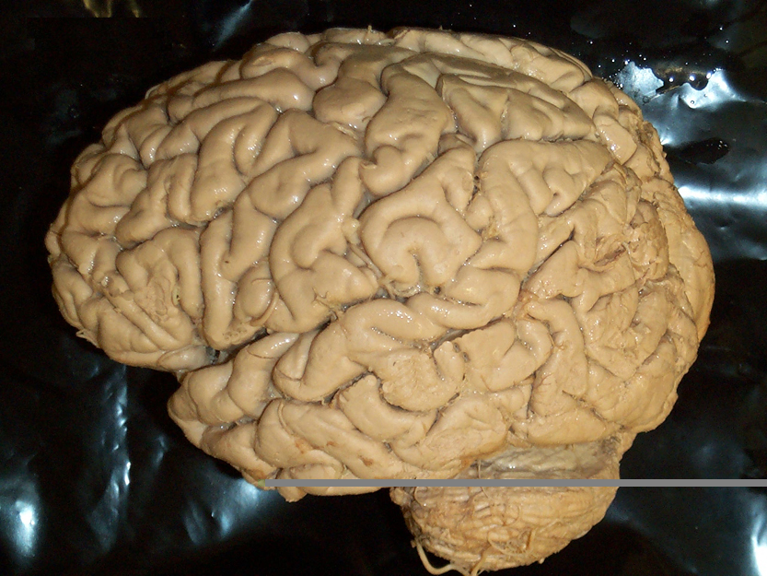
1. The area in blue is:
Broca’s area
Wernicke’s area
Somatosensory cortex
Primary Auditory cortex
Quiz #7 2010

Slide 102
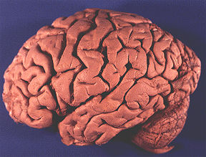
2. The area important for detection of motion and location.
1
2
3
4
3
1
4
2
Quiz #7 2010

Slide 103
3. The arrow points to the:
Cingulate gyrus.
Cuneate gyrus.
Lateral frontal gyrus.
Orbitofrontal cortex
Quiz #7 2010

Slide 104
4. The area in red is the
Motor cortex
Premotor cortex
Supplementary motor cortex
Quiz #7 2010

Slide 105
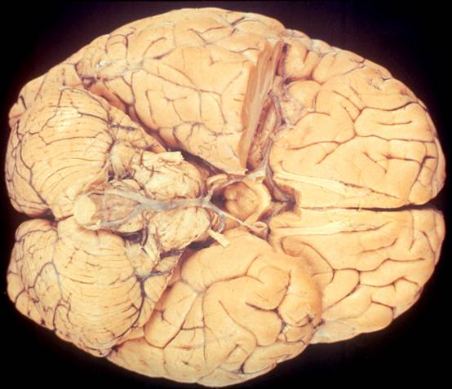
5. The area outlined in red is the:
Orbital frontal cortex.
Lateral prefrontal cortex.
Visual cortex.
Inferior temporal cortex.
Quiz #7 2010

Slide 106
1. The part of the brain that is most involved in behavioral choice is the:
Frontal lobe
Parietal lobe
Temporal lobe
Occipital lobe
Quiz #8 2010

Slide 107
2. Projections from the thalamus synapse on which layer of the cortex?
3
4
5
6
Quiz #8 2010

Slide 108
3. When intermediary processing is shallow:
The stimulus and response are not linked.
The stimulus leads to preprogrammed behaviors.
Context is always taken into account.
Behavior is guided by context.
Quiz #8 2010

Slide 109
4. The face and object recognition network is largely associated with the:
Frontal lobe
Parietal lobe.
Occipital lobe.
Temporal lobe.
Quiz #8 2010

Slide 110
5. For language:
Wernicke’s area is the motor area.
Broca’s area is the sensory area.
The left hemisphere is dominant.
The right hemisphere is dominant.
Quiz #8 2010

Slide 111
6. A key role in memory and learning is played by the:
Hippocampus.
Amygdala
Cingulate gyrus.
Nucleus accumbens
Quiz #8 2010

Slide 112
7. Which nucleus is most involved in behavior and emotions?
Hippocampus
Amygdala
Nucleus accumbens
Cingulate gyrus
Quiz #8 2010

Slide 113
8. Alzheimer’s disease and other dementias are often associated with a loss of neurons in the:
Hippocampus
Amygdala
Cingulate gyrus
Nucleus accumbens
Quiz #8 2010

Slide 114
9. Anterograde amnesia is the
Loss of memory about places visited as a child.
Loss of memory about childhood events.
Loss of memory about anything that happened after the first episode of amnesia.
Loss of memory about anything that happened before the first episode of amnesia.
Quiz #8 2010

Slide 115
10. The accumbens nucleus is associated with:
Fear
Anxiety
Pleasure
Pain
Quiz #8 2010

Slide 116
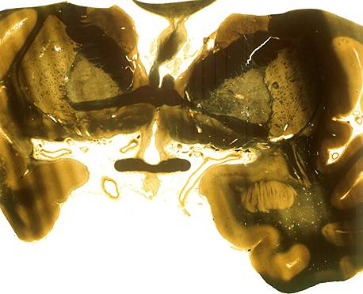
1. The arrow points to the:
Hippocampus
Fornix
Amygdala
Caudate nucleus
Quiz #8 2010

Slide 117
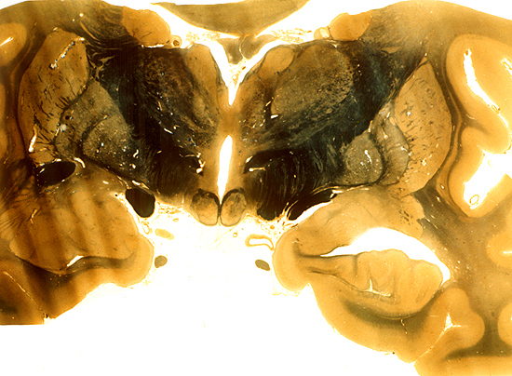
2. The arrow points to the:
Parahippocampus
Fornix
Mammillary bodies
Hippocampus
Quiz #8 2010

Slide 118
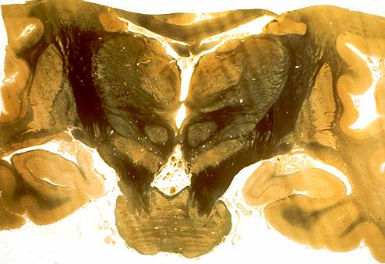
3. The arrow points to the:
Amygdala
Hippocampal formation.
Medial dorsal nucleus.
Putamen
Quiz #8 2010

Slide 119
4. Identify the cranial nerve at the tip of the pointer.
Olfactory
Optic
Occulomotor
Trochlear
Quiz #8 2010

Slide 120
5. The arrows point to the:
Anterior limb of the internal capsule.
Hypothalamus
Caudate nucleus
Fornix
Quiz #8 2010

Slide 121
1. Procedural memory involves the cerebral cortex and the:
Cerebellum
Amygdala
Hippocampus
Prefrontal cortex
Quiz #9 2010

Slide 122
2. Which is a primary reinforcer?
Visual information
Auditory information
Pain
Memories
Quiz #9 2010

Slide 123
3. As a patient moves toward a negative reinforcer they would experience:
Sadness
Frustration
Apprehension
Grief
Quiz #9 2010

Slide 124
4. With loss of the hippocampus on both sides of the brain your patient would have lost:
Short term memory.
Memory of past episodes.
Future memories.
Procedural memory.
Quiz #9 2010

Slide 125
5. With the loss of the amygdala the most difficult face to recognize is on that shows:
Fear
Disgust
Happiness
Sadness
Quiz #9 2010

Slide 126
6. The most anterior part of the hypothalamus is associated with the:
Optic chiasm
Pituitary gland
Pineal gland
Mamillary body.
Quiz #9 2010

Slide 127
7. Located in the post posterior part of the hypothalamus is the:
Red nucleus
Infundibulum
Medial geniculate.
Mamillary bodies.
Quiz #9 2010

Slide 128
8. Input to the hypothalamus is:
Neural only
Humoral only
Both neural and humoral
Neither neural nor humoral.
Quiz #9 2010

Slide 129
9. Output from the hypothalamus is:
Humoral only
Neural only
Humoral and neural
Neither neural nor humoral
Quiz #9 2010

Slide 130
10. What type of portal system is the hypophysial portal system?
Arterial
Venous
Quiz #9 2010

Slide 131
1. You are looking at a section through the:
Anterior hypothalamus
Middle hypothalamus
Posterior hypothalamus
Quiz #9 2010

Slide 132
2. Identify the structure at the tip of the pointer.
Corpus callosum
Fornix
Anterior commisure
Hypothalamus
Quiz #9 2010

Slide 133
3. You are looking at a section through the:
Anterior hypothalamus
Posterior hypothalamus
Middle hypothalamus
Quiz #9 2010

Slide 134
4. Identify the structure at the tip of the pointer.
Olfactory tract.
Olfactory nerve.
Optic nerve
Optic tract
Quiz #9 2010

Slide 135
5. Identify the structure at the tip of the pointer.
Hippocampus
Amygdala
Hypothalamus
Basal forebrain
Quiz #9 2010

Slide 136
1. Acidophils produce:
Prolactin
TSH
LH
ACTH
Quiz #10 2010

Slide 137
2. The secretory products of basophils act on the:
Mammary gland
Kidney
Thyroid
Uterus
Quiz #10 2010

Slide 138
3. Secretory products that act on the mammary gland arise from cells in the:
Hypothalamus only
Pars nervosa only
Pars distalis only
Hypothalamus and pars nervosa
Hypothalamus and Pars distalis
Quiz #10 2010

Slide 139
4. Heat loss is regulated in the:
Anterior hypothalamus.
Intermediate hypothalamus
Posterior hypothalamus.
Quiz #10 2010

Slide 140
5. In the hypothalamus satiety is regulated by the:
Lateral intermediate portion
Medial intermediate portion
Lateral anterior portion
Medial anterior portion
Quiz #10 2010

Slide 141
6. The cranial nerve that innervates the pupillary constrictor is:
Occulomotor
Trochlear
Abducens
Vagus
Quiz #10 2010

Slide 142
7. The cranial nerve that causes the parotid gland to secrete is the:
Oculomotor
Facial
Glopharyngeal
Vagus
Quiz #10 2010

Slide 143
8. The cranial nerve that innervates the lacrimal gland is the:
Occulomotor
Facial
Glossopharyngeal
Vagus
Quiz #10 2010

Slide 144
9. The sympathetic preganglionic nerve fibers arise from the:
Upper cervical spinal cord.
Upper thoracic spinal cord
Lower lumbar spinal cord.
Lower sacral spinal cord.
Quiz #10 2010

Slide 145
10. Parasympathetic preganglionic neurons arise from the:
Cervical spinal cord.
Thoracic spinal cord.
Lumbar spinal cord.
Sacral spinal cord.
Quiz #10 2010

Slide 146
1. What cranial nerve nucleus would not be found in the medulla?
Dorsal motor nucleus
Nuc. Ambiguous
Facial nucleus
Spinal nucleus of 5
Quiz #10 2010

Slide 147
2. What nucleus is found in the midbrain?
Edinger-Westphal.
Abducens
Mains sensory nucleus of 5
Globus pallidus
Quiz #10 2010

Slide 148
3.Which nucleus does not span the medulla and pons?
Spinal nucleus of 5
Main sensory nucleus of 5
Facial motor nucleus
Vestibular nuclei
Quiz #10 2010

Slide 149
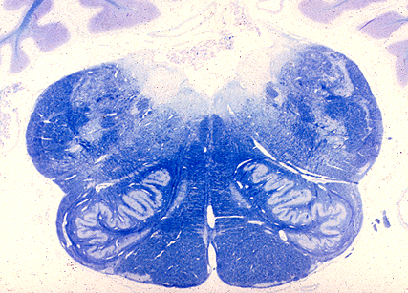
4. Identify the nucleus.
Dorsal Motor nucleus.
Nuc. Ambiguous
Olive
Spinal nucleus of 5
Quiz #10 2010

Slide 150
5. Identify the nucleus.
Facial.
Motor nucleus of 5
Sensory nucleus of 5
Abducens
Quiz #10 2010

Slide 151
1. Dialation of the iris is caused by:
Sympathetic neurons from the superior cervical gangion.
Sympathetic neurons from the middle cervical ganglion
Parasympathetic neurons from the ciliary ganglion.
Parasympathetic neurons from the otic ganglion.
Quiz #11 2010

Slide 152
2. Preganglionic fibers that cause dialation of the bronchi arise from the:
Thoracic spinal cord.
Sympathetic chain ganglia T1- T5.
Dorsal motor nucleus of the vagus.
S2 - 4
Quiz #11 2010

Slide 153
3. Decreaed heart rate is caused by preganglionic nerve cell bodies located in the:
Sympathetic trunk.
Brainstem
Spinal cord.
Heart
Quiz #11 2010

Slide 154
4. The vagus nerve innervates all of these structures EXCEPT
Heart.
Lungs.
Stomach.
Bladder.
Quiz #11 2010

Slide 155
5. Postganglionic parasympathetic neurons to the parotid gland arise in the:
Brainstem
Submandibular ganglion.
Otic ganglion
Pterygopalatine ganglion.
Quiz #11 2010

Slide 156
6. Alterations in which basal forebrain nucleus are associated with decreased cerebral cortical cholinergic activity in Alzheimer disease?
Nucleus accumbens
Septal nuclei
Basal nucleus of Meynert.
Hippocampus.
Quiz #11 2010

Slide 157
7. The pleasure induced by psychostimulants such as amphetamine or cocaine is associated with increased activity of what neurotransmitter:
Acetylcholine
Dopamine
Serotonin
Norepinephrine
Quiz #11 2010

Slide 158
8. Bilateral lesions at which CNS levels result in respiratory arrest
Medulla
Middle pons
Upper pons
Midbrain
Quiz #11 2010

Slide 159
9. Which part of the brain is chiefly associated with REM sleep?
Medulla
Pons
Midbrain
Hypothalamus
Quiz #11 2010

Slide 160
10. Dopaminergic neurons would most likely be found in the:
Medulla
Mid pons
Upper pons
Midbrain
Quiz #11 2010

Slide 161
1. Information about what modality lies in this region?
Pain from the leg.
Temperature from the face.
Pressure from the buttocks.
Vibrations from the lips.
Quiz #11 2010

Slide 162
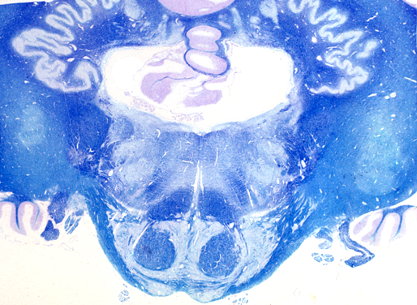
2. Identify the tract located at the tip of the pointer.
Reticulospinal.
Corticobulbar.
Vestibulospinal.
Spinal tract of 5.
Quiz #11 2010

Slide 163
3. Identify the cranial nerve at the tip of the pointer.
5th
6th
7th
9th
Quiz #11 2010

Slide 164
4. What modality is associated with the structure at the tip of the pointer.
Vision
Balance
Hearing
Pain
Quiz #11 2010

Slide 165
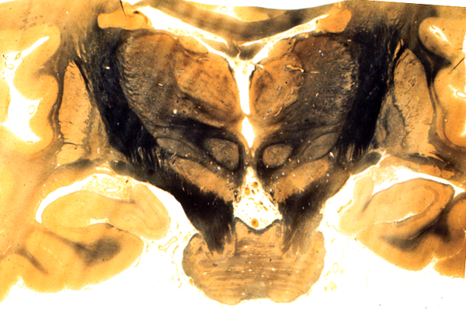
5. Which pathway would NOT be found in the region at the tip of the pointer:
Corticospinal tract.
Reticulospinal tract.
Medial lemniscus/PWC.
ALS
Quiz #11 2010

