Slide 1
Second 5 quizzes

Slide 2
Quiz #6

Slide 3
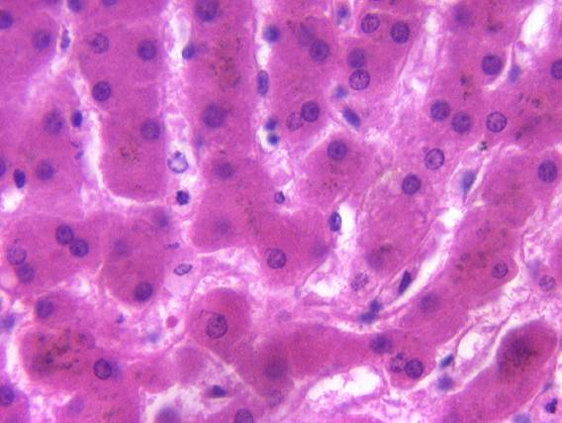

1. The tip of the red arrow is in a:
Sinusoid
Space of Disse
Bile canaliculus
Bile Duct
60

Slide 4
2. Barbiturates and antibiotics are inactivated by methylation in the:
Rough endoplasmic reticulum
Smooth endoplasmic reticulum
Lysosomes
Mitochondria.
60

Slide 5
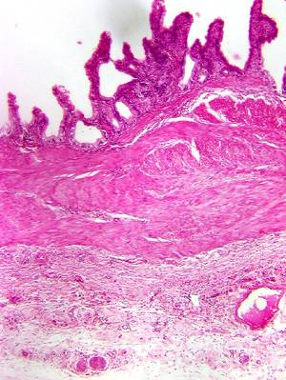
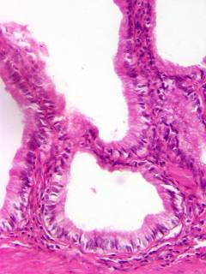
3. Identify the organ.
Jejunum
Gall bladder
Pharynx
Anal canal
60

Slide 6
  4. Which cells make a serous bicarbonate-rich alkaline fluid?
Chief cells of the stomach.
A (α) cells of the pancreas.
Enteroendocrine cells of the duodenum.
Intercalated duct cells of the pancreas.
60

Slide 7
5. The cell in the Islet of Langerhan that makes glucagon is the:
A (α) cell
B (β) cell
D (δ) cell
F cell
60

Slide 8
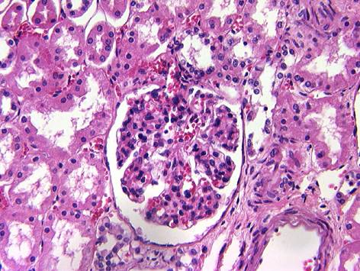
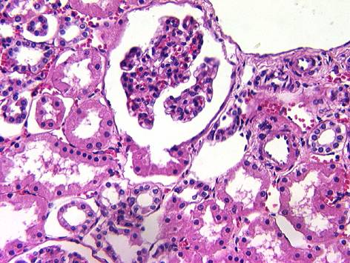
6. The tubule at the tip of the pointer is a:
Proximal convoluted tubule.
Descending thick tubule.
Ascending thick tubule
Collecting tubule
60

Slide 9
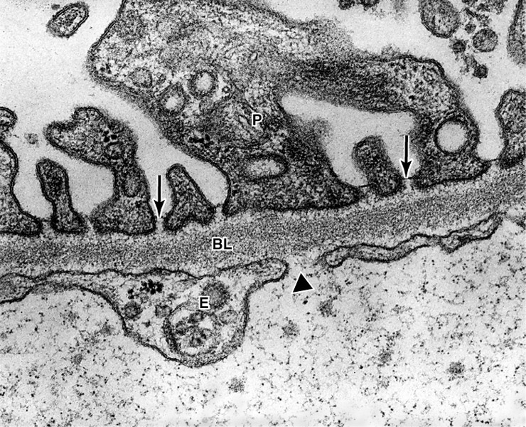
7. What type of capillary is seen in this slide?
Continuous.
Discontinuous.
Fenestrated with diaphragms.
Fenestrated without diaphragms .
60

Slide 10
8. What converts angiotensinogen to angiotensin I?
Converting enzyme in the lung.
Renin
Aldosterone
Trypsinogen
60

Slide 11
9. Most of the water reabsorbed by the nephron is taken up by the:
Proximal convoluted tubule.
Ascending thin limb of Henle
Distal convoluted tubule.
Collecting duct.
60

Slide 12
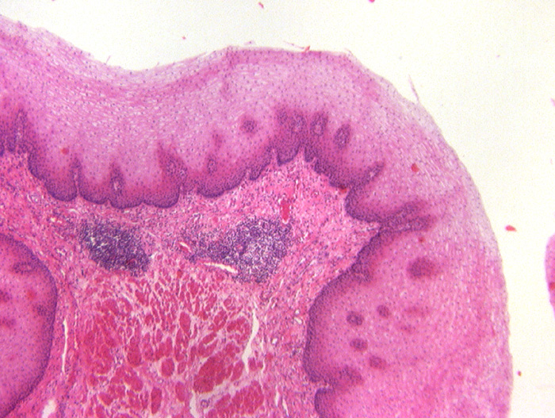
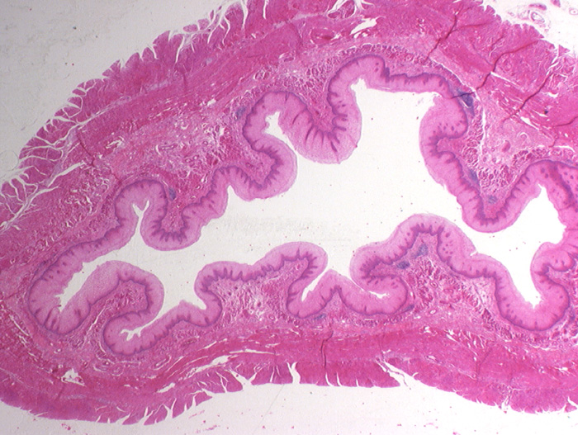
10. Identify the organ
Gall bladder.
Ureter.
Rectum
Esophagus
60

Slide 13
Quiz #7

Slide 14
1. Basophils in the pars distalis produce.
ADH
Oxytocin
FSH
Prolactin
60

Slide 15
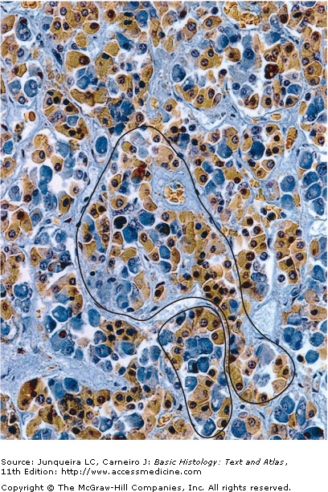
2. The cell at the tip of the pointer produces:
Growth hormone
LH
FSH
TSH
60

Slide 16
3. To lower calcium levels you would expect to see increased secretion from the:
Parathyroid gland.
Parafollicular cells of the thyroid gland.
Adrenal gland
Thyroid follicular cells.
60

Slide 17
4. What hormone stimulates the osteoblast to synthesize RANKL?
Thyroid hormone.
Parathyroid hormone.
Calcitonin
Aldosterone
60

Slide 18
5. Which region of the adrenal gland secretes aldosterone?
Zona glomerulosa
Zona reticularis
Zona fasciculata
Zona pellucida
60

Slide 19
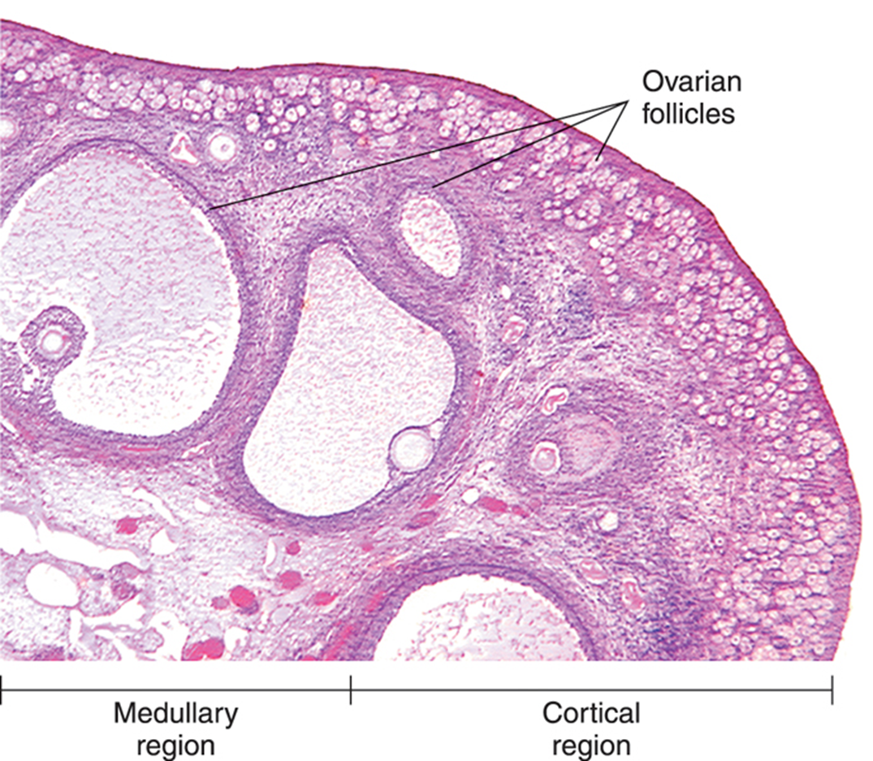
6. The follicle at the tip of the black pointer is a
Primordial follicle
Primary follicle
Secondary follicle
Mature Graffian follicle
60

Slide 20
7. A surge in which of the following induces ovulation?
Estrogen
Progesterone
LH
FSH
60

Slide 21
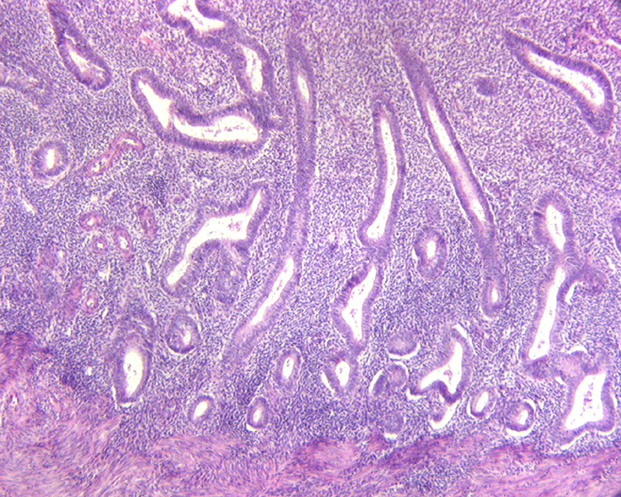
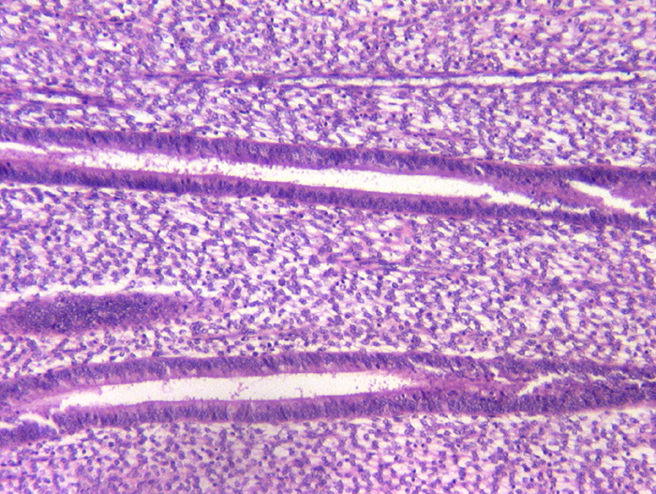
8. The organ on the right is at what day of the menstrual cycle?
4
10
18
25
60

Slide 22
9. Identify this organ.
Ureter
Isthmus of the uterine tube
Infundibulum of the uterine tube.
Esophagus.
60

Slide 23
10. The most eggs that a female will have is at:
6 – 9 months of gestation.
6 – 9 months after birth.
6 – 9 years after birth.
6 – 9 months after puberty.
60

Slide 24
Quiz #8

Slide 25
1. To increase testosterone production:
Acidophils would produce more FSH.
GNRH secretion would be reduced.
Sertoli cells would release androgen binding protein.
LH levels would increase.

Slide 26
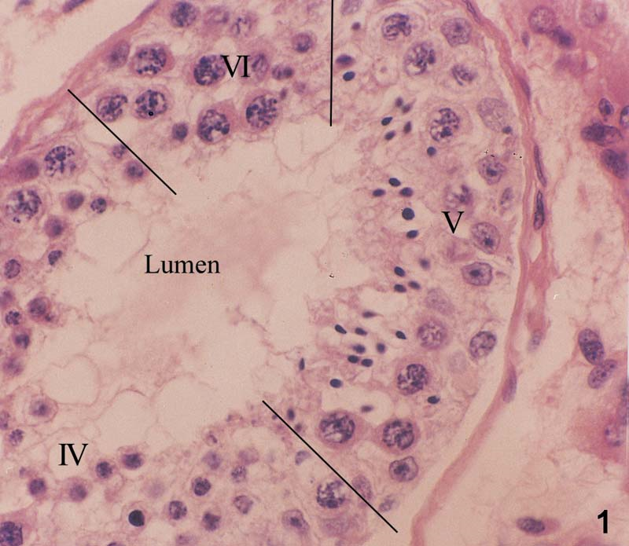
2. The cell at the tip of the pointer is a:
Sertoli cell
Spermatogonia
Primary spermatocyte
Spermatid

Slide 27
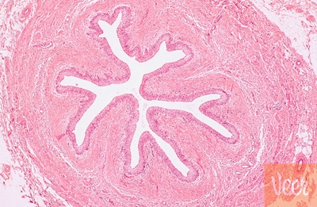
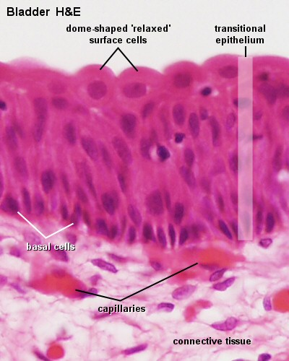
3. Identify the organ.
Vas deferens
Uterine tube
Ureter
Epididymis

Slide 28
4. For sperm to be motile they must travel through the:
Efferent ductules
Epididymis
Prostate
Uterine tube

Slide 29
5. Capacitation occurs in the.
Seminiferous tubules.
Epididymis
Vas deferens
Uterine tube

Slide 30
6. The auditory tube connects the:
Middle ear cavity and the mastoid air cells.
External auditory canal and the middle ear cavity.
The middle ear cavity and the nasopharynx.
The inner ear and the middle ear cavity.

Slide 31
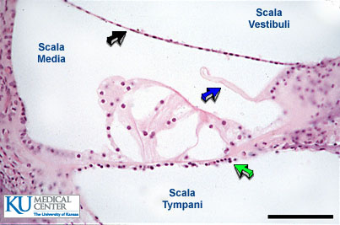
7. The basilar membrane is located at the:
Green arrow.
Blue arrow.
Black arrow.

Slide 32
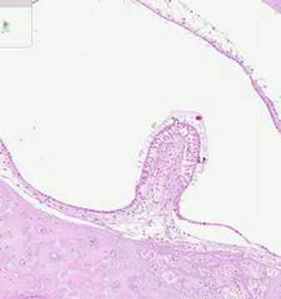
8.The structure in this image:
Is surrounded directly by perilymph.
Detects rotational movement.
Is found in the utricle.
Is found in the saccule.

Slide 33
9. Stereocilia would NOT be found in the:
Inner ear.
Epididymis
Vas Deferens
Uterine tube.

Slide 34
10. The stapes attaches to the:
Round window
Oval window
Tympanic membrane
None of the above.

Slide 35
Quiz #9

Slide 36
1. The anterior continuation of the sclera is the:
Cornea
Lens
Ciliary body
Iris
60

Slide 37
2. The flow of aqueous humor is from the:
Posterior chamber to the vitreous body.
Posterior chamber to the anterior chamber.
Anterior chamber to the vitreous body.
Anterior chamber to the posterior chamber
60

Slide 38
3. High quality vision is found in the:
Peripheral retina
Optic disk
Fovea centralis
Macula densa
60

Slide 39
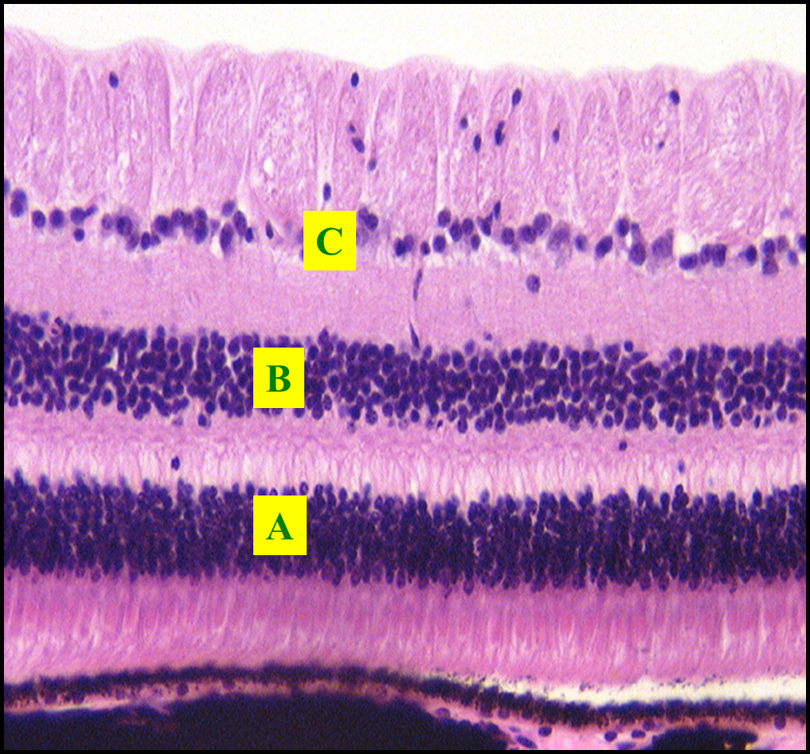
4. The layer where the ganglion cells are found:
A
B
C
D
60

Slide 40
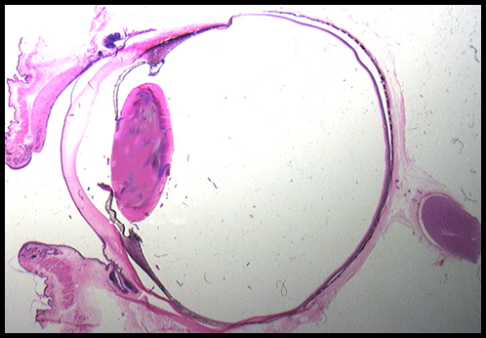
5. The sphincter pupillae muscle is located at:
A
B
C
D
B
A
C
D
60

Slide 41
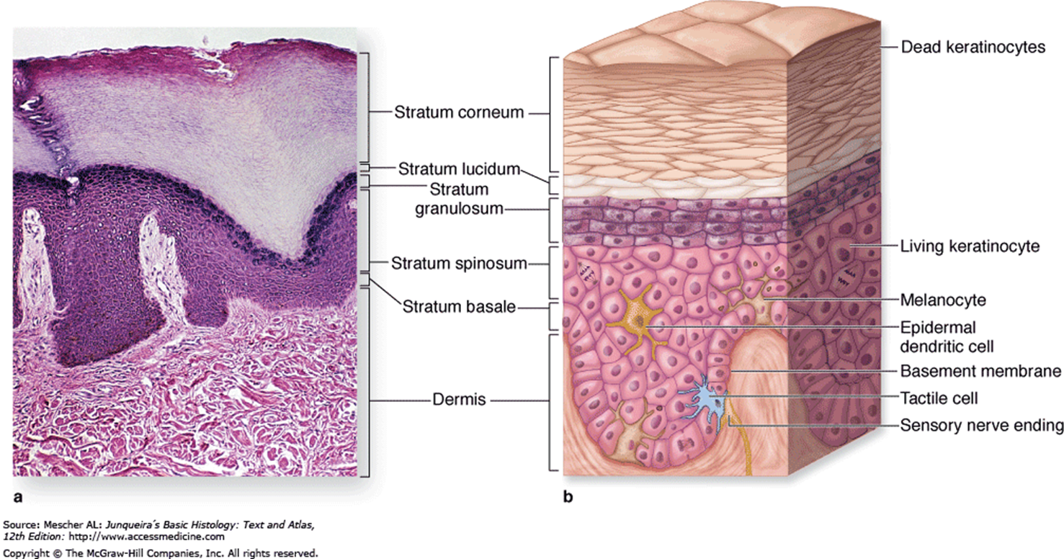
6. The layer at the tip of the pointer is the:
Stratum Basale
Stratum Spinosum
Stratum Granulosum
Stratum Corneum
60

Slide 42
7. Pressure is detected best by:
Meissner’s corpuscles
Merckel cell
Pacinian corpuscles
Free nerve endings.
60

Slide 43
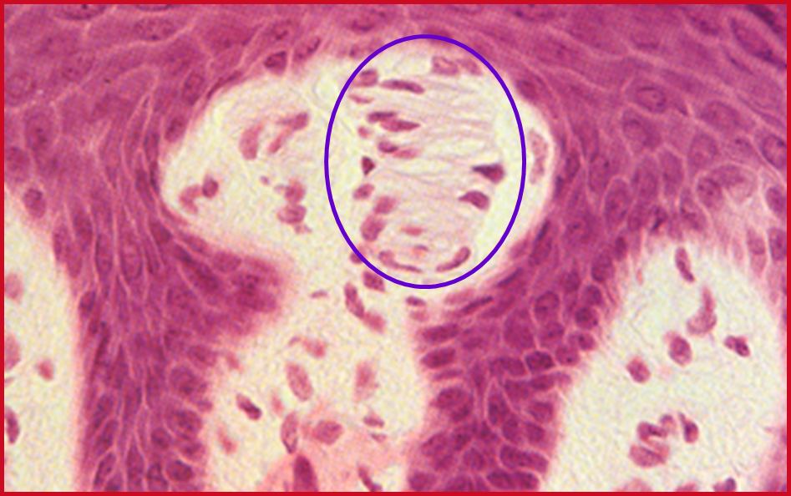
8. The circled structure is a:
Pacinian corpuscle
Meissner’s corpuscle
Merkel cell
Capillary plexus
60

Slide 44
9. The structure at the tip of the pointer is the:
Sebaceous gland
Sweat gland
Arrector pili
Hair follicle.
60

Slide 45
10. The structure at the tip of the pointer is a:
Duct of a sweat gland.
Secretory portion of a sweat gland.
Arteriole
Venule
60

Slide 46
Quiz #10

Slide 47
1. You have a patient with an embryo that is 14 days of gestation. You know that the embryo has :
Undergone gastrulation.
Implanted.
Established the vertebrate body plan
Three germ layers.

Slide 48
2. A woman in your dental chair is pregnant. Her last menstrual cycle began 21 days ago. You know that her embryo has.
An inner cell mass.
Three germ layers.
A beating heart.
A zona pellucida.

Slide 49
3. Neural crest cells are derived from:
Ectoderm
Mesoderm
Endoderm

Slide 50
4. The fetal component of the placenta comes from the:
Inner cell mass.
Trophoblast.
Ectoderm
Blastocyst cavity.

Slide 51
5. The percentage of fertilized eggs that make it to birth is:
90%
70%
30%
10%

Slide 52
6. The pharyngeal pouch that gives rise to the thymus is the:
1st
2nd
3rd
4th

Slide 53
7. The tip of the nose develops from the:
Frontonasal process
Maxillary process
Mandibular process
First pharyngeal arch.

Slide 54
8. The upper incisors develop from the
Medial nasal processes
Maxillary processes
Lateral nasal processes.
A and B
A, B and C

Slide 55
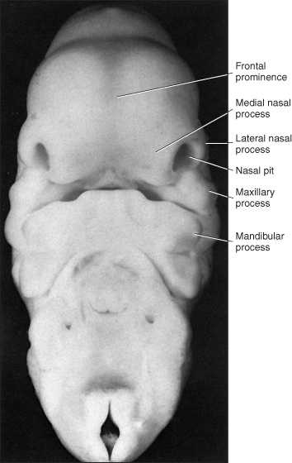
9. The mandibular process is found at the tip of pointer
A
B
C
D
E
A
B
C
D
E

Slide 56
10. An upper cleft jaw would occur between the:
Medial and lateral incisors.
Lateral incisor and the canine
Canine and first molar.

