Slide 1
More Quizzes

Slide 2
Quiz #11

Slide 3

1. The earliest development of the tooth is directed by the expression of:
FGF by the ectoderm
FGF by the endoderm
SHH by neural crest cells
BMP by neural crest cells.
60

Slide 4
2. Later tooth development and tooth patterning is directed by:
Ectoderm
Neural crest
Somites
Lateral plate mesoderm.
60

Slide 5
3. The dental follicle gives rise to:
Enamel
Dentin
Cementum
Enamel organ
60

Slide 6
4. Osteoblasts forming alveolar bone develop from:
Oral Ectoderm
Neural crest
Dental papilla
Enamel organ
60

Slide 7
5. The initiation of the primary dentition begins at:
6 – 8 weeks of gestation
20 weeks of gestation
6 – 8 weeks after birth.
6 months after birth.
60

Slide 8
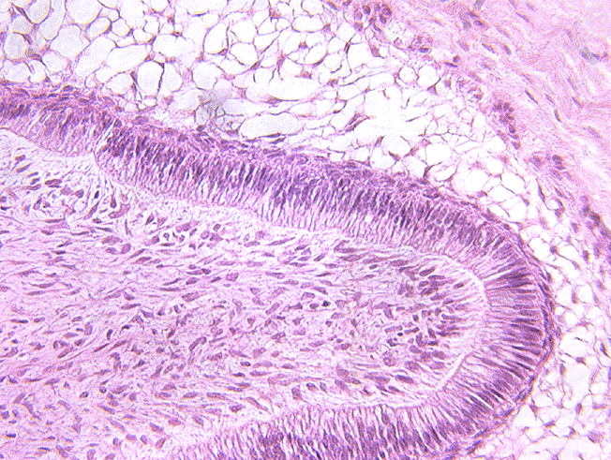
6. The cells at the tip of the pointer are:
Odontoblasts
Presecretory ameloblasts
Secretory ameloblasts
Ruffled ameloblasts
60

Slide 9
7. During the secretory phase the percentage of mineral in enamel is:
10%
30%
50 %
95%
60

Slide 10
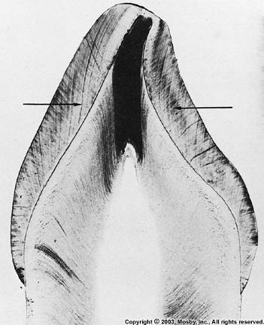
8. The arrows point to:
Enamel lamellae
Dentinal tubules
Incremental lines of Retzius
Enamel rods.
60

Slide 11
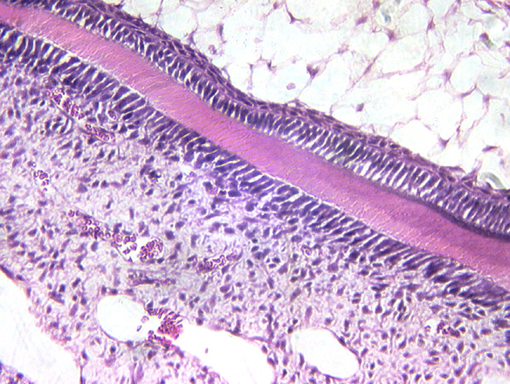
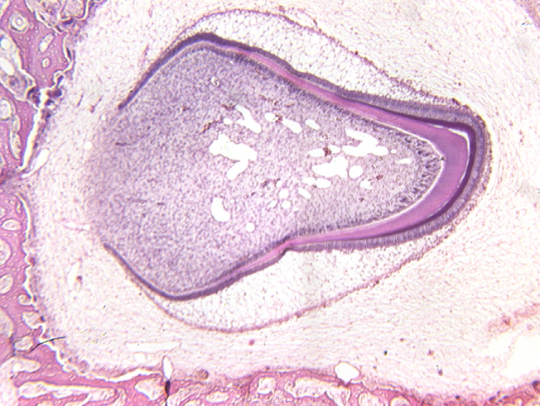
9. Secretory ameloblasts are found at:
A
B
C
D
A
B
C
D
60

Slide 12
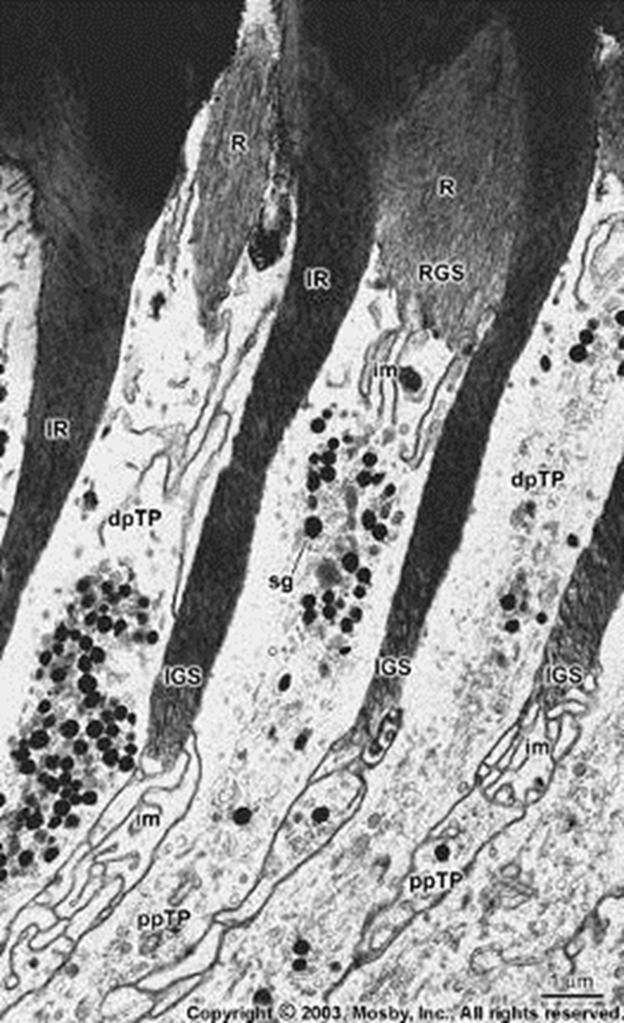
10. The structure at the tip of the pointer is a:
Ruffled border of an ameloblast
Enamel spindle
Tome’s process
Extra Credit quiz #4
60

Slide 13
Extra Credit Quiz #3

Slide 14
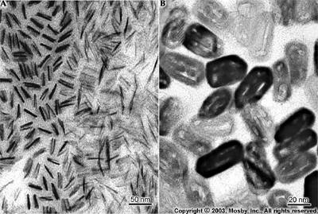
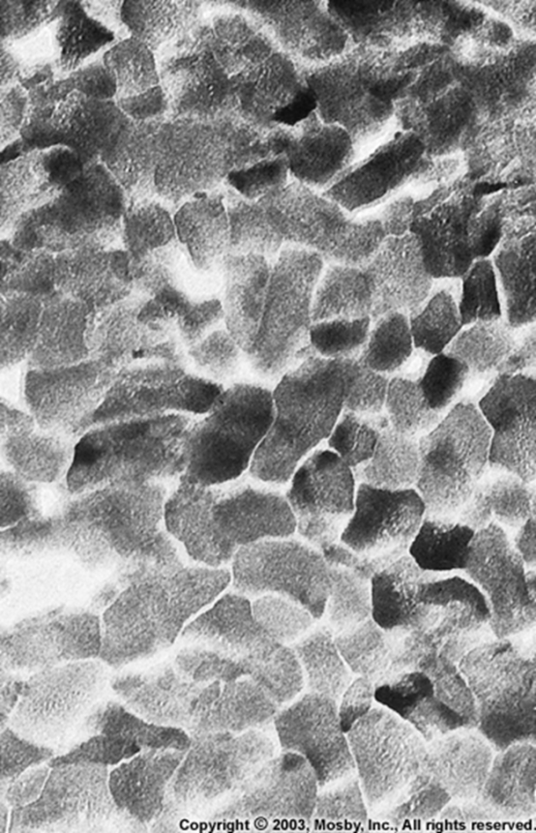
1. Which of these images comes from the most mature tooth?
A
B
C
60
A
B
C

Slide 15
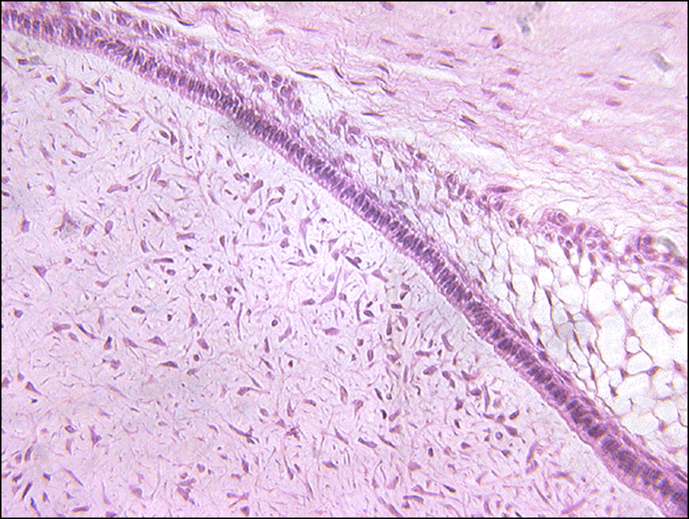
2. The stellate reticulum is located at:
A
B
C
A
C
B
60

Slide 16
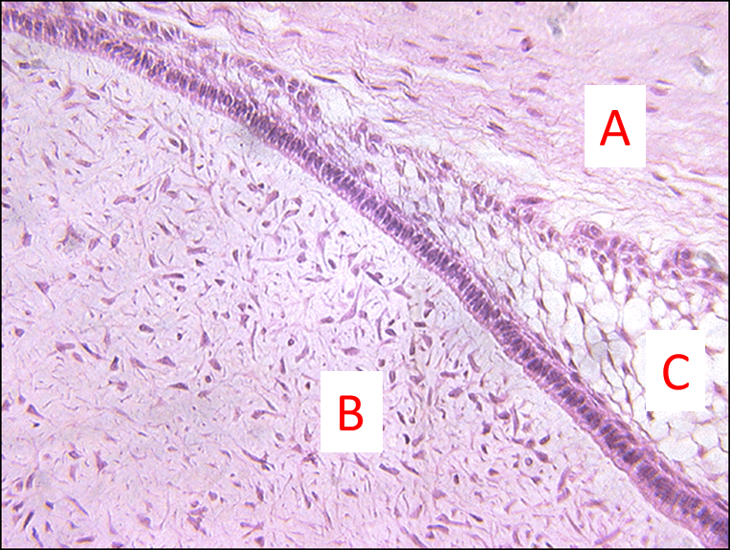
3. Cells derived from neural crest are found at:
A only
B only
C only
A and B
A, B, and C
60

Slide 17
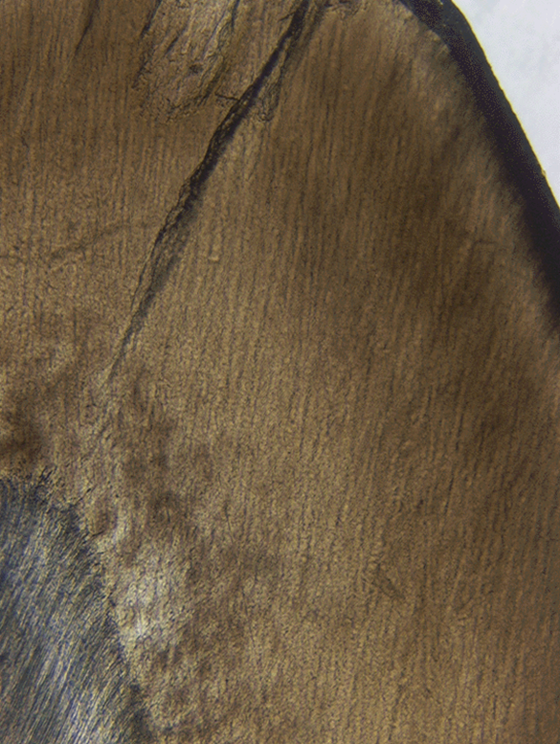
4. Gnarled enamel is seen at:
A
B
C
D
A
B
C
D
60

Slide 18
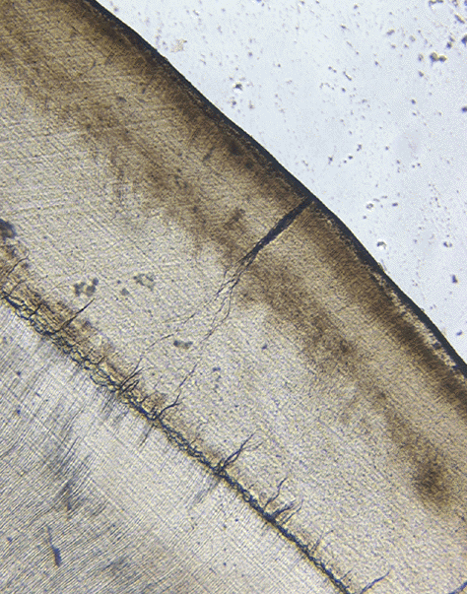
5. The structure at the tip of the pointer is a(n):
Enamel lamella
Enamel tuft
Enamel spindle
Hunter Schrager band.
60

