Slide 1
Quiz #12

Slide 2

1. Which layer of dentin is closest to enamel?
Primary dentin
Secondary dentin
Reparative dentin
Mantle dentin
60

Slide 3
2. Which of the following is 70% inorganic material?
Enamel
Dentin
Cementum
Bone
60

Slide 4
3. Which of the following does not use collagen as a scaffolding for deposition of matrix?
Enamel
Dentin
Cementum
Bone
60

Slide 5
4. Mineralized matrix in dentin is nucleated upon what type of collagen?
Type I
Type II
Type III
Type XII
60

Slide 6
5. Where would you find pulp stones?
The periodontal ligament.
Reparative dentin
The pulp cavity
Tomes granular layer.
60

Slide 7
6. Which cells are most associated with Von Korff’s fibers?
Fibroblasts of the periodontal ligament.
Odontoblasts
Ameloblasts
Cementoblasts.
60

Slide 8
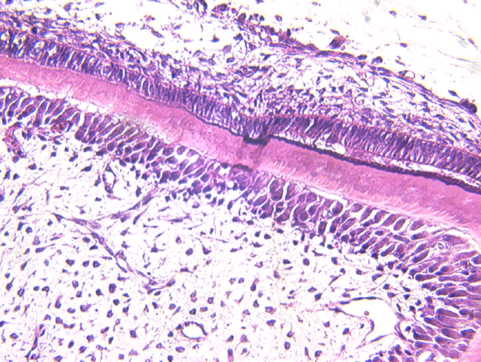
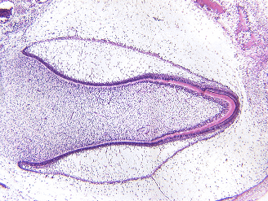
7. The cells at the tip of the pointer are:
Ameloblasts
Odontoblasts
Cementoblasts
60

Slide 9
8. Which is formed first.
Primary cementum
Secondary cementum
Dentin
Enamel
60

Slide 10
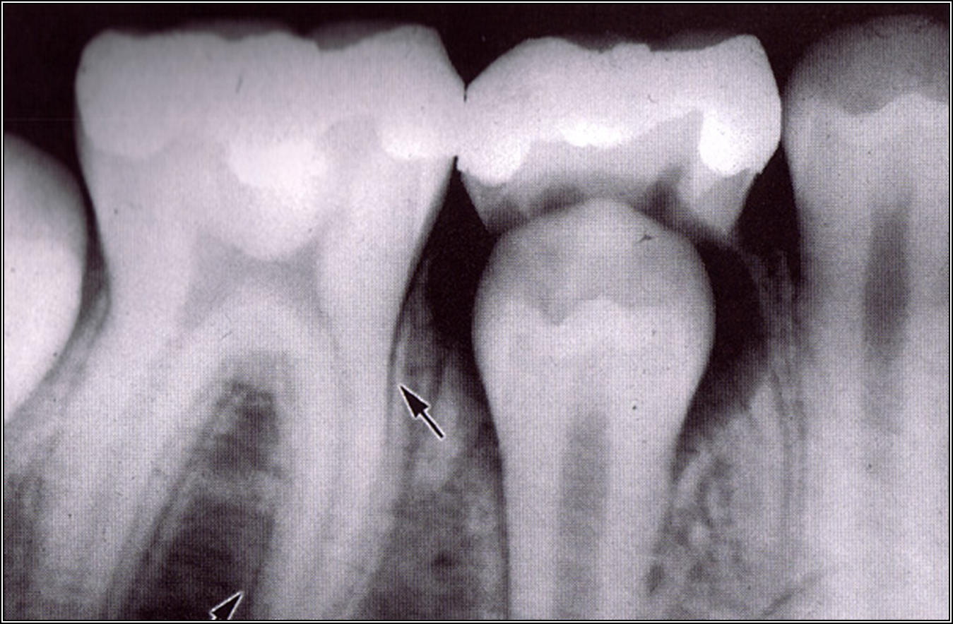
9. The arrow points to the:
Cementum.
Lamina dura.
Spongy bone.
Alveolar crest.
60

Slide 11
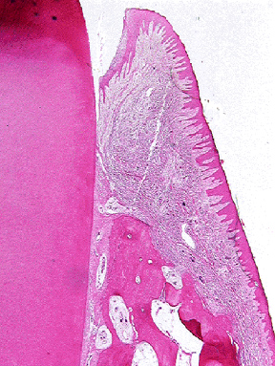
10. The fibers at the tip of the pointer are the:
Dentogingival fibers
Oblique fibers
Interradicular fibers
Alveolar crest fibers.
60

