Slide 1
Quiz #12

Slide 2
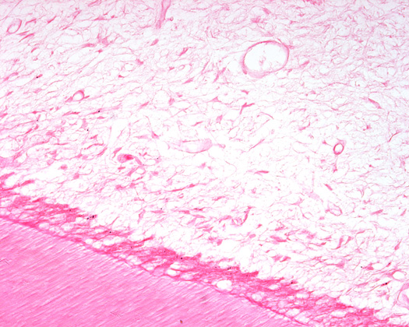
1. Nerve fibers (axons) are found in:
1
2
3
4
All of the above
A
D
C
B
:60

Slide 3
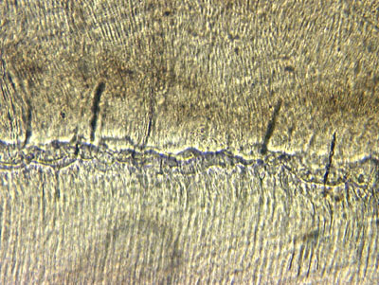
2. The lines between the arrows are:
Lines of Retzius
Lines of Owen
Enamel spindles
Incremental lines of cementum
:60

Slide 4
3. The Tomes granular layer is found in:
Dentin-Enamel Junction (DEJ)
Cementum
Dentin-Cementum Junction (DCJ)
Pulp
:60

Slide 5
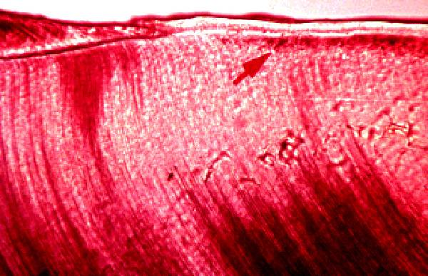
4. Interglobular dentin:
B
A
B
C
D
A
C
D
:60

Slide 6
5. Predentin contains:
Fibroblasts
Collagen fibers
Minerals
:60

Slide 7
6. Incremental lines in cementum:
A
B
C
A
B
C
:60

Slide 8
7. Cells with canaliculi can be found in:
Enamel
Alveolar bone
Cementum
B & C
All of the above
:60

Slide 9
8. Cementocytes differentiate from the:
Internal Enamel Epithelium
Dental papilla
Dental follicle
Oral epithelium
:60

Slide 10
9. Sharpey’s fibers of the PDL are found in:
Alveolar bone only
Cementum only
Both A & B
None of the above
:60

Slide 11
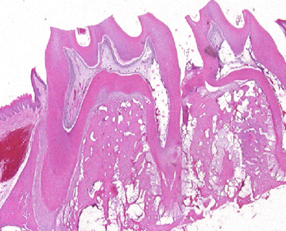
10. Inter-radicular bone:
A
B
C
D
D
C
B
A
:60

