Slide 1
Lucky QUIZ 13

Slide 2
1. Both mucous AND serous secreting cells are obvious and typically found in:
Submandibular gland
Parotid gland
Von Ebner’s gland in the tongue
All of the above.
:60

Slide 3
2. Saliva is made hypotonic (less sodium) by:
Striated duct cells.
Intercalated duct cells.
Myoepithelial cells.
All of the above.
:60

Slide 4
3. Non-keratinized epithelium is typically found on the:
A. Inside of the cheek.
B. Mid-line palate.
C. Free gingiva.
D. All of the above.
:60

Slide 5
4. The specializations that attach the junctional epithelium to enamel:
A. Hemidesmosomes .
B. Gap junctions.
C. Loose connective tissue (lamina propria).
D. Basal striations.
:60

Slide 6
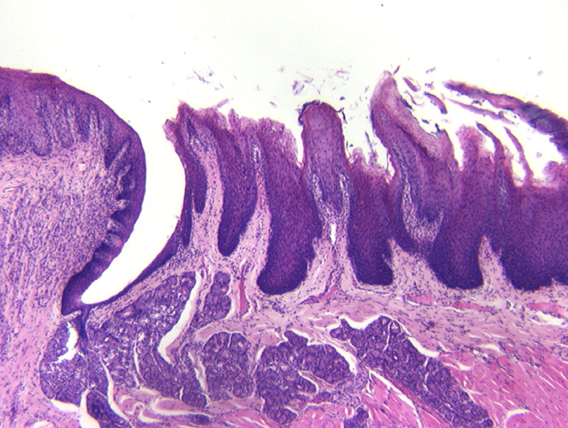
5. Circumvallate papilla
A
D
B
C
A
B
C
D
:60

Slide 7
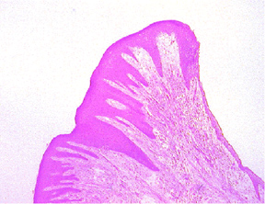
6. Attached gingiva
C
A
B
C
B
Enamel
A

Slide 8
7. The recruitment of monocytes into the tooth follicle to become osteoclasts is coincident with a rise in:
CSF1 (M-CSF)
SHH
Hox
:60

Slide 9
8. Parathyroid hormone causes:
An decrease in osteoprotegerin synthesis.
An decrease in RankL expression.
Fewer osteoclasts.
Fewer osteoblasts.
:60

Slide 10
9. These are the grandchildren of:
Dr. Lamperti
Dr. Marino

Slide 11
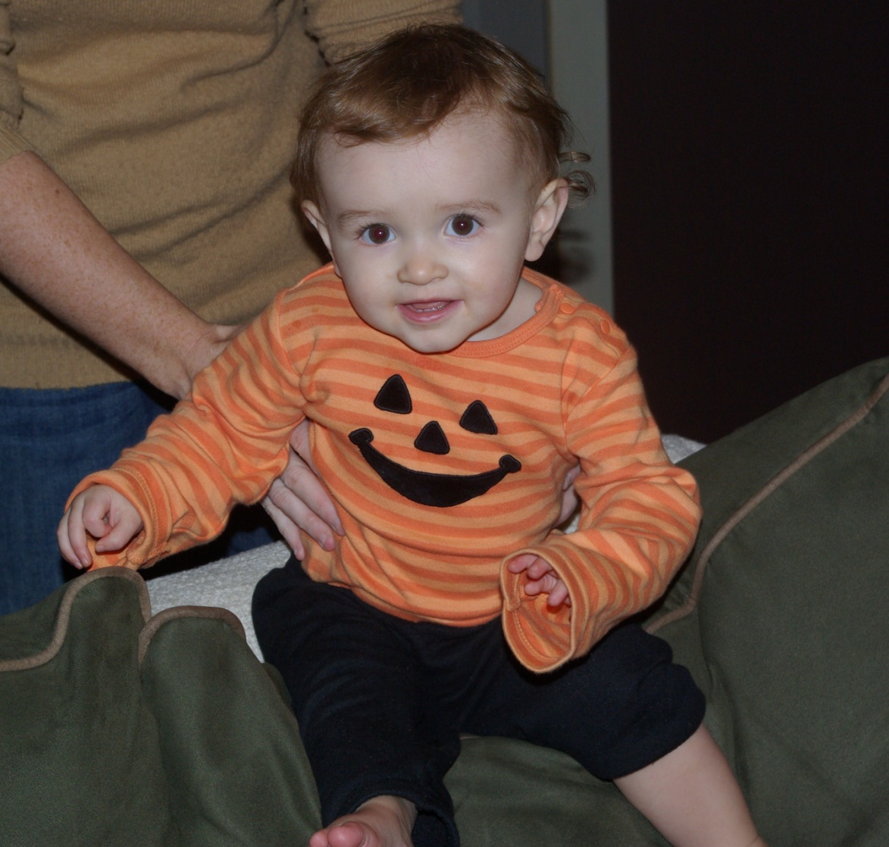
This is the granddaughter of:
Dr. Marino
Dr. Lamperti

